Slide 1
Agnostic Programing Models “Less is More”
PhD. Pedro Valero-Lara,
Computer Scientist at Programming Systems Group valerolarap@ornl.gov

Slide 2
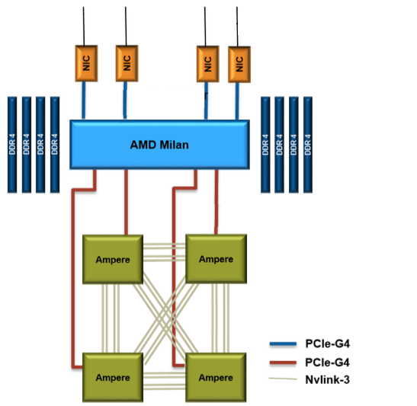
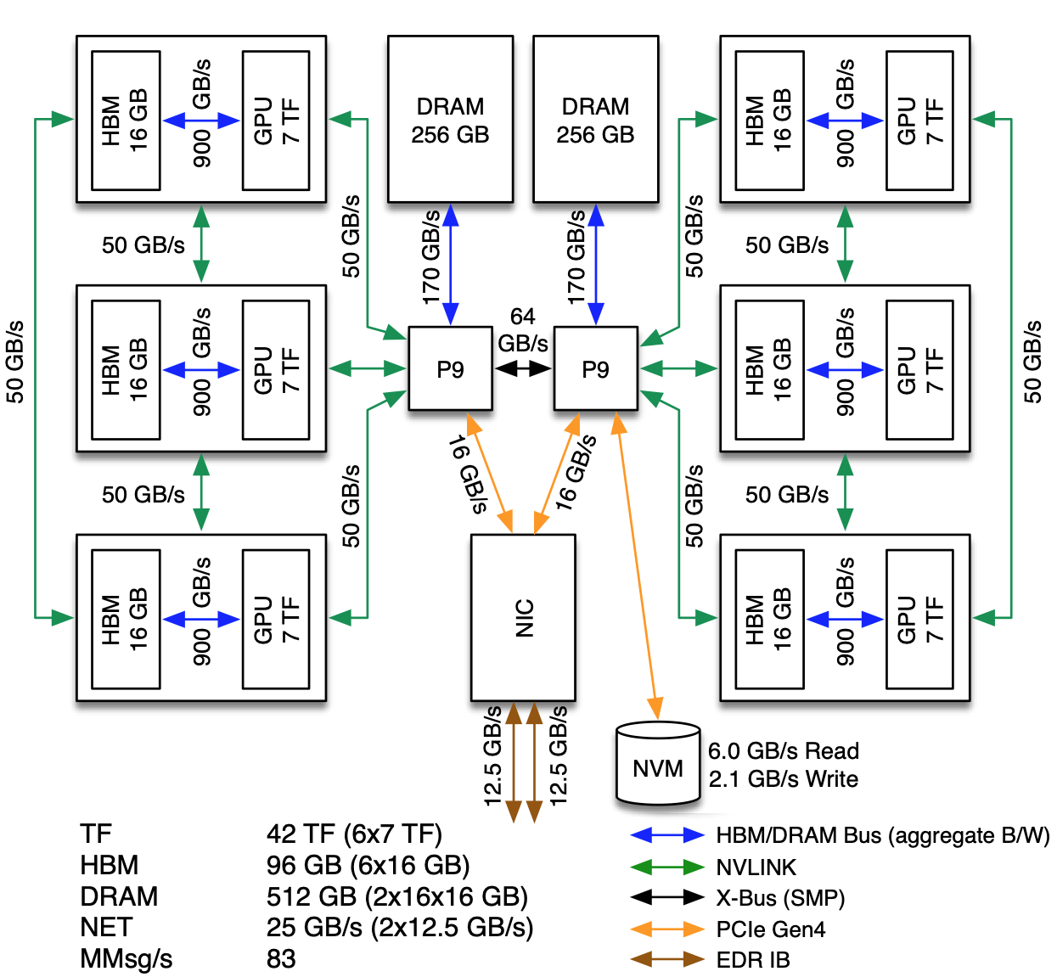
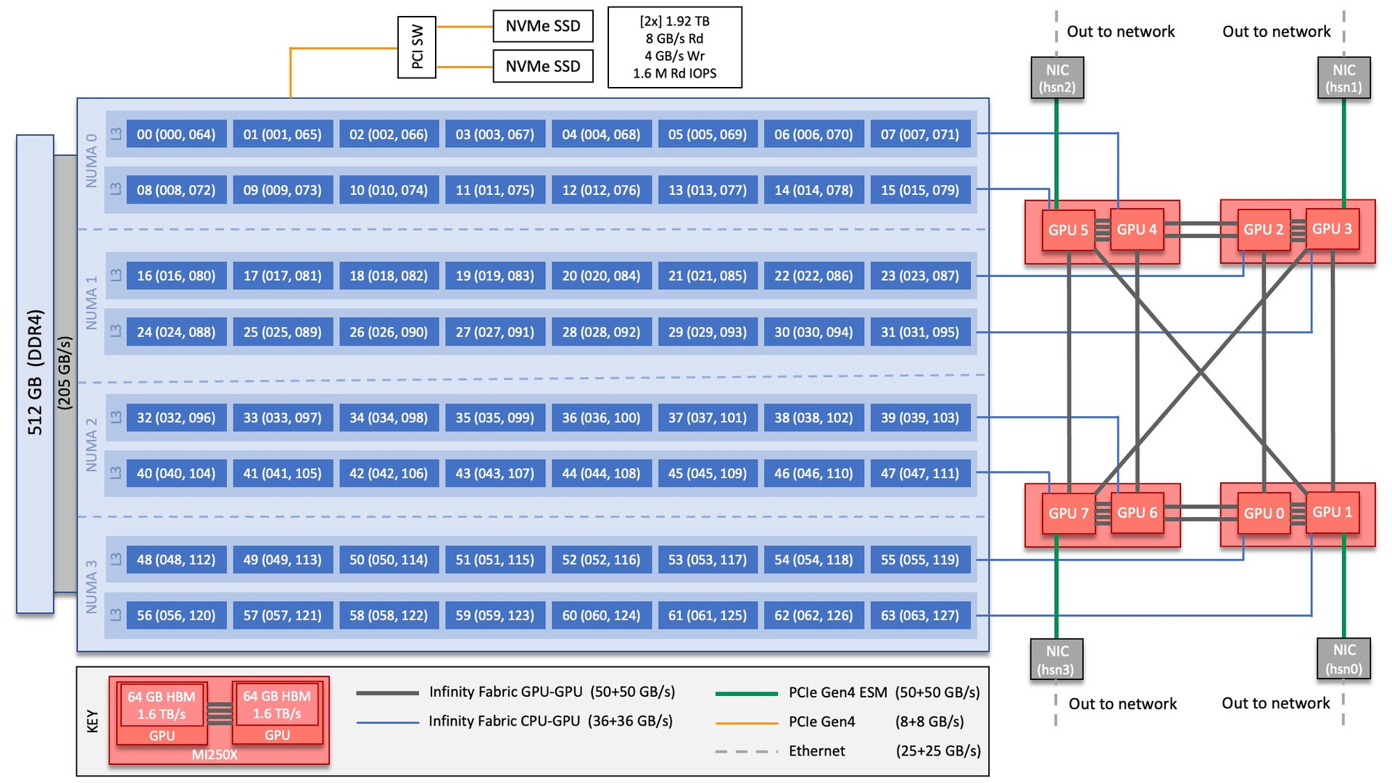
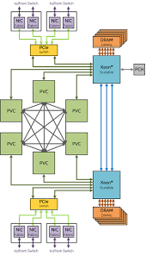
Motivation -> Performance Portability
Performance portability is an important problem for the US Department of Energy ( DOE)
The DOE leadership computing facilities are “heterogeneous” GPU-accelerated systems
Performant portable layers are a requirement in DOE: e.g. Kokkos, Raja, OpenMP, OpenACC
Program “once” and deploy “many times”

Slide 3
Agnostic Programing Models
A software paradigm in which no particular programming model is promoted
“Teaching principles rather than programing models features”
“Interoperable across the systems and there are no prejudices towards using a specific technology, model, methodology or data”
“A technology that can be used with any type of system, regardless of underlying systems' technology or architecture”
Less complicated programs are often more performing
Proactive, not reactive

Slide 4
C++ Programming Models: Kokkos (KokkACC, sKokkos, MultiGPU support) and SEER
PhD. Pedro Valero-Lara,
Computer Scientist at Programming Systems Group valerolarap@ornl.gov

Slide 5
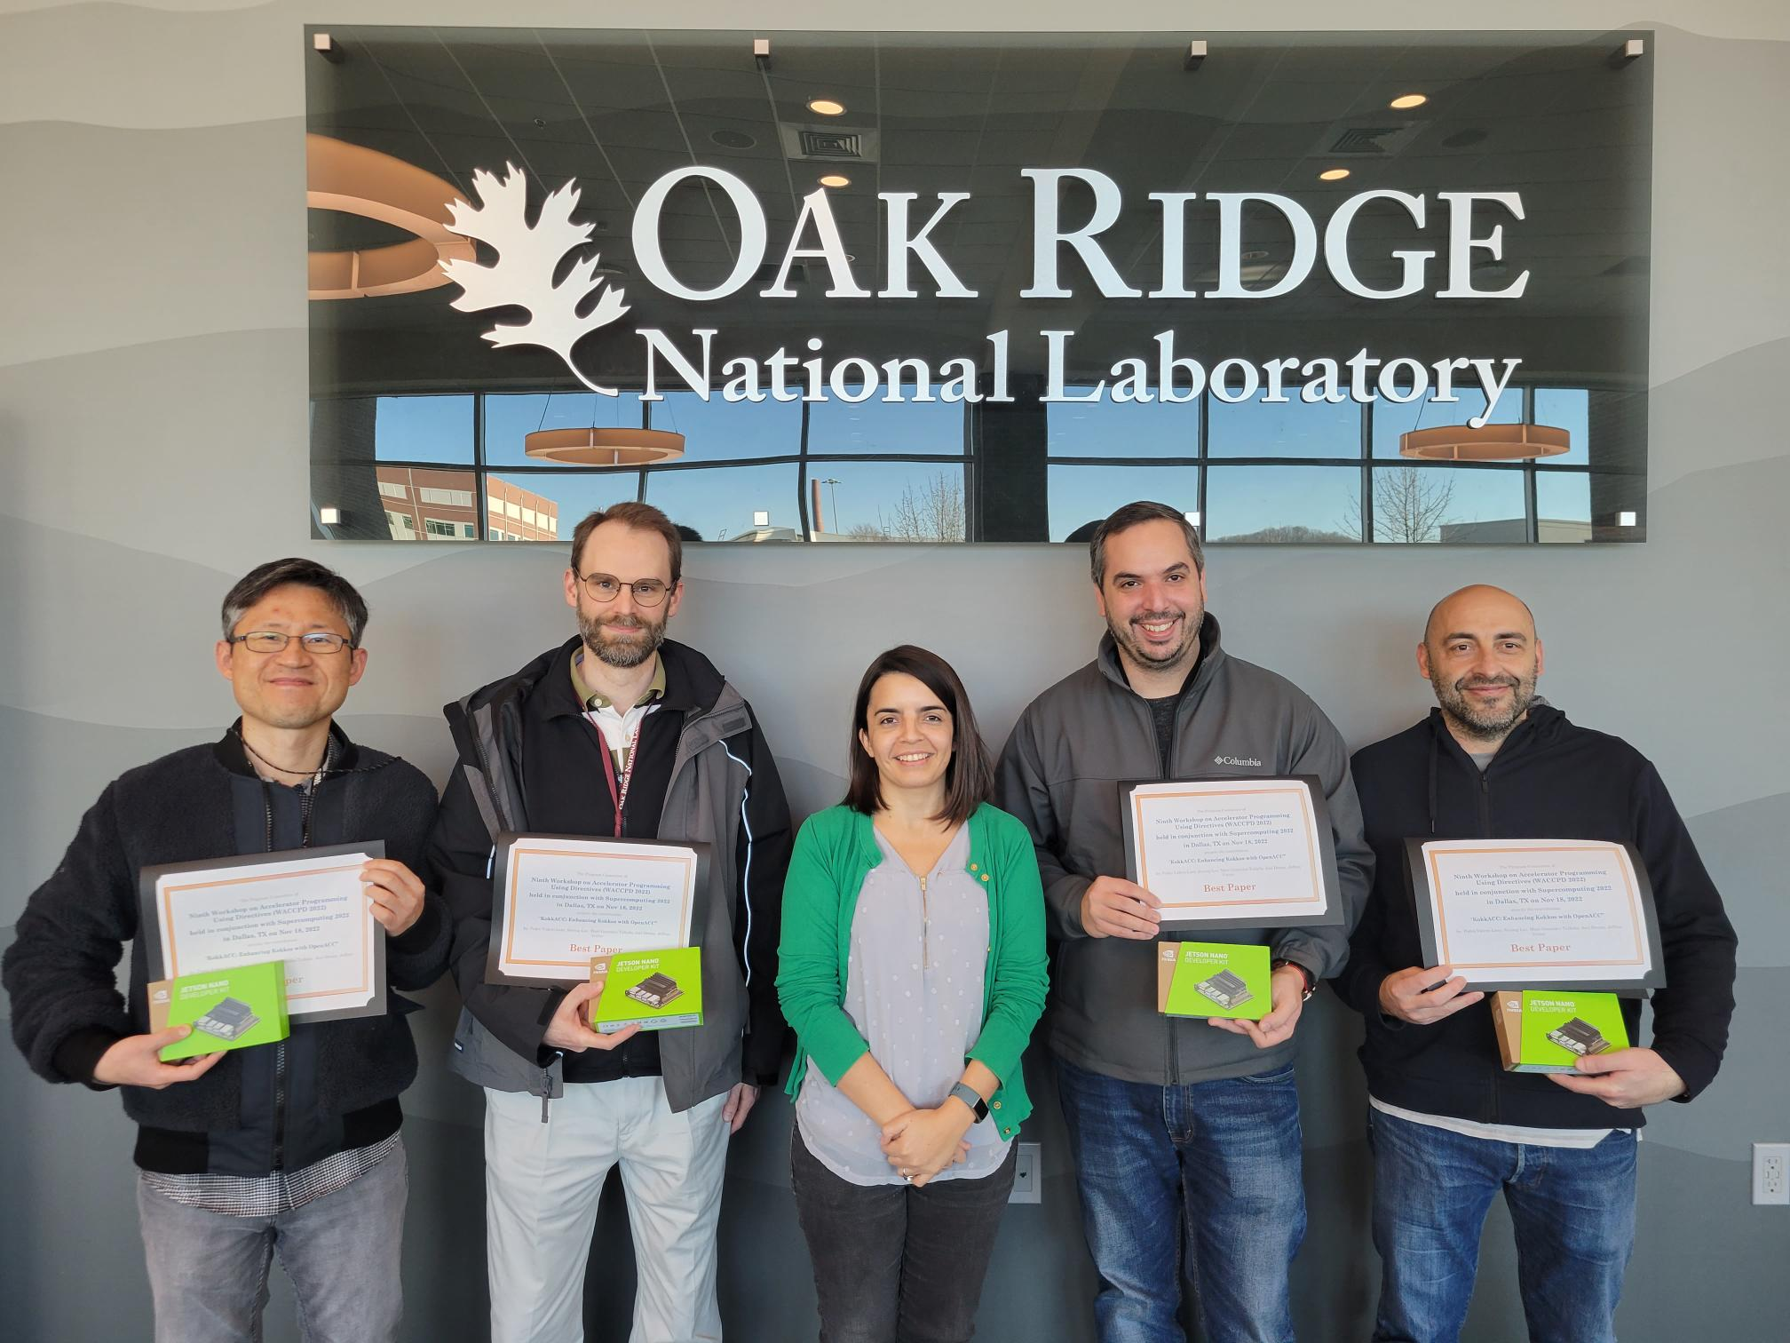
C++ Programming Models:
Funded by ECP Proteas-TUNE project
ORNL Team: Seyong Lee, Joel Denny, Marc Gonzalez, Jeffrey S. Vetter, Pedro Valero-Lara (PI)
Collaborations: SNL, TAMIU, and other ORNL groups
KokkACC
OpenACC back-end of Kokkos. One “agnostic” back-end targeting multiple architectures.
(smart) Kokkos: sKokkos
Enabling Kokkos with Transparent Device Selection on Heterogeneous Systems.
MultiGPU support on Kokkos
CUDA and HIP back-ends. Use multiple GPUs in a transparent way. Autotuning: How many GPUs?
SEER: An on-node Performance-Portable C++ Library for Heterogeneous Systems
Publications:
Pedro Valero-Lara, Seyong Lee, Marc González Tallada, Joel E. Denny, Jeffrey S. Vetter: KokkACC: Enhancing Kokkos with OpenACC. WACCPD@SC 2022: 32-42
Pedro Valero-Lara, Jeffrey S. Vetter: A MultiGPU Performance-Portable Solution for Array Programming Based on Kokkos. ARRAY@PLDI 2023: 1-12
Awards: Best paper award, KokkACC: Enhancing Kokkos with OpenACC, 9th Workshop on Accelerator Programming and Directives (WACCPD@SC 2023)
Links (repositories):
https://github.com/kokkos/kokkos
https://code.ornl.gov/5pv/skokkos
https://github.com/pedrovalerolara/Multi-GPU-Kokkos

Slide 6
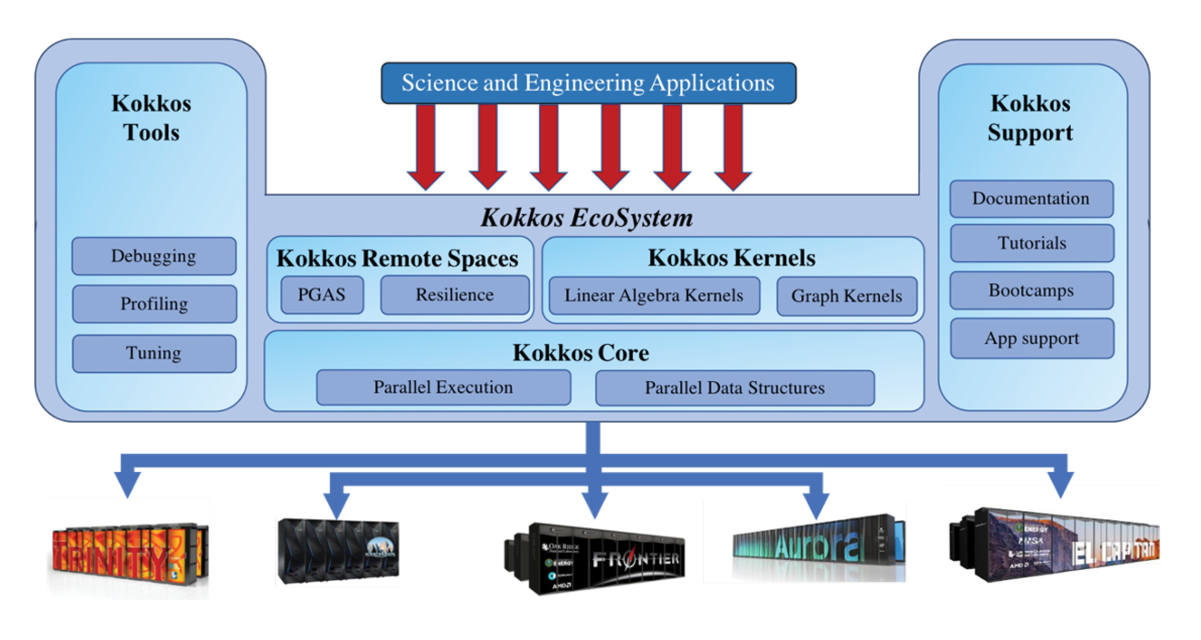
Kokkos Programing Model
Open-source performance portability C++ template and metaprogramming
It is implemented as a template library on top of:
CUDA, HIP, OpenMP, OpenMP Target, HPX, SYCL, etc, and now OpenACC too!!
Target back end must be defined at compilation time
(KOKKOS_DEVICE=OpenACC)
It can only use one back end/device at a time
Memory management is composed by:
Kokkos_malloc and Kokkos views
Data parallel execution:
parallel_for, parallel_reduce and parallel_scan
3 different APIs
Single Range,
Multi-Dimensional Range
Hierarchical Parallelism
Each Kokkos construct has:
Number of iterations
A C++ Lambda that acts like a function

Slide 7
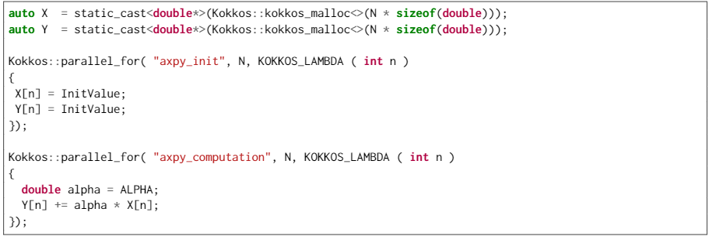
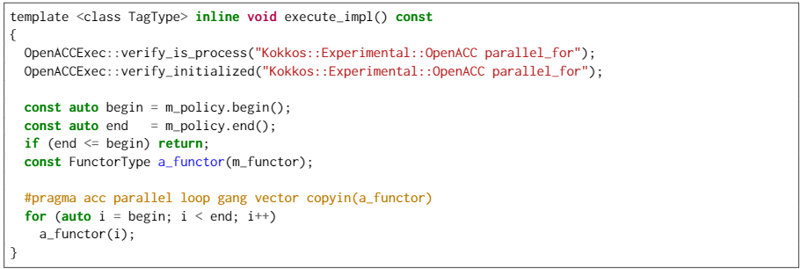
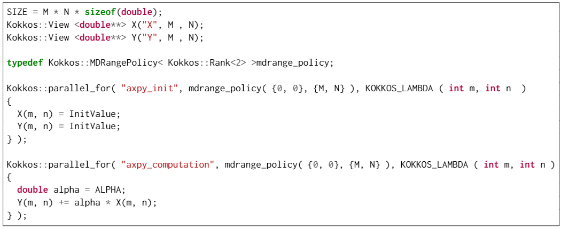
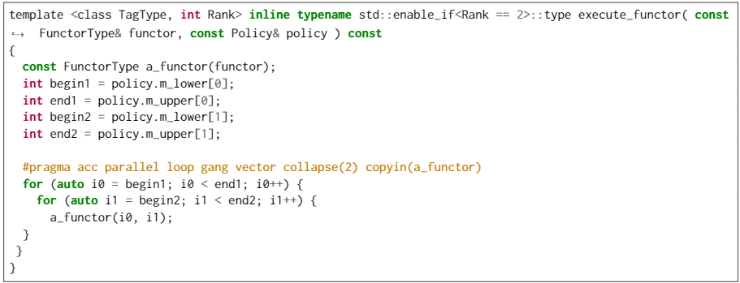
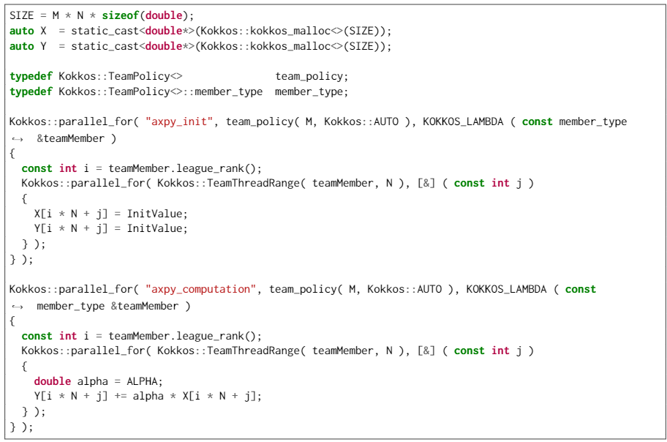
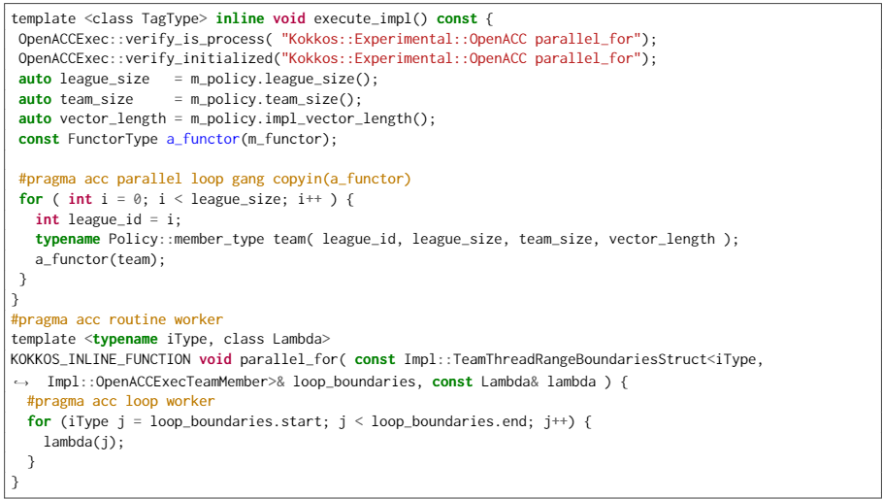
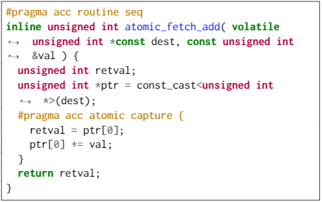
KokkACC Implementation
Both models attempts to be architecture agnostic
Strong connection between Kokkos front-end and OpenACC specification
All this makes easy the implementation, maintainability and sustainability of the OpenACC back end
https://github.com/kokkos/kokkos/tree/develop/core/src/OpenACC

Slide 8
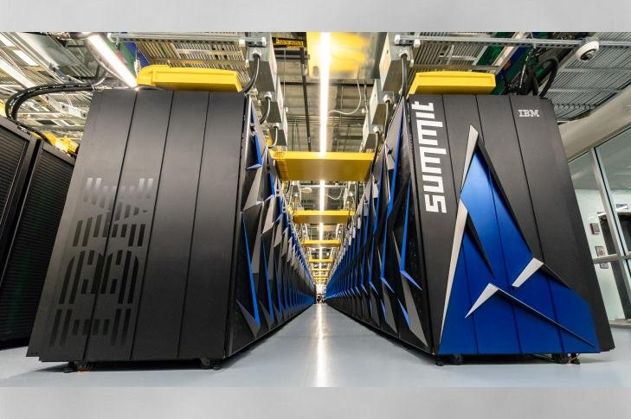
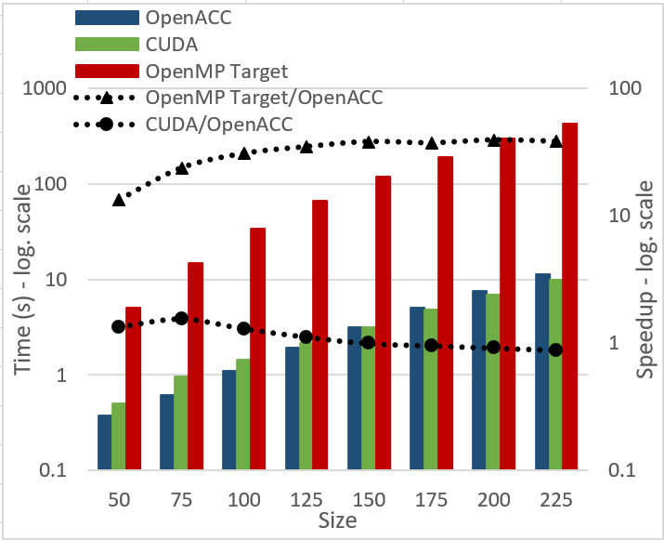
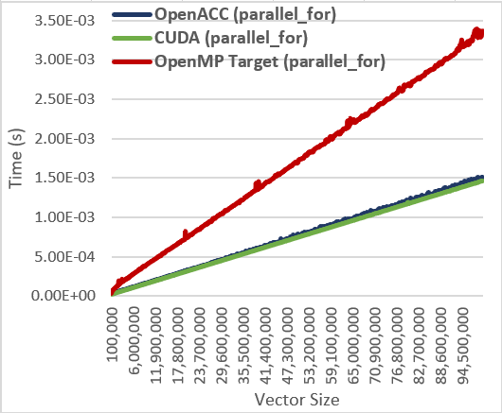
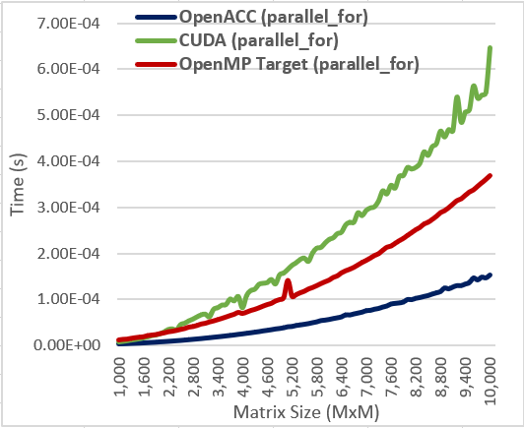
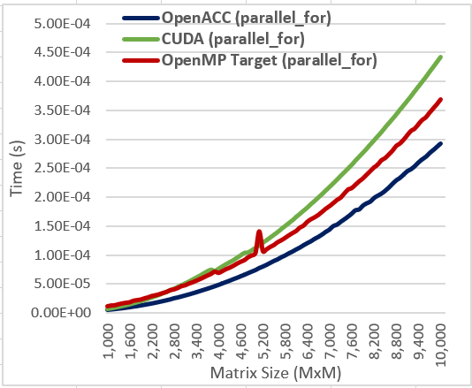
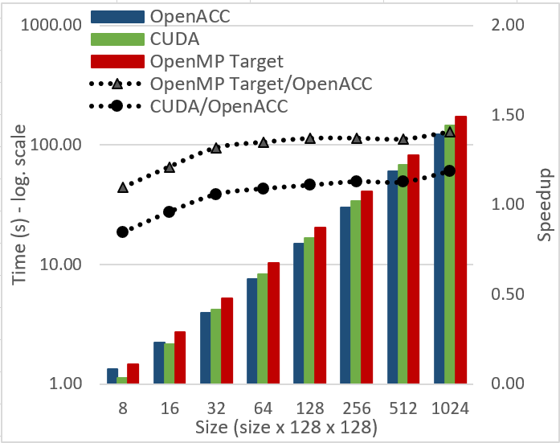
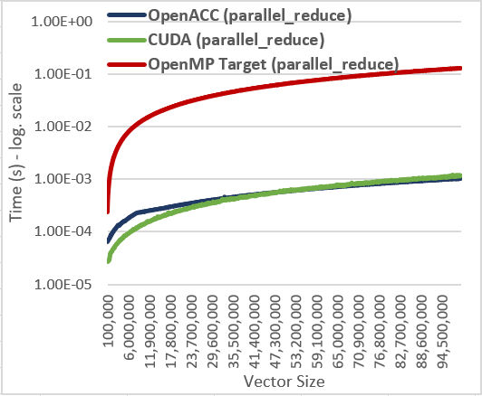
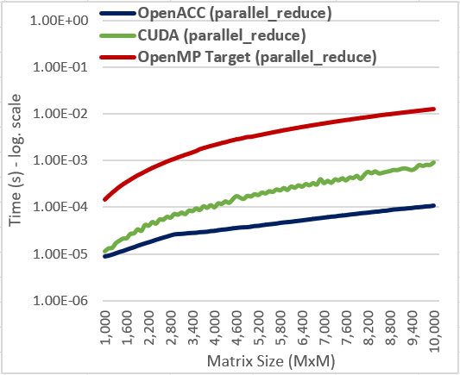
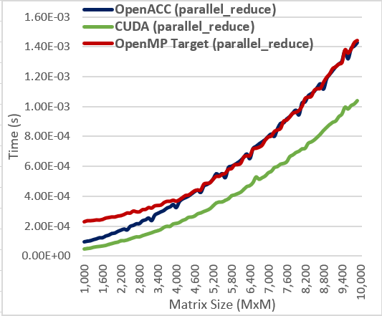
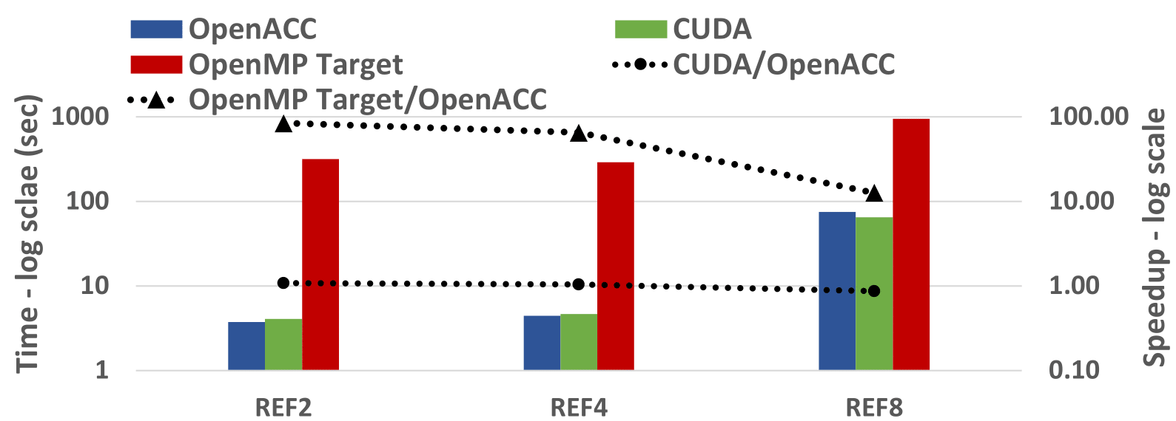
Performance Evaluation on SUMMIT
LULESH
MiniFE
LAMMPS-SNAP
ORNL SUMMIT
1x NVIDIA C100 GPU (16GB)
CUDA (CUDA 11.0.3)
OpenMP Target (LLVM 15.0.0)
OpenACC (NVHPC 21.3)
Mini-benchmarks

Slide 9
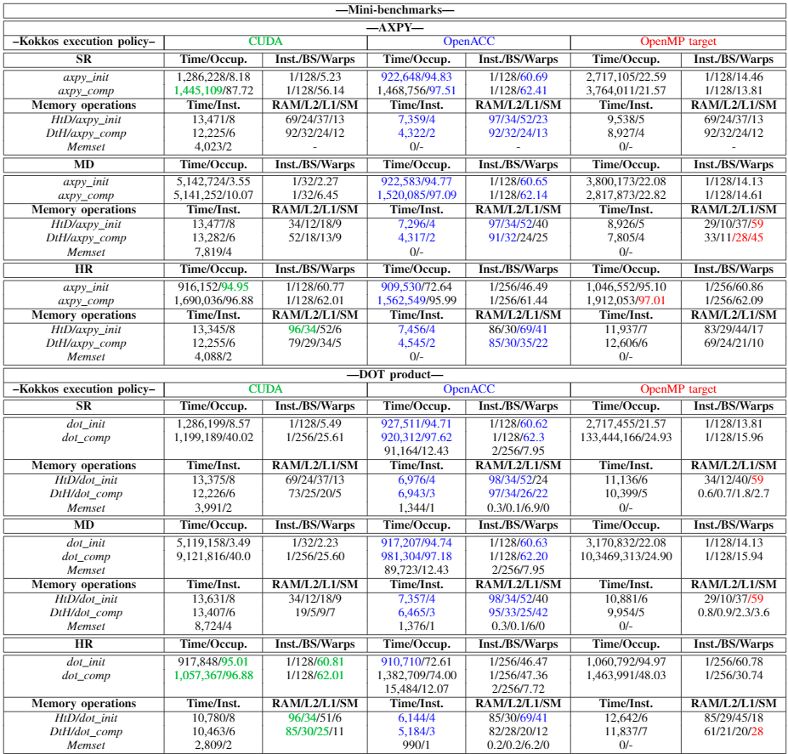
“Low-Level” Performance Evaluation on SUMMIT
Time
Occupancy
#Instructions
Block size
Warps
Bandwidth
Global memory (RAM)
L2
L1
Shared memory

Slide 10
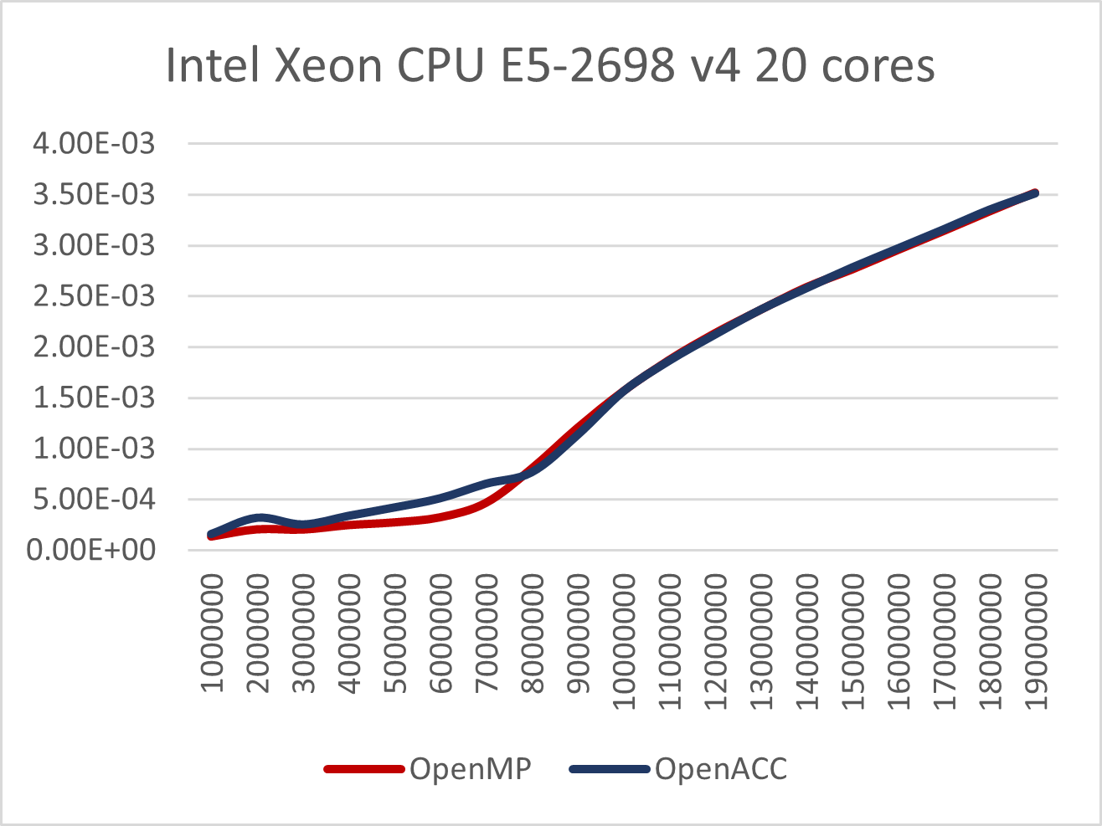
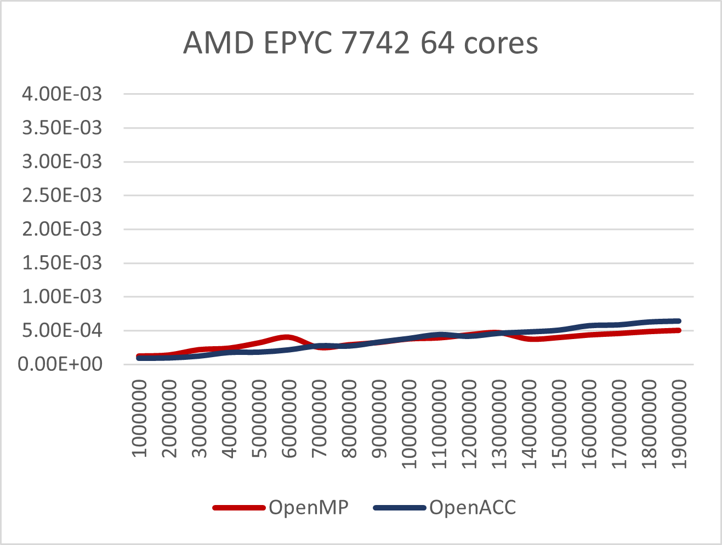
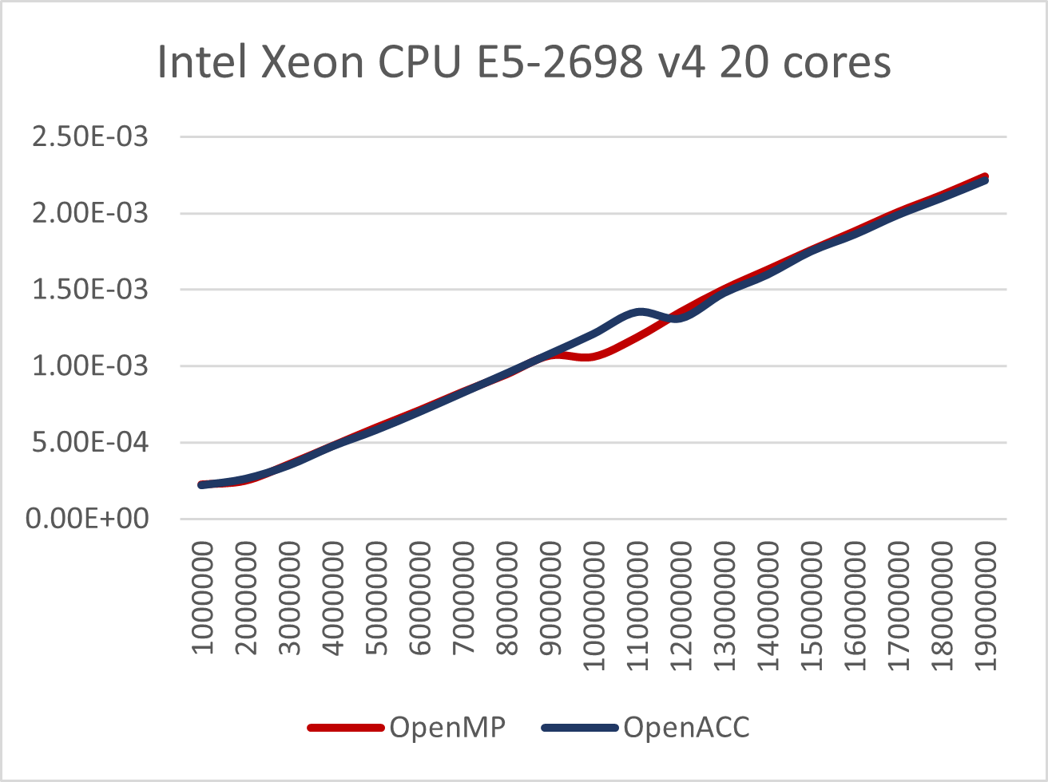
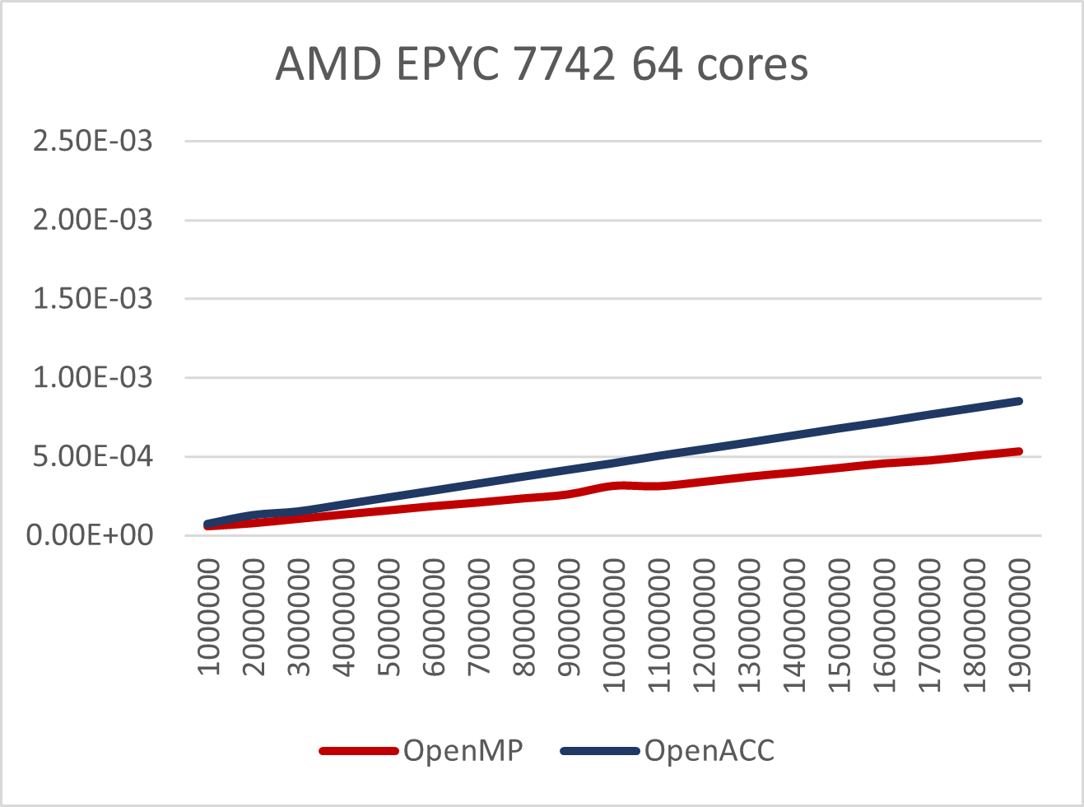
Performance on CPUs
Intel and AMD CPUs
Mini-benchmarks (AXPY on top, DOT on bottom)

Slide 11
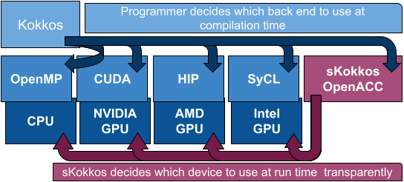
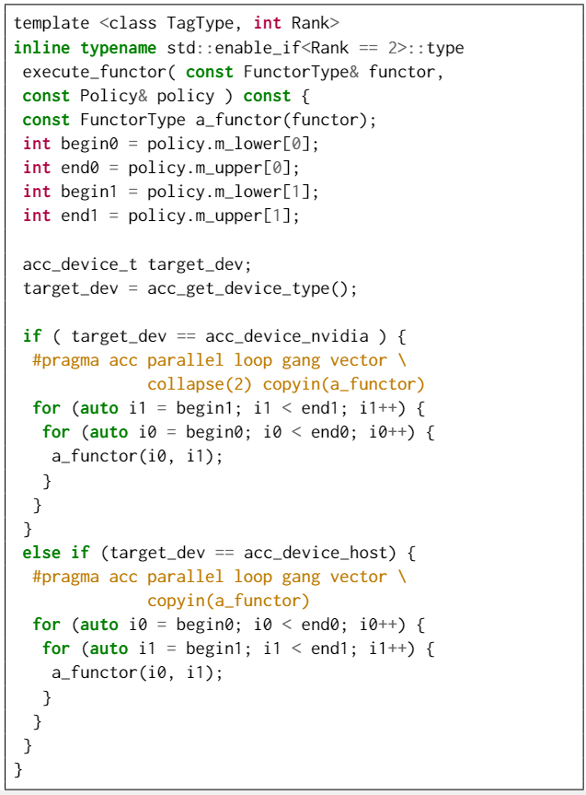
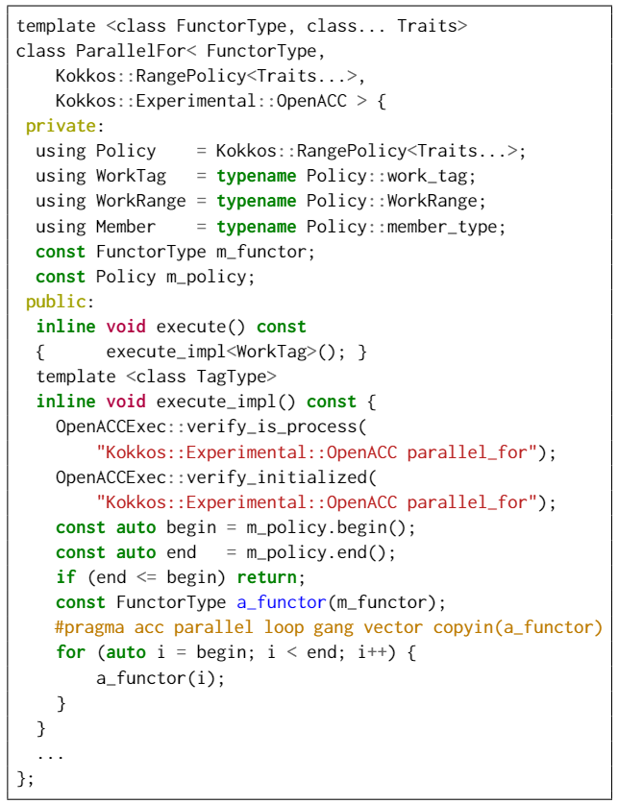
sKokkos: Enabling Kokkos with Transparent Device Selection on Heterogeneous Systems
sKokkos decides which device (CPU or GPU) is better at runtime (at the very beginning)
Kokkos::set_device(tunning factor)
Tuning factor: number of operations, nnz elements, size of the grid, etc.
CPU performance = Tuning factor/CPU flops
GPU performance = Tuning factor/GPU flops + GPU overhead
https://code.ornl.gov/5pv/skokkos

Slide 12
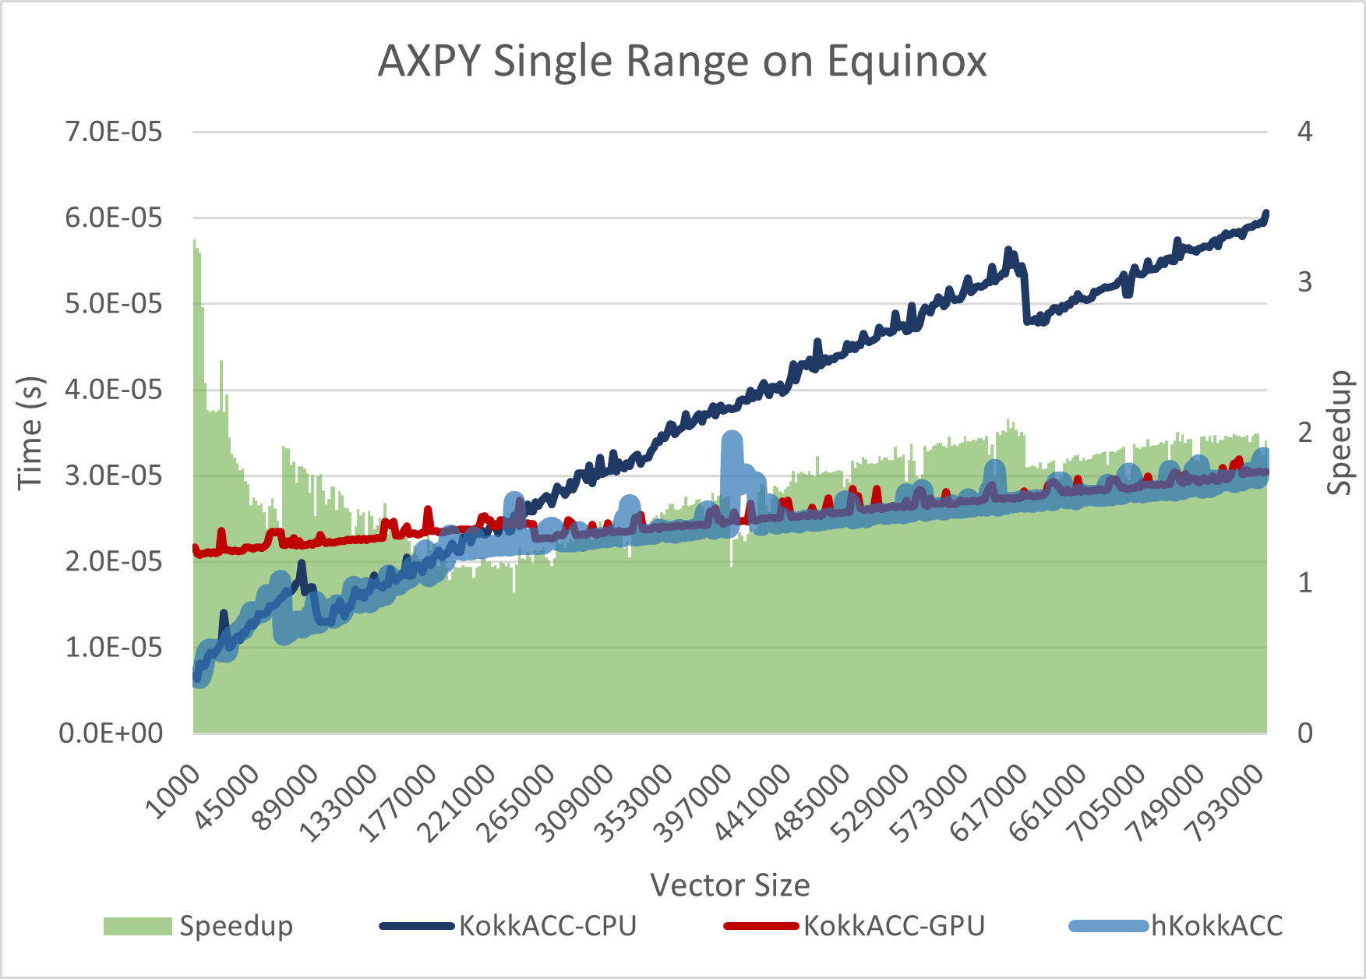
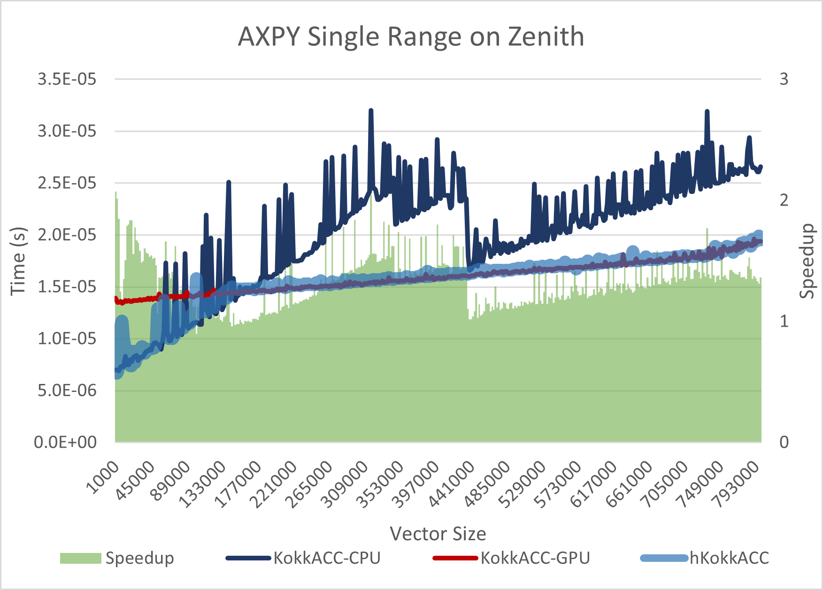
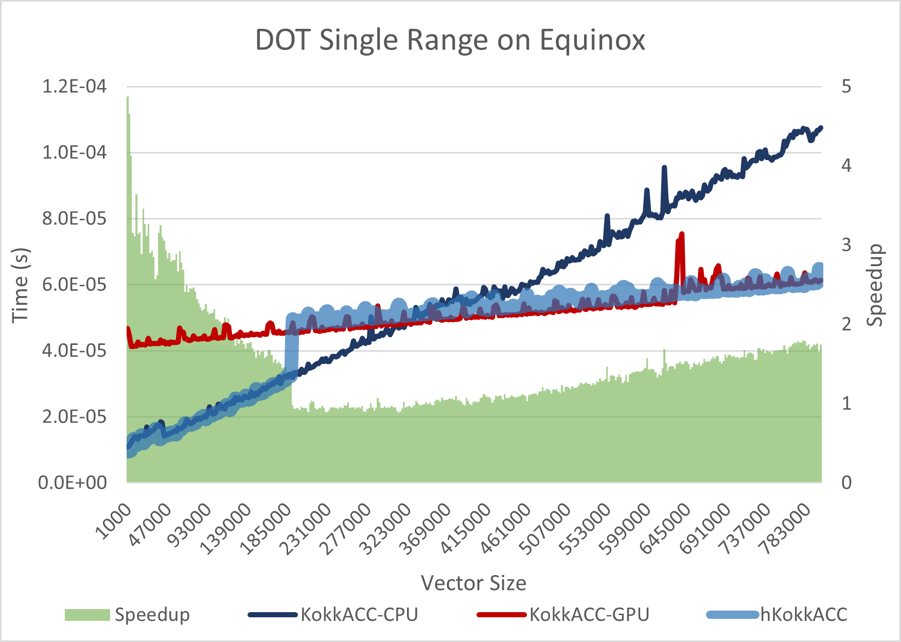
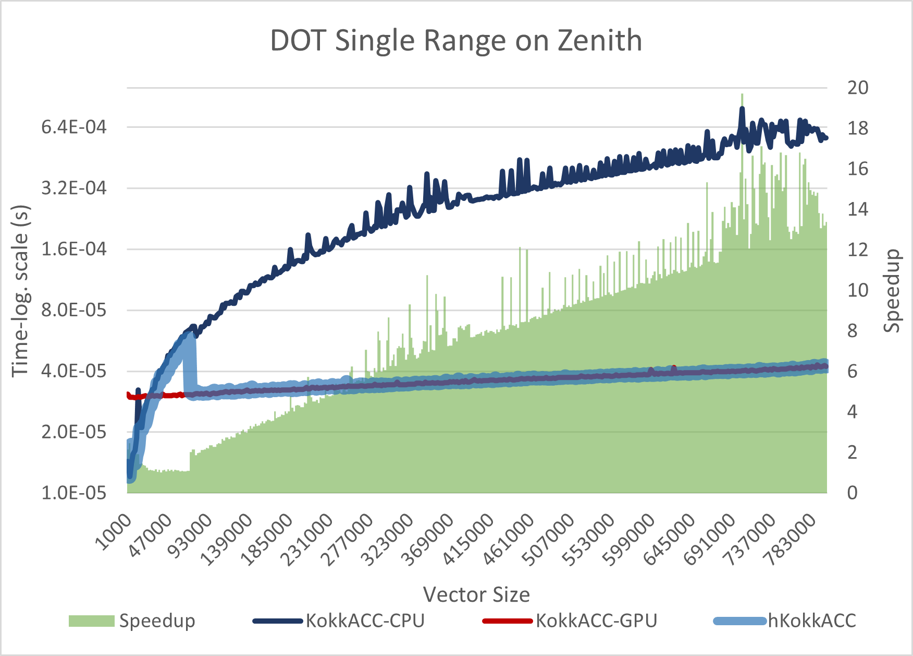
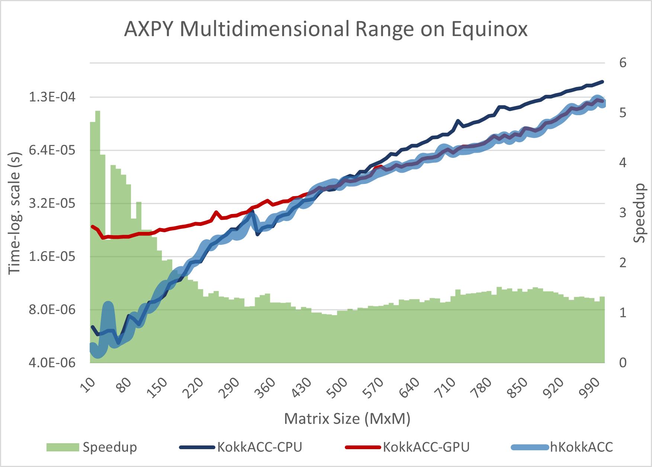
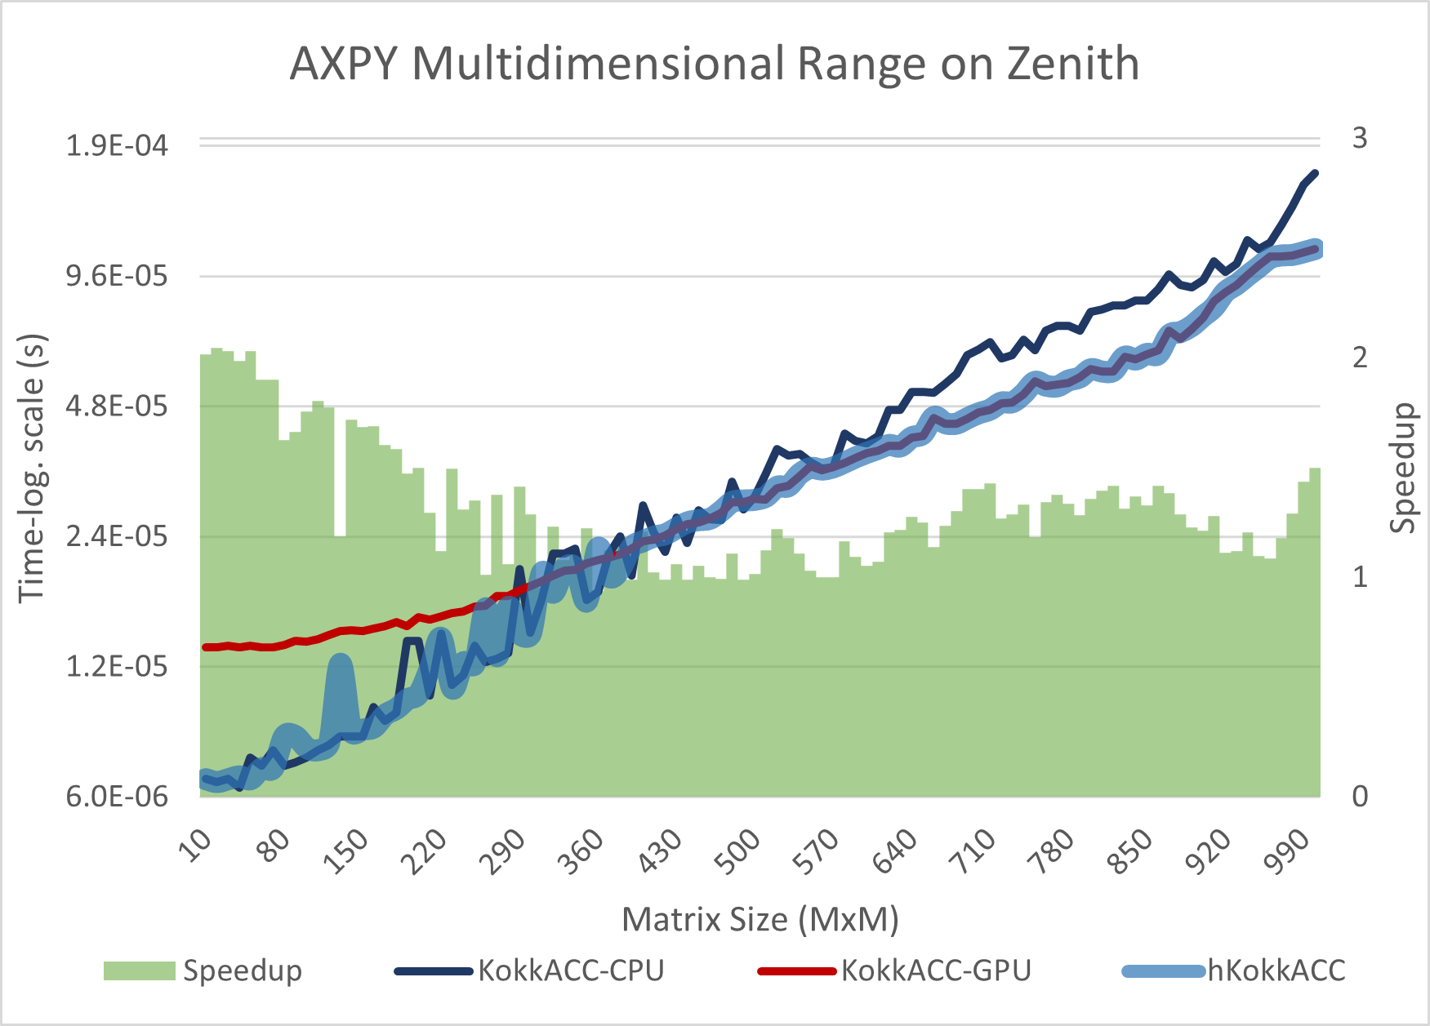
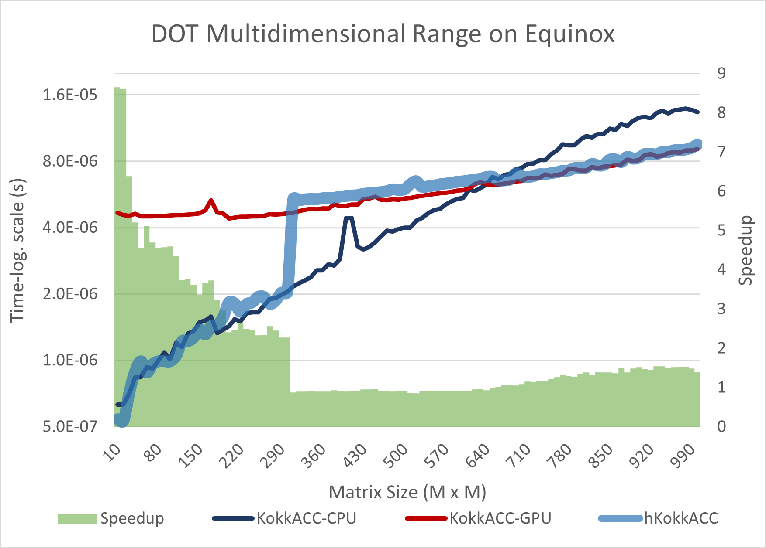
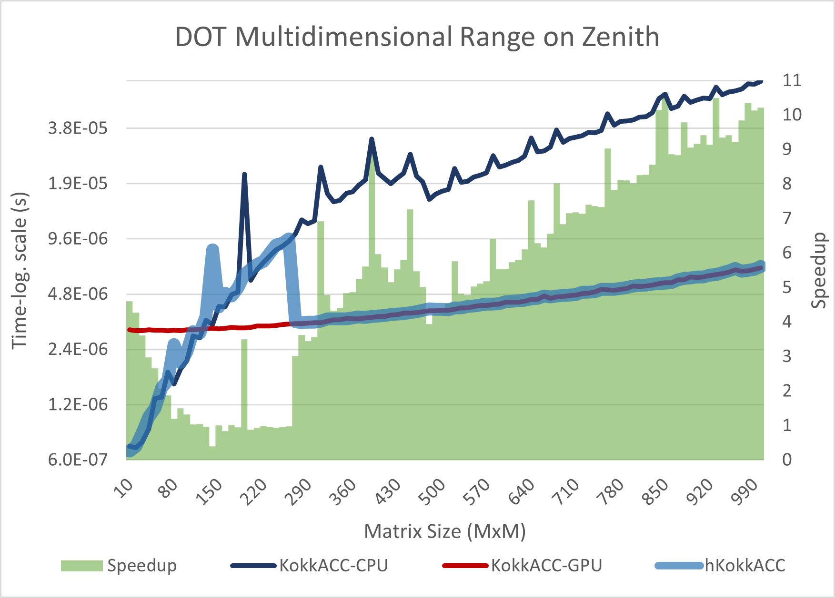
sKokkos Performance: Mini-benchmarks
Two different heterogeneous systems (ExCL ORNL):
Equinox: 1x Intel Xeon E5-2698 v4 20-Core CPU + 1x NVIDIA V100 GPU
Zenith: 1x AMD Ryzen 3970X 32-Core CPU + 1x NVIDIA GeForce RTX 3090 GPU
Mini-benchmarks:

Slide 13
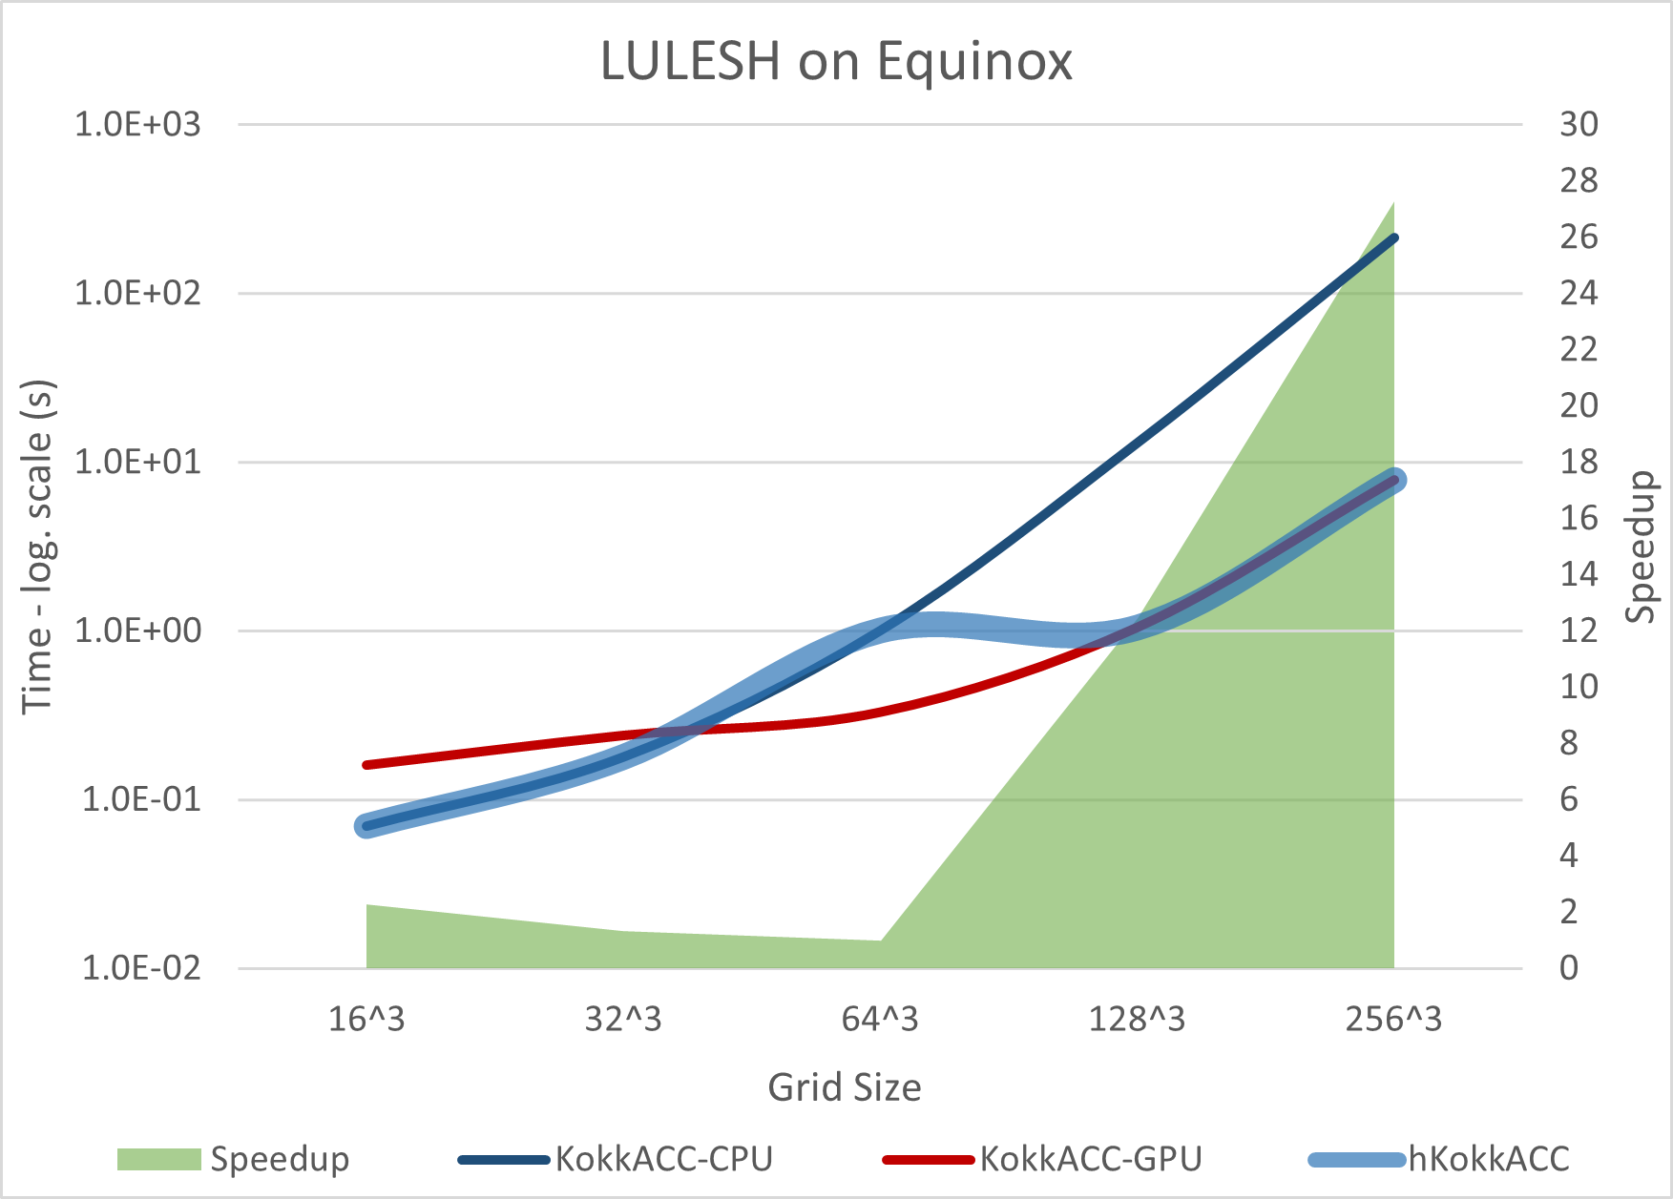
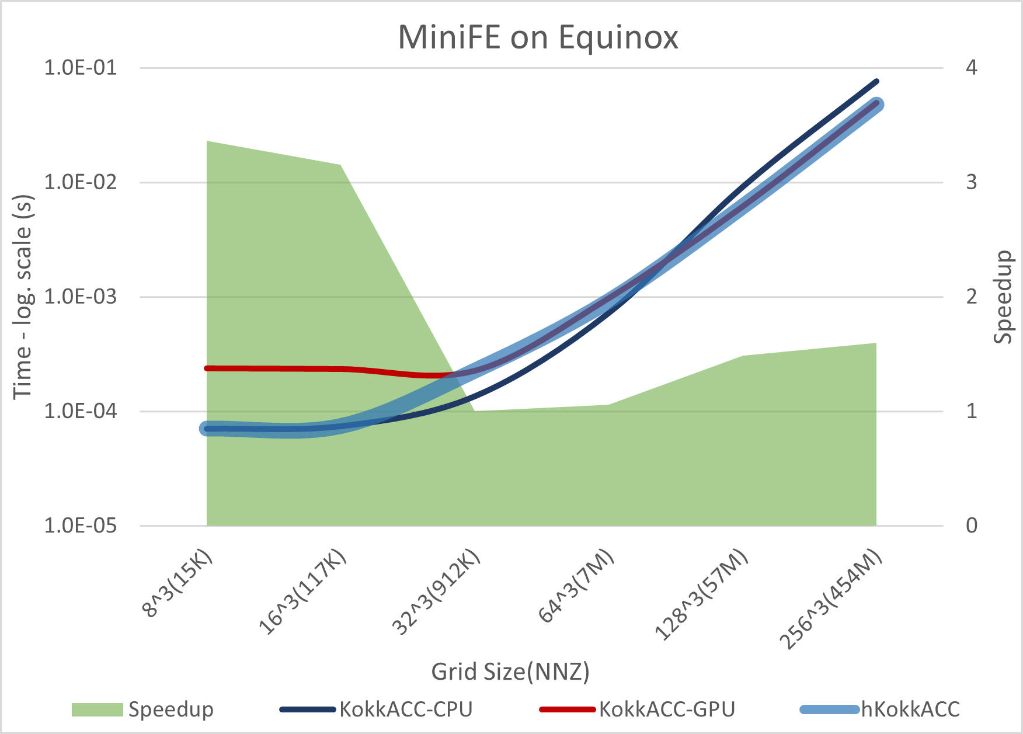
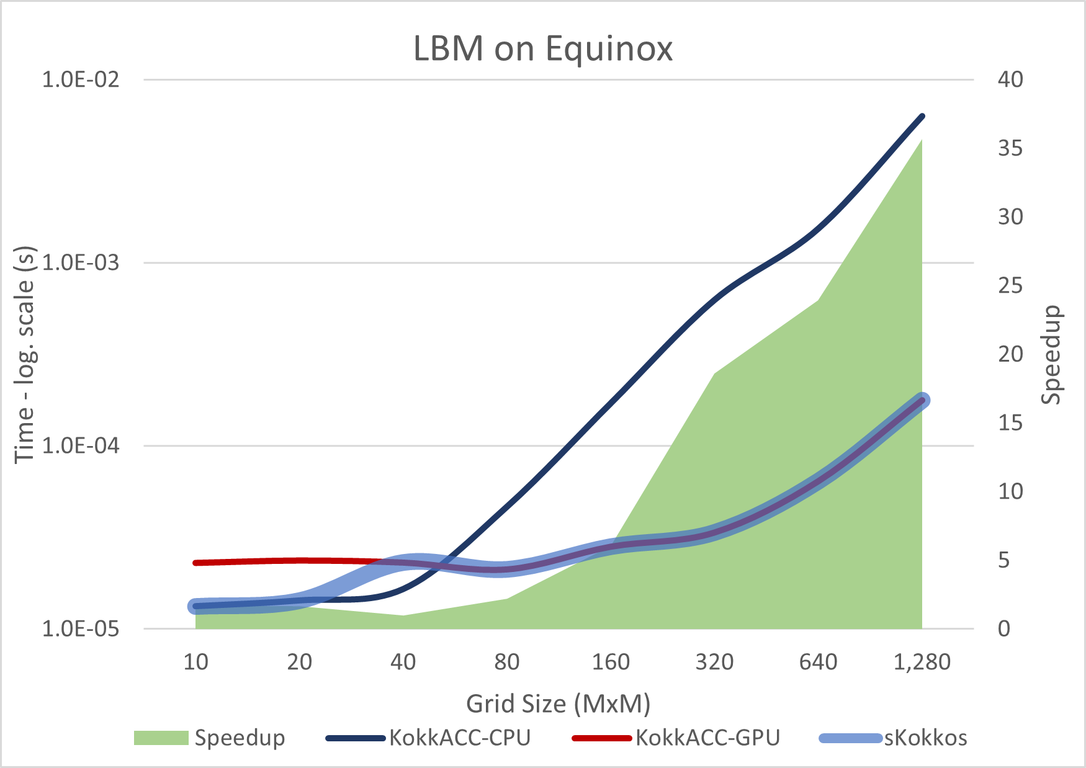
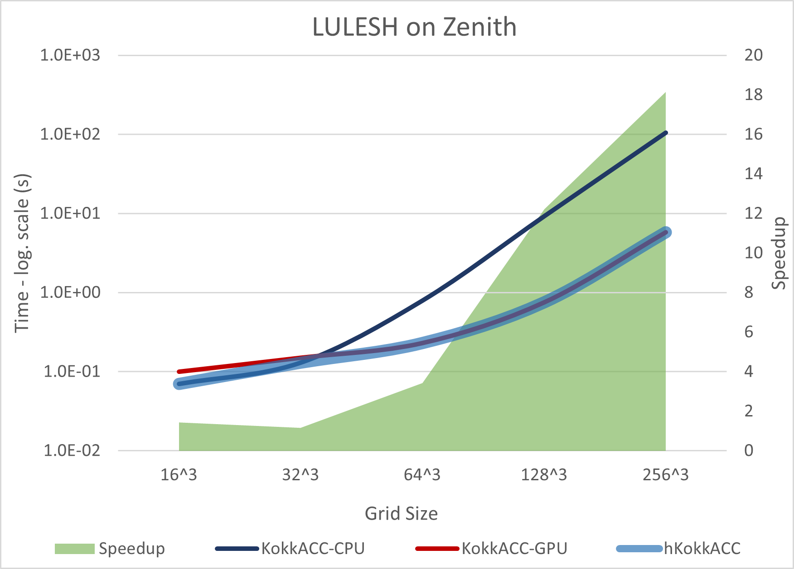
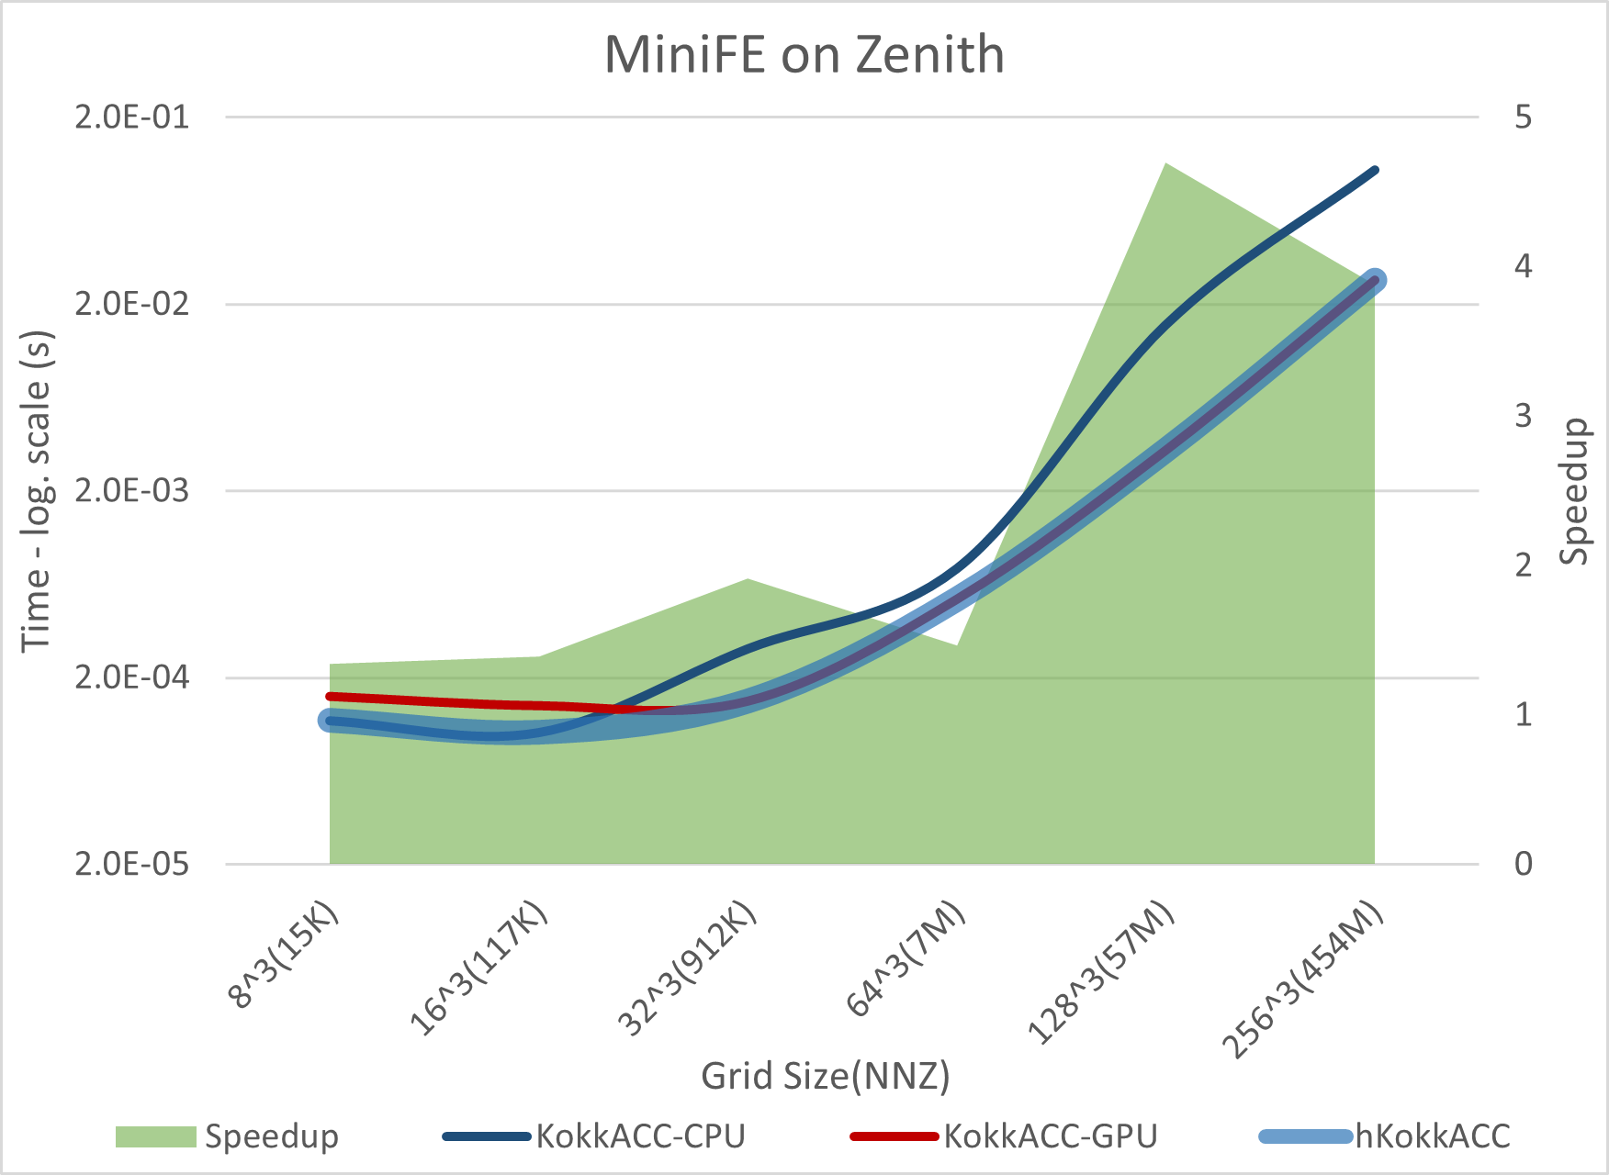
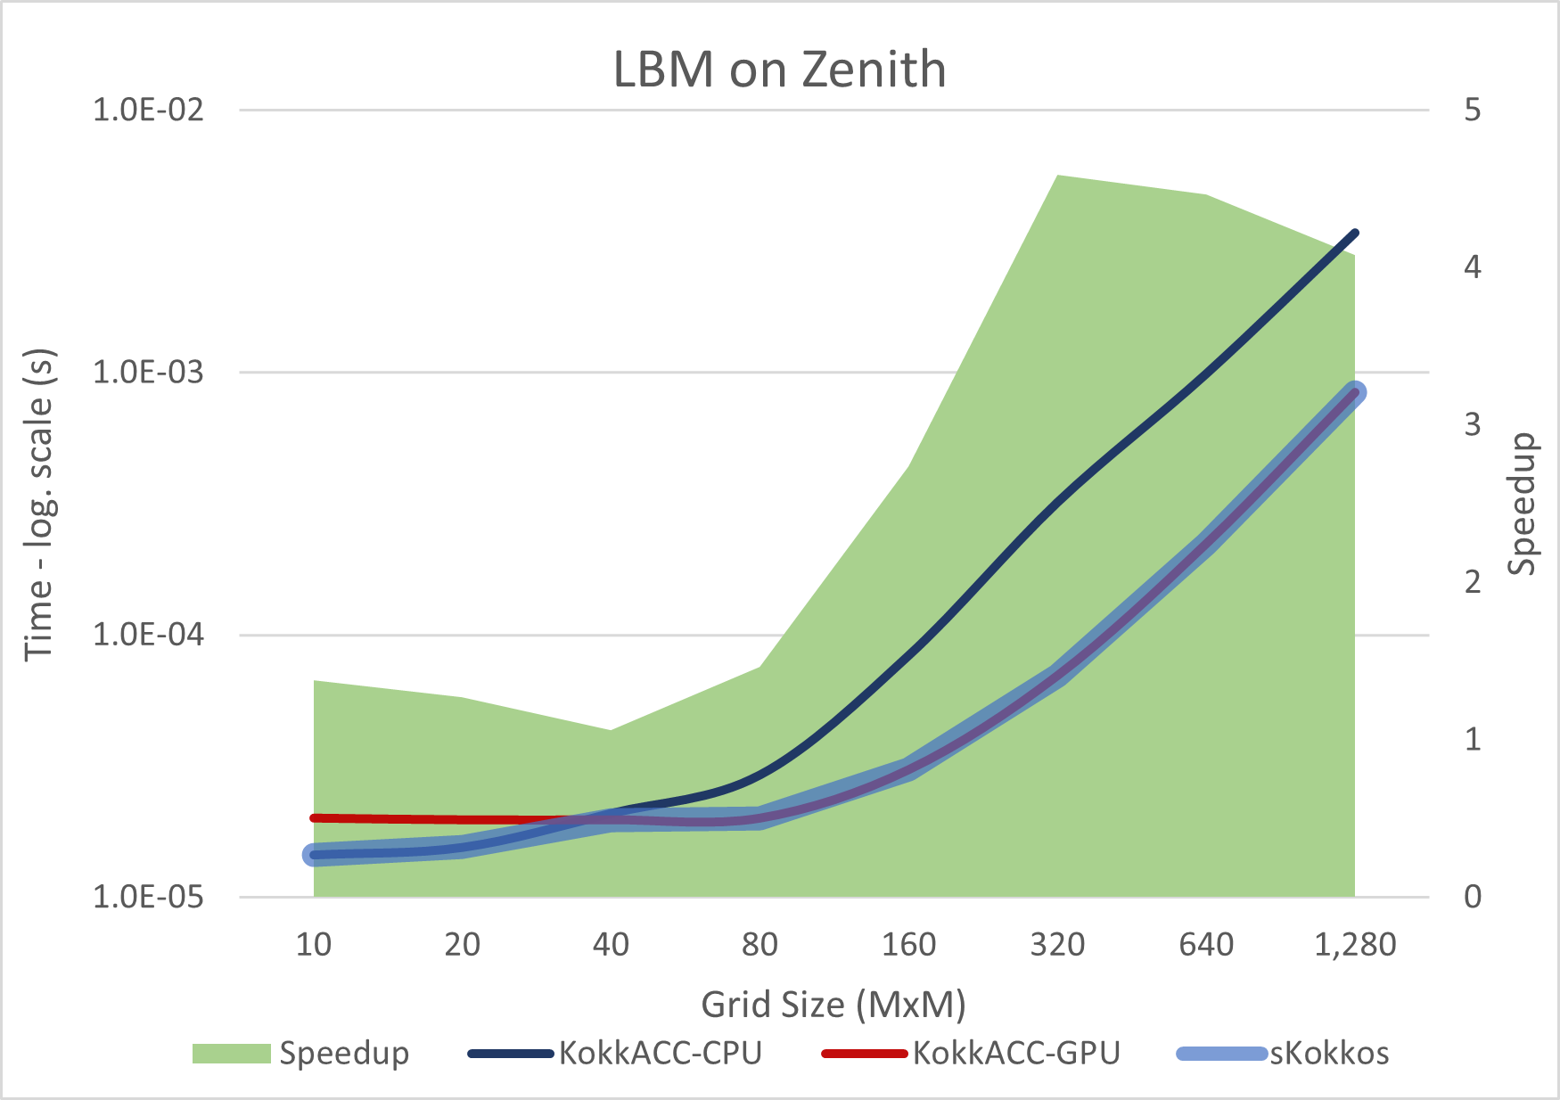
sKokkos Performance: Mini-apps
Two different mini-apps (tunning factors):
Lulesh: Stencil computation on the 3D domain (size of the domain)
MiniFE: Conjugate Gradient (#nnz)
LBM: Lattice-Boltzmann Method (#operations)

Slide 14
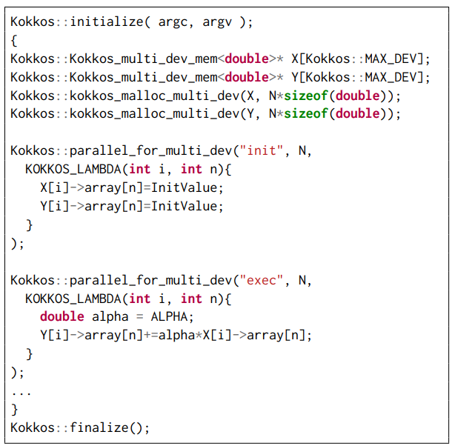
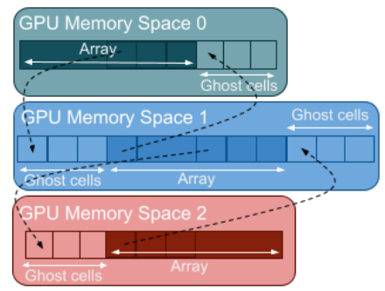
Multi-GPU Support on Kokkos
Use multiple GPUs in a transparent way
Added a few new functions for memory management
Use of “array”
Autotuning
Decide which number of GPUs is more appropriate
Transparent GPU-GPU communication for “stencil computation”

Slide 15
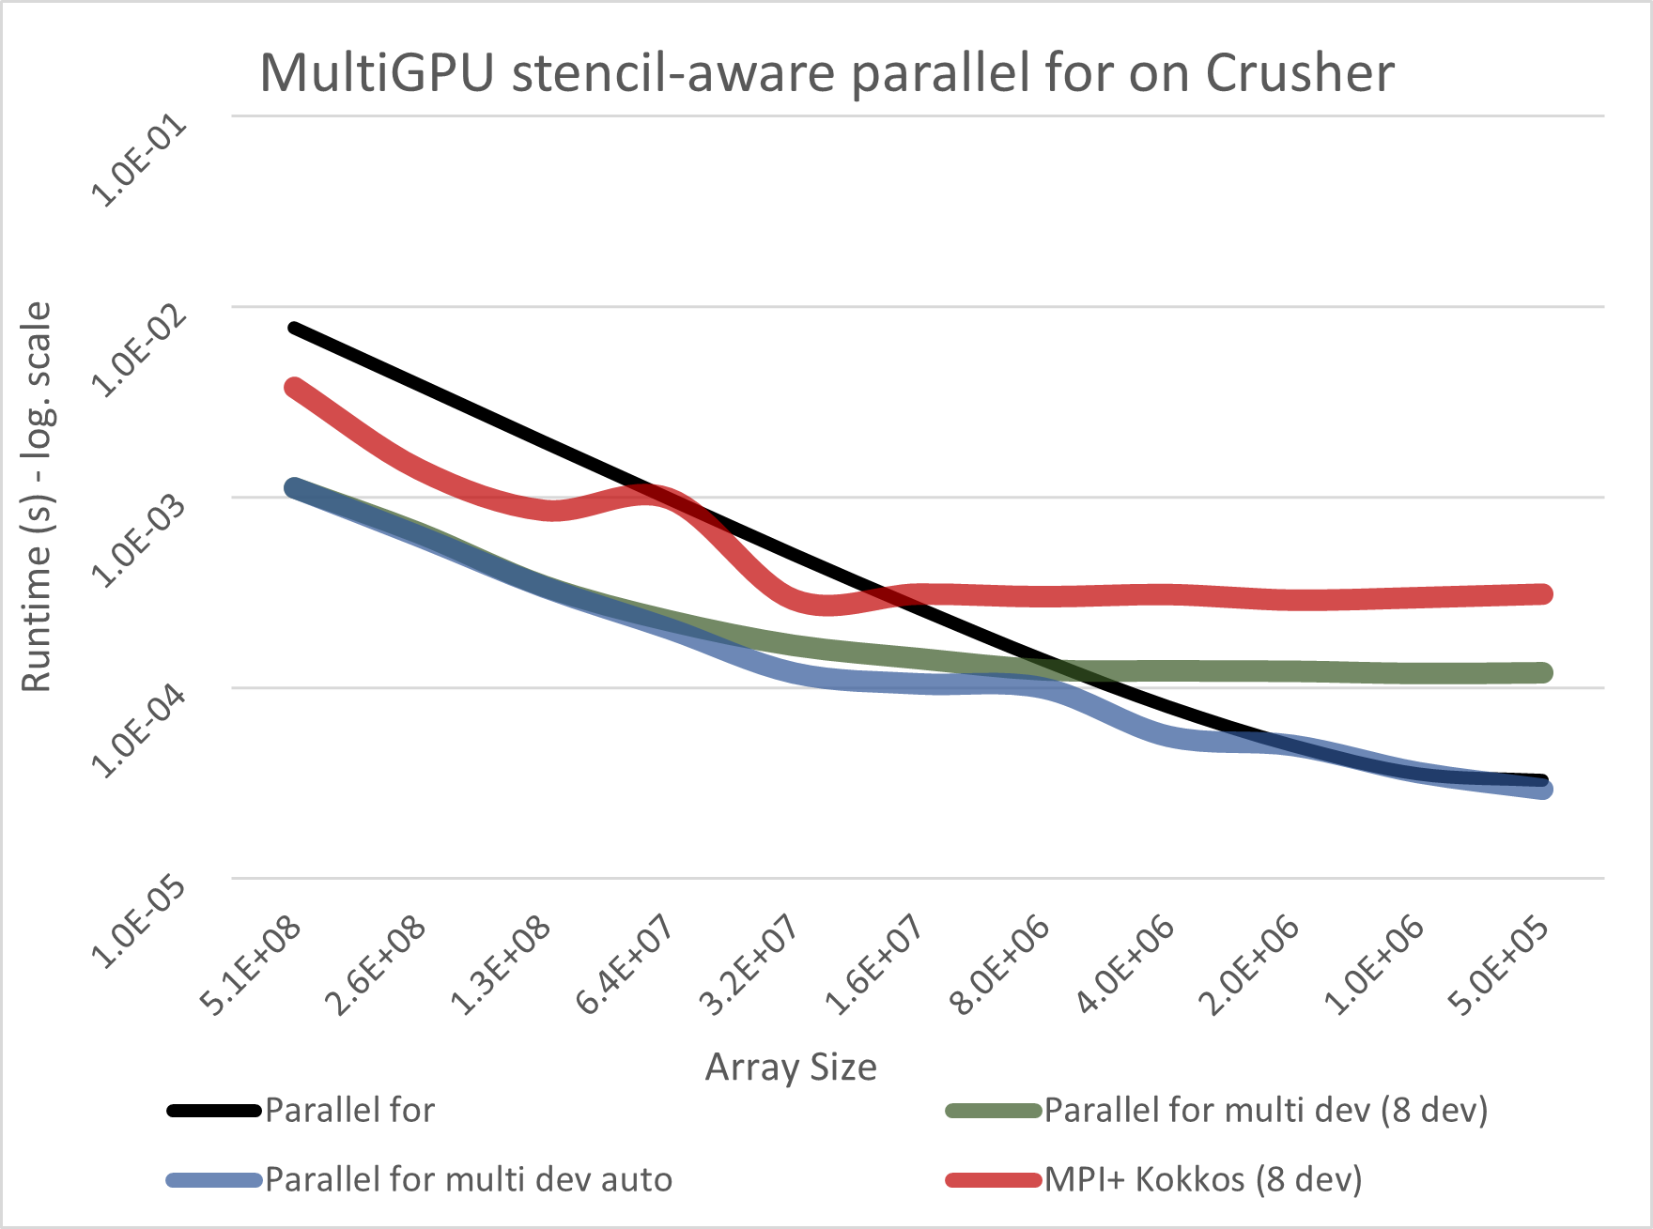
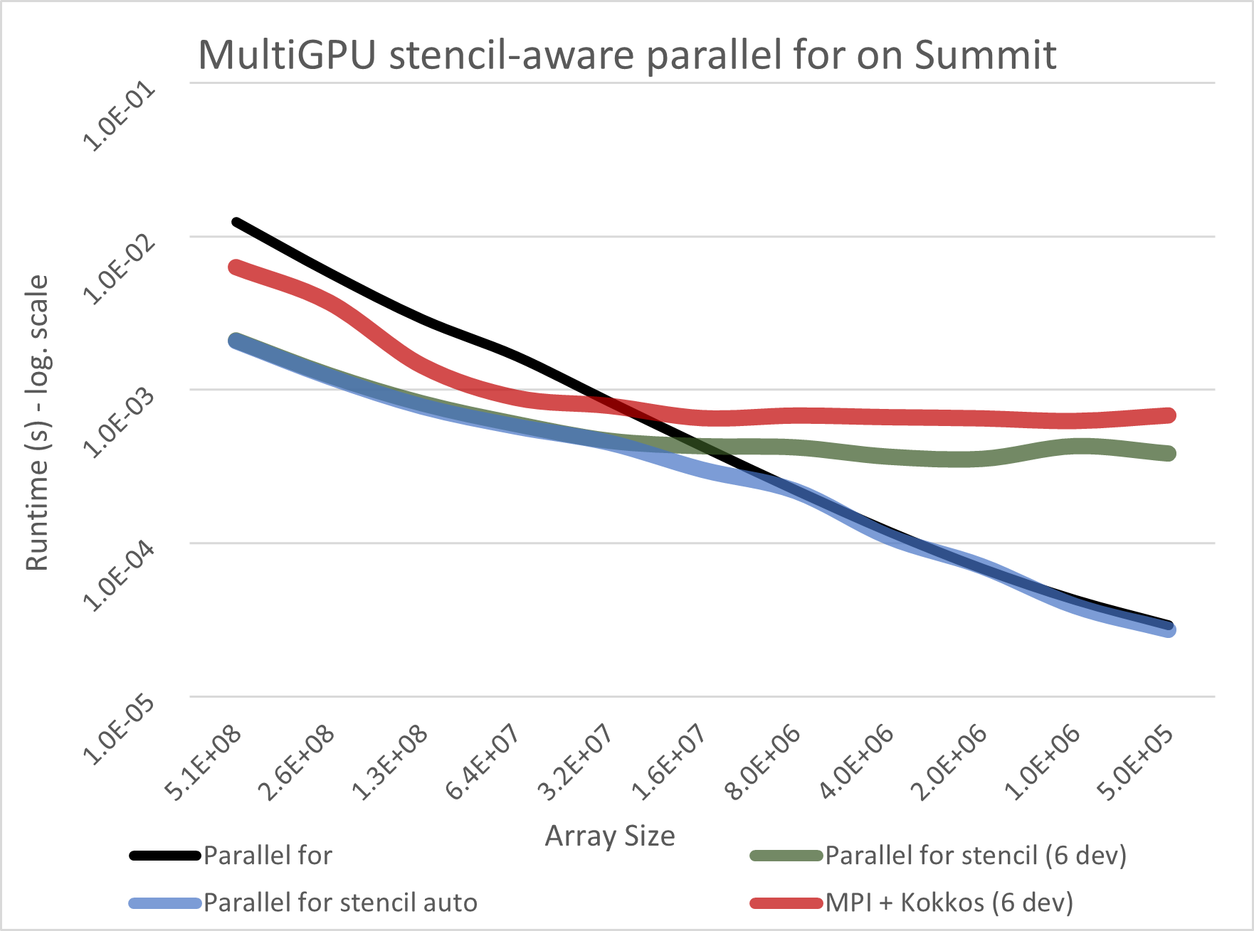
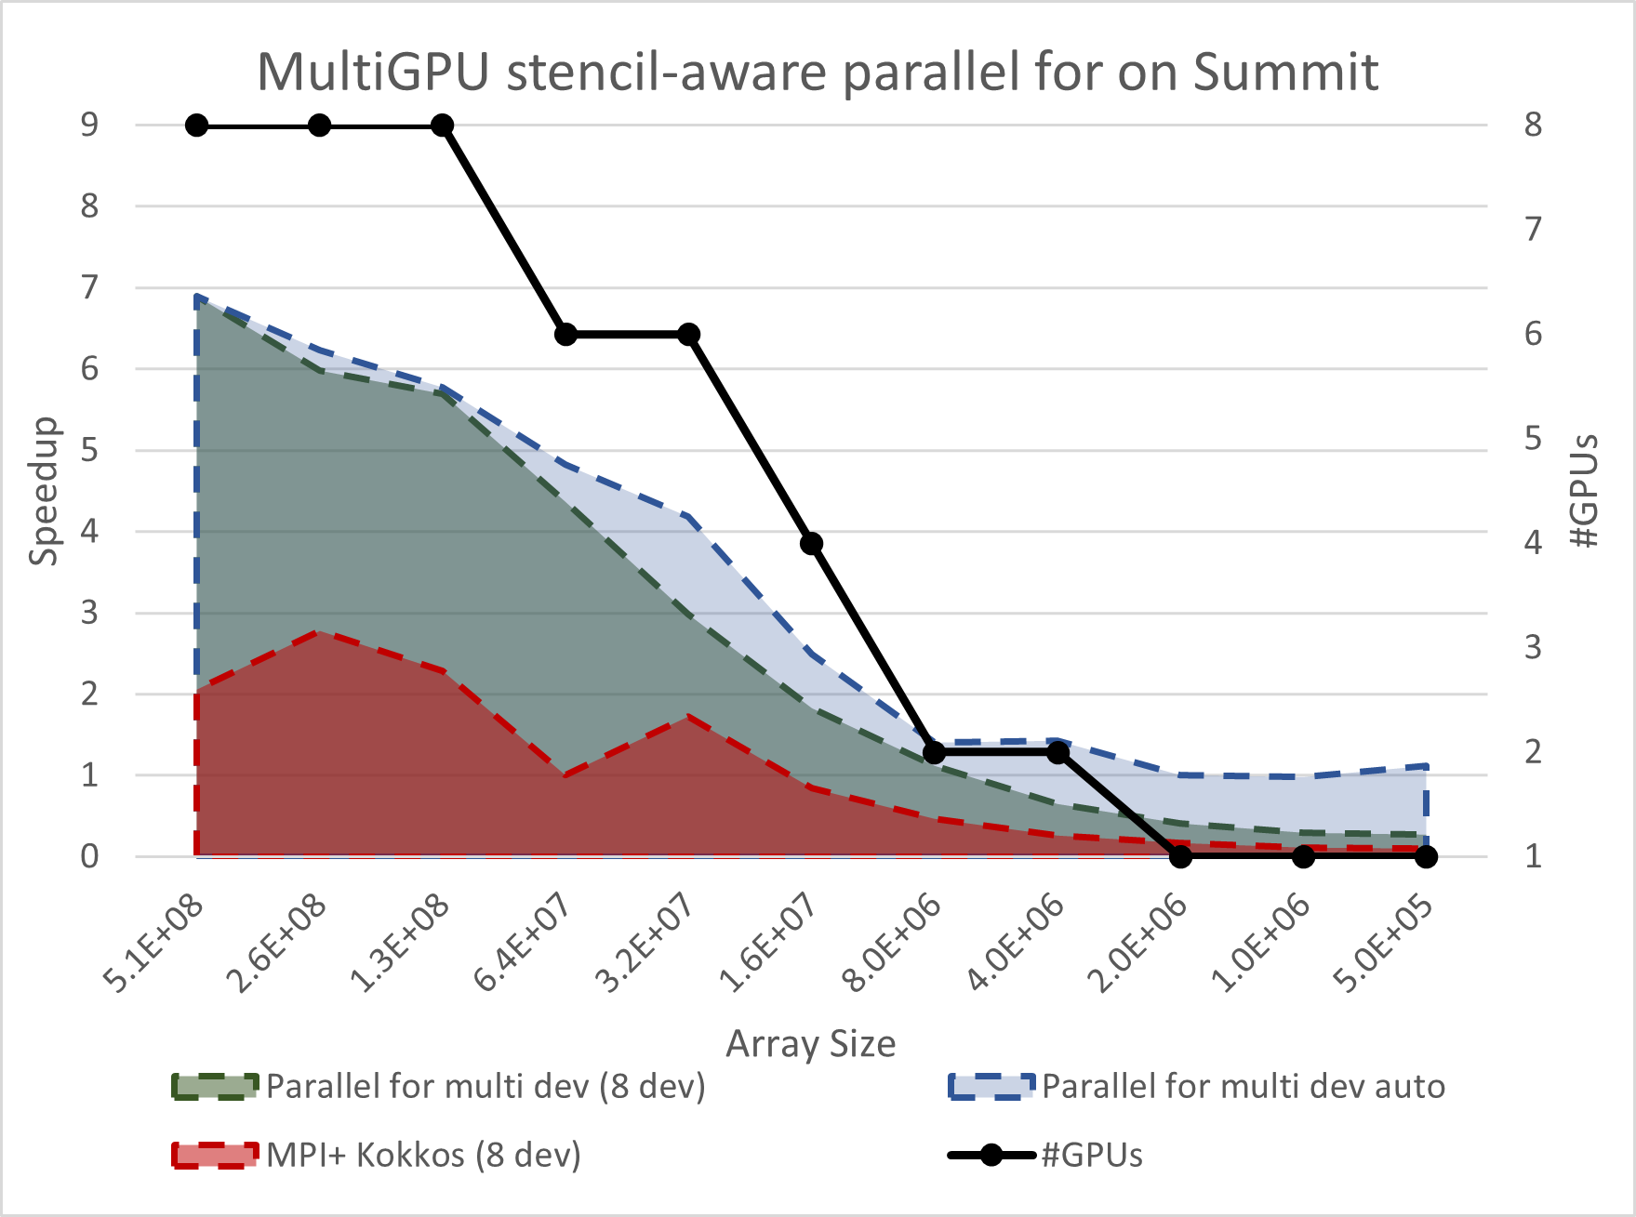
Multi-GPU Support on Kokkos
Two systems
Crusher/Frontier (#1 TOP500)
SUMMIT (#5 TOP500)
Stencil
Autotuning
How many GPUs?
Select the best #GPUs
Hardware features
Computational cost of the application

Slide 16
SEER: An on-node Performance-Portable C++ Library for Heterogeneous Systems
A unified API
On top of
OpenMP, CUDA, HIP, OpenMP Target
Memory
Data Parallel Construct
parallel_for and parallel_reduce
Agnostic
Programmers do not have the control on
Memory mapping
Device/s execution
Autotuning
Make decision on
Memory mapping and transfers
Device/s exploitation
https://code.ornl.gov/5pv/seer

Slide 17
SEER API

Slide 18
SEER Example: AXPY
BLAS Level-1 Vector-Vector operation
Y = alpha * X + Y
Definition of functions and parameters
init_axpy and axpy
Memory creation
mem_axpy
Parallel constructs execution
2x parallel_for

Slide 19
SEER Example: Conjugate Gradient
Iterative problem
Sparse tridiagonal system
2 different memory objects
mem_space_0/1
Compute operations on both memory objects in parallel
Parallel_for and parallel_reduce
AXPY and DOT
SEER-node
Multiple AXPY and DOT can be computed in parallel
SEER_FORK(2)

Slide 20
SEER Performance

Slide 21
MatRIS, Math Library on IRIS runtime
PhD. Pedro Valero-Lara,
Computer Scientist at Programming Systems Group valerolarap@ornl.gov

Slide 22
MatRIS Efforts
Publications:
Pedro Valero-Lara, Jungwon Kim, and Jeffrey Vetter: A Portable and Heterogeneous LU Factorization on IRIS. Asynchronous Many-Task systems for Exascale (AMTE), Euro-Par Workshops. 2022.
Narasinga Rao Miniskar, Mohammad Alaul Haque Monil, Pedro Valero-Lara, Frank Liu, Jeffrey S. Vetter: IRIS-BLAS: Towards a Performance Portable and Heterogeneous BLAS Library. 29th IEEE International Conference on High Performance Computing, Data, and Analytics (HiPC). 2022.
Mohammad Alaul Haque Monil, Narasinga Rao Miniskar, Frank Y. Liu, Jeffrey S. Vetter, Pedro Valero-Lara: LaRIS: Targeting Portability and Productivity for LAPACK Codes on Extreme Heterogeneous Systems by Using IRIS. IEEE/ACM Redefining Scalability for Diversely Heterogeneous Architectures Workshop, RSDHA@SC. 2022
Narasinga Rao Miniskar, Mohammad Alaul Haque Monil, Pedro Valero-Lara, Frank Liu, Jeffrey S. Vetter: IRIS-DMEM: An Efficient Memory Management for Heterogeneous Computing. IEEE HPEC 2023
Narasinga Rao Miniskar, Mohammad Alaul Haque Monil, Pedro Valero-Lara, Frank Liu, Jeffrey S. Vetter: Tiling Framework for Heterogeneous Computing of Matrix-Based Tiled Algorithms, ExHET@PPoPP. 2023.
Mohammad Alaul Haque Monil, Narasinga Rao Miniskar, Keita Teranishi, Jeffrey S. Vetter, Pedro Valero-Lara: MatRIS: Multi-level Math Library Abstraction for Heterogeneity and Performance Portability using IRIS Runtime, P3HPC@SC. 2023.
Awards:
Outstanding paper, IRIS-DMEM: An Efficient Memory Management for Heterogeneous Computing. IEEE HPEC 2023.
Links (repositories):
https://iris-programming.github.io/
https://github.com/ORNL/iris
Funded by BLUESTONE (DOE ASCR X-Stack program)
ORNL team: Mohammad Alaul Haque Monil, Narasinga Rao Miniskar, Pedro Valero-Lara (PI)
Collaboration with CMU and RIKEN (Japan)
Our motivation: Take the next step in programing productivity solutions for HPC Math Libraries
Separate implementation and deployment
We focus on algorithm implementation only
Which devices to use depends on IRIS at runtime
Portable and agnostic
Same code running on different architectures
No architecture details in the code
Multi-device and heterogeneity
Use of all available resources
Co-design, debug and benchmarking of IRIS

Slide 23
IRIS Runtime
Task-based runtime
Python, C, C++, Fortran APIs
Multi-platform
CPU, NVIDIA/AMD GPUs, DSP, Qualcomm,…
Memory Model
Host memory -> CPU memory
Device memory
CPU, GPU, DSP, ….
Transparent
https://iris-programming.readthedocs.io/en/latest/index.html

Slide 24
IRIS API – Memory and Tasks
https://iris-programming.readthedocs.io/en/latest/index.html

Slide 25
IRIS API – Policies and Task Dependencies
https://iris-programming.readthedocs.io/en/latest/index.html

Slide 26
IRIS API – DAG
Policies
One policy per task
One policy per DAG
IRIS_ANY
Use whatever is available
IRIS-MEM
No H2D or D2H or D2D
https://iris-programming.readthedocs.io/en/latest/index.html

Slide 27
LU Factorization
Widely used by HPC scientific applications and benchmarking
No pivoting
Three major components:
DGETRF LaPACK routine (no pivoting LU factorization)
DTRSM BLAS level 3 routine (triangular solve)
SGEMM BLAS level 3 routine (matrix-matrix multiplication)

Slide 28
MatRIS Software Stack
IRIS-BLAS
A unified API for standard BLAS and LaPACK libraries
IRIS-BLAS is mapped on one specific vendor or open-source solution at runtime (IRIS driven)
MatRIS:
We implement the tiled algorithms by using IRIS-BLAS Architecture Agnostic API

Slide 29
MatRIS code
We focused on algorithm only
Tasks, memory and dependencies
No architecture, vendor, library, …, details at this level
Life cycle:
We create a DAG
Launch DAG
Each task is optimized for a specific system
Use of vendor libraries (IRIS_BLAS)

Slide 30
Portable and Optimized code
One single algorithm (or DAG)
Multiple different mappings
Hardware
Algorithm
IRIS (task-based runtime)driven

Slide 31
Performance
16,384 x16,384 Matrix (~ 1,440 tasks)
Portability
NVIDIA DGX-1
1x Intel CPU + 4x NVIDIA Volta GPUs
Crusher (Frontier) node
1x AMD CPU + 4x AMD MI250x GPUs
CADES
1x AMD CPU + 4x NVIDIA A100 GPUs + 4x AMD MI100 GPUs
Colors
DGETRF - Red
DTRSM - Yellow
DGEMM – Blue

Slide 32
Performance (Zoom-in Cades)

Slide 33
Optimizations on MatRIS
Poor scalability using IRIS-ANY policy
Use a different policy based on 2D Block Cyclic Algorithm
This algorithm is used in High Performance Linpack (HPL) benchmark
Instead of every color corresponding to a MPI process, every color correspond to one device
IRIS Mem
No implicit H2D or D2H necessary
Poor performance -> no GPU-GPU communication
IRIS DMem
Optimization of IRIS MEM
GPU-GPU communication

Slide 34
MatRIS Scalability

Slide 35
MatRIS - Sparse LU
Similar to dense LU factorization code
Fill-in, dynamic use of memory management and memory allocation
Relative low density (≈ 3 × 10−4)
~400 tasks
Representative synthetic matrices
Simulates the important characteristics of real sparse matrices

Slide 36
Tile-size is important
Big tile size
Lower number of tiles/iterations
Big tasks and small DAGs
Small tile size
Higher number of tiles/iterations
Small tasks and big DAGs
What is the best?

Slide 37
Conclusions
Improve portability and programming productivity
Program “once” and deploy “many times”
Separate algorithm/application description from its mapping on heterogeneous systems
Not having the control of everything is good!
Application developers should not deal with low level hardware or software details
Different systems need different mappings of the same algorithm (DAG)
Number and kind of computing units, network topology, hierarchy of memory, …

Slide 38
Julia for HPC + AI
PhD. Pedro Valero-Lara,
Computer Scientist at Programming Systems Group valerolarap@ornl.gov

Slide 39
Julia Efforts
Funded by BLUESTONE (DOE ASCR X-Stack program)
ORNL team: William F. Godoy, Pedro Valero-Lara (PI)
Collaboration with MIT, NERSC and ANL
Introduction:
LLVM frontend with Just-in-Time compilation
Aims to provide performant code for technical/scientific computing
Language design enables scientists to develop novel algorithms and contribute to the language
Motivation:
Explore the benefit of Julia for HPC and AI
HPC support
Workflows
HPC+AI integration
Provide better solution for performance portability
JACC
Publications:
William F. Godoy, Pedro Valero-Lara, Caira Anderson, Katrina W. Lee, Ana Gainaru, Rafael Ferreira da Silva, and Jeffrey S. Vetter: Julia as a unifying end-to-end workflow language on the Frontier exascale system. WORKS@SC. 2023.
Pedro Valero-Lara, William F. Godoy, and Jeffrey S. Vetter: JACC.jl: A Julia CPU/GPU Portable Functional Layer (in progress)
Awards:
Best paper award, Julia as a unifying end-to-end workflow language on the Frontier exascale system, WORKS@SC 2023.
Links (repositories):
https://julialang.org/
https://github.com/JuliaORNL/JACC.jl/tree/main

Slide 40
Evaluating Julia as a Unifying Workflow Language on Frontier
The Achievement
Our ORNL team evaluated the use of Julia to shorten workflow development paths on Frontier from idea to science.
The Science
We explored the readiness of the LLVM-powered Julia ecosystem to deploy a scientific workflow based on a 7-point stencil memory-bound kernel on Frontier.
On AMD GPUs, measurements demonstrated that Julia’s kernel was 2x slower than the vendor’s HIP C++ version. Weak scaling showed negligible overheads for the bindings to MPI and I/O (using ADIOS2), on up to 512 nodes, while online data analysis was done on JupyterHub.
Despite a reasonable LLVM-IR, Julia still shows that the generated kernel on AMD GPU is not fully optimized showing it’s 2X slower (300 GB/s) when compared to the equivalent vendor HIP C++ kernel (600 GB/s) memory-bandwidth.
The Impact
Ultimately, Julia can facilitate scientists to spin end-to-end workflows on a single language. Julia reduces development costs and interoperability barriers in the fragmentation of high-performance (C, C++, Fortran) and AI, Data Science (Python) ecosystems.
Our vision is to improve the performance of compute intensive Julia kernels, including just-in-time compilation, on heterogeneous architectures.
PI/Facility Lead(s): Jeffrey S Vetter
ASCR Program/Facility: X-Stack / Oak Ridge Leadership Computing (OLCF)
ASCR PM: Hal Finkel
Funding: ASCR, ECP
Publication(s) for this work: William F Godoy, Pedro Valero-Lara, Caira Anderson, Katrina W Lee, Ana Gainaru, Rafael Ferreira da Silva, Jeffrey S Vetter: “Julia as a Unifying End-to-End Workflow Language on the Frontier Exascale System” 18th Workshop on Workflows in Support of Large-Scale Science, International Conference for High Performance Computing, Networking, Storage, and Analysis 2023, SC23.
DOI: https://doi.org/10.1145/3624062.3624278 pre-print: arXiv:2309.10292v3 News article: The Next Platform
Notes:
ORNL Team Members: William F Godoy, Pedro Valero-Lara, Caira Anderson, Katrina W Lee, Ana Gainaru, Rafael Ferreira da Silva, Jeffrey S Vetter
Deliverables:
Paper accepted at SC23@WORKS workshop
Poster accepted at SC23 research track
A breakdown article published by The Next Platform tech news outlet: https://www.nextplatform.com/2023/09/26/julia-still-not-grown-up-enough-to-ride-exascale-train/
Two intern program presentations: Sustainable Research Pathways and OMNI
A Julia tutorial at Oak Ridge Leadership Computing Facility (~100 participants)
Community venues: ECP BoF Days, ECP Tutorial Days, SC22/23 BoF
A visible diverse set of ORNL co-authors, (3 female, 3 Hispanic, 1 African-American, 1 Asian-American, 2 White).
Notes:
We tested a 3D diffusion-reaction end-to-end workflow solver (Gray-Scott) https://github.com/JuliaORNL/GrayScott.jl for:
7-point stencil kernel generation on AMD GPUs,
MPI communication,
parallel I/O using ADIOS2, and
data analysis on OLCF’s JupyterHub.
Results show a 50% memory bandwidth performance gap with AMD HIP, whereas the MPI and ADIOS2 bindings provide zero-overhead on up to 4,096 GPUs. When testing half of Frontier, GPUs execute normally while underlying MPI failures occur.
Challenges:
i) Development of Julia code caught bugs in AMDGPU.jl for random number generation addressed upstream.
ii) Packaging required orchestration between Julia’s package manager with underlying MPI, ROCm and ADIOS2 system wide library back ends
iii) Despite a reasonable LLVM-IR, Julia still shows that the generated kernel on AMD GPU is not fully optimized showing it’s 2X slower (300 GB/s) when compared to an equivalent vendor HIP C++ kernel (600 GB/s) when measuring memory-bandwidth.
iv) Julia’s MPI and parallel I/O bindings add negligible overheads to the system back ends, regardless of on-node performance.
v) The Just-in-time nature of Julia adds some initial overhead (10X slower solver than optimized), but this cost is amortized over time.
iv) Some work is needed to enable Julia kernels on OLCF’s JupyterHub as it’s not out-of-the-box supported.

Slide 41
JACC.jl Model
Uses a “functional” approach. Think of Kokkos and passing “kernel” functions
Portable code front end between CPU and GPU
We don’t reinvent the wheel:
Back ends: CPU Threads, and GPU CUDA.jl and AMDGPU.jl….OneAPI? (Intel GPUs?)
Preferences.jl to select a back end (we don’t mix back ends)
Julia v1.9 [weakdeps]
Coarse and fine granularity included
https://github.com/JuliaORNL/JACC.jl

Slide 42
JACC.jl Description
Follows: Julia is SIMPLE for science
Descriptive, not prescriptive
Run simple portable kernels on CPU and GPU
Components:
JACC.Array: alias to the corresponding back end
JACC.parallel_for (N, f, x…)
f: function “argument”
x… variadic
https://github.com/kokkos/kokkos-tutorials/blob/main/Intro-Short/KokkosTutorial_Short.pdf
import JACC
function axpy (i , alpha , x , y ) x[i] += alpha * y[i] end
SIZE = 1000000 x = round.( rand( Float64 , SIZE ) * 100) y = round.( rand( Float64 , SIZE ) * 100) alpha = 2.5 dx = JACC.Array( x ) dy = JACC.Array( y ) JACC.parallel_for(SIZE, axpy, alpha, dx, dy)

Slide 43
JACC.jl: Weak dependencies
Thread.jl (CPUs)
Memory:
Computation (parallel_for):
CUDA.jl (NVIDIA GPUs)
Memory:
Computation (parallel_for):

Slide 44
Results
Conjugate Gradient
Lattice Boltzmann
Summit/Frontier
AXPY

Slide 45
Generative AI for HPC programming
PhD. Pedro Valero-Lara,
Computer Scientist at Programming Systems Group valerolarap@ornl.gov

Slide 46
AI LLMs efforts for HPC and HPC-AI integration
Funded by BLUESTONE (DOE ASCR X-Stack program)
ORNL team: William F. Godoy, Pedro Valero-Lara
Collaboration with TAMIU
Motivation:
Explore and evaluate the impact of AI LLMs on HPC
Kernel generation
Automatic parallelization
Code translation
…
HPC-AI integration
ChatBLAS
Hypothesis:
“AI technologies can replace human intervention in critical tasks in HPC technologies providing an autonomous and a sustainable HPC ecosystem able to implement and manage complex HPC codes”
Publications:
William F. Godoy, Pedro Valero-Lara, Keita Teranishi, Prasanna Balaprakash, Jeffrey S. Vetter: Evaluation of OpenAI Codex for HPC Parallel Programming Models Kernel Generation. ICPP Workshops 2023:
Pedro Valero-Lara, Alexis Huante, Mustafa Al Lail, William F. Godoy, Keita Teranishi, Prasanna Balaprakash, Jeffrey S. Vetter: Comparing Llama-2 and GPT-3 LLMs for HPC kernels generation. LCPC. 2023.
Links (repositories):
https://github.com/mustafalail/Llama-2-70b-HPC-Kernels
https://github.com/mustafalail/Llama-2-70b-HPC-Kernels

Slide 47
Kernel Generation with Copilot
Correctness
Non-knowledge (0), no code at all or not a single correct code
Novice (0.25), one correct code, but includes other several correct or incorrect programming models
Learner (0.5), one correct code, there are other incorrect codes, but all of them are using the requested programming model.
Proficient (0.75), all the codes are correct using the programming model requested.
Expert (1), only one piece of code and is correct.
Different kernels
AXPY, GEMV, GEMM, SpMV (CSR), Jacobi, Conjugate Gradient
Different languages and programming models
C++ (OpenMP, Kokkos, CUDA, …), Fortran (OpenMP, OpenACC, …), Julia, Python

Slide 48
Llama-2 vs Copilot
Correctness
Non-knowledge (0), no code at all or not a single correct code
Novice (0.25), one correct code, but includes other several correct or incorrect programming models
Learner (0.5), one correct code, there are other incorrect codes, but all of them are using the requested programming model.
Proficient (0.75), all the codes are correct using the programming model requested.
Expert (1), only one piece of code and is correct.
Llama-2 is more aggressive at the cost of being less reliable
Copilot GPT is mor reliable at the cost of being less optimal

Slide 49
Ongoing efforts
Automatic parallelization
Sequential C code to a OpenMP/CUDA C code
Code translation
Fortran to Julia
Integrate AI LLMs into HPC
Train our own models for specific missions
ChatBLAS
Generate BLAS kernels on top of
OpenMP/OpenACC, CUDA, HIP, SyCL, …
Using:
C/C++, Fortran, Juilia, …
Easy to validate
Correctness and performance
Compilation and building
Training

Slide 50
Agnostic Programing Models “Less is More”
Thanks!!
Questions??
PhD. Pedro Valero-Lara,
Computer Scientist at Programming Systems Group valerolarap@ornl.gov

