Slide 1
Safety in AI Systems: SMT-Based Verification of Deep Neural Networks
Guy Katz
Universidad Complutense de Madrid
April $2024$

Slide 2
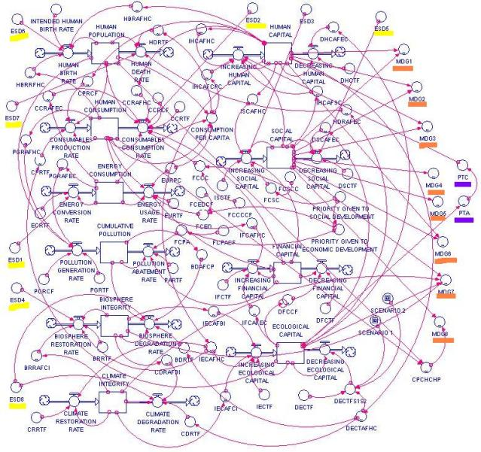
Programming by Machine Learning
How can we certify these systems?
Requirements
Training Algorithm
Artifact
Input/Output Pairs

Slide 3
When Things Go Wrong
Tesla model-s autopilot slams into a wall ($2017)$

Slide 4
Adversarial Inputs
Slight input perturbations cause misclassification
State-of-the-art networks are vulnerable
Goodfellow et al., $2015$
$$ε$$

Slide 5
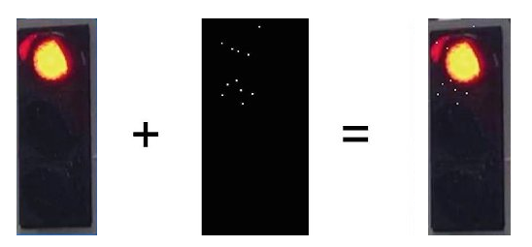
Adversarial Inputs (cnt’d)
Attacks exist in the real world
And attackers are getting better
How can we ensure robustness before deployment?
Traffic Light
$11$ White Pixels
Oven

Slide 6
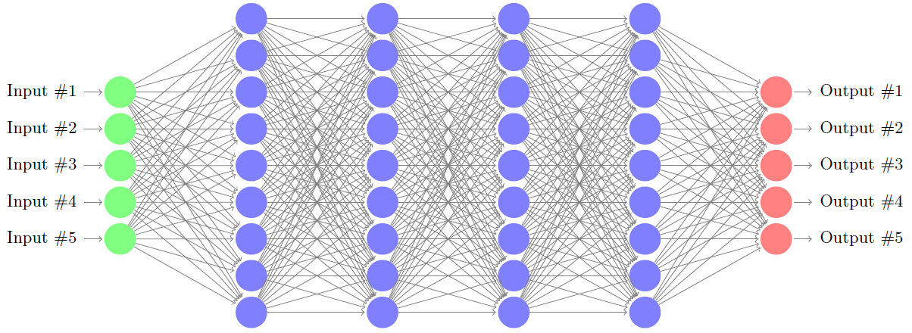
DNN Verification
Given: network $N$, properties $P$ and $Q$
$Q$ is the negation of the desired property
SAT: the discovered point is a counter example
UNSAT: property holds
Input Space
Output Space
$Q$
$P$

Slide 7
Some Applications….

Slide 8
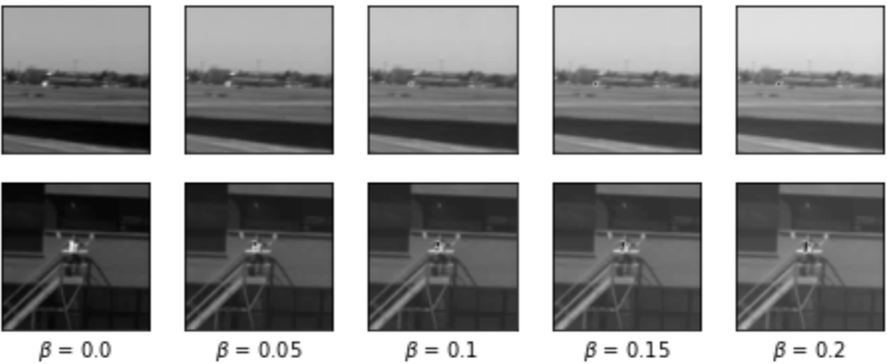
Application $1$: System Safety
Runway object classifier for safe aircraft taxiing
Under development by Airbus
Safety: ensure the network is robust to different brightness levels
Verification can measure this accurately
Robustness Assessment of a Runway Object Classifier for safe Aircraft Taxiing.
Elboher et al., Proc. DASC 2024

Slide 9
Application 2: System Security
Measure the smallest amount of noise required to fool networks
Verified that network is immune to smaller perturbations, even for best attackers
Can also find the best adversarial input using verification
Can be used to measure the usefulness of attack and defense technologies
Kitchen Oven
Provably Minimally-Distorted Adversarial Examples. Carlini et al., arXiv, $2017$

Slide 10
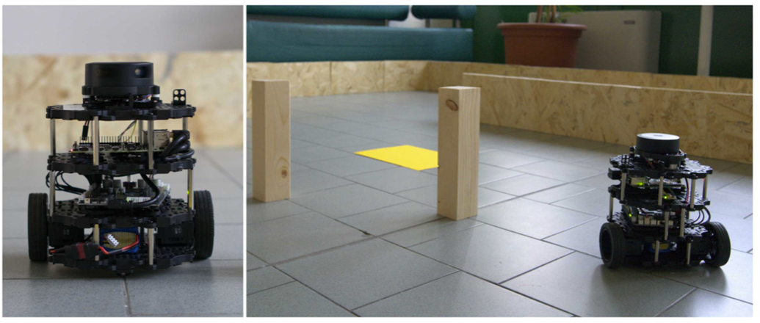
Application 3: Liveness
DNNs used as controllers in critical systems
Computer networks, robotics
Safety can sometimes be enforced via hand-crafted rules
But what about liveness?
Turtlebot3 controller: identify infinite loops
Verifying Learning-Based Robotic Navigation Systems. Amir et al., TACAS 2023

Slide 11
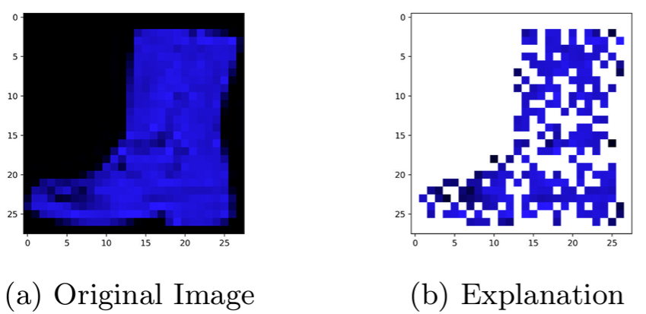
Application $4$: Explainability
Need to explain neural network’s decisions
E.g., why was a credit card application rejected?
E.g., “debt history” field led to rejection
Check a hypothesis using verification
Obtain minimal explanations
Towards Formal XAI: Formally Approximate Minimal Explanations of Neural Networks. Bassan and Katz, TACAS 2023

Slide 12
But how is it done?

Slide 13
DNN Verification Complexity
Many approaches have been proposed
Complete and incomplete
Everyone is struggling with network sizes
Problem is NP complete:
$n$ neurons lead to $2^{n}$ operations
So what can we do?

Slide 14
The Culprits: Activation Functions
Steps:
Weighted sum
Activation function
$$2$$
$$1$$
$$0$$
$$3$$
$$f(4)$$
$$2⋅1+0⋅3+(−1)⋅\left(−2\right)=4$$
$$−1$$
$$−2$$

Slide 15
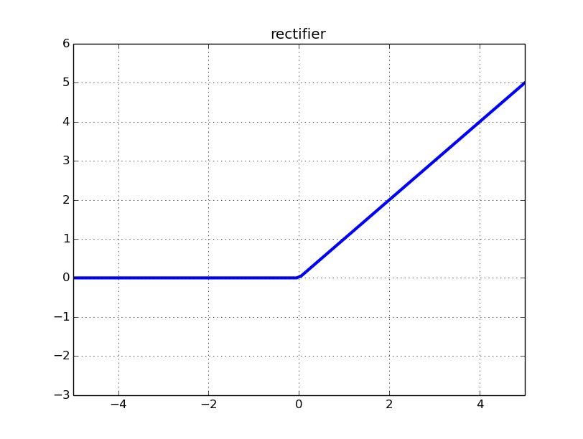
Rectified Linear Units (ReLUs)
ReLU($x$) = $max⁡(0,x)$
$x≥0$: active case, return $x$
$x<0:$ inactive case, return $0$
$$2$$
$$1$$
$$1$$
$$0$$
$$3$$
$$−2$$
$$0$$
$$4$$
$$1⋅1+\left(−2\right)⋅3+0⋅\left(−2\right)=−5$$
$$2⋅1+0⋅3+(−1)⋅\left(−2\right)=4$$
$$−1$$
$$−2$$
$$0$$

Slide 16
Case Splitting
A property: linear constraints on inputs and outputs
If the wall is too near, the robot doesn’t move foward
Without activation functions, network would be linear
Linear programs are easy to solve
Handling ReLUs: translate into a sequence of linear problems

Slide 17
Case Splitting (cnt’d)
Case splitting approach:
Fix each ReLU to a linear segment (active or inactive)
Solve the resulting linear problem
If property is violated for this configuration, stop
But if property holds, backtrack and try other option
State explosion: $n$ ReLUs $→2^{n}$ checks
$$a+b+c=5, b>c$$
$$y=ReLU(x)$$
$$a+b+c=5, b>c$$
$$y=x, x≥0$$
$$a+b+c=5, b>c$$
$$y=0, x≤0$$

Slide 18
An SMT Based Approach
A way to mitigate this state explosion
Lazy approach: no case splitting in advance
ReLU constraints satisfied incrementally
Split only if we must
Conflict analysis to prune the search space
Orders-of-magnitude larger than a naïve search
Sound and Complete

Slide 19
Improving Scalability via Abstraction

Slide 20
Abstraction
Key idea: use a smaller network
Input Space
Output Space
$$N$$
$Q$
$P$
$$\overline{N}$$
An Abstraction-Based Framework for Neural Network Verification. Elboher et al., CAV 2020

Slide 21
But why is this Sound?
Network $\overline{N}$ is related to $N$
It is an over-approximation
Common theme in verification
If $〈P,\overline{N},Q〉$ is UNSAT, then $〈P,N,Q〉$ is also UNSAT
And what if $〈P,\overline{N},Q〉$ is SAT?
Ambiguous
We will handle this case later

Slide 22
Over-Approximations
Input Space
Output Space
$Q$
$$\overline{S}$$
$P$
$$S$$
$$\overline{R}$$
$R$

Slide 23
Over-Approximations (cnt’d)
Over-approximation has all behaviors of original system
It is simpler, and easier to verify
If over-approximation is safe, so is original
If over-approximation query is UNSAT, original query also UNSAT
So how do we over-approximate neural networks?

Slide 24
Output Assumption
Assume, without loss of generality:
Network $N$ has single output, $y$
Output property $Q$: $y>c$
Over-approximation network $\overline{N}$: $∀x. \overline{N}\left(x\right)≥N(x)$
If over-approximate query is UNSAT, $∀x. \overline{N}\left(x\right)≤c$
And hence, $N\left(x\right)≤c$
So original query also UNSAT

Slide 25
Constructing $\overline{N}$
Idea: merge two neurons into one
And repeat
Input weight: max
Output weight: sum
Example: $N\left(1\right)=17≤\overline{N}\left(1\right)=32$
$$N$$
$$v_{1}$$
$$\overline{N}$$
$$1$$
$$5$$
$$4$$
$$8$$
$$x$$
$$y$$
$$x$$
$$v$$
$$\overline{y}$$
$$4$$
$$3$$
$$v_{2}$$

Slide 26
Constructing $\overline{N}$ (cnt’d)
Why did it work?
Works because:
Weights $c$ and $d$ were positive
We wanted $\overline{y}$ to increase
$$v_{1}$$
$$a$$
$$c$$
$$max⁡(a,b)$$
$$c+d$$
$$x$$
$$y$$
$$x$$
$$v$$
$$\overline{y}$$
$$b$$
$$d$$
$$v_{2}$$
Monotonic increasing

Slide 27
Constructing $\overline{N}$ (cnt’d)
In order to merge two neurons:
All outgoing edges must have same sign
Next-layer neurons either need to increase, or decrease
Four categories of neurons: $\{pos,neg\}×\{inc, dec\}$
Neurons from same category can be merged
Input network not guaranteed to meet requirements
So we will preprocess them!

Slide 28
Preprocessing
Part $1$: all outgoing edges need to have same sign
We will double the network size
$$v_{1}$$
$$2$$
$$1$$
$$v_{1}$$
$$v_{4}$$
$$1$$
$$3$$
$$x_{1}$$
$$−3$$
$$−1$$
$$−2$$
$$v_{2}$$
$$v_{5}$$
$$y$$
$$x_{2}$$
$$1$$
$$v_{3}$$
$$v_{6}$$

Slide 29
Preprocessing (cnt’d)
$$v_{1}$$
$$2$$
$$v_{4}$$
$$1$$
$$1$$
$$x_{1}$$
$$1$$
$$2$$
$$−3$$
$$1$$
$$−2$$
$$v_{1}^{+}$$
$$v_{5}$$
$$1$$
$$−2$$
$$x_{2}$$
$$−2$$
$$−3$$
$$v_{1}^{−}$$
$$v_{6}$$

Slide 30
Preprocessing (cnt’d)
Assume all neurons are pos/neg
Now classify as inc/dec
Inc: if neuron value increases, output neuron increases
Dec: if neuron value decreases, output neuron increases
Start with output, work backwards
Double neurons again, if needed

Slide 31
Preprocessing (cnt’d)
All neurons classified as pos/neg, inc/dec
$$2$$
$$v_{4}$$
$$1$$
$$v_{1}^{I}$$
Inc
Inc
$$3$$
$$x_{1}$$
$$1$$
$$2$$
$$1$$
$$1$$
$$−1$$
$$v_{1}^{D}$$
$$v_{5}$$
$$y$$
$$v_{1}^{+}$$
$$−2$$
$$−2$$
Dec
Dec
Inc
$$x_{2}$$
$$−3$$
$$1$$
$$−2$$
$$v_{1}^{−}$$
$$v_{6}$$
Dec
Inc

Slide 32
Preprocessing: Summary
Mark output neuron as inc
From the last-before-layer, backwards:
If neuron has positive and negative outgoing weights, double it (pos/neg)
If neuron is connected to inc and dec neurons, double it (inc/dec)
Preprocessed network completely equivalent to original
Up to 4 times larger
Wlog, assume input network is already preprocessed

Slide 33
Abstraction Operator
Recall the pos/inc case:
$$v_{1}$$
$$a$$
$$c$$
$$max⁡(a,b)$$
$$c+d$$
$$x$$
$$y$$
$$x$$
$$v_{1}$$
$$\overline{y}$$
$$b$$
$$d$$
Inc
Inc
$$v_{2}$$

Slide 34
Abstraction Operator (cnt’d)
Pos/dec case:
$$v_{1}$$
$$a$$
$$c$$
$$min⁡(a,b)$$
$$c+d$$
$$x$$
$$y$$
$$x$$
$$v_{1}$$
$$\overline{y}$$
Dec
Dec
$$b$$
$$d$$
$$v_{2}$$

Slide 35
Current Abstraction Algorithm
(Preprocess network)
Apply abstraction to saturation
Each hidden layer has 4 nodes at most
Verify abstract network $\overline{N}$
If UNSAT, original query is UNSAT
But what if SAT?

Slide 36
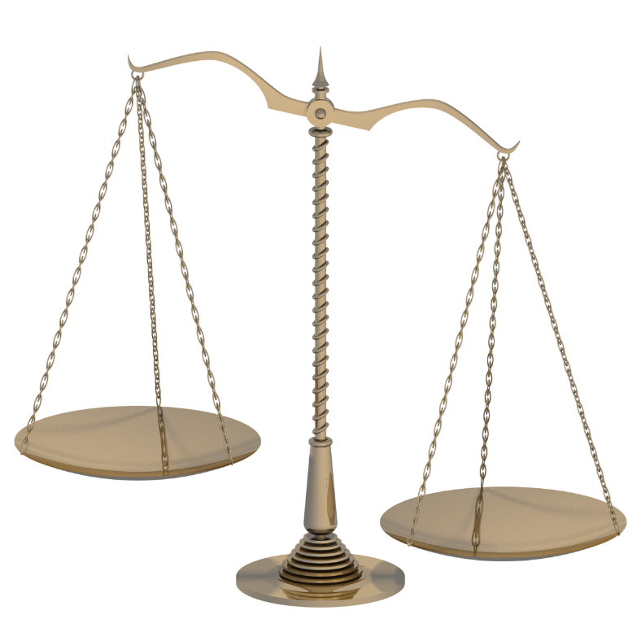
Coarse Abstractions
Abstraction to saturation takes us to one extreme
Will likely be too coarse
Small network
Imprecise and fast
Large network
Precise and slow

Slide 37
Coarse Abstractions (cnt’d)
Suppose we need to prove that $N\left(x\right)≥5$is UNSAT
We create abstract network, and get SAT
$\overline{N}\left(x_{0}\right)=7$
But $N\left(x_{0}\right)=3$
Spurious counter-example
Abstract network not suitable
Create a slightly less abstract network, $\overline{N}′$
$\overline{N}′\left(x_{0}\right)=4$
Maybe this is a better network to work with

Slide 38
Refinement
The opposite of abstraction
Split previously-abstracted nodes
Still an abstraction of the original network
But less abstract
More formally:
Start with $N\left(x\right)≤\overline{N}(x)$
Now: $N\left(x\right)≤{\overline{N}}^{′}\left(x\right)≤\overline{N}(x)$

Slide 39
Refinement Operator
Maintain a mapping from neuron to abstract neuron
Edge weights re-computed
$$v_{1}$$
$${\overline{v}}_{2}$$
$$v_{2}$$
$${\overline{v}}_{1}$$
$$v_{3}$$

Slide 40
Verification Algorithm
Generate initial abstraction $\overline{N}$
Verify $\overline{N}$
If UNSAT
Stop and return UNSAT
If SAT
Obtain counter example $x$
Check whether $x$ is a counter example for the original $N$
If yes, stop and return SAT
Else, refine $\overline{N}$ and go to step $2$
The algorithm is guaranteed to converge
Sound and complete if underlying verifier is sound and complete

Slide 41
Which Node to Refine?
In abstraction, we abstract to saturation
What about refinement?
Want to refine as little as possible
But also want to rule out the spurious counter example $x$
We will combine two criteria:
Weight-based
Counter-example guided

Slide 42
Weight-Based Refinement
Look for coarse min/max abstractions
Use refinement to make them more precise
$$5$$
$$v_{1}$$
$$4$$
$$5$$
$$700$$
$$v_{2}$$
$${\overline{v}}_{1}$$
$$700$$
$$700$$
$$v_{3}$$
$${\overline{v}}_{2}$$

Slide 43
Is Weight-Based Enough?
It’s definitely a good start
But, it doesn’t consider $x$
Solution: maximize $\left|w_{max}−w_{min}\right|⋅v(x)$
Counter-example guided abstraction refinement
CEGAR
$$700$$
$$0$$

Slide 44
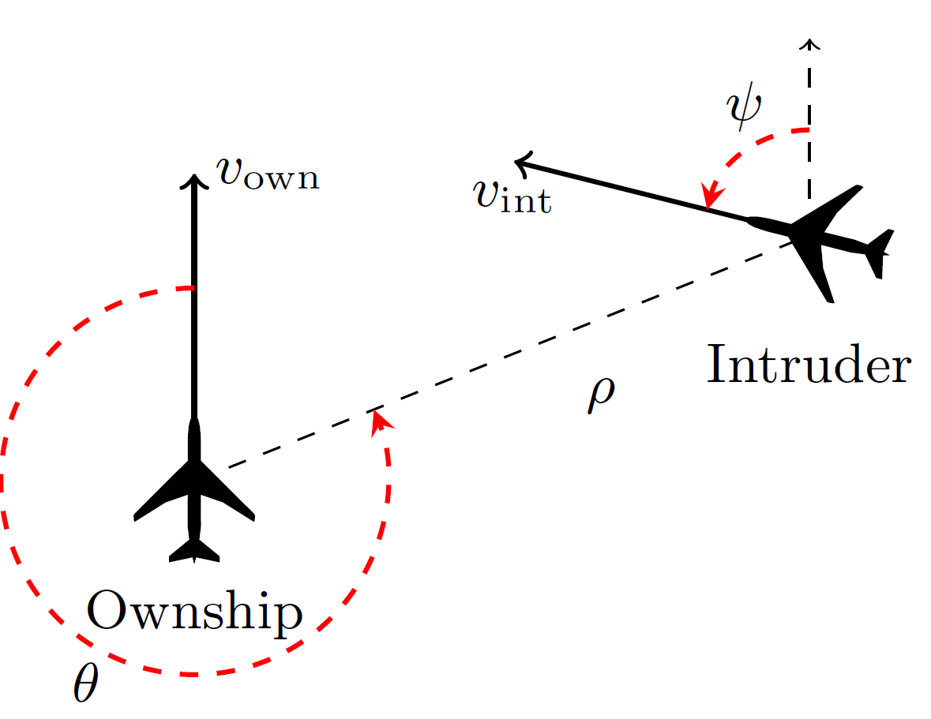
The ACAS Xu System
Airborne Collision-Avoidance System for drones
A new standard being developed by the FAA
Produce advisories:
Strong left (SL)
Weak left (L)
Strong right (SR)
Weak right (R)
Clear of conflict (COC)
FAA considering an implementation that uses $45$ deep neural networks
But wants to verify them!

Slide 45
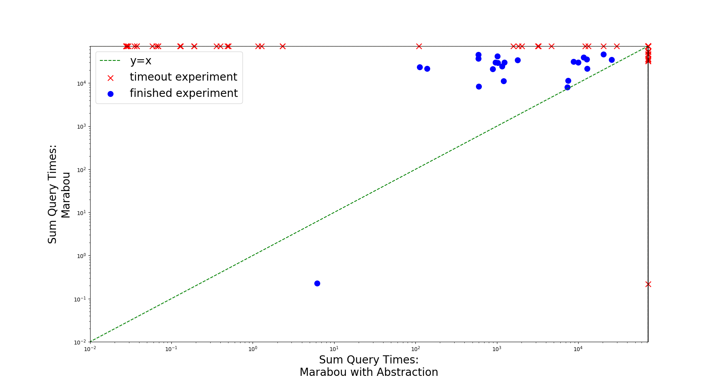
The ACAS Xu System (cnt’d)
Verified arbitrary properties of ACAS Xu
Similar to the ones specified by the FAA

Slide 46
The ACAS Xu System (cnt’d)
$90$experiments total, $20$hour timeout
Abstraction solved $58$, vanilla just $35$
Median query time for abstraction: $1045$ seconds. Vanilla: $63671$
Average final network size for abstraction: $385$ nodes
Original networks: $310$
But still faster

Slide 47
Adversarial Inputs
Slight input perturbations cause misclassification
Can use verification to prove the absence of such inputs
Goodfellow et al., $2015$
$$ε$$

Slide 48
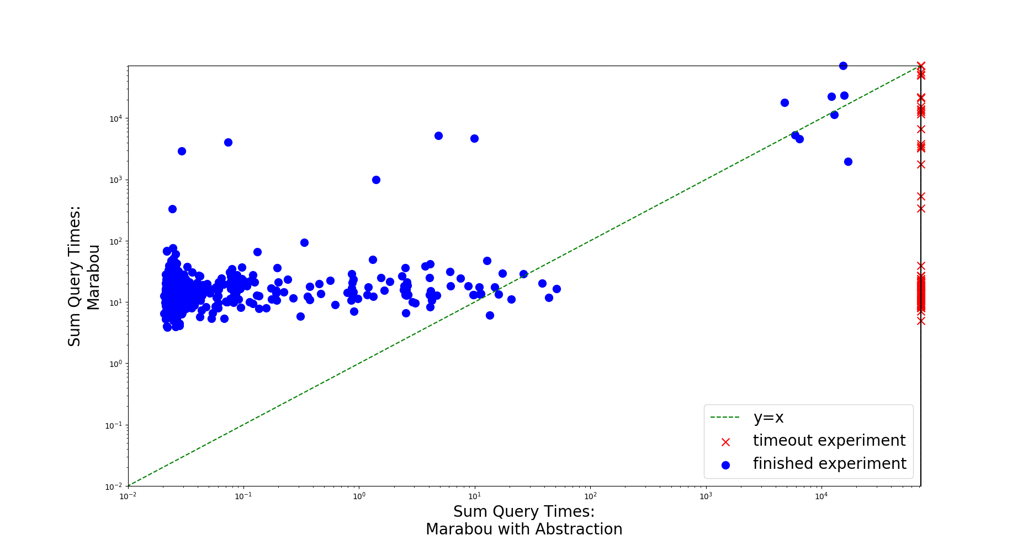
Adversarial Robustness
Verified adversarial robustness properties of ACAS Xu

Slide 49
Adversarial Robustness (cnt’d)
$900$experiments total, $20$hour timeout
Abstraction solved $805$, vanilla solved $893$
Median query time for abstraction: $0.026$ seconds. Vanilla: $15.07$
$99\%$ reduction in time
Average final network size for abstraction: $104.4$ nodes
Original networks: $310$
Much smaller

Slide 50
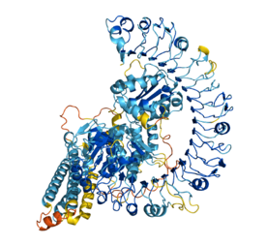
Conclusion
Dire need for rigorous reasoning about ML systems
Bring the success of verification to this field
Make the approach scale, apply to real-world settings

Slide 51
Questions
Thank You!

