Slide 1





Building Smart and Fast
Systems using
Machine Learning and Computer Vision.
Smart
Fast
Systems
Machine Learning
Thaleia Dimitra Doudali
Assistant Research Professor @IMDEA Software Institute
Computer Vision

Slide 2






The Era of Data
Scientific Simulations
Exploded
Data Sizes
Big Data
“More than 65 ZB of data will be created, captured, copied, and consumed in the world this year.”
Source: International Data Corporation, March 2021.
Artificial Intelligence
Capture
Process
Store
Analyze
Use
Video Analytics
Data Analytics Pipeline
ZBs of data
Need for speed and massive storage capacities!

Slide 3
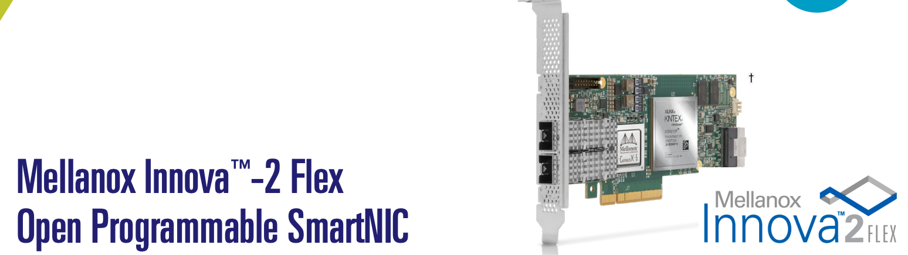
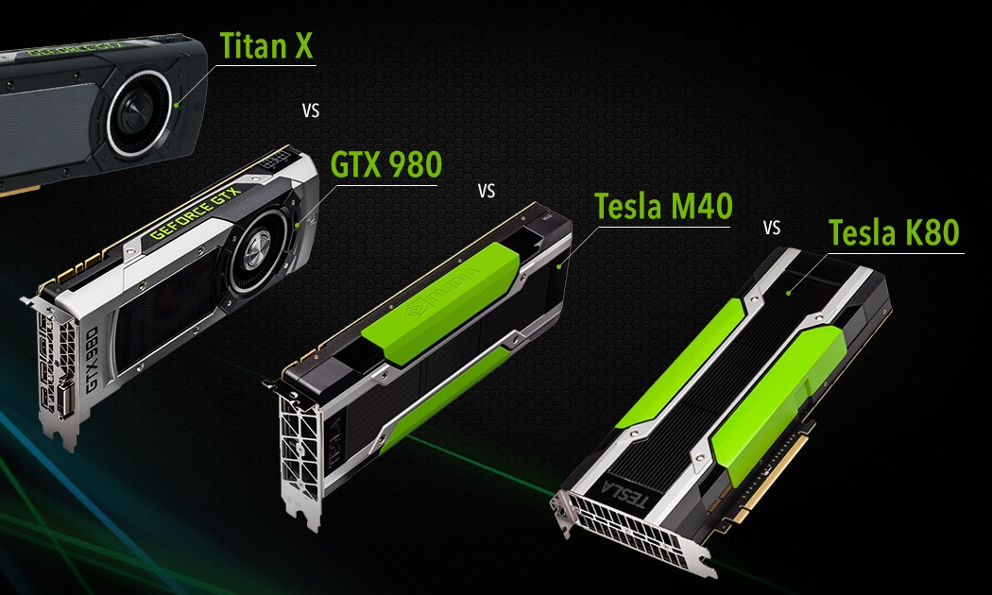
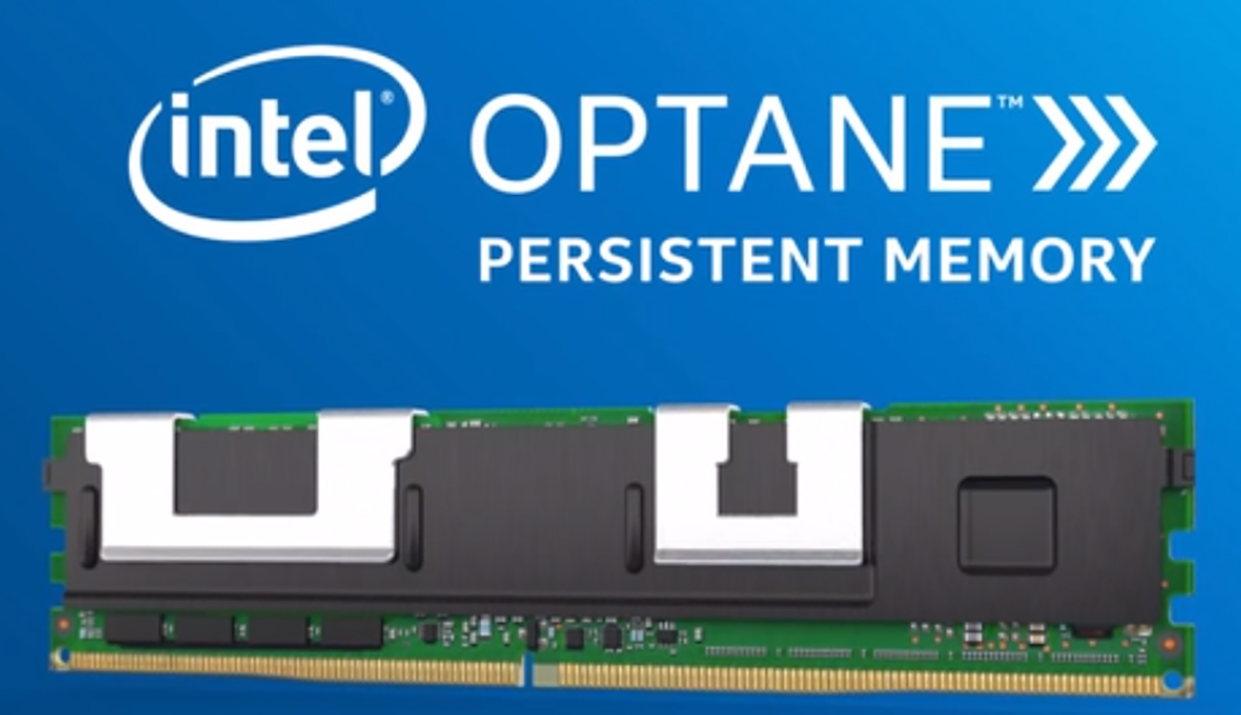
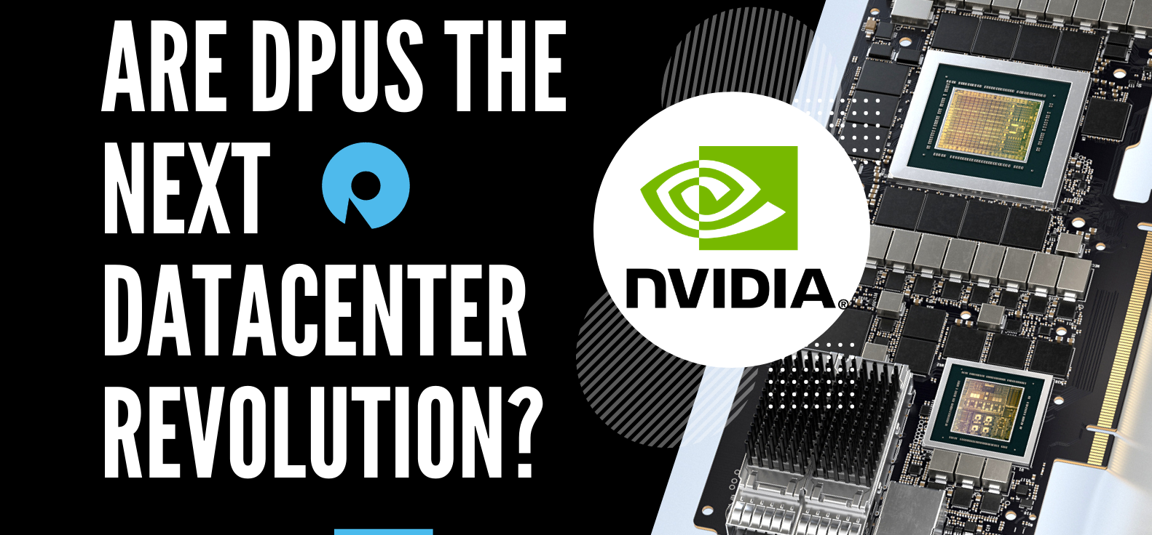

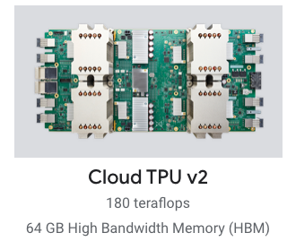

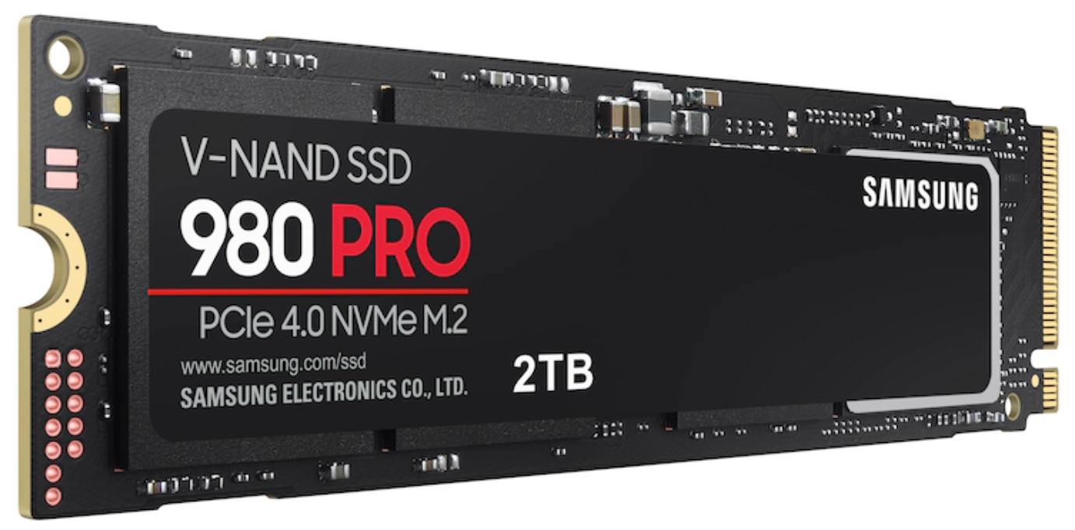
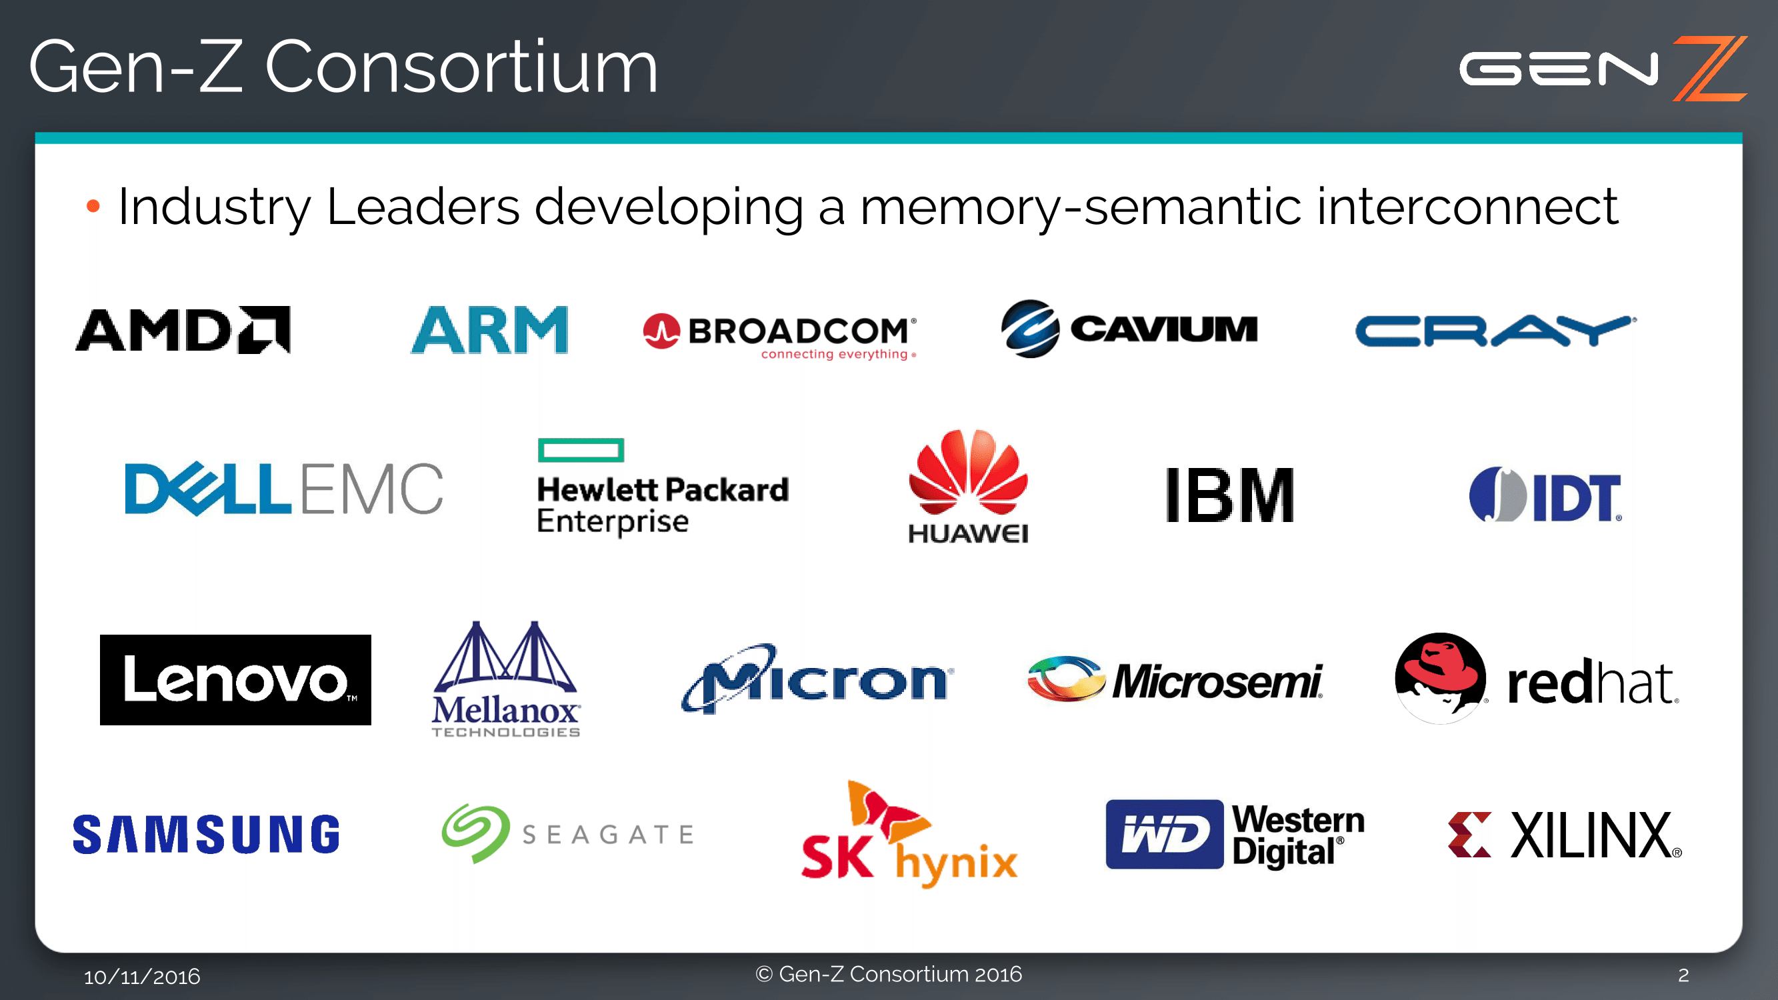

The Era of Heterogeneous Hardware
Network Acceleration
Compute Acceleration
Data Storage Acceleration
Nvidia GPUs
Interconnection Standards

Slide 4
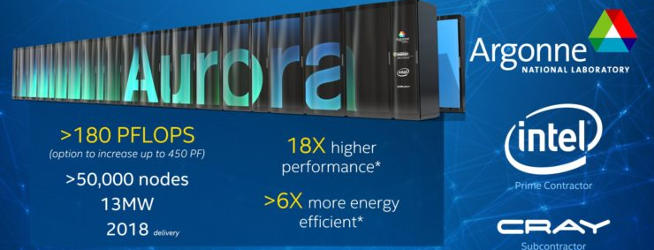
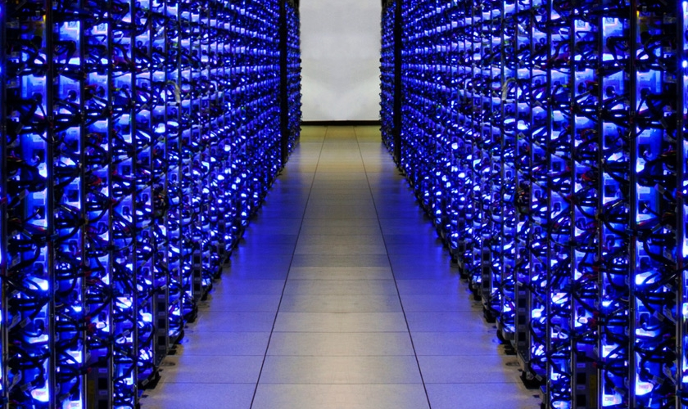

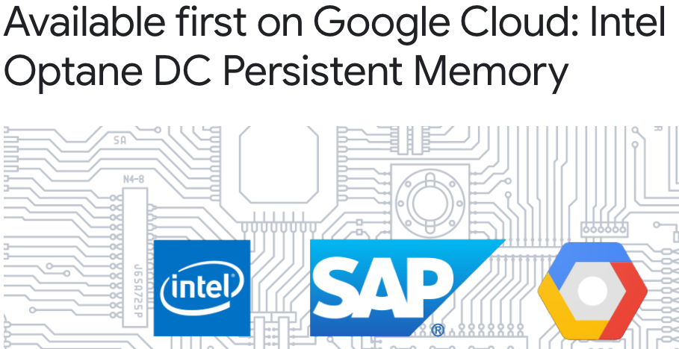
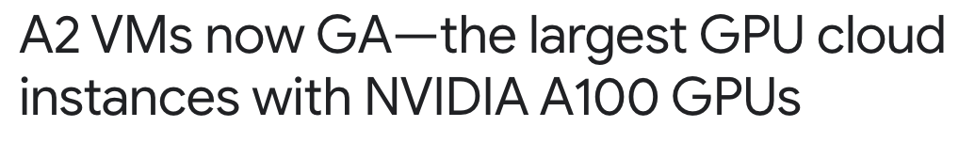
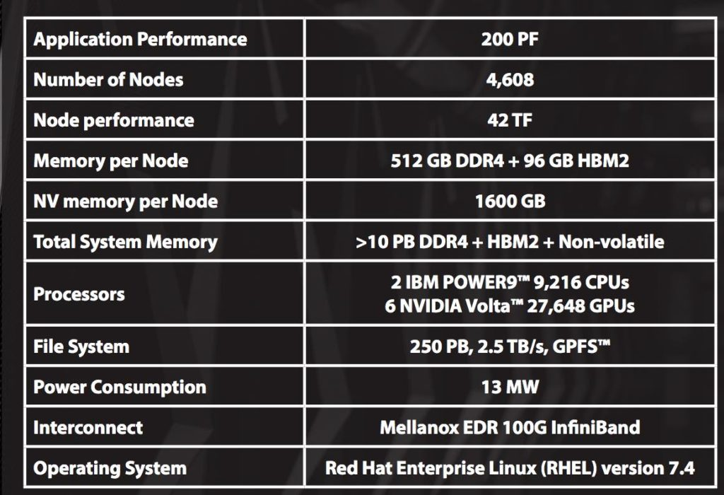
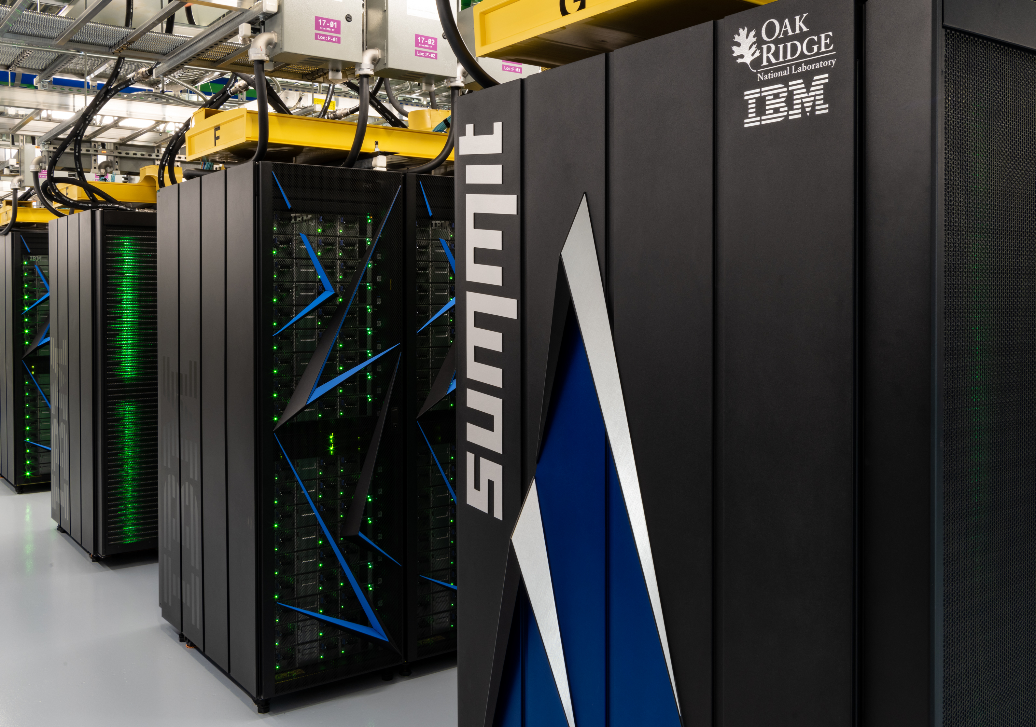
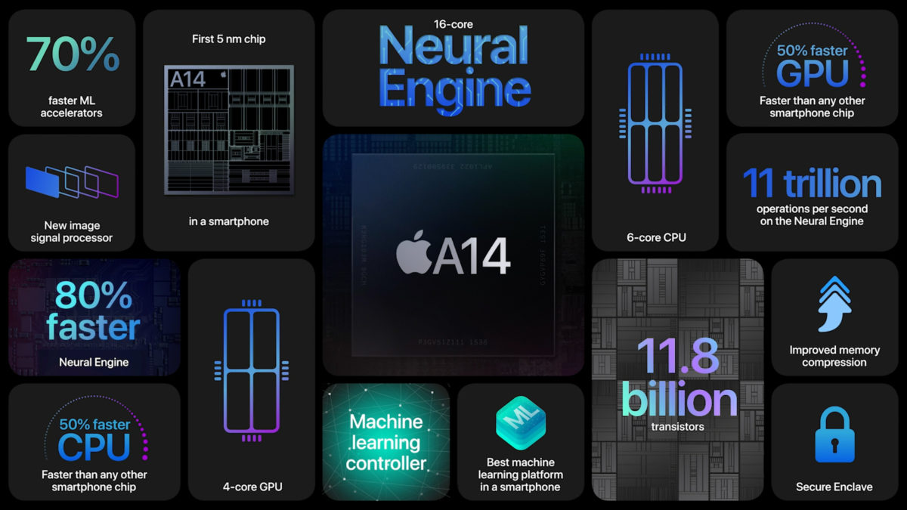
Heterogeneity Across Computing Platforms
Supercomputers
Datacenters
Exascale Era
Specifications
Personal Devices

Slide 5
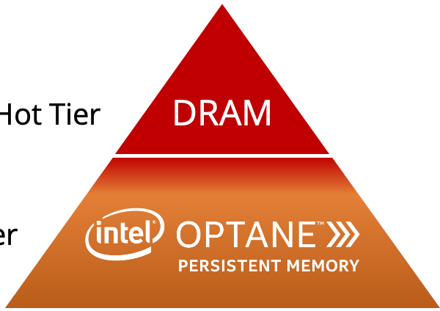



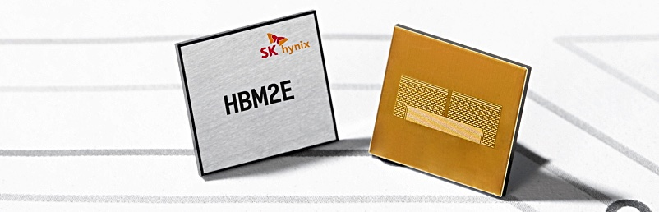
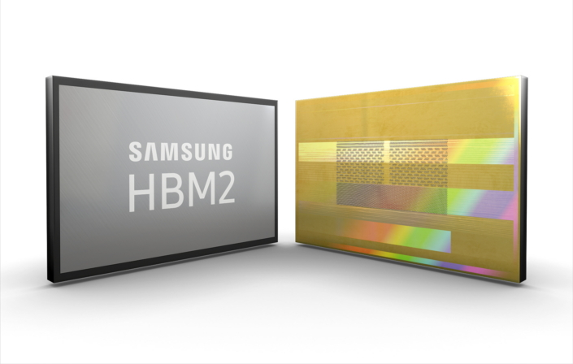
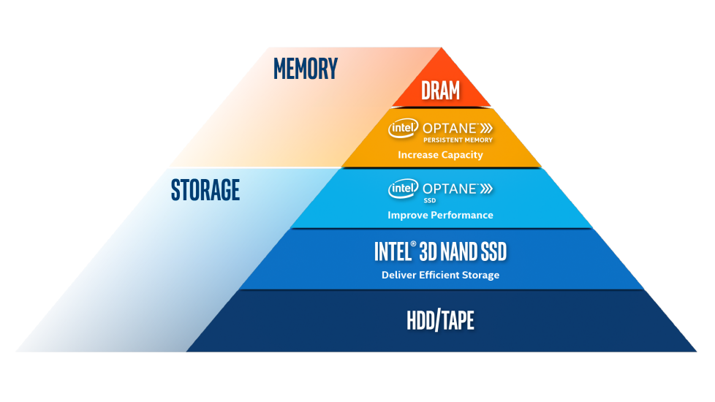


Heterogeneity Trade-offs
3x slower
2x cheaper
Characteristic
Technology
Hardware Vendors
2x bigger
Low Latency
MRAM
Source: memverge.com
High Bandwidth
HBM
Persistence
PMEM
Slower Speed
Lower Cost
Examples of other heterogeneous memory technologies.
Source:
intel.com
Capacity

Slide 6
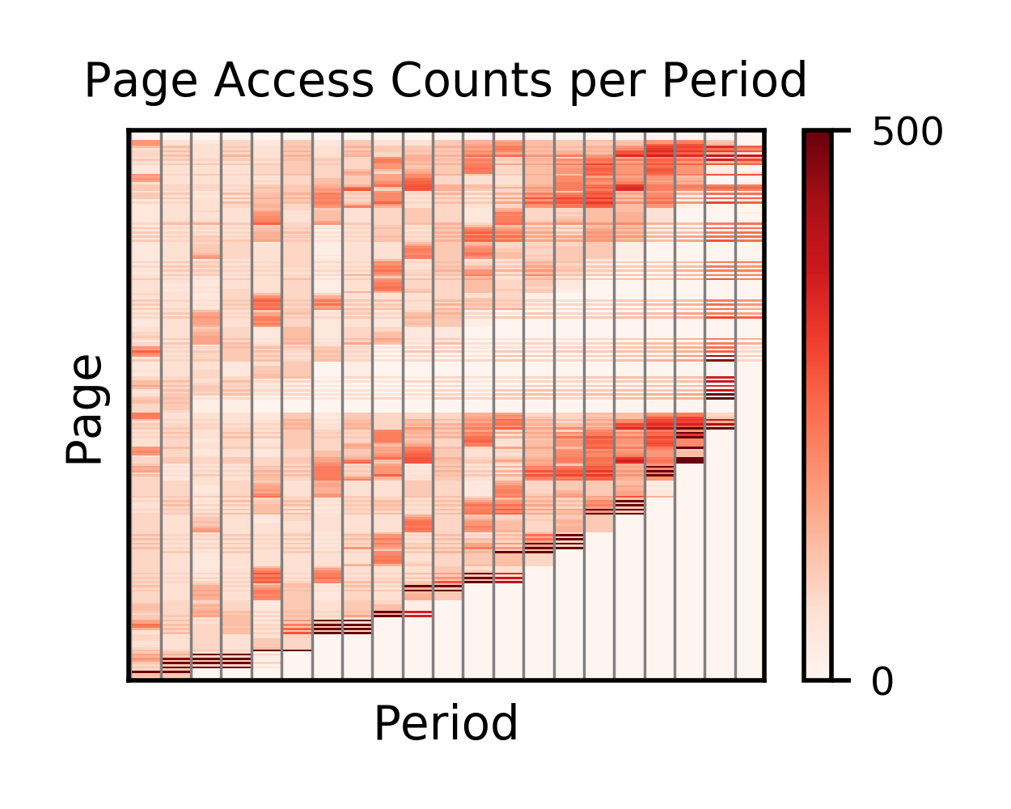





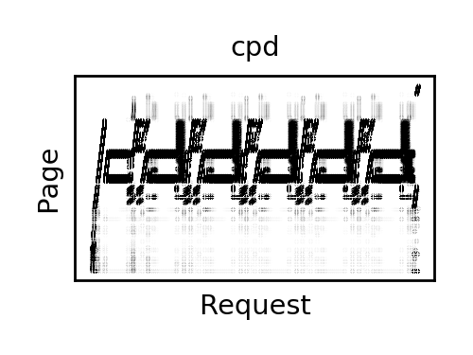


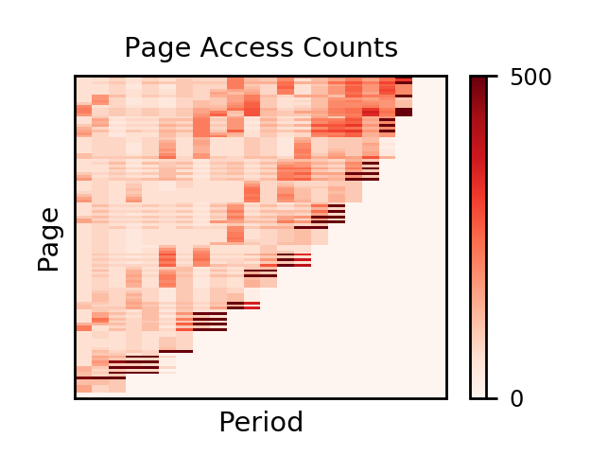
Building Software to Maximize the Hardware Efficiency
Data Allocated
across Memories
Dynamic Data
Movements!
It is a complex decision mix to manage the data allocated across memories.
Runtime
E.g., Which / How much / Where / When to move data?
Application Level
Why do we need smarter and faster systems?
ZBs
Resource Management
Software
practicality
performance
System Level
Hardware Level
Application
data sizes
Complex data
access patterns
Exploded system
parameter space
hot data
Hard to balance
Hybrid Memory
cold data

Slide 7

Talk Outline
Building Smart Systems
Foundations for practical Machine Learning (ML)-based Management
Building Fast Systems
Reducing ML-based Management Overheads with Visualization
Open Research Questions

Slide 8


Talk Outline
Building Smart Systems
Foundations for practical Machine Learning (ML)-based Management
Building Fast Systems
Reducing ML-based Management Overheads with Visualization
Open Research Questions

Slide 9
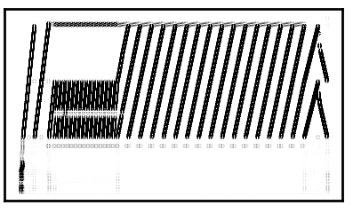

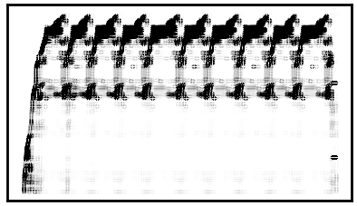


The Vision
ML-augmented heterogeneous resource manager.
Applications
System-level Resource Manager
Heterogeneous
Hardware
ML
training
Hybrid Memory
yes
Data Access
Monitoring
prediction
Resource Management
Re-train?
no
practical
Trained
Models
Notes:
It is a system that keeps learning and adapts to changes in the underlying heterogeneous hardware configuration and application classes executing.

Slide 10
Contributions Towards the Vision
Laying the grounds for the practical integration of ML.
Applications
System-level Resource Manager
Heterogeneous
Hardware
Which data
needs ML?
ML
training
What to
Predict?
Hybrid Memory
Exploded
Data Sizes
yes
Where to use ML?
prediction
Resource Management
Data Access
Monitoring
Which
ML method?
Re-train?
no
practical
How to
practically
use ML?
Trained
Models

Slide 11


System design of Kleio
Kleio is a hybrid memory page scheduler with machine intelligence. [HPDC ‘19]
Applications
System-level Resource Manager
Heterogeneous
Hardware
Page Selector
1. Page Access Monitoring
Page Hotness
2. Page Hotness Prediction
Hybrid Memory
small subset
Page Migrations
hot pages
Pages for ML
Page Hotness
Prediction
ML-based predictions
(Per page RNN models)
cold pages
bigger subset
Pages for History
History-based predictions
3. Page Migration Selection
Calculate hot vs. cold pages
Not all pages “need” ML.
Kleio extends existing lightweight hybrid memory management with the necessary amount of machine intelligence to boost application performance.

Slide 12

The Key to Success
Selecting a small page subset for ML-based management.
Memory Access Trace
Performance
Goal
Hybrid Memory
Configuration
Page
RNN
Kleio’s
Page
Selector
Page
RNN
priority
Page
RNN
History
Policy
Page
RNN
Perf. Model
Page
RNN
Misplaced Pages
Perf
Page hotness
predictions
History / Oracle
Hybrid Policy
Perf. Model
Pages Prioritized for ML
Pool of Pages
History
Repeat
Kleio’s Page Selector
Pages Ordered for ML
It is not a lightweight process, but necessary to maximize the effects of ML on application performance.
Kleio bridges the performance gap left by existing solutions by 80%, on average.

Slide 13

Talk Outline
Building Smart Systems
Foundations for practical Machine Learning (ML)-based Management
Building Fast Systems
Reducing ML-based Management Overheads with Visualization
Open Research Questions

Slide 14
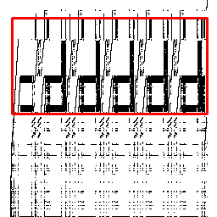

Reducing Operational Overheads of ML-based Management
Kleio’s Page Selector
Memory Access Trace
Performance
Goal
Hybrid Memory
Configuration
History
Policy
Perf. Model
Misplaced Pages
Perf
History / Oracle
Hybrid Policy
Perf. Model
Pages Prioritized for ML
Repeat
Pages Ordered for ML
Pages Ordered for ML
Can we accelerate the page selection process via image-based decisions?

Slide 15


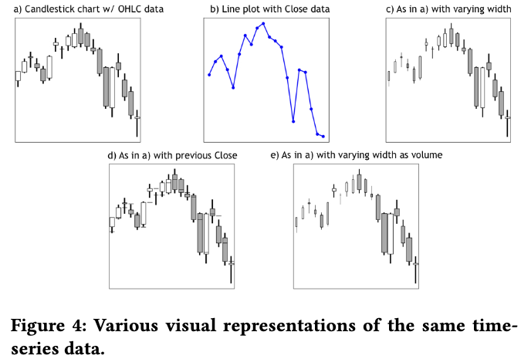
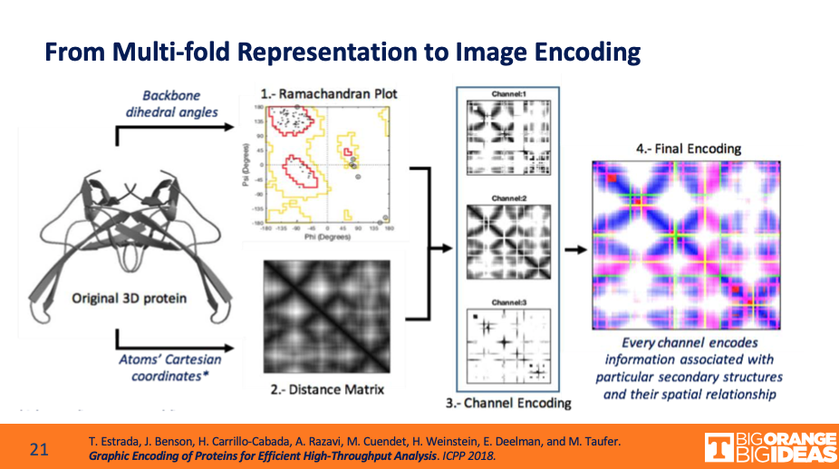
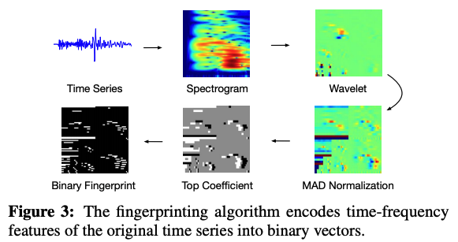
Why images?
Personal Experience
Image-based ML Classifiers
I came up with great observations and insights, by visualizing memory access patterns.
Source: J.P. Morgan AI labs.
Finance: Trading by learning time series data as images.
Feature Extraction
Source: Kexin Rong et al. at VLDB ‘18.
Source: Presentation from Michela Taufer.
Earthquake Detection: Extract Frequencies of Seismic Waves.
Bioinformatics: Learn protein functions.

Slide 16
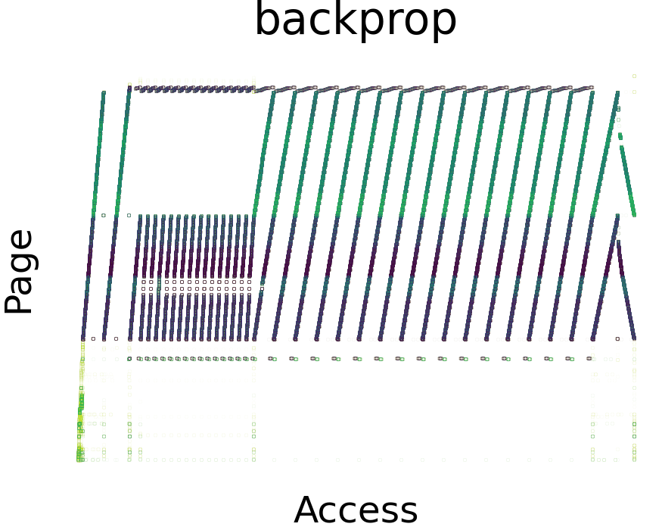
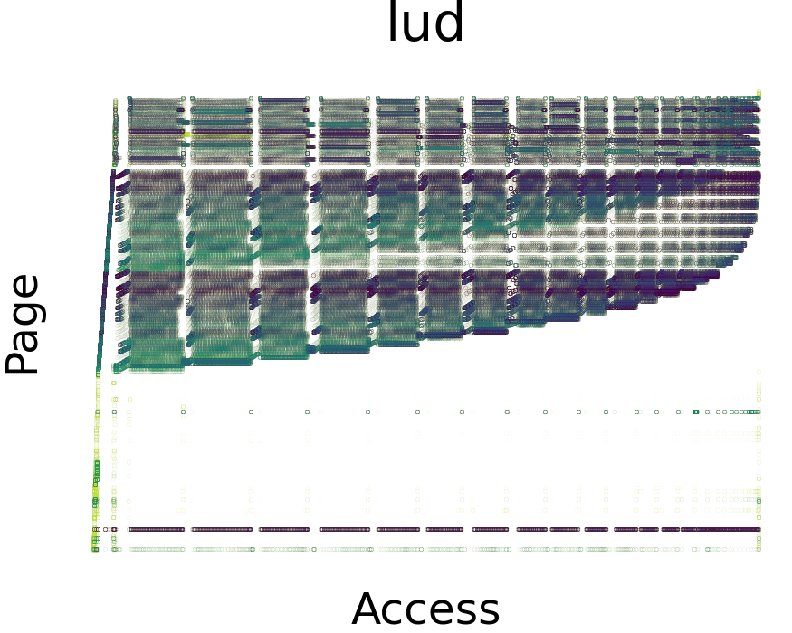
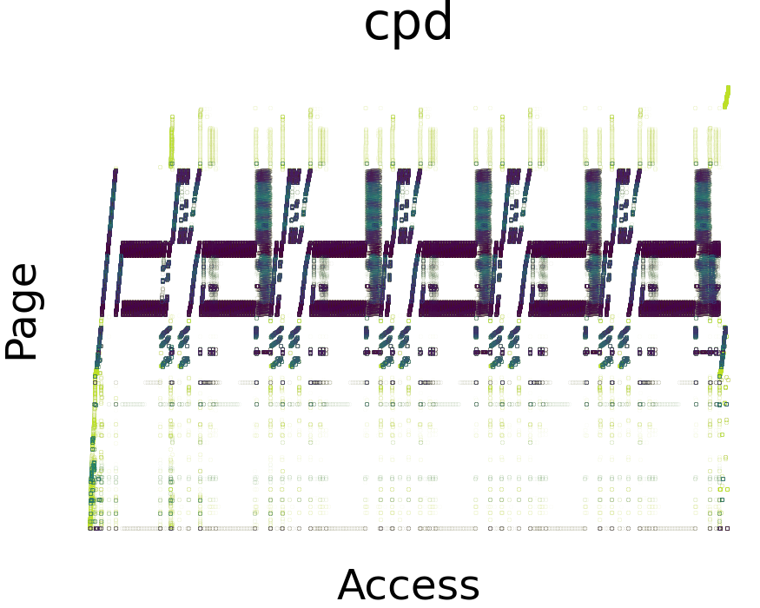
Visualizing Pages Selected for ML
Page
RNN
Kleio’s
Page
Selector
Page
RNN
priority
Page
RNN
Page
RNN
Page
RNN
Page hotness
predictions
Pool of Pages
History
Neighboring pages that are part of distinct access patterns across time receive similar priority for ML.

Slide 17
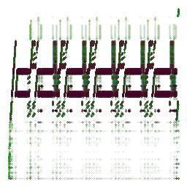
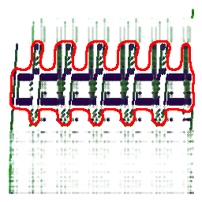
Towards Image-based Page Selection
Memory Access Trace
Memory Access Trace
Priority = Page hotness
Page
RNN
Page
RNN
Page
RNN
Page
RNN
Page
RNN
KLEIO
Page hotness
predictions
Pool of Pages
History
1. Image Creation
2. Pattern Detection
3. Page Selection
Notes:
The RNNs will be trained over the raw memory access trace data.

Slide 18
Page Selection Comparison
Similar page orderings between our initial approach (vis-bbox)
and the performance-based selection of Kleio.

Slide 19

Performance Evaluation
1. Application Performance
2. Page Selection Time
Lower is better.
Performance
slowdown
from a
DRAM-only
platform.
75x
Comparable application
performance levels.
Accelerates the time to select pages for ML-based management.

Slide 20
Talk Outline
Building Smart Systems
Foundations for practical Machine Learning (ML)-based Management
Building Fast Systems
Reducing ML-based Management Overheads with Visualization
Open Research Questions

Slide 21
ML-augmented Heterogeneous Resource Manager
Applications
System-level Resource Manager
Heterogeneous
Hardware
ML
training
yes
Data Access
Monitoring
prediction
Resource Management
Re-train?
no
practical
Trained
Models
Notes:
It is a system that keeps learning and adapts to changes in the underlying heterogeneous hardware configuration and application classes executing.

Slide 22
Remaining Challenges
Fully integrated adaptive resource manager.
Applications
System-level Resource Manager
Heterogeneous
Hardware
ML
training
Pattern – Model
Matching?
yes
Re-train,
use trained model,
create new model?
Data Access
Monitoring
prediction
Resource Management
Re-train?
no
practical
Trained
Models
How to accelerate training?
Where to Store?
How to amortize the training cost?
Notes:
Immediate follow on questions

Slide 23
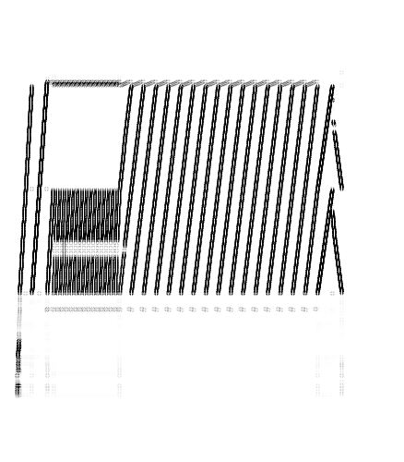
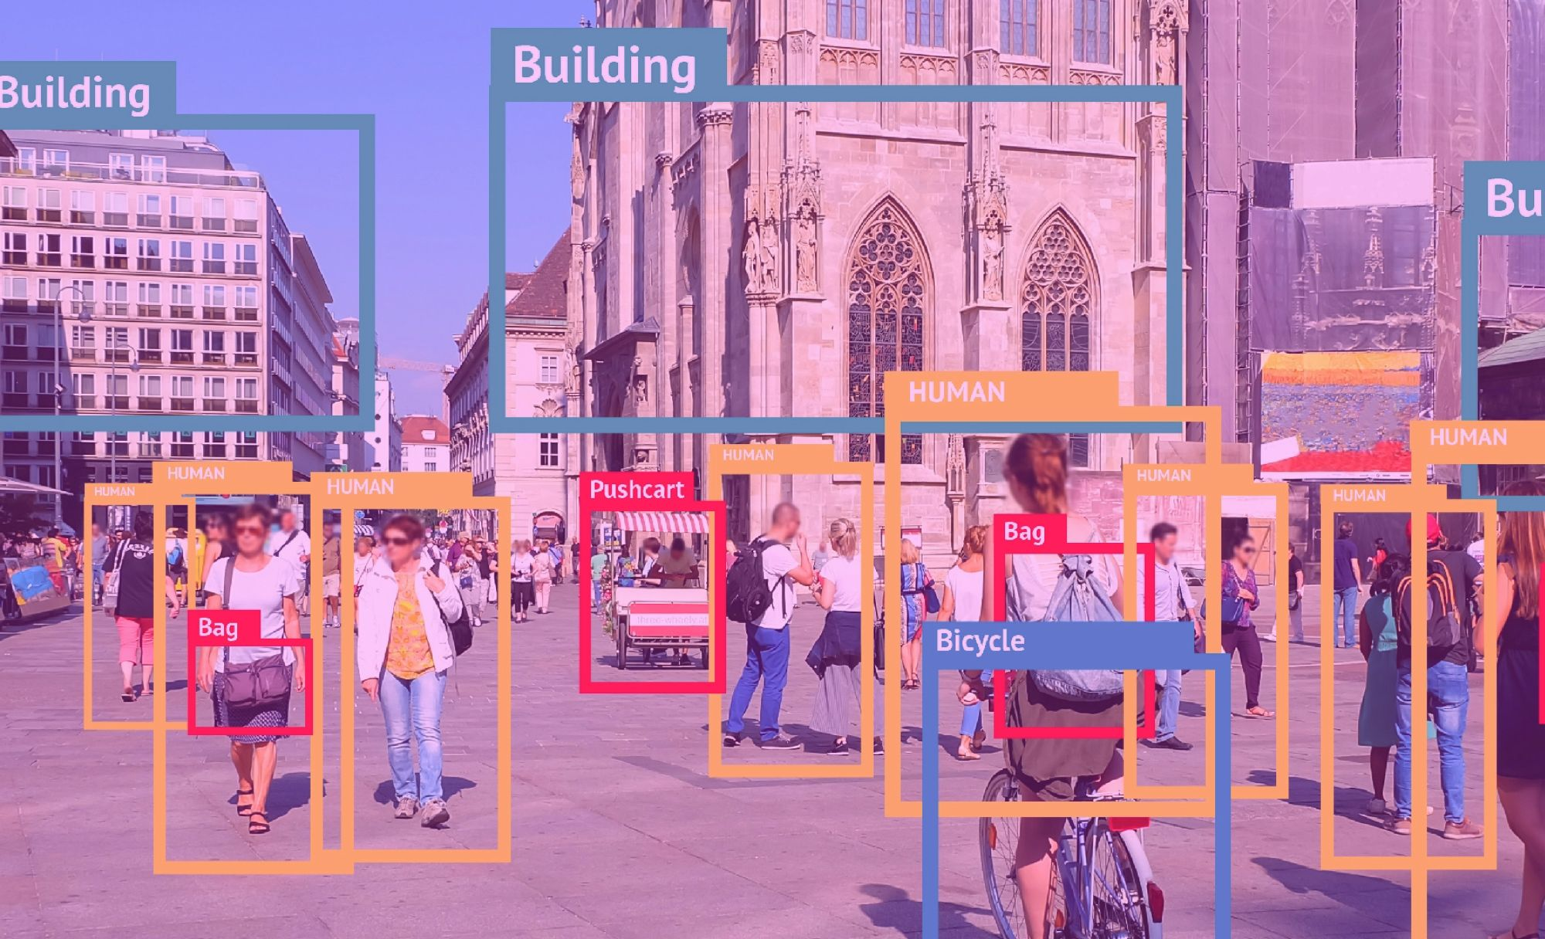
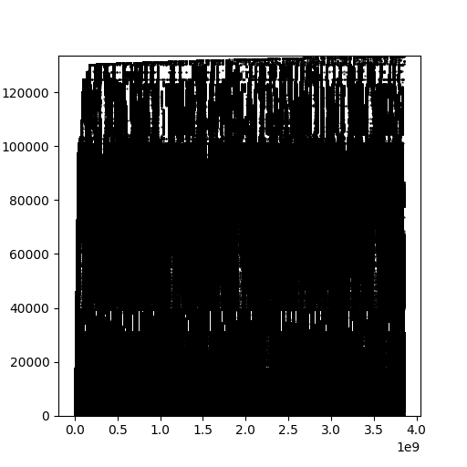
Computer Vision + Machine Learning
Pattern Recognition.
Applications
System-level Resource Manager
Heterogeneous
Hardware
Example Use Cases
Pattern Recognition
Select ML model
Pattern
Class
Take ML related
action
Resource Management
Decision
Build an “ImageNet” for memory access patterns.
Train classifiers to take actions upon recognizing a pattern.
What Classes
to define?
Metadata?
Label guidelines for open contributions?
How to zoom-in?
Storage?
Image Resolution?

Slide 24
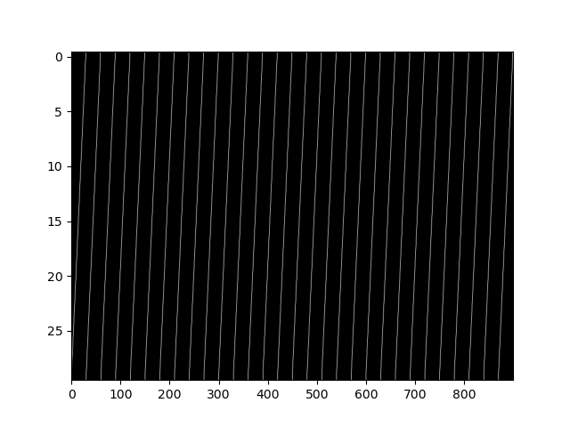

Computer Vision + Machine Learning
Pattern Prediction.
Applications
System-level Resource Manager
Heterogeneous
Hardware
Pattern Prediction
Future memory
access patterns
Resource Management
Decision
ML
models
Ground truth
Prediction
Compare with RNN-only?
Prediction result of a Convolutional + Recurrent Neural Network.
1 model per app or per pattern?
“ML models over images have better predictive capabilities.”
Page-to-image
mapping
From OSDI ‘21 Keynote from J.P. Morgan AI labs.

Slide 25


Scan this to find more about my work.
Smart
Fast
Systems
How can we use our human intelligence to build practical systems that leverage machine learning and computer vision?
Machine Learning
Computer Vision

