Slide 1
Quantum Error Correction Code
Samira Sayedsalehi
samira.sayedsalehi@gmail.com
samirasa@ucm.es

Slide 2
Outline
What is quantum computer?
Quantum Error
Bit-flip Quantum Error Correction Code
Phase-flip Quantum Error Correction Code
Shor’s Nine-Qubit Code
Stabilizer code
Coherent parity checker
Surface code
Quantum repetition code with Qiskit

Slide 3
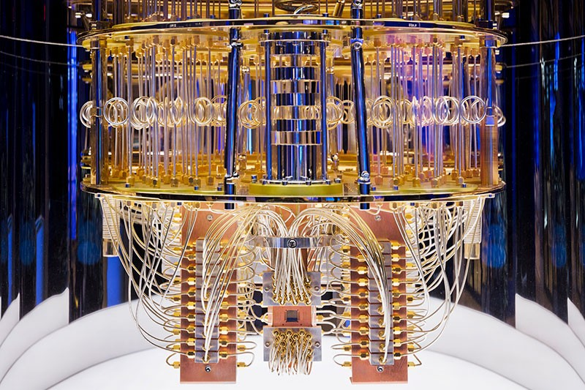
What is quantum computer?
A quantum computer is a machine that relies on quantum phenomena like superposition, quantum uncertainty, and entanglement.
Notes:
A quantum computer is a machine that relies on quantum phenomena like superposition, quantum uncertainty, and entanglement.
SUPERPOSITION: there is an equal probability that something is either in one state (1) or another (0). Thus, something is in both states, or between both states at the same time until observedQuantum Uncertainty: states that the position and velocity of a particle are unknown until observed.
Quantum Nonlocality—Entanglement: When two particles share the same quantum state they are entangled. This means that two or more particles will share the same properties: for example, their spins are related. Even when removed from each other, these particles will continue to share the same properties.
We can say:
Information is stored in a physical medium, and manipulated by physical processes. Therefore, the laws of physics dictate the capabilities of any information processing device.
As we know, classical physics is incomplete to explain some physical events especially on the atomic and subatomic level and has been replaced by a more powerful framework: quantum mechanics. Consequently, a computer that operates on quantum states can perform tasks that are beyond the capability of any conceivable classical computer.

Slide 4
The power of quantum computer
Google announced it has a quantum computer that is 100 million times faster than any classical computer in its lab.
Not only is this expected to make quantum computers faster and more efficient than even the most powerful current supercomputer, it’s thought they could have potential uses and solve problems that we can’t even comprehend yet.
Notes:
Google announced it has a quantum computer that is 100 million times faster than any classical computer in its lab.
For example, a quantum computer with 30 qubits equals the processing power of conventional computer that running at 10 teraflop (trillions of floating-point operations per second).
Not only is this expected to make quantum computers faster and more efficient than even the most powerful current supercomputer, it’s thought they could have potential uses and solve problems that we can’t even comprehend yet because of quantum phenomena like quantum superposition and entanglement.
Quantum computer are good at solving certain classes of problems like factoring large primes, random walks, unordered data retrieval, etc.
Not good at things like: exact answers, logic, pattern recognition, unconstrained control problems.

Slide 5
History of quantum computing
Yuri Manin(1980) and Richard Feynman (1981) proposed independently the concept of Quantum Computer.
David Deutsch (1985) developed the quantum Turing machine, showing that quantum circuits are universal.
Peter Shor (1994) came up with a quantum algorithm to factor very large numbers in polynomial time.
Lov Grover (1996) invents quantum database search algorithm.

Slide 6
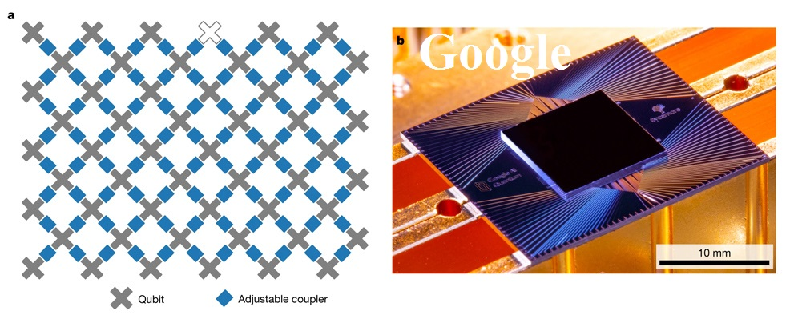
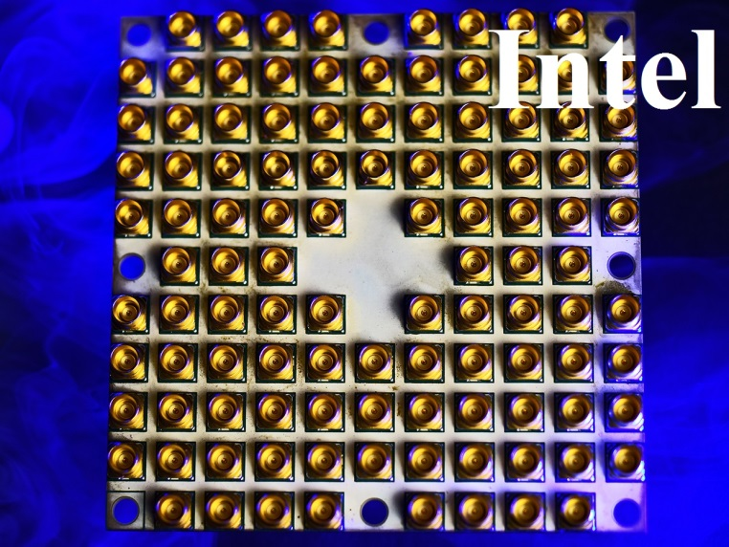
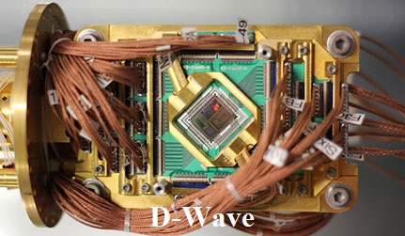
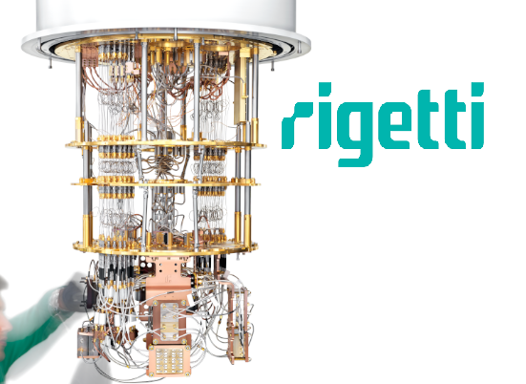
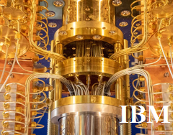
Which companies build Quantum computer?
Notes:
In 2016, IBM was the first company to put a quantum computer on the cloud. The company has since built up an active community of more than 260,000 registered users, who run more than one billion every day on real hardware and simulators.
In 2017, IBM was the first company to offer universal quantum computing systems via the IBM Q Network.
Intel designed and fabricated the new 49-qubit superconducting quantum chip in 2018.
Founded in 1999, D-Wave claims to be the first company to sell a commercial quantum computer, in 2011, and the first to give developers real-time cloud access to quantum processors with Leap, its quantum cloud service.
D-Wave's approach to quantum computing, known as quantum annealing, is best suited to optimization tasks.
In nature, physical systems tend to evolve toward their lowest energy state: objects slide down hills, hot things cool down, and so on. This behavior also applies to quantum systems. To imagine this, think of a traveler looking for the best solution by finding the lowest valley in the energy landscape that represents the problem.
Google built a quantum computer with 53 qubits.

Slide 7
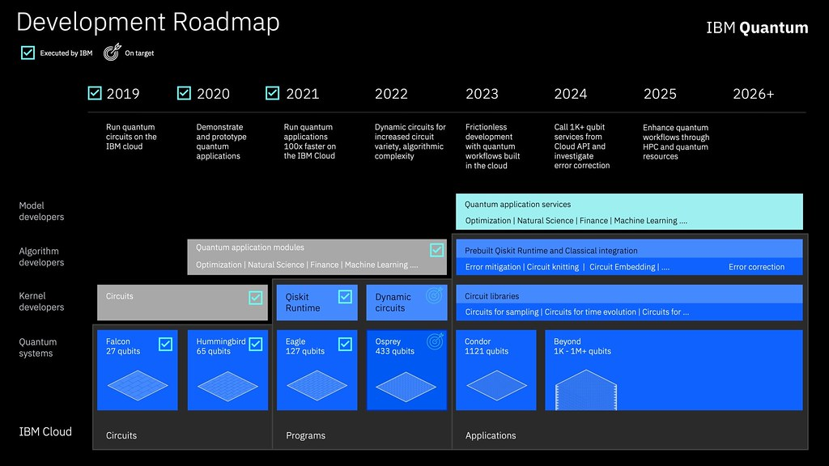
Future of quantum computer
Notes:
This picture presents IBM’s roadmap to advance quantum computers from today’s noisy, small-scale devices to larger, more advance quantum systems of the future.
Currently the company's researchers are developing a suite of scalable, increasingly larger and better processors, with a 1,000-plus qubit device - called IBM Quantum Condor - targeted for the end of 2023.

Slide 8
Quantum bit (Qubit)
In quantum computing the information is encoded in Quantum bits
  Two basic states
  Superposition
  Where α and β are complex numbers and are called quantum amplitudes,
  A qubit in superposition is in both of the states at the same time with probabilities
Notes:
In quantum computing the information is encoded in Quantum bits (or qubits), which are somewhat analogous to the bit in classical computation. This information is described by a state in a 2-level quantum mechanical system which is formally equivalent to a two-dimentional vector space over the complex numbers. The two basis states are conventionally written as ∣0⟩ and ∣1⟩ (pronounced: 'ket 0' and 'ket 1'), this notation is called Dirac notation.
A qubit can be in ∣0⟩, ∣1⟩ or (unlike a classical bit) in a linear combination of both states. The name of this phenomenon is superposition.
Superposition: there is an equal probability that something is either in one state (1) or another (0). Thus, something is in both states, or between both states at the same time until observed.
Where α and β are complex numbers and are called quantum amplitudes.
A qubit in superposition is in both of the states at the same time with probabilities.
In other words, ${\left|α\right|}^{2}$: tells us the probability of finding ∣ψ⟩ in state ∣0⟩ and ${\left|β\right|}^{2}$: tells us the probability of finding ∣ψ⟩ in state ∣1⟩.

Slide 9
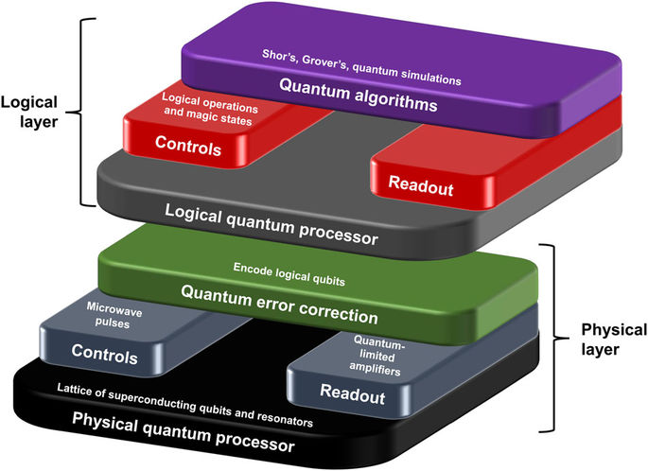

Slide 10
Quantum error
In reality, a quantum system that is not closed system is always in interaction with its environment.
This interaction inevitably alters the state of the quantum system, which causes loss of information encoded in the system.
This process is called decoherence whereby a pure state is turned into a mixed state via interactions with the environment.
The effect of noise on a single qubit is described by saying that quantum noise acts on qubits via the application of one of the operators I , X, Y , Z .

Slide 11

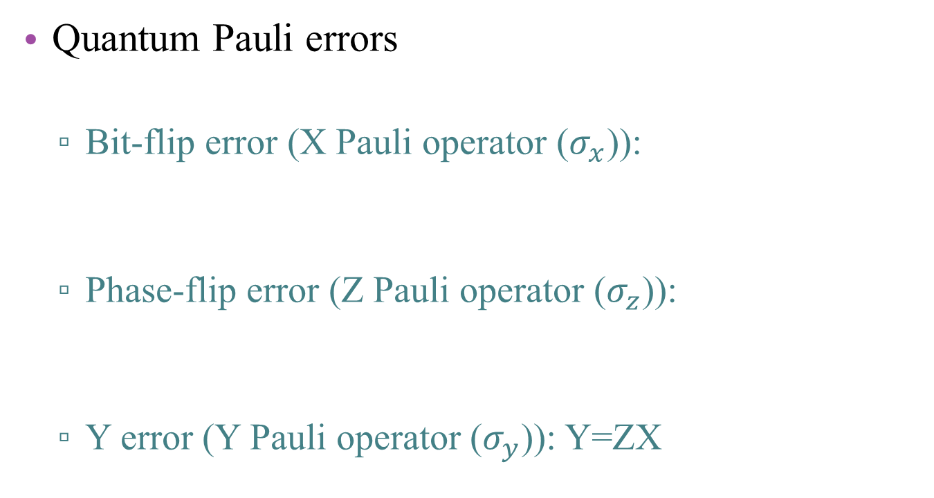
Quantum error
Quantum Pauli errors
  Bit-flip error (X Pauli operator ($σ_{x}$)):
  Phase-flip error (Z Pauli operator ($σ_{z}$)):
  Y error (Y Pauli operator ($σ_{y}$)): Y=ZX
Notes:
It turns out that we can describe the interaction of a single qubit with the environment and hence single-qubit errors with the familiar operators I,X,Y,Z.
The identity operator, of course, represents no error at all.
In the case of a classical bit, which can be 0 or 1, engineers are concerned with bit flip errors. The physical details aren’t important for us, but we can imagine some stray electromagnetic field causing a bit to change from 1 to 0, for example. A similar type of error can affect qubits, where we have |0>→|1> and |1>→|0>. This type of error is described by the X operator,
In quantum systems, bit flip errors are not the only problem that we can encounter. We can also have phase flip errors. we readily see that a phase flip error is described by the Z Pauli operator. We recall that Z acts on a qubit in the following way:
The Y operator is related to a phase flip followed by a bit flip.
Later we will see how quantum error-correcting codes work on bit flip and phase flip errors

Slide 12
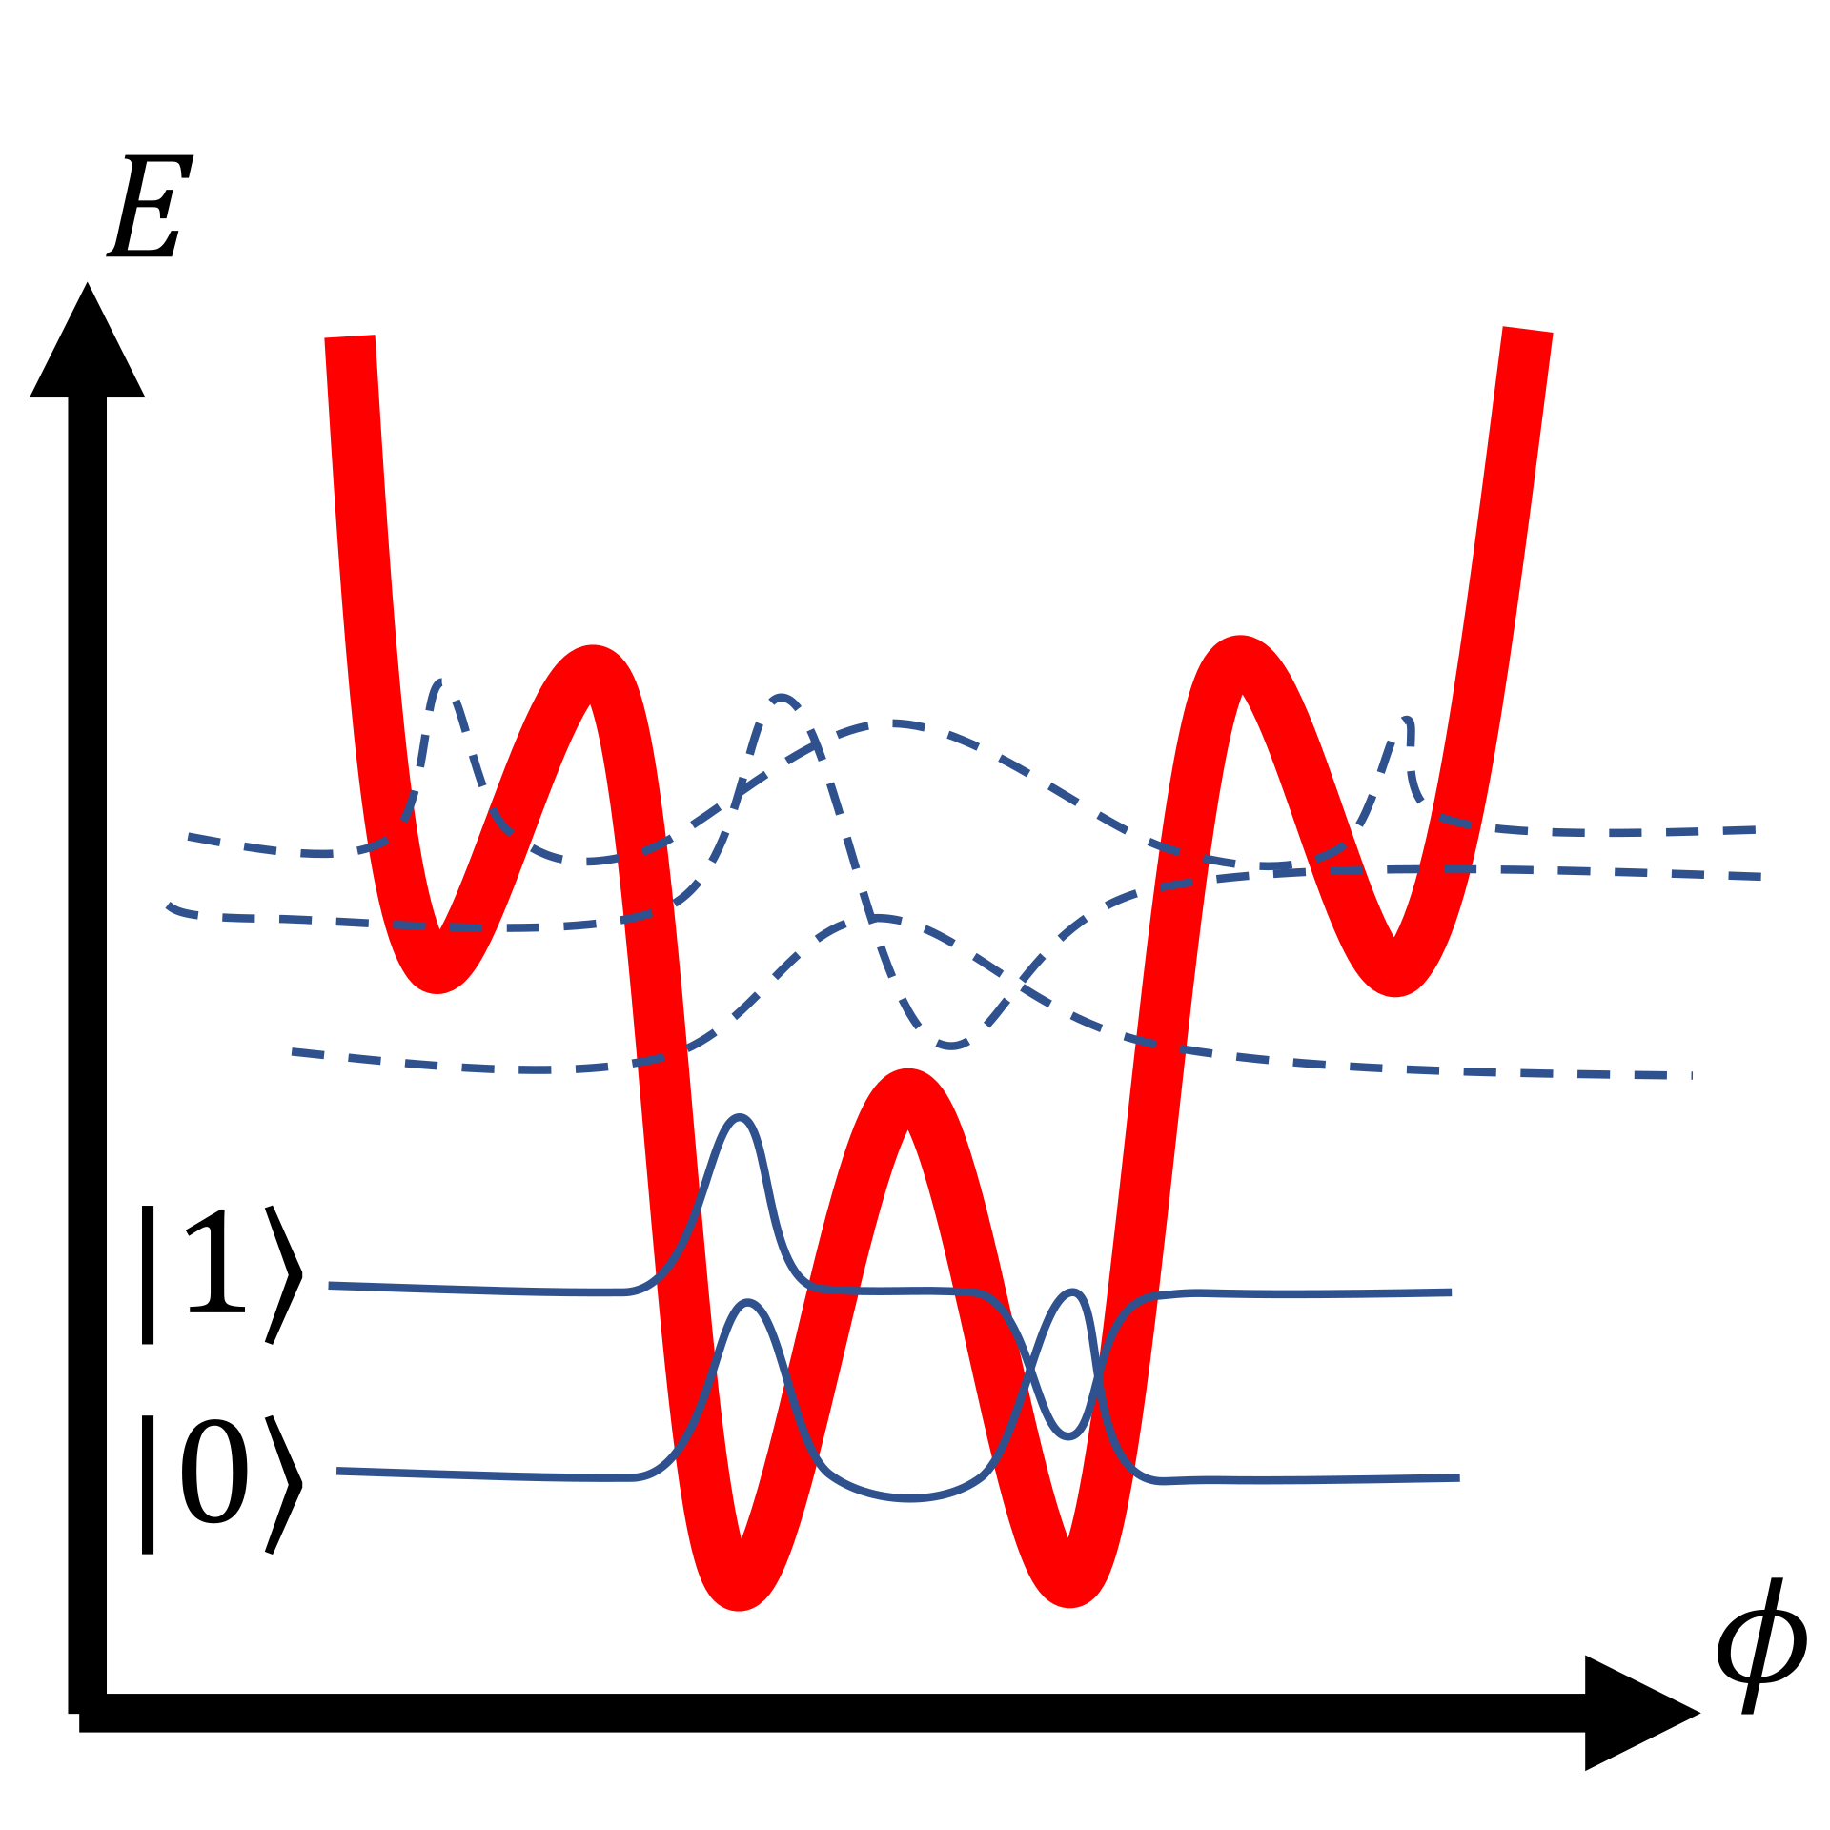
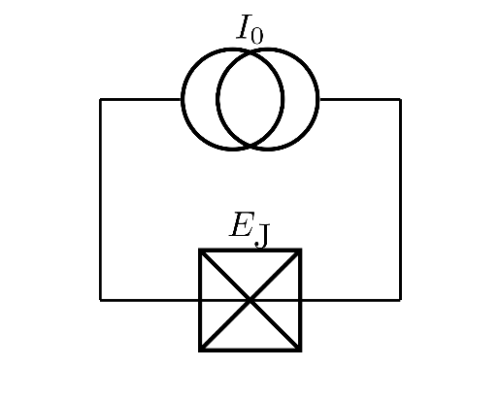
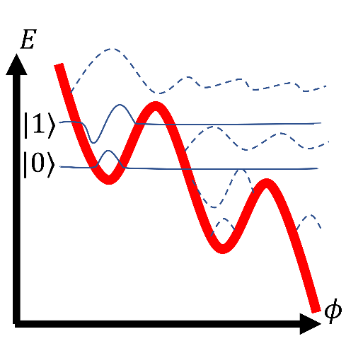
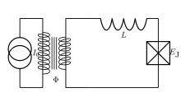
Leakage error
Leakage error occurs when a qubit leaves the defined computational subspace.
Leakage errors not only spread additional errors to other qubits, but also lead to measurement errors and will accumulate unless removed.
Phase Qubit
Flux Qubit
Flux Qubit

Slide 13
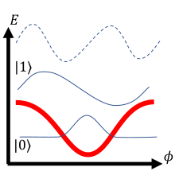
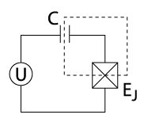
Leakage error
Leakage error occurs when a qubit leaves the defined computational subspace.
Leakage errors not only spread additional errors to other qubits, but also lead to measurement errors and will accumulate unless removed.
Charge Qubit
Flux Qubit

Slide 14
The problems for Quantum error correction code
There are some limitations in quantum:
  Measurement of error destroys quantum data.
  No-cloning theorem prevents repetition.
  There are some type errors in quantum computing like phase and bit flip errors
  How continuous errors are corrected in quantum computing?

Slide 15
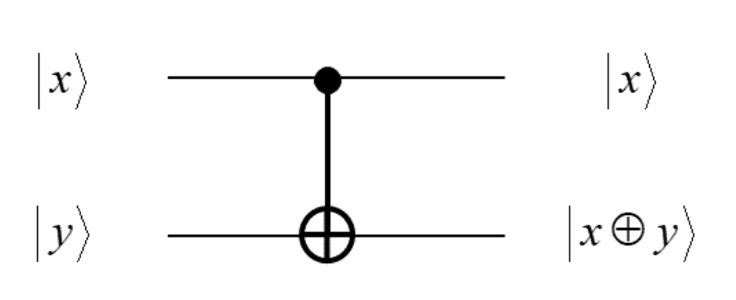
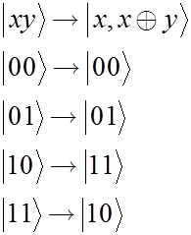
Why it is impossible to copy qubits?
Controlled-Not (CNOT)

Slide 16
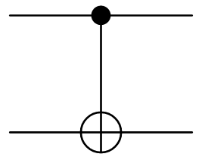

Why it is impossible to copy qubits?
If there is a bit information, it can be copied
a
a
a
a
0
0
=
$$⊕$$

Slide 17
Why it is impossible to copy qubits?
But in quantum:

Slide 18


Bit-flip Quantum Error Correction Code (QECC)
Encoding
  Let us recall that the action of a CNOT gate is
  Therefore, it duplicates the control bit j ∈ {0, 1} when the initial target bit is set to |0⟩. We use this fact to triplicate the basis vectors as
  Where |ψ⟩L denotes the encoded state. The state |ψ⟩L is called the logical qubit, while each constituent qubit is called the physical qubit. We borrow terminologies from classical error correcting code (ECC) and call the set
  The code and call each member of C a codeword.
Notes:
The repetition code works in a classical channel, because classical bits are easy to measure and to repeat. Repetition code in quantum is not possible because of no-cloning theorem. A different method, such as the so-called three-qubit bit flip code, has to be used. This technique uses entanglement and syndrome measurements and is comparable in performance with the repetition code.
It is important to note that the state |ψ> is not triplicated but only the basis vectors are triplicated.
This redundancy makes it possible to detect errors in |ψL> and correct them as we see in the next figure.

Slide 19
Bit-flip QECC
Without any error:
0
0
Notes:
The gate NX stands for the bit-flip noise
Now the state |ψL> is sent through a quantum channel which introduces bitflip error with a rate p for each qubit independently. We assume p is sufficiently small so that not many errors occur during the qubit transmission. The received state depends on in which physical qubit(s) the bit-flip occurred.
Two ancillary qubits are perpared in the state |00> as depicted in Fig and applies four CNOT operations whose control bits are the encoded qubits while the target qubits are two ancillary qubits. Let |x1x2x3 > be a basis vector has received and let A (B) be the output state of the first (second) ancilla qubit. (A = x1 ⊕ x2 and B = x1 ⊕ x3)

Slide 20
Bit-flip QECC
Bit-flip error on the first qubit:
X
X
X
X
1
X
1
Notes:
The gate NX stands for the bit-flip noise
Now the state |ψL> is sent through a quantum channel which introduces bitflip error with a rate p for each qubit independently. We assume p is sufficiently small so that not many errors occur during the qubit transmission. The received state depends on in which physical qubit(s) the bit-flip occurred.
Two ancillary qubits are perpared in the state |00> as depicted in Fig and applies four CNOT operations whose control bits are the encoded qubits while the target qubits are two ancillary qubits. Let |x1x2x3 > be a basis vector has received and let A (B) be the output state of the first (second) ancilla qubit. (A = x1 ⊕ x2 and B = x1 ⊕ x3)

Slide 21
Error syndrome correction Phase in bit-flip QECC
If we received the following logical qubit
Both of the ancillary qubits are flipped for both |100⟩ and |011⟩. The set of two bits is called the syndrome, and it tells us in which physical qubit the error occurred during transmission.
We have detected an error without measuring the received state. These features are common to all QECC.

Slide 22
Bit-flip QECC
Bit-flip error on the second qubit:
X
X
X
X
1
0
Notes:
The gate NX stands for the bit-flip noise
Now the state |ψL> is sent through a quantum channel which introduces bitflip error with a rate p for each qubit independently. We assume p is sufficiently small so that not many errors occur during the qubit transmission. The received state depends on in which physical qubit(s) the bit-flip occurred.
Two ancillary qubits are perpared in the state |00> as depicted in Fig and applies four CNOT operations whose control bits are the encoded qubits while the target qubits are two ancillary qubits. Let |x1x2x3 > be a basis vector has received and let A (B) be the output state of the first (second) ancilla qubit. (A = x1 ⊕ x2 and B = x1 ⊕ x3)

Slide 23
Bit-flip QECC
Bit-flip error on the third qubit:
X
X
X
0
X
1
Notes:
The gate NX stands for the bit-flip noise
Now the state |ψL> is sent through a quantum channel which introduces bitflip error with a rate p for each qubit independently. We assume p is sufficiently small so that not many errors occur during the qubit transmission. The received state depends on in which physical qubit(s) the bit-flip occurred.
Two ancillary qubits are perpared in the state |00> as depicted in Fig and applies four CNOT operations whose control bits are the encoded qubits while the target qubits are two ancillary qubits. Let |x1x2x3 > be a basis vector has received and let A (B) be the output state of the first (second) ancilla qubit. (A = x1 ⊕ x2 and B = x1 ⊕ x3)

Slide 24
Correction Phase in bit-flip QECC
Ignoring multiple error states with small probabilities, we immediately find that the following action must be taken:
Error syndrome | Correction to be made
(00) | identity operation (nothing is required)
(01) | apply X3
(10) | apply X2
(11) | apply X1

Slide 25



Phase-Flip QECC
Let us consider a phase-flip channel. Phase flip
occurs with probability p for each qubit independently when it is sent through a channel.
To correct phase flip errors, we can again use a three-qubit code to encode logical states. This is done using the |±⟩ basis instead of the computational basis.
The encoded code
Notes:
We consider how to correct phase-flip error mimicking the prescription given for a bit-flip error. We generate a logical qubit that takes α|000>+β|111>, and then apply Hadamard gates to each qubit.

Slide 26

Phase-Flip QECC
Note that : $HZH=X$
Z
X
X
X
X
1
X
1

Slide 27
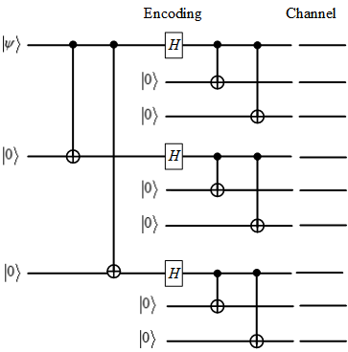

Shor’s Nine-Qubit Code
Encoding circuit for Shor’s nine-qubit QECC, which maps
We encode |0⟩ and |1⟩ as
then

Slide 28
QEC code
In general, most of the QEC codes work as
A quantum data register |ψ⟩D is entangled with redundancy qubits |0⟩R via an encoding operation to create a logical |ψ⟩L.
The set of auxillary qubits |0⟩A is called the syndrome, and it tells us in which physical qubit the error occurred during transmission

Slide 29
Stabilizer
Stabilizer is a subgroup S of the Pauli group 𝒢_{n} on n qubits with the following two properties:
  The subgroup is Abelian (i.e., all operators in the subgroup commute);
  The subgroup does not contain the element -I.
We can say
Stabilizer code can be defined as
An important property of the Pauli group is that any two Pauli operators either commute or anticommute.
A valid code word will be a +1 eigenvalue of all the stabilizer generators.
Notes:
An n–qubit quantum state is called a stabilizer state if it is stabilized by nontrivial subgroup of Pauli group.
An important property of the Pauli group is that any two Pauli operators either commute or anticommute Based on this property we can see how a stabilizer code detects and corrects errors.
A valid code word will be a +1 eigenvalue of all the stabilizer generators.
Suppose that an error operator E will anticommute with some of the stabilizer generators, and commute with others. The error will be detected that it anticommute with some of the stabilizer generators.

Slide 30
The stabilizer of bit-flip repetition code
The error syndrome for this code is determined by measuring the two stabilizer generators Z₁Z₂ ≡ ZZ𝐼 and Z₂Z₃ ≡ 𝐼ZZ.

Slide 31
Coherent parity check (CPC)
Encode stage: The data register is entangled with the parity qubit .
Decode stage: The register is disentangled from the parity qubit via the application of the unitary inverse of the first parity check. The final syndrome measurement of qubit tells us whether the results of the two parity checks differ.

Slide 32
Coherent parity check (CPC)

Slide 33
Coherent parity check (CPC)

Slide 34
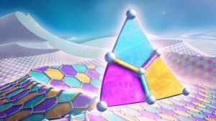
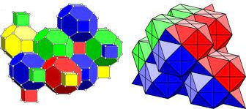
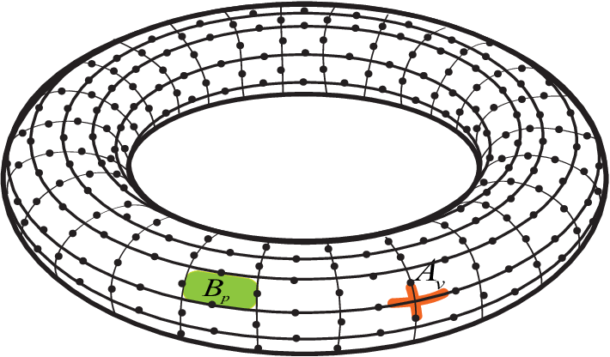
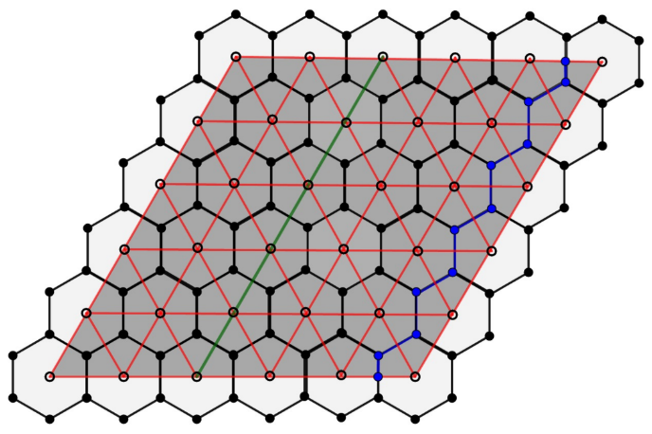
Topological code

Slide 35
Surface code
One of the topological QEC codes is surface code that is a stabilizer code arranged on a 2-D lattice with nearest-neighbor interactions. It encodes a single logical qubit in a number of physical qubits that is determined by the code distance d.

Slide 36
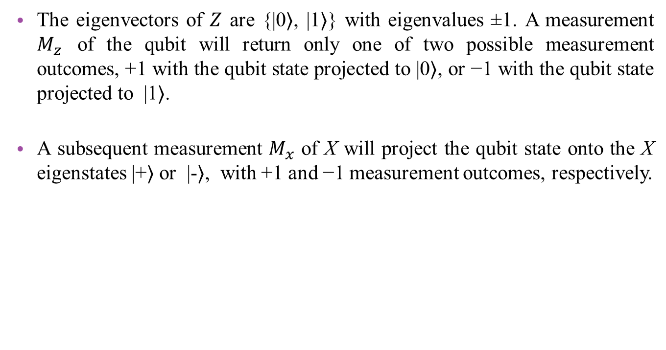
Surface code
The eigenvectors of $Z$ are {|0⟩, |1⟩} with eigenvalues ±1. A measurement $M_{z}$ of the qubit will return only one of two possible measurement outcomes, +1 with the qubit state projected to |0⟩, or −1 with the qubit state projected to |1⟩.
A subsequent measurement $M_{x}$ of X will project the qubit state onto the X eigenstates |+⟩ or |-⟩, with +1 and −1 measurement outcomes, respectively.
Notes:
As errors occur from the random and unpredictable appearance of X and Z operations, they must be detected by repeatedly measuring each qubit, which can be done with combined X and Z measurements.

Slide 37

Surface code
A single error on data qubit will be indicated by changes in the measurement outcomes.
Because of $\left[X,Z\right]≠0,$ operators X and Z anticommute.

Slide 38
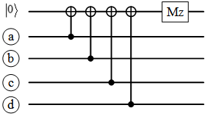
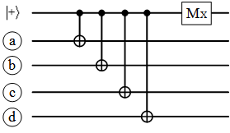
Surface code
X
X
Z
Z
X
X
Z
Z

Slide 39
Distance-three surface code layouts
Surface-25
Surface-17
Surface-13

Slide 40
Distance-three surface code layouts

Slide 41
Surface-13

Slide 42
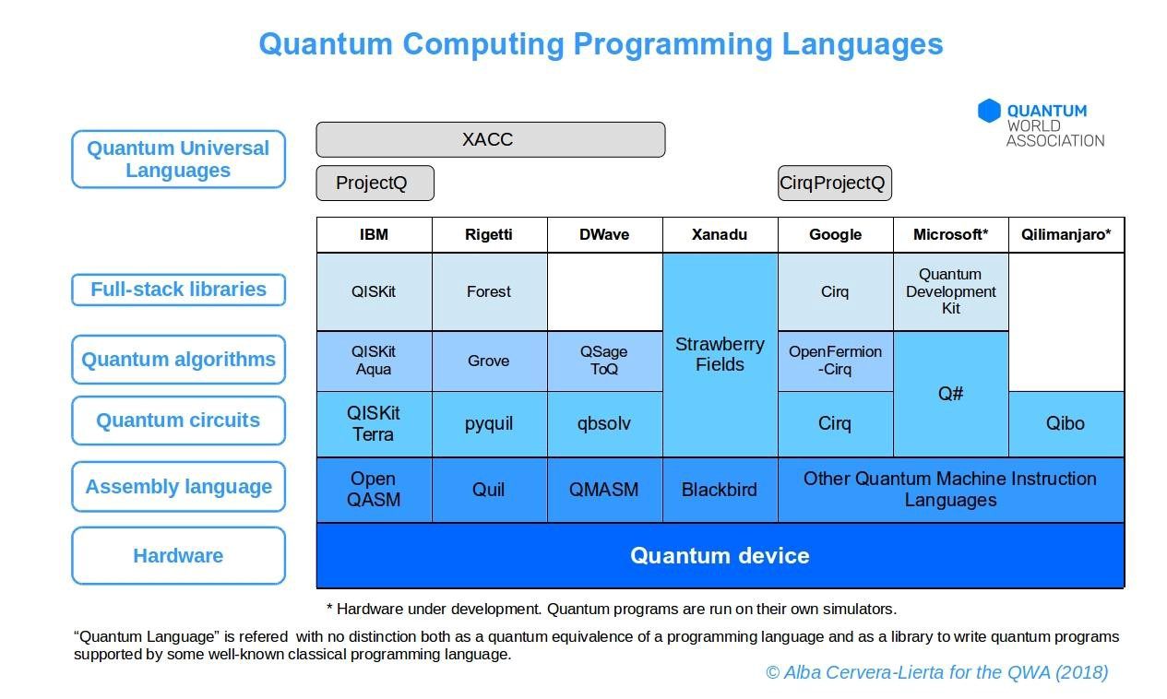
Simulation tools for quantum computing

Slide 43
Noise model with Qiskit
The function below creates a simple noise model in order to see the effects of imperfect qubits in Qiskit.
First, we need to import all the tools we will need
  from qiskit.providers.aer.noise import NoiseModel
  from qiskit.providers.aer.noise.errors import pauli_error, depolarizing_error
  from qiskit import QuantumRegister, ClassicalRegister
  from qiskit import QuantumCircuit, Aer, transpile, assemble
  from qiskit.visualization import plot_histogram
  aer_sim = Aer.get_backend('aer_simulator')

Slide 44
Noise model
return noise_model
  def get_noise(p_meas,p_gate):
      error_meas = pauli_error([('X',p_meas), ('I', 1 - p_meas)])
      error_gate1 = depolarizing_error(p_gate, 1)
      error_gate2 = error_gate1.tensor(error_gate1)
      noise_model = NoiseModel()
      noise_model.add_all_qubit_quantum_error(error_meas, "measure") # measurement error is applied to measurements
      noise_model.add_all_qubit_quantum_error(error_gate1, ["x"]) # single qubit gate error is applied to x gates
      noise_model.add_all_qubit_quantum_error(error_gate2, ["cx"]) # two qubit gate error is applied to cx gates return noise_model
  return noise_model

Slide 45
Quantum repetition code with Qiskit
In this code, |000⟩ is built and also a noise model is created with a probability of 1% for each type of error.
  noise_model = get_noise(0.01,0.01)
  qc0 = QuantumCircuit(3) # initialize circuit with three qubits in the 0 state
  qc0.measure_all() # measure the qubits
  # run the circuit with the noise model and extract the counts
  qobj = assemble(qc0)
  counts = aer_sim.run(qobj, noise_model=noise_model).result().get_counts()
  plot_histogram(counts)
Notes:
A error gate, is called depolarizing noise, is an imperfection in any operation we perform. The effect of this will be, with probability Pgate ,to replace the state of any qubit with a completely random state.
The other form of noise is that for measurement. This simply flips between a 0 to a 1 and vice-versa immediately before measurement with probability Pmeas.
def get_noise(p_meas,p_gate):

Slide 46
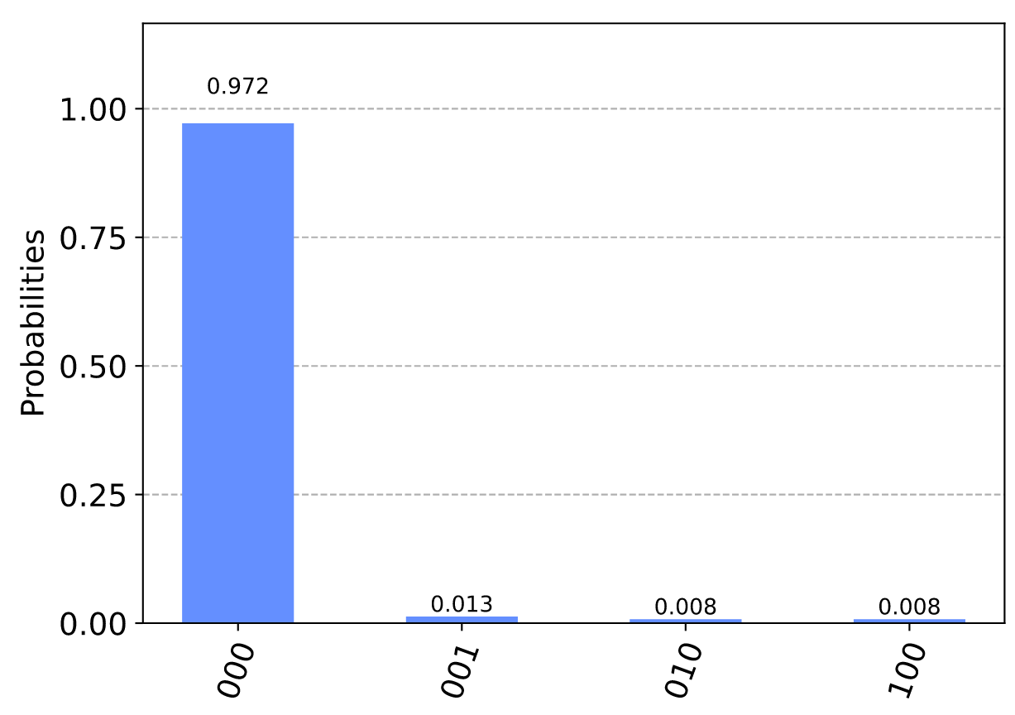
Quantum repetition code with Qiskit
Here we see that almost all results still come out '000', as they would if there was no noise. Of the remaining possibilities, those with a majority of 0s are most likely. In total, much less than 10 samples come out with a majority of 1s.
Notes:
A error gate, is called depolarizing noise, is an imperfection in any operation we perform. The effect of this will be, with probability Pgate ,to replace the state of any qubit with a completely random state.
The other form of noise is that for measurement. This simply flips between a 0 to a 1 and vice-versa immediately before measurement with probability Pmeas.
def get_noise(p_meas,p_gate):

Slide 47
Quantum repetition code with Qiskit
In this code, |111⟩ is built and also a noise model is created with a probability of 1% for each type of error.
  noise_model = get_noise(0.01,0.01)
  qc0 = QuantumCircuit(3) # initialize circuit with three qubits in the 0 state
  qc0.measure_all() # measure the qubits
  # run the circuit with the noise model and extract the counts
  qobj = assemble(qc0)
  counts = aer_sim.run(qobj, noise_model=noise_model).result().get_counts()
  plot_histogram(counts)
Notes:
A error gate, is called depolarizing noise, is an imperfection in any operation we perform. The effect of this will be, with probability Pgate ,to replace the state of any qubit with a completely random state.
The other form of noise is that for measurement. This simply flips between a 0 to a 1 and vice-versa immediately before measurement with probability Pmeas.
def get_noise(p_meas,p_gate):

Slide 48
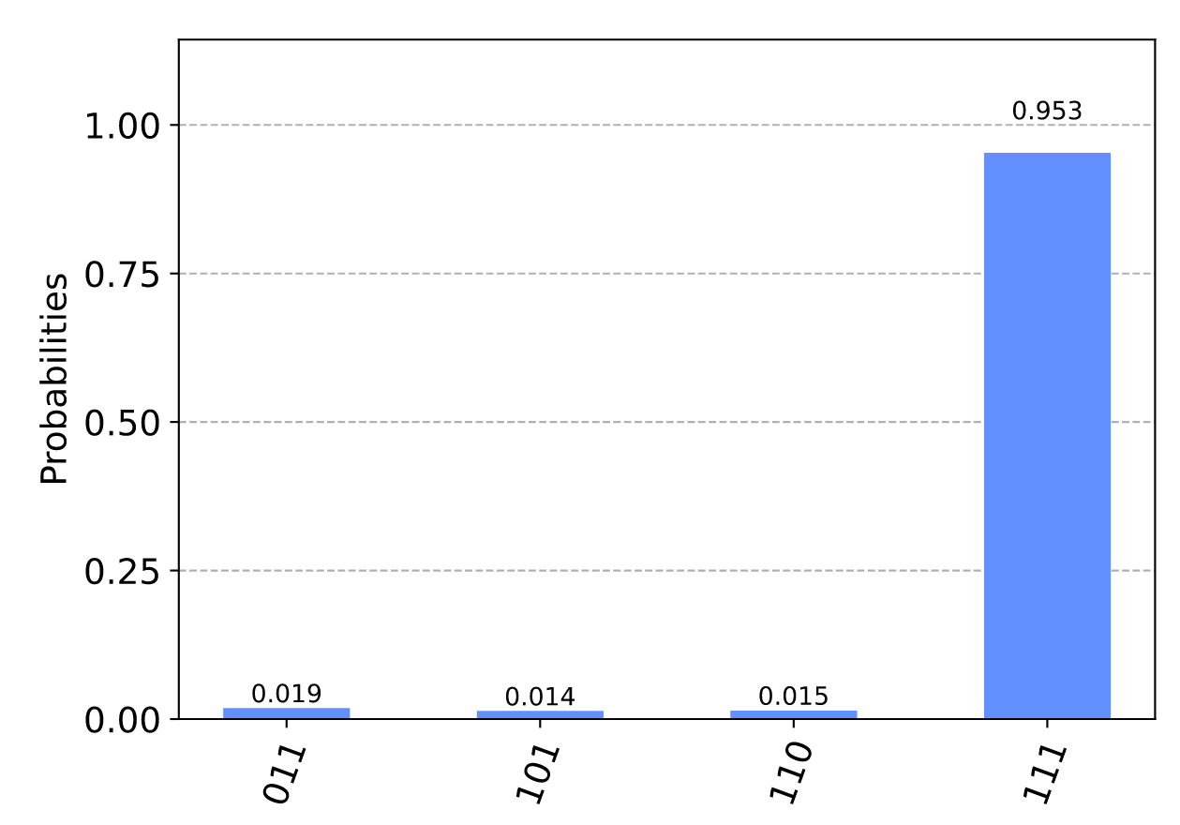
Quantum repetition code with Qiskit
The number of samples that come out with a majority in the wrong state (0 in this case) is again much less than 10, so P<1%.
Notes:
A error gate, is called depolarizing noise, is an imperfection in any operation we perform. The effect of this will be, with probability Pgate ,to replace the state of any qubit with a completely random state.
The other form of noise is that for measurement. This simply flips between a 0 to a 1 and vice-versa immediately before measurement with probability Pmeas.
def get_noise(p_meas,p_gate):

Slide 49
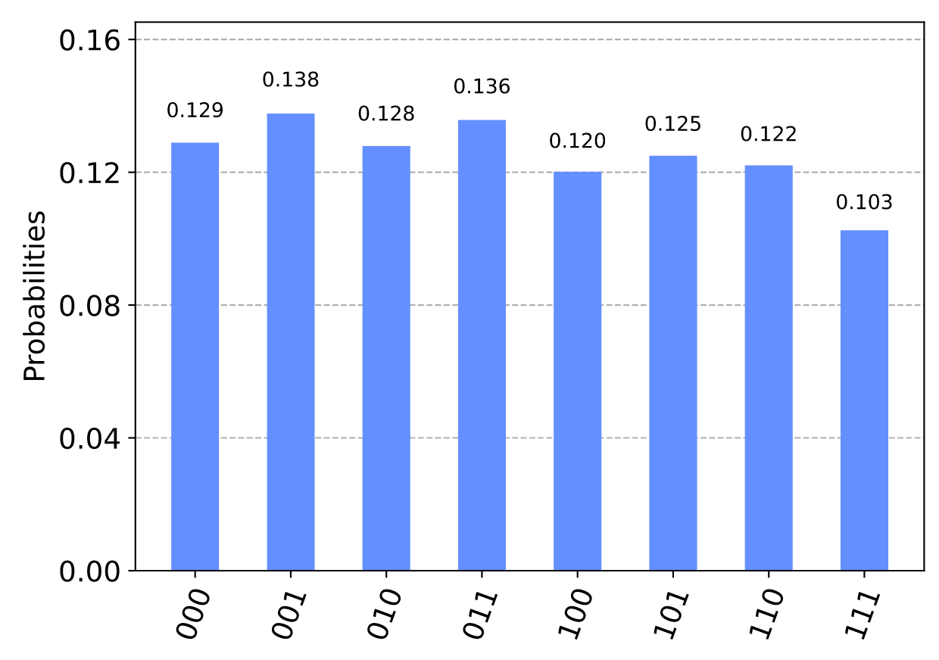
Quantum repetition code with Qiskit
As we increase pmeas and pgate, the higher the probability P will be. The extreme case of this is for either of them to have a 50/50 chance of applying the bit flip error, x. For example, let's run the same circuit as before but with pmeas = 0.5 and pgate = 0.5.
  noise_model = get_noise(0.5,0.0)
  qobj = assemble(qc1)
  counts = aer_sim.run(qobj, noise_model=noise_model).result().get_counts()
  plot_histogram(counts)
Notes:
With this noise, all outcomes occur with equal probability, with differences in results being due only to statistical noise. No trace of the encoded state remains. This is an important point to consider for error correction: sometimes the noise is too strong to be corrected. The optimal approach is to combine a good way of encoding the information you require, with hardware whose noise is not too strong.

Slide 50
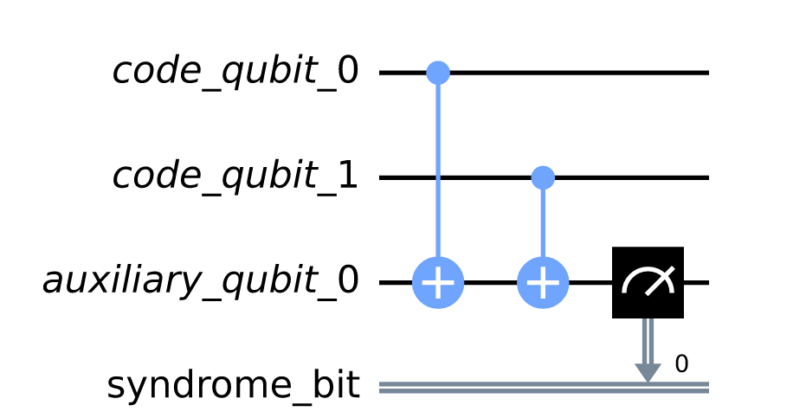
Quantum repetition code with Qiskit
The code qubits are initially |00⟩.
  cq = QuantumRegister(2, 'code_qubit')
  lq = QuantumRegister(1, 'auxiliary_qubit')
  sb = ClassicalRegister(1, 'syndrome_bit')
  qc = QuantumCircuit(cq, lq, sb)
  qc.cx(cq[0], lq[0])
  qc.cx(cq[1], lq[0])
  qc.measure(lq, sb)
  qc_init = QuantumCircuit(cq)
  qc.compose(qc_init).draw()

Slide 51
Quantum repetition code with Qiskit
We can use it in Qiskit by importing the required tools from Ignis.
  from qiskit.ignis.verification.topological_codes import RepetitionCode
In the version 0.7.0 Qiskit Ignis is deprecated has been supersceded by Qiskit Experiments project
  Import qiskit_experiments.library
The circuits for the repetition code can then be created automatically from using the RepetitionCode object from Qiskit-Ignis.
  n = 3
  T = 1 #one syndrome measurement round
  code = RepetitionCode(n, T)

Slide 52
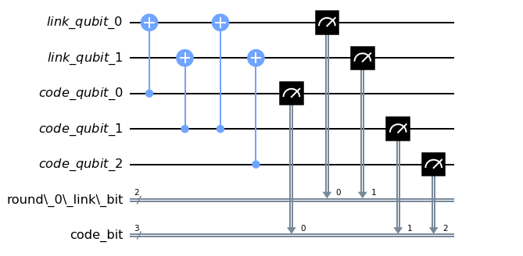
Quantum repetition code
The RepetitionCode contains two quantum circuits that implement the code: One for each of the two possible logical bit values. Here are those for logical 0 and 1, respectively.
  code.circuit['0'].draw(‘mpl’)
Notes:
In these circuits, we have two types of physical qubits. There are the 'code qubits', which are the three physical qubits across which the logical state is encoded. There are also the 'link qubits', which serve as the auxiliary qubits for the syndrome measurements.
Our single round of syndrome measurements in these circuits consist of just two syndrome measurements. One compares code qubits 0 and 1, and the other compares code qubits 1 and 2. One might expect that a further measurement, comparing code qubits 0 and 2, should be required to create a full set. However, these two are sufficient. This is because of the information on whether 0 and 2 have the same z basis state can be inferred from the same information about 0 and 1 with that for 1 and 2. Indeed, for n qubits, we can get the required information from just n−1 syndrome measurements of neighbouring pairs of qubits.

Slide 53
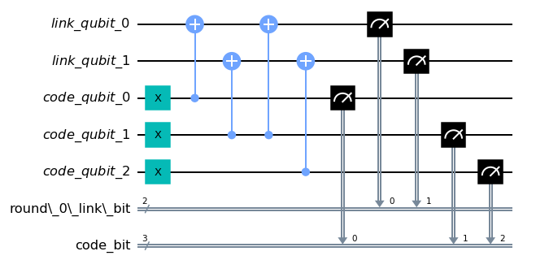
Quantum repetition code
  code.circuit[‘1'].draw(‘mpl’)

Slide 54
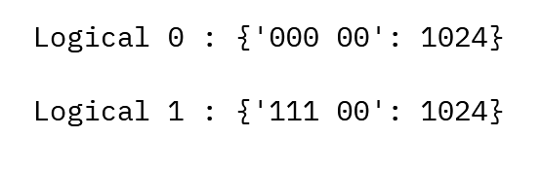
Quantum repetition code
Running these circuits on a simulator without any noise leads to very simple results.
  def get_raw_results(code,noise_model=None):
    circuits = code.get_circuit_list()
    raw_results = {}
    for log in range(2):
      qobj = assemble(circuits[log])
      job = qasm_sim.run(qobj, noise_model=noise_model)
      raw_results[str(log)] = job.result().get_counts(str(log))
  return raw_results raw_results = get_raw_results(code)
  for log in raw_results:
    print('Logical', log, ':', raw_results[log], '\n')

Slide 55
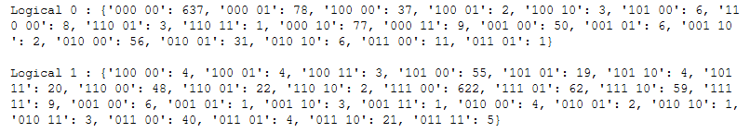
Quantum repetition code
Repetition code with some noise:
  code = RepetitionCode(3,1)
  noise_model = get_noise(0.05,0.05)
  raw_results = get_raw_results(code,noise_model)
  for log in raw_results:
    print('Logical', log,':', raw_results[log],'\n')
Result :

Slide 56
References
https://qiskit.org/textbook/preface.html
Fowler, A.G., Mariantoni, M., Martinis, J.M. and Cleland, A.N., 2012. Surface codes: Towards practical large-scale quantum computation. Physical Review A, 86(3), p.032324.
Tomita, Y. and Svore, K.M., 2014. Low-distance surface codes under realistic quantum noise. Physical Review A, 90(6), p.062320.
Nakahara, M. and Ohmi, T., 2008. Quantum computing: from linear algebra to physical realizations. CRC press.

Slide 57
References
Roffe, J., Headley, D., Chancellor, N., Horsman, D. and Kendon, V., 2018. Protecting quantum memories using coherent parity check codes. Quantum Science and Technology, 3(3), p.035010.
Roffe, J., 2019. Quantum error correction: an introductory guide. Contemporary Physics, 60(3), pp.226-245.
https://www.nextbigfuture.com/2018/04/improved-quantum-error-correction-could-enable-universal-quantum-computing.html

