Slide 1
Computer Design Concepts for Machine Learning
Nader Bagherzadeh
University of California, Irvine
EECS Dept.
Notes:
Abstract:

Slide 2
AI, ML, and Brain-Like
Artificial Intelligence (AI): The science and engineering of creating intelligent machines. (John McCarthy, 1956)
  Machine Learning (ML): Field of study that gives computers the ability to learn without being explicitly programmed. (Arthur Samuel, 1959); requires large data sets
    Brain-Like: A machine that its operation and design are strongly inspired by how the human brain functions.
      Neural Networks
        Deep Learning: many layers used for data processing
      Spiking

Slide 3
Major Technologies Impacted by Machine Learning
Data Centers
  Heterogenous
  Power
  Thermal
  Machine Learning
Autonomous Vehicles
  Reliability
  Cost
  Safety
  Machine Learning
Edge
  Extreme low power
  Sensor integration
  Environment monitoring

Slide 4

Intuition vs. Computation
“A self-driving car powered by one of the more popular artificial intelligence techniques may need to crash into a tree 50,000 times in virtual simulations before learning that it’s a bad idea. But baby wild goats scrambling around on incredibly steep mountainsides do not have the luxury of living and dying millions of times before learning how to climb with sure footing without falling to their deaths.”
“Will the Future of AI Learning Depend More on Nature or Nurture?” IEEE Spectrum, October 2017

Slide 5
Fun Facts about Your Brain
1.3 Kg neural tissue that consumes 20% of your body metabolism
A supercomputer running at 20 Ws, instead of 20 MWs for exascale Computation and storage is done together locally
Network of 100 Billion neurons and 100 Trillion synapses (connections)
Neurons accumulate charge like a capacitor (analog), but brain also uses spikes for communication (digital); brain is mixed signal computing
There is no centralized clock for processing synchronization
Simulating the brain is very time consuming and energy inefficient
Direct implementation in electronics is more plausible:
  10 femtojules for brain; CMOS gate 0.5 femtojules; synaptic transmission = 20 transistors
  PIM is closer to the neuron; coexistence of data and computing

Slide 6
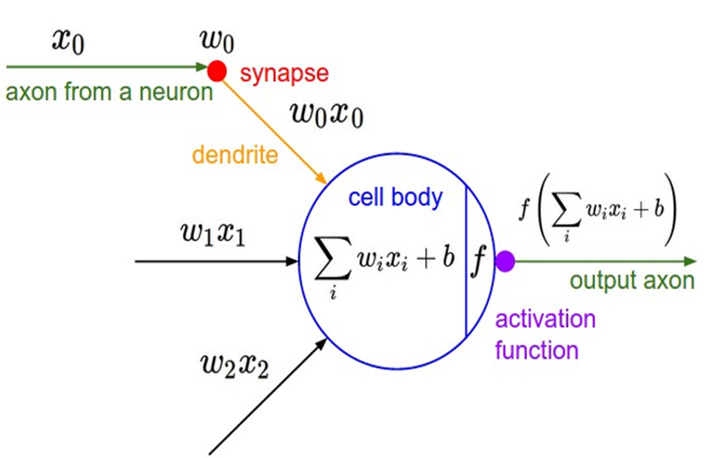
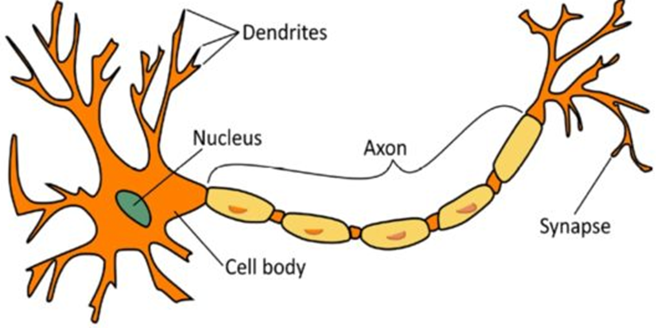
Modeling Biological Neurons
Notes:
The most fundamental unit of neural network is an artificial neuron. It tries to mimic the actual brain functionality.
In real neuron, Dendrites take input signals and process them. Then pass the output to another neuron. In mathematic model, artificial neural network takes the input, calculate the weighted sum and pass it through a nonlinear function and then gives an output. The output then can be the input for next artificial neuron.

Slide 7
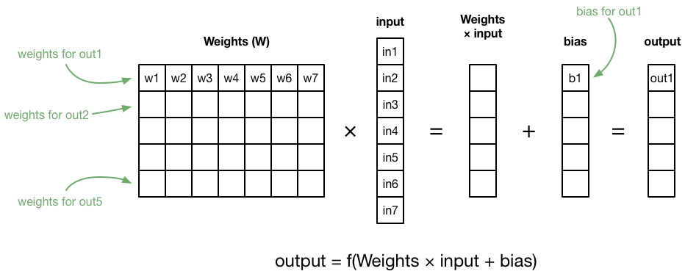
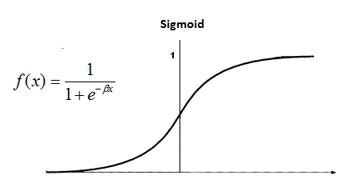
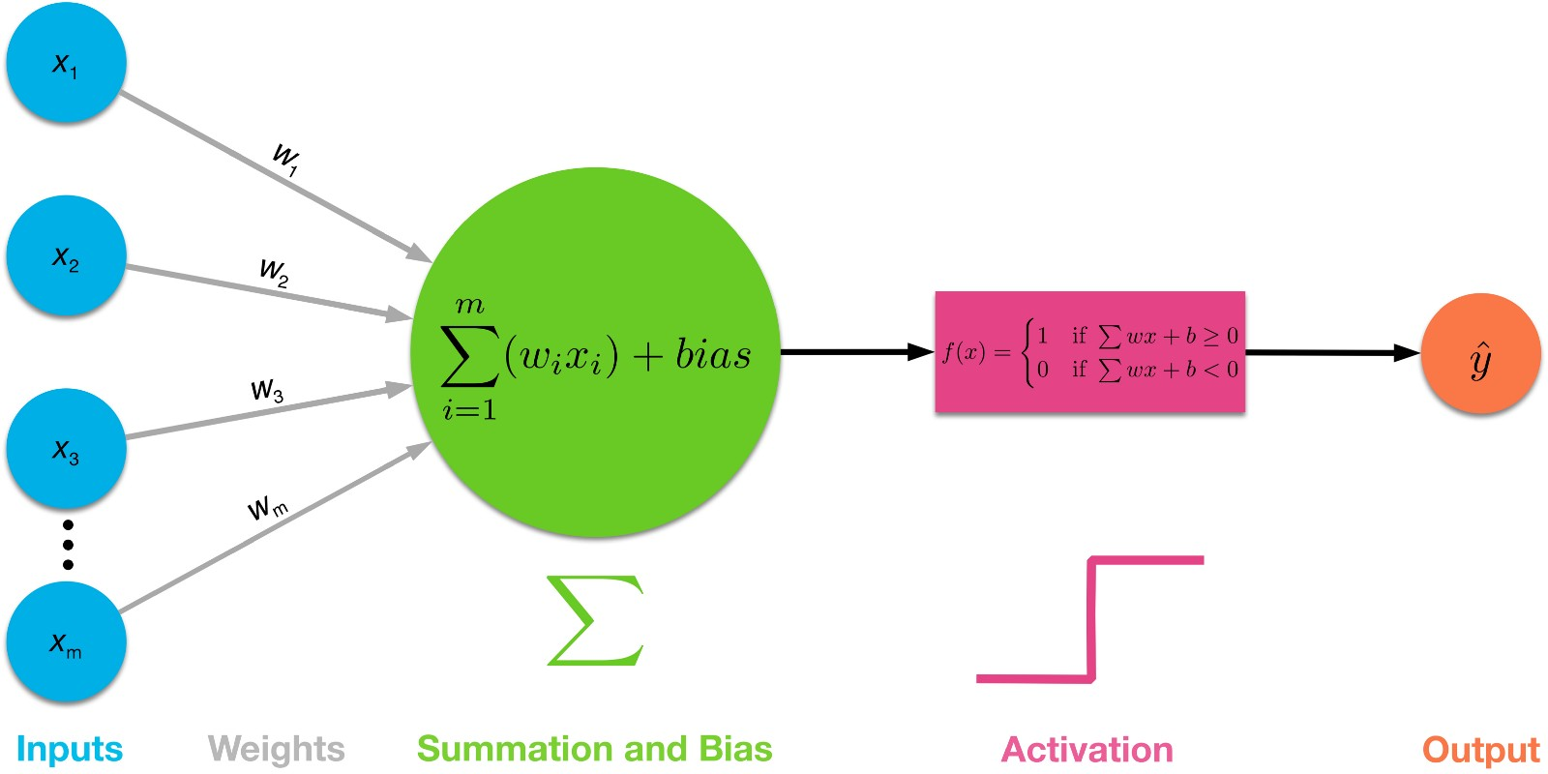
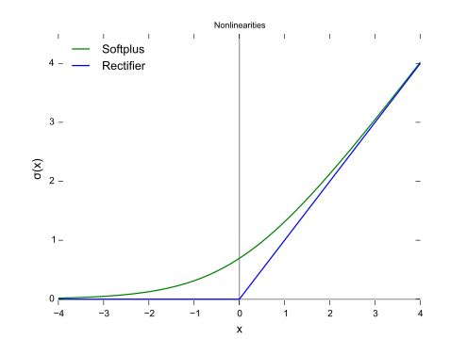
ML Computation is Mostly Matrix Multiplications
M by N matrix of weights multiplied by N by 1 vector of inputs
Need an activation function after this matrix operation: Rectifier, Sigmoid, and etc.
Matrices are dense

Slide 8
Biological Neurons are not Multiplying and Adding
We can model them by performing multiply and add operations
Efficient direct implementation is not impossible but still far away
Computer architecture in terms of development of accelerators and approximate computation are some of the current solutions
We are far below in capability what neurons can do in terms of connectivity and the number of active neurons (computing nodes)
VLSI scaling is a limiting factor
Computing with an accelerators is making a come back

Slide 9
Deep Learning Limitation and Advantages
Better than K-means, liner regression, and others, because it does not require data scientists to identify the features in the data they want to model.
Related features are identified by the deep learning model itself.
Deep learning is excellent for language translation but not good at the meaning of the translation.

Slide 10
Data Quality Impacts ML Performance
Garbage-in Garbage-out
Data must be correct and properly labeled
Data must be the “right” one; unbiased over the input dynamic range
Data is training a predictive model, and must meet certain requirements

Slide 11
7 Revealing Ways AIs Fail
IEEE Spectrum Oct 2021; C. Choi
Brittleness: “A 2018 study found that state-of-the-art AIs that would normally correctly identify the school bus right-side-up failed to do so on average 97 percent of the time when it was rotated.” Lacks mental rotation.
Embedded Bias: “AI is used to help support major decisions impartially, such as who receives a loan, the length of a jail sentence, and who gets health care first. Research has found that biases embedded in the data on which these AIs are trained can result in automated discrimination, posing immense risks to society. “
Catastrophic Forgetting: “The tendency of an AI to entirely and abruptly forget information it previously knew after learning new information, essentially overwriting past knowledge with new knowledge. “Artificial neural networks have a terrible memory,” Tariq says.
Explainability: “They can give you different explanations every time.” Not consistent.
Quantifying Uncertainty: Currently AIs “can be very certain even though they’re very wrong. Robustness needed for Self-driving cars and medical diagnosis.
Common Sense: AIs lack common sense—the ability to reach acceptable, logical conclusions based on a vast context of everyday knowledge that people usually take for granted
Math: Neural networks nowadays can learn to solve nearly every kind of problem “if you just give it enough data and enough resources, but not math,”

Slide 12
Training and Inference
Learning Step: Weights are produced by training, initially random, using successive approximation that includes backpropagation with gradient descent. Mostly floating-point operations. Time consuming.
Inference Step: Recognition and classifications. More frequently invoked step. Fixed point operation.
Both steps are many dense matrix vector operations

Slide 13

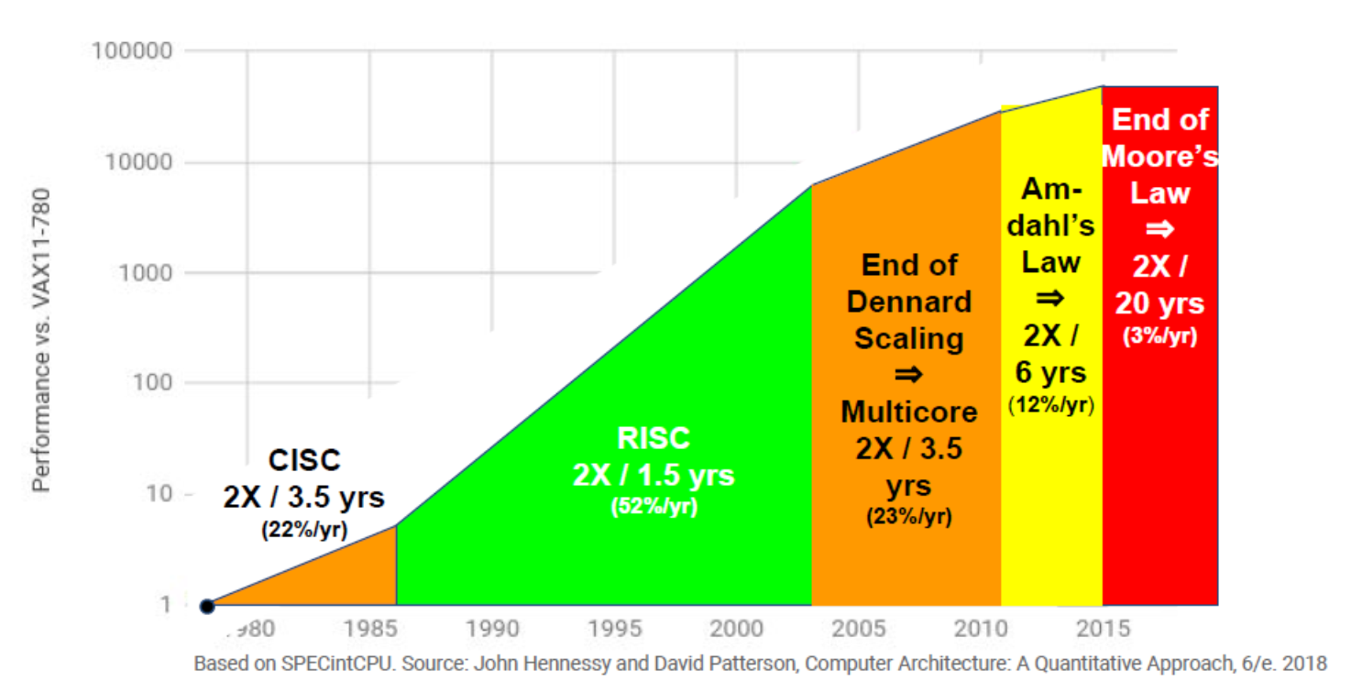
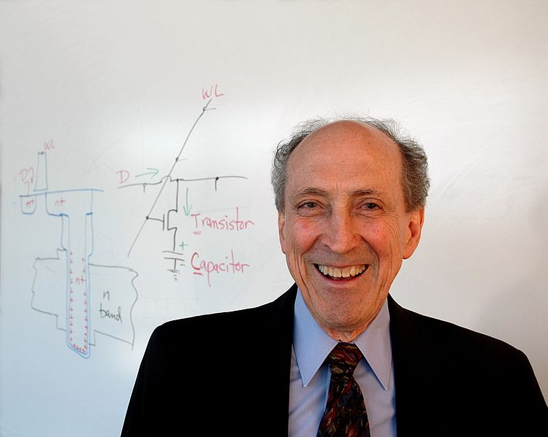
VLSI Laws are not Scaling Anymore
Moore’s law:
  Doubling of the number of transistors
  every about 18 months is slowing down.
Dennard’s law:
  Transistors shrink =>
    L, W are reduced.
    Delay is reduced (T=RC), frequency increased (1/f).
    I & V reduced since they are proportional to L, W.
  Power consumption (P = C * V²* f) stays the same is no longer valid.

Slide 14
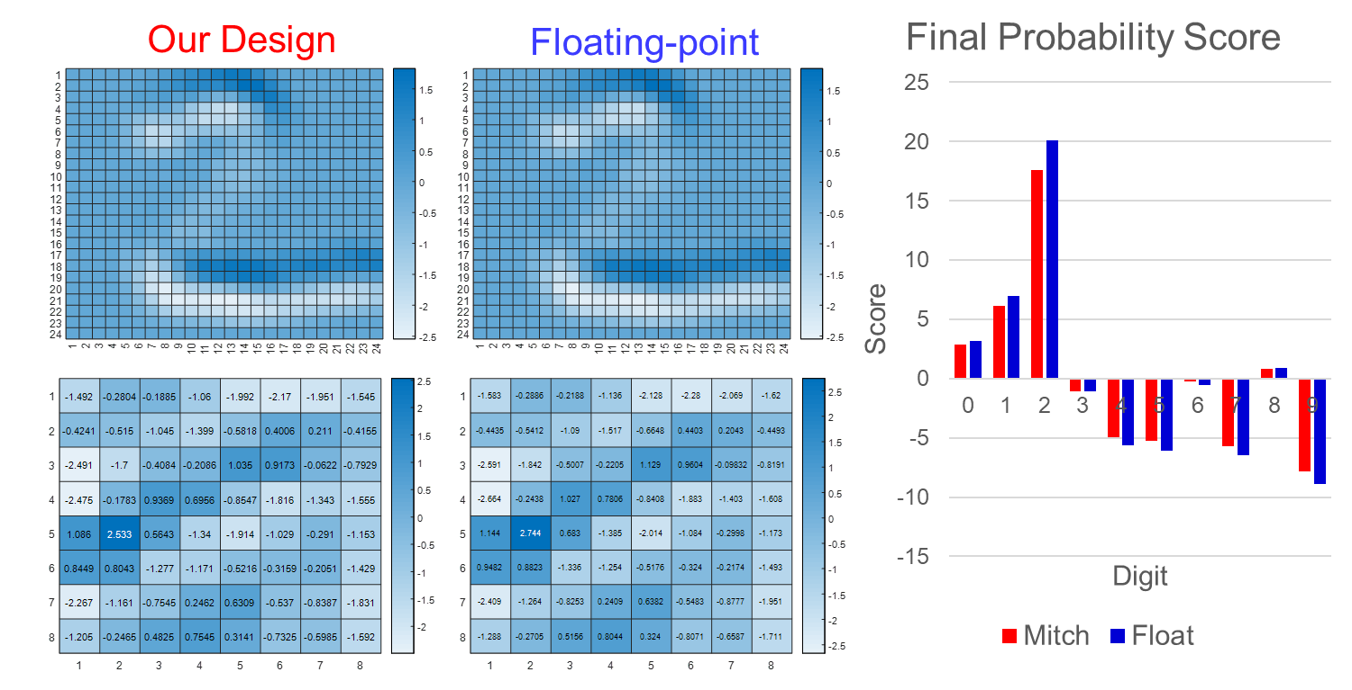
Computer Architecture is Making a Come Back
Past success stories:
  Clock speed
  Instruction Level Parallelism (ILP); spatial and temporal; branch prediction
  Memory hierarchy; cache optimizations
  Multicores
  Reconfigurable computing
Current efforts:
  Accelerators; domain specific ASICs
  Exotic memories; STT-RAM, RRAM
  In memory processing
  Approximate computing (log domain multiplication)
  Systolic resurrected; non-von Neuman memory access
  ML is not just algorithms; HW/SW innovations
Notes:
Mitchel’s vs Floating
Right shows the outputs of the final fully connected layer from the sample inference.
Absolute magnitudes of the scores are reduced because Mitchell’s multiplication has negative error.
But the prediction is still accurate because the relative order is preserved.
The effect is as if the inference was performed with a lighter image.
Same effects are observed with ImageNet, only more difficult because the 1000 outputs were much closer together.
Same effects are observed with Mitch-w designs.

Slide 15
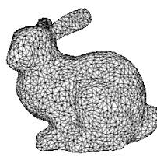
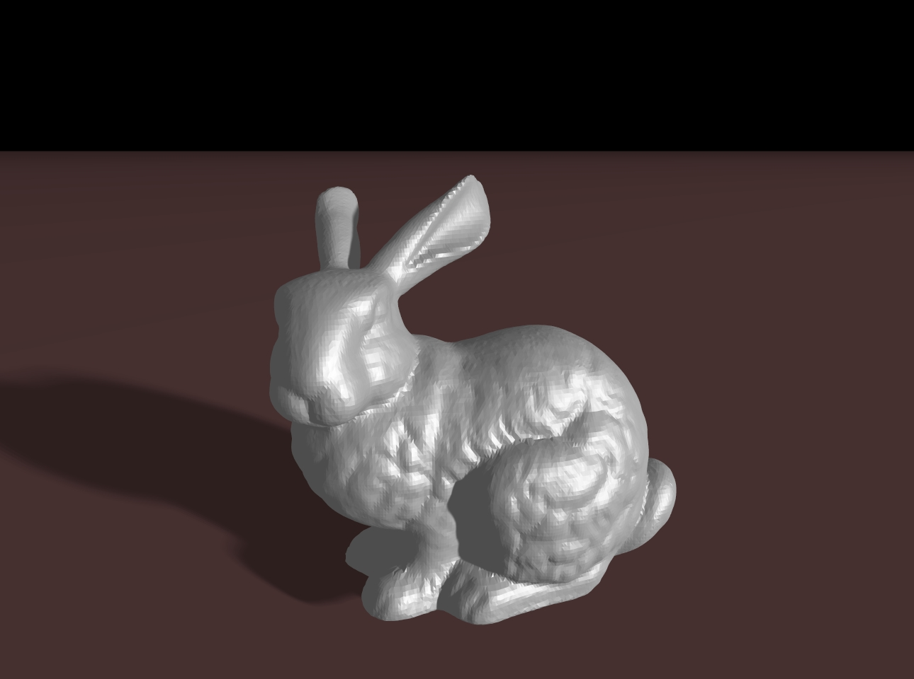
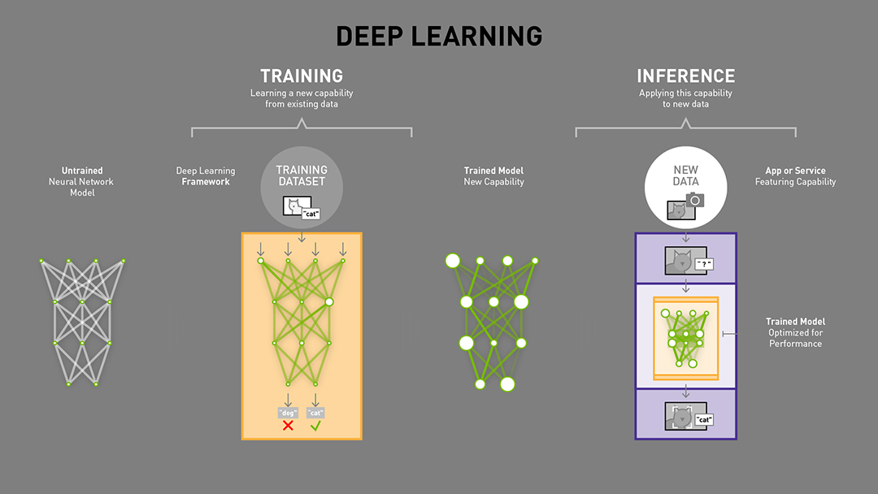
Computation Types
Graphics
  Vertex Processing; floating point;
  Pixel processing and rasterization; integer
ML
  Training; floating point
  Inference; integer

Slide 16
Coarse Grain Reconfigurable

Slide 17
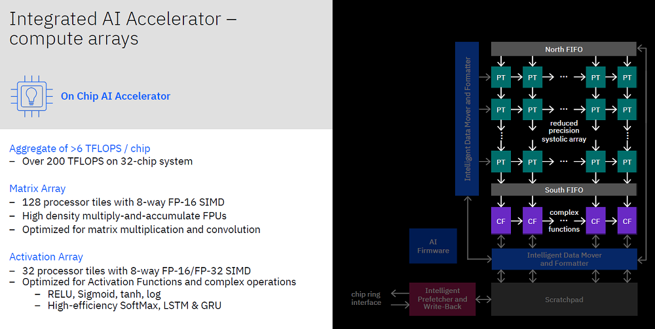
Telum: IBM AI Array Accelerator
Notes:
Telum chip design is specifically optimized to run these kinds of mission critical, heavy duty transaction processing and batch processing workloads, while ensuring top-notch security and availability.
The goal for this processor and the AI accelerator was to enable embedding AI with super low latency directly into the transactions without needing to send the data off-platform, which brings all sorts of latency inconsistencies and security concerns," said Jacobi. "Sending data over a network, oftentimes personal and private data, requires cryptography and auditing of security standards that creates a lot of complexity in an enterprise environment. We have designed this accelerator to operate directly on the data using virtual address mechanisms and the data protection mechanisms that naturally apply to any other thing on the IBM Z processor.“
Each Telum processor contains eight processor cores and use a deep super-scalar, out-of-order instruction pipeline. Running with more than 5GHz clock frequency, the redesigned cache and chip-interconnection infrastructure provides 32MB cache per core and can scale to 32 Telum chips. The dual-chip module design contains 22 billion transistors and 19 miles of wire on 17 metal layers.

Slide 18
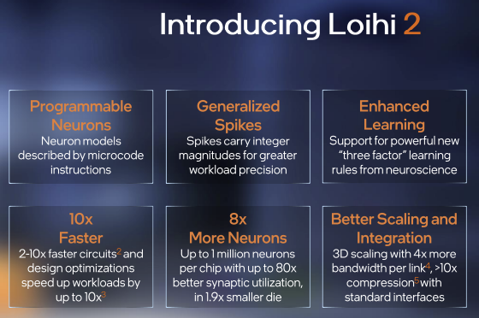
Intel Neurocomputing
Notes:
Four years after the introduction of Loihi, Intel’s first neuromorphic chip, the company is introducing its successor. According to Intel, the second-generation chip will provide faster processing, higher resource density and greater energy efficiency. Intel is also introducing Lava, a software framework for neuromorphic computing.
Various processors and pieces of code are often compared to brains, but neuromorphic chips work to much more directly mimic neurological systems through the use of computational “neurons” that communicate with one another. Intel’s first-generation Loihi chip, introduced in 2017, has around 128,000 of those digital neurons. Over the ensuing four years, Loihi has been packed into increasingly large systems, learned to touch and even been taught to smell.
However, Loihi 2 is still in its early days. Initially, Intel is offering two Loihi 2-based systems through its neuromorphic research cloud to select members of its Intel Neuromorphic Research Community (INRC). Those systems are Oheo Gulch, which uses a single Loihi 2 chip on an Intel Arria 10 FPGA and is intended for early evaluation, and Kapoho Point, which offers eight Loihi 2 chips in a stackable, “approximately 4×4-inch form factor with an Ethernet interface … ideal for portable projects”
The key difference between a traditional ANN and SNN (spiking) is the information propagation approach.
SNN tries to more closely mimic a biological neural network. This is why instead of working with continuously changing in time values used in ANN, SNN operates with discrete events that occur at certain points of time. SNN receives a series of spikes as input and produces a series of spikes as the output (a series of spikes is usually referred to as spike trains).

Slide 19
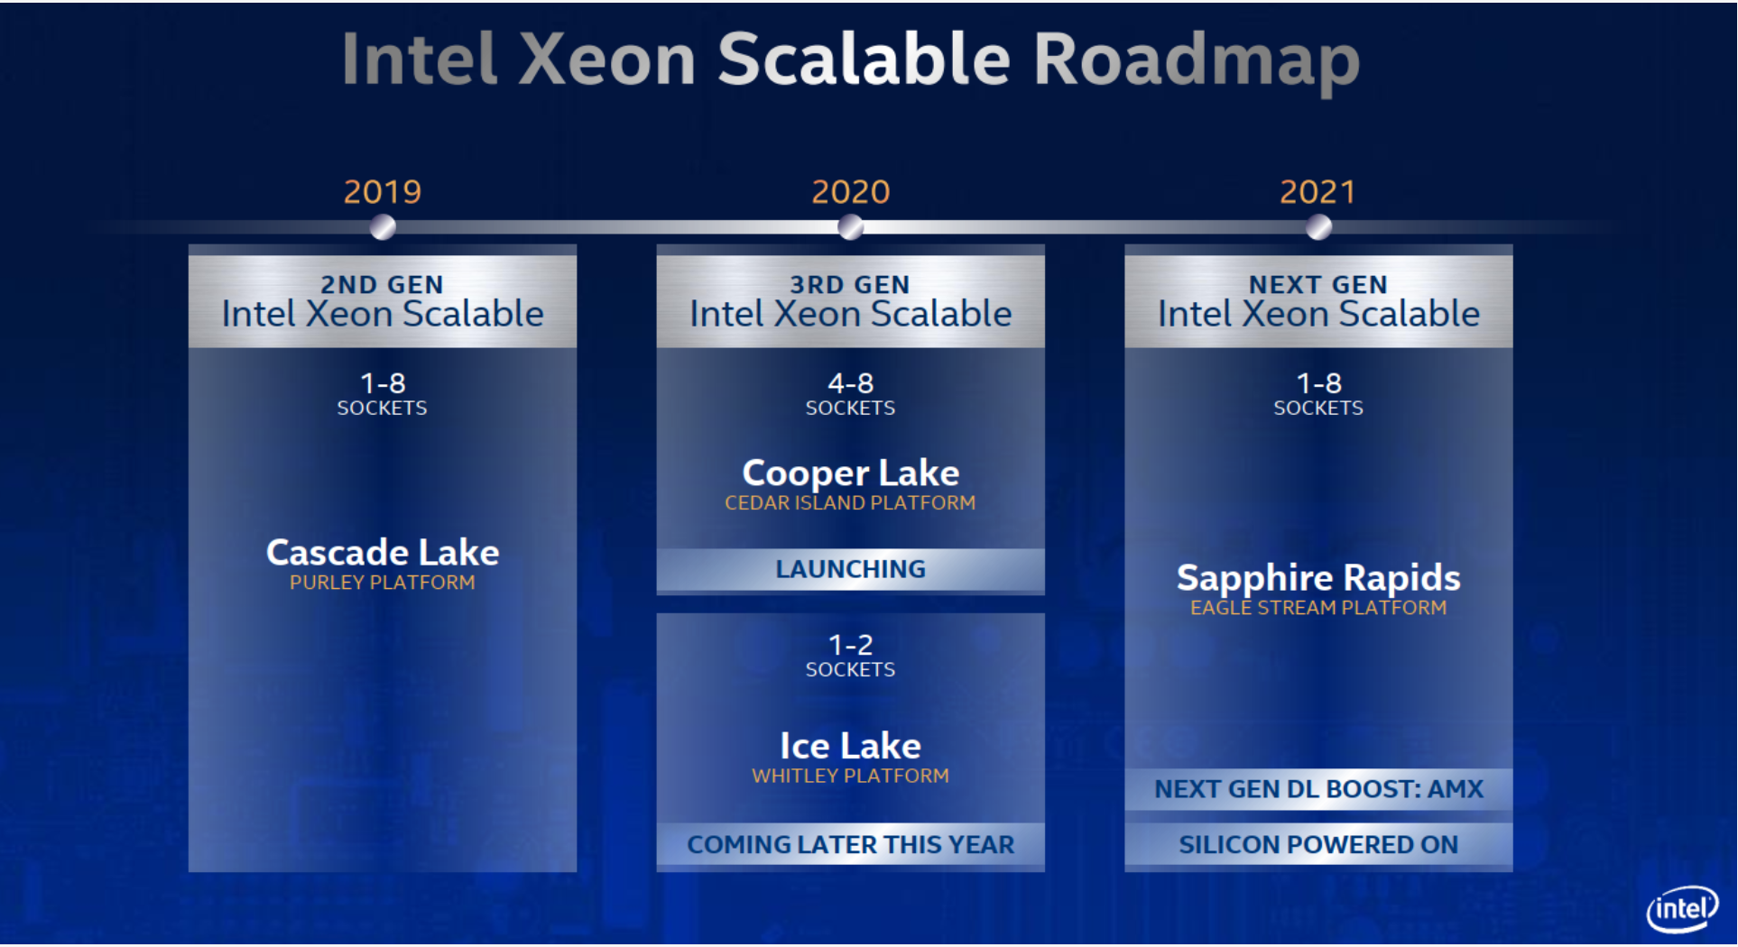
Intel: Advanced Matrix Extension
Intel has introduced a new x86 extension called Advanced Matrix Extensions (AMX)
An accelerator in the next generation Xeon server processors based on Intel 7 process.
  Sapphire Rapids microarchitecture
  Release sometime in 2022
  Part of Intel's DL-Boost feature set
Thanks to my student Andrew Ding for AMX slides
Notes:
Intel 7 is rebranded 10 nm Enhanced SuperFin process.

Slide 20
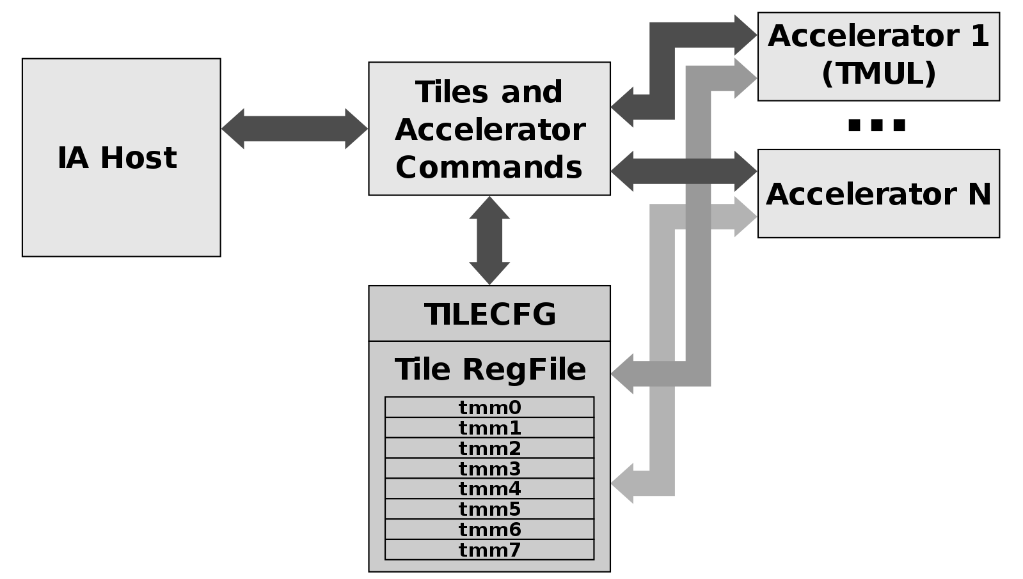
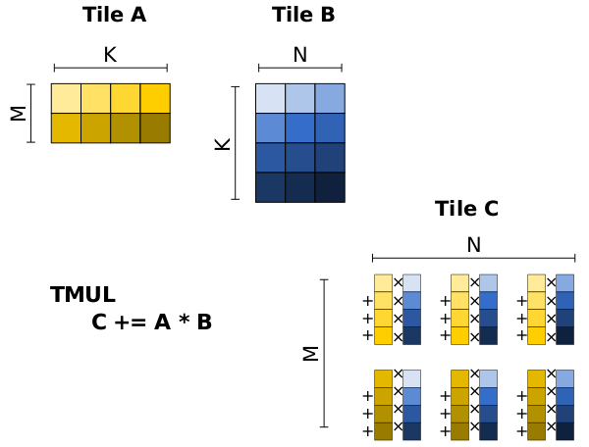
Features
Includes a massive 8KB register file for matrix operations
  Organized into 8 tiles, each tile has 16 rows by 64 bytes or1KB per tile
  Tile Registers are named TMM0-TMM7
  Tiles are software configurable
  SIMD extension
A TMUL accelerator for matrix multiplications
  AMX is extensible so new accelerators can be added
64 Bit programming paradigm
Notes:
AMX consists of two components: a set of 2-dimensional registers (tiles) representing sub-arrays from a larger 2-dimensional memory image,
and an accelerator able to operate on tiles, the first implementation is called TMUL (tile matrix multiply unit).

Slide 21
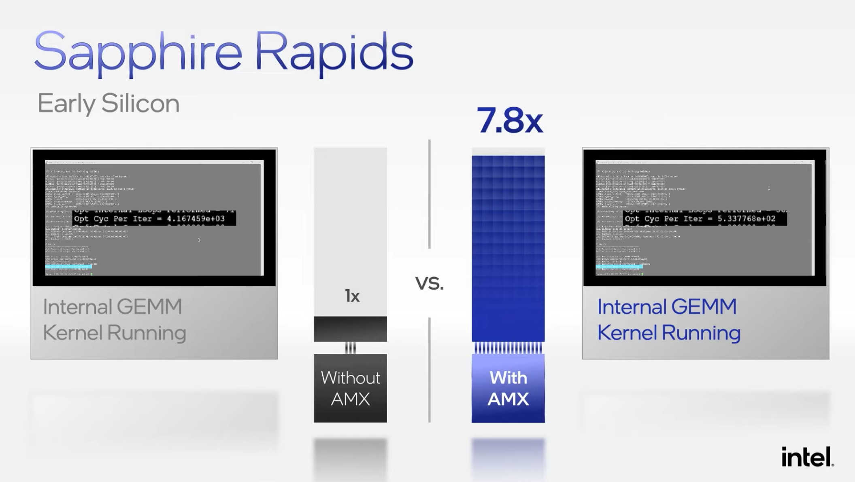
Purpose and Performance
Meant to accelerate both training and inference of deep neural networks.
  More matrix multiplies per clock cycle
  2K INT8 or 1K BF16 ops/cycle
Targeted for datacenter
Intel claims 7.8X improvement for matrix operations
System software can disable AMX
Notes:
The intel demo uses an internally optimized general matrix multiply gem kernel with and without amx
It is recommended that system software initialize AMX state (e.g., by executing TILERELEASE)
before disabling amx. This is because maintaining AMX state in a non-initialized state may have negative power and
performance implications.

Slide 22
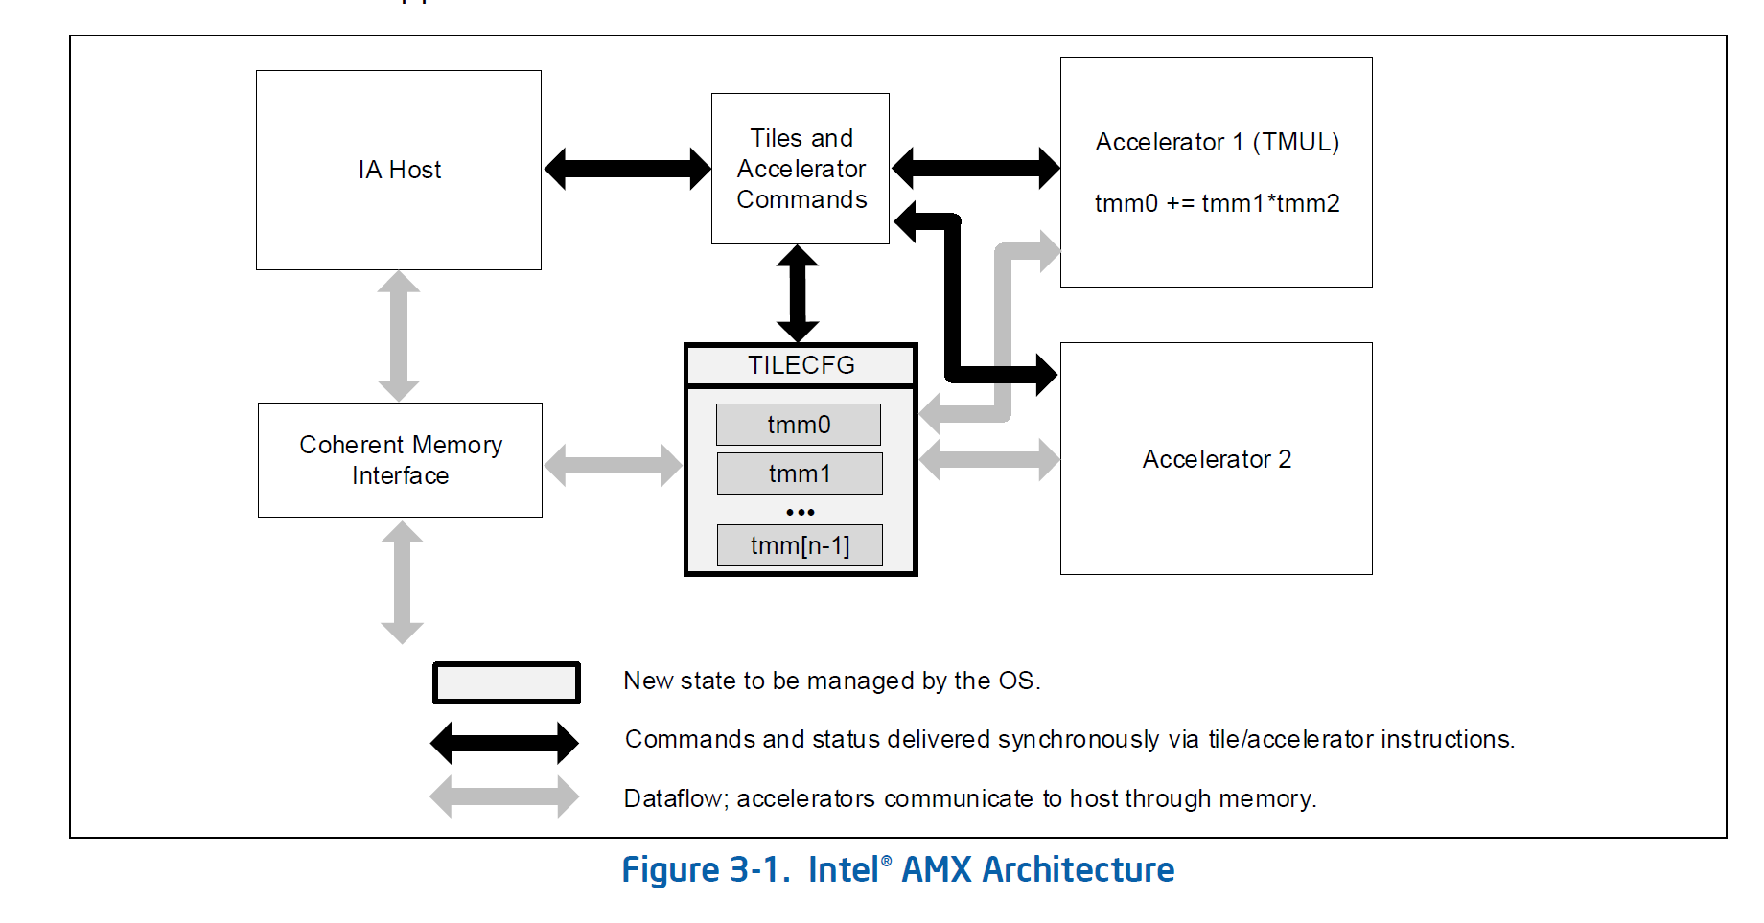
Intel AMX Architecture
Notes:
An Intel architecture host drives the algorithm, the memory blocking, loop indices and pointer arithmetic.
Tile loads and stores and accelerator commands are sent to multi-cycle execution units. Status, if required, is reported back.
Intel AMX instructions are synchronous in the Intel architecture instruction stream and the memory loaded and stored by the tile instructions is coherent with respect to the host’s memory accesses.
There are no restrictions on interleaving of Intel architecture and Intel AMX code or restrictions on the resources the host can use in parallel with Intel AMX (e.g., Intel AVX-512).

Slide 23
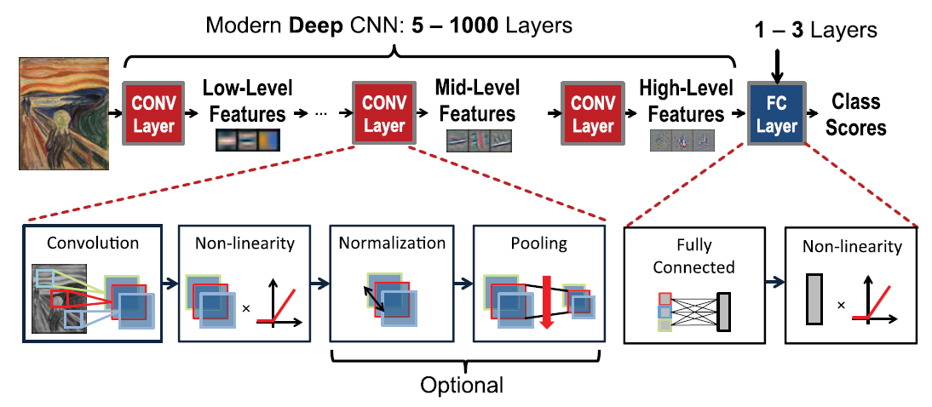
Convolutional Neural Network
Convolution alone accounts for more than 90% of CNNs’ computations.
Notes:
Another form of neural network is convolutional neural network which is mostly used for image recognition, classification and object detection. This network consists of multiple conv-layers and fully-connected layers. Inside the conv-layers there is a form of computation called convolution which passes multiple filters across the input image through sliding window method to extract important features of input image. The convolution accounts for more than 90% of overall time and energy consumption.
(CNN is also known as CONV net.)

Slide 24
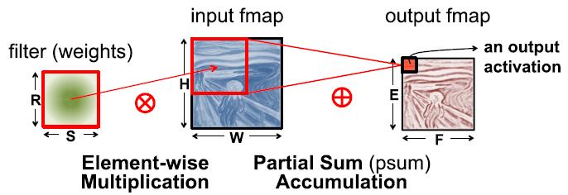
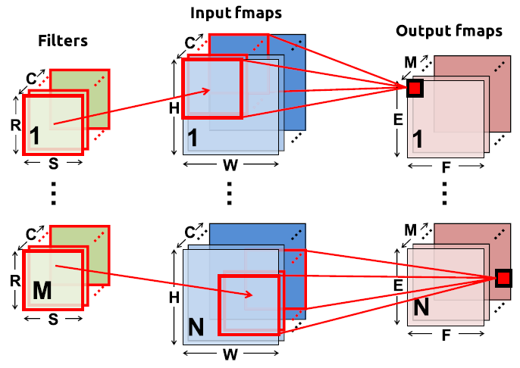
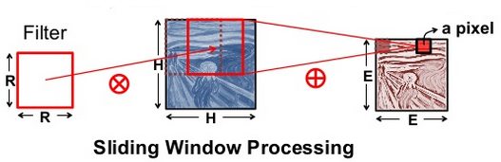
What is convolution?
2-D convolution in
traditional image processing
High dimensional convolutions
in convolutional neural network
Sze. et. al. Efficient Processing of Deep Neural Networks: A Tutorial and Survey Article in Proceedings of the IEEE · March 2017
Notes:
In the left picture, you can see 2dimensional convolution. It passes a filter across the input image, performs element-wise matrix multiplications and then sum all the results and then we have an output activation.
In next step it moves filter to another part of the image and preforms the same process for entire input image. In right image you can see high-dimensional convolution which applies multiple filters on multiple input image.
Input feature map(input Fmap)
Output feature map(output Fmap)

Slide 25
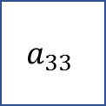
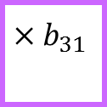
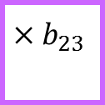
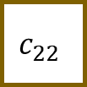












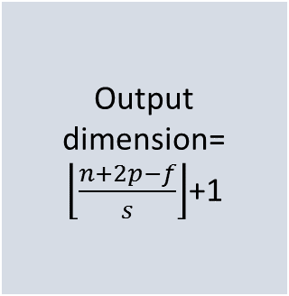




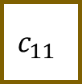








Convolution (cont.)
$${×b}_{11}$$
$${×b}_{12}$$
$${×b}_{13}$$
Output dimension=
$\left\lfloor \frac{n+2p−f}{s}\right\rfloor$+1
$$a_{11}$$
$$a_{12}$$
$$a_{13}$$
$$a_{14}$$
$$c_{11}$$
$$c_{12}$$
$$a_{21}$$
$$a_{22}$$
$$a_{23}$$
$$a_{24}$$
*
$${×b}_{21}$$
$${×b}_{22}$$
$${×b}_{23}$$
=
$$a_{31}$$
$$a_{32}$$
$$a_{33}$$
$$a_{34}$$
$$c_{21}$$
$$c_{22}$$
$$a_{41}$$
$$a_{42}$$
$$a_{43}$$
$$a_{44}$$
$${×b}_{31}$$
$${×b}_{32}$$
$${×b}_{33}$$
$$a_{11}$$
$${×b}_{11}$$
$$a_{12}$$
$${×b}_{12}$$
$${×b}_{11}$$
$$a_{13}$$
$${×b}_{13}$$
$${×b}_{12}$$
$$a_{14}$$
$${×b}_{13}$$
$c_{11}$=$b_{11}×a_{11}+b_{12}×a_{12}$+ $b_{13}×a_{13}$+ $b_{21}×a_{21}$+ $b_{22}×a_{22}$+ $b_{23}×a_{23}$+ $b_{31}×a_{31}$+ ${ b}_{32}×a_{32}$+ $b_{33}×a_{33}$
$$a_{21}$$
$${×b}_{21}$$
$${×b}_{11}$$
$$a_{22}$$
$${×b}_{22}$$
$${×b}_{21}$$
$${×b}_{12}$$
$${×b}_{11}$$
$$a_{23}$$
$${×b}_{23}$$
$${×b}_{22}$$
$${×b}_{13}$$
$${×b}_{12}$$
$$a_{24}$$
$${×b}_{23}$$
$${×b}_{13}$$
$c_{12}$=$b_{11}×a_{12}+b_{12}×a_{13}$+ $b_{13}×a_{14}$+ $b_{21}×a_{22}$+ $b_{22}×a_{23}$+ $b_{23}×a_{24}$+ $b_{31}×a_{32}$+ ${ b}_{32}×a_{33}$+ $b_{33}×a_{34}$
$$a_{31}$$
$${×b}_{31}$$
$${×b}_{21}$$
$$a_{32}$$
$${×b}_{32}$$
$${×b}_{31}$$
$${×b}_{22}$$
$${×b}_{21}$$
$$a_{33}$$
$${×b}_{33}$$
$${×b}_{32}$$
$${×b}_{23}$$
$${×b}_{22}$$
$$a_{34}$$
$${×b}_{33}$$
$${×b}_{23}$$
$c_{21}$=$b_{11}×a_{21}+b_{12}×a_{22}$+ $b_{13}×a_{23}$+ $b_{21}×a_{31}$+ $b_{22}×a_{32}$+ $b_{23}×a_{33}$+ $b_{31}×a_{41}$+ ${ b}_{32}×a_{42}$+ $b_{33}×a_{43}$
$$a_{41}$$
$${×b}_{31}$$
$$a_{42}$$
$${×b}_{32}$$
$${×b}_{31}$$
$$a_{43}$$
$${×b}_{33}$$
$${×b}_{32}$$
$$a_{44}$$
$${×b}_{33}$$
$c_{22}$=$b_{11}×a_{22}+b_{12}×a_{23}$+ $b_{13}×a_{24}$+ $b_{21}×a_{32}$+ $b_{22}×a_{33}$+ $b_{23}×a_{34}$+ $b_{31}×a_{42}$+ ${ b}_{32}×a_{43}$+ $b_{33}×a_{44}$
Notes:
Here we are showing the sliding window process and also, we are emphasizing that this process is nothing only some MAC operations.
The input is a 4*4 matrix, and the filter is 3*3. We perform the convolution and obtain the output matrix.
Output height = (Input height + padding height top + padding height bottom - kernel height) / (stride height) + 1
(4 + 2*0 -3)/1 + 1 = 2 2 by 2
The example below is taken from the lectures in deeplearning.ai shows that the result is the sum of the element-by-element product (or "element-wise multiplication". The red numbers represent the weights in the filter:
(1∗1)+(1∗0)+(1∗1)+(0∗0)+(1∗1)+(1∗0)+(0∗1)+(0∗0)+(1∗1)=1+0+1+0+1+0+0+0+1=4
enter image description here

Slide 26
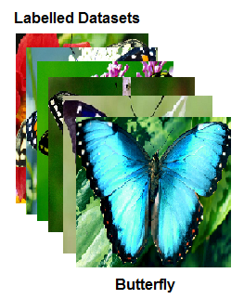
Training(learning)
A common machine learning algorithm or deep neural networks (DNNs) have two phases:
Training phase in neural networks is a one-time process based on two main functions: feedforward and back-propagation. The network goes through all instances of the training set and iteratively update the weights. At the end, this procedure yields a trained model.
Weight updating
Training phase
Notes:
There are two phases in neural network processing: training and inference.
For training a CNN classifier, we have lots of known and labeled images, feed them to the CNN and train it , after that we have a predicted model which can classify a new input image.

Slide 27







Inference(prediction)
Inference phase uses the learned model to classify new data samples. In this phase only feed-forward path is performed on input data.
Classification
Bird
$$P_{1}$$
Dog
$$P_{2}$$
$$⋯$$
Butter
fly
$$P_{3}$$
cat
$$P_{4}$$
$$⋯$$
convolution
Max pooling
Fully connected layers
Notes:
In the inference phase we are using the trained model. We take the trained CNN, apply a new image (which was not in the training set) to the network and get some output prediction with different probabilities. If the value of P3 is more than other probabilities, our CNN could predict the target correctly.
Typically, we train CNNs once on large GPU/FPGA cluster. In contrast, the inference is implemented each time a new data sample has to be classified. Therefore, the literature mostly focuses on accelerating the inference phase.

Slide 28
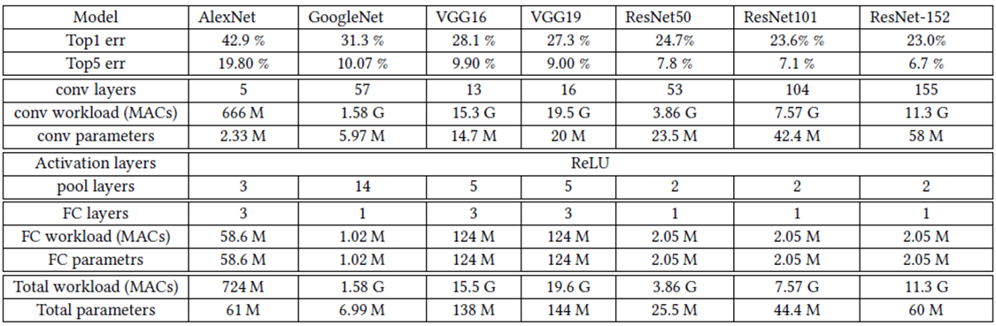
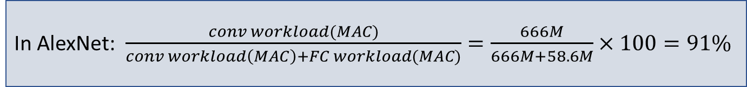
Workload of CNNs’ inference
The accuracy of CNN models have been increased at the price of high computational cost, because in these networks, there are a huge number of parameters and computational operations (MACs).
In AlexNet: $\frac{conv workload(MAC)}{conv workload\left(MAC\right)+FC workload(MAC)}=\frac{666M}{666M+58.6M}×100=91\%$
Notes:
In this figure you can see the accuracy of different CNNs and their total MAC operations and parameters. By looking the amount of these operation and parameters we can get the idea about the huge workload that these CNNs are facing. For efficiency of these networks finding ways that accelerate the computation and reduce the energy consumption are important.
Top5 means failing selecting correcting in its top 5 guesses

Slide 29
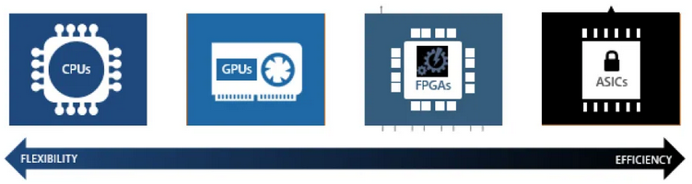
Devices for Deep neural network
CPUs have a few but complex cores. They are fast on sequential processing.
CPUs are good at fetching small amount of data quickly, but they are not suitable for big chunk of data.
Deep learning involves lots of matrix multiplications and convolutions, so it would take a long time to apply sequential computational approach on them.
We need to utilize architectures with high data bandwidth which can takes advantage of parallelism in DNNs.
Thus the trend is toward other three devices rather than CPUs to accelerate the training and inferencing.
CPU
Notes:
As you can see in above picture if we want to compare current DNNs hardware, we ‘ll have more efficiency from CPU toward ASIC while we’ll have less flexibility.
CPUs have one or multiple cores and they are good for sequential processing. They can fetch a small amount of data quickly. In the other hand, there are lots of huge matrix operations in DNNs (big chunk of data and lots of MAC operation which need parallel processing) so CPUs don’t seem a good choice for DNNs.

Slide 30
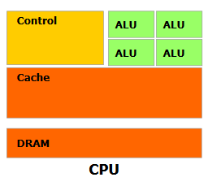
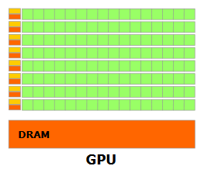
CPU vs. GPU
GPUs are designed for high parallel computations. They contain hundreds of cores that can handle many threads simultaneously. These threads execute in SIMD manner.
They can fetch high dimensional matrices in DNNs and perform the calculations in parallel.
They have high memory bandwidth, and they can fetch a large amount of data.
Designed for high-throughput:
Small caches
Simple control
Energy efficient ALUs
Latencies compensated by large number of threads
Designed for low-latency operation:
Large caches
Sophisticated control
Powerful ALUs
Notes:
GPUs contain hundreds of cores that can handle many threads simultaneously. Those threads execute the same instruction on different data elements. Basically those threads are executing in the SIMD manner.

Slide 31
RISC-V with Extensions for AI
Esperanto Technologies RISC-V to compete with GPUs
  47 basic RISC-V instructions with added vector instruction for VMM (8bit, 16bit FPT, and 32bit FPT)
  24 billion transistors @ 7nm at 570 sqmm
Ceremorphic
  RISC-V with ARM and custom accelerators
Intel Mobileye
  12 RISC-V with accelerator
  For Level 4 autonomous vehicles

Slide 32
Espranto Power Efficiency
Hot Chips 33, D. Ditzel, et al.
Notes:
Reducing the operating voltage to 0.75 V, the nominal
voltage in 7 nm, would result in 164 W, still way too high.
Just to get under 120 W on a single chip, we would
have to reduce the voltage down to about 0.67 V, but
then that one chip would use up the entire power budget.
If we operate at the best energy-efficiency point
(0.3 V), each chip will consume only 8.5 W, and six
chips will fit in the 120-W budget with room to spare.
With six chips the performance would be 2.5 times
better than the 118-W single-chip solution, and the
energy efficiency is 20 times better than trying to
operate at the highest voltage.

Slide 33
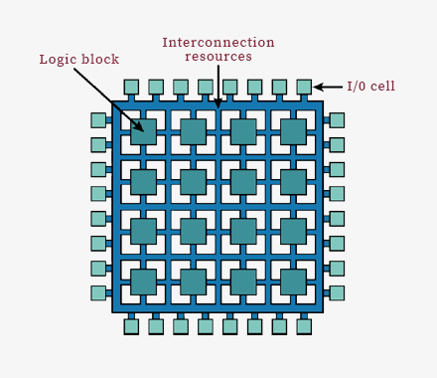
FPGAs for neural network
Field Programmable Gate Arrays (FPGAs) are semiconductor devices consist of configurable logic blocks connected via programmable interconnects. Because of their high energy-efficiency, computing capabilities and reconfigurability they are becoming the platform of choice for DNNs accelerators. E.g., Catapult Microsoft
GPU vs. FPGA :
Depending on the application data type (16 FP) and the GPU native supported data path (16 FP), it can have a better power efficiency than FPGAs.
programming a GPU is usually easier than FPGAs
According to flexibility of FPGAs, they can support various data type like binary or ternary data type.
Datapath in GPUs is SIMD while in FPGA user can configure a specific data path.
Notes:
If you want to use FPGA as hardware for DNNs, you must know how program a FPGA in addition to neural network knowledge. But for programming a GPU you need only neural network knowledge.
GPUs are good at floating point computation and if we want to use other simpler data types, using GPUs is not efficient because of their high-power consumption.
SIMD: Single Instruction and Multiple Data.

Slide 34
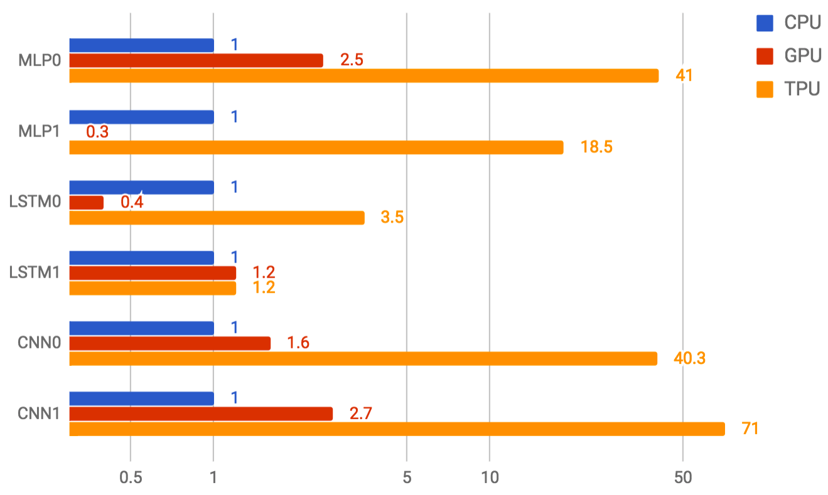
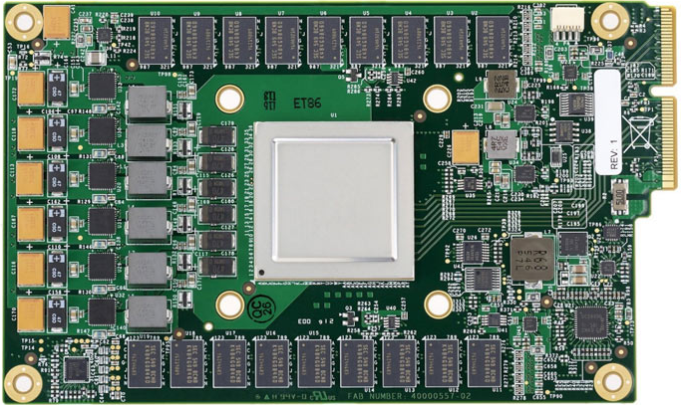
ASICs-based Neural Network Processors
GPUs and FPGAs perform better than CPUs for DNNs’ applications, but more efficiency can still be gained via an Application-Specific Integrated Circuit (ASIC).
ASICs are the least flexible but the most high-performance options. They can be designed for either training or inference.
They are most efficient in terms of performance/dollar and performance/watt but require huge investment costs that make them cost-effective only in very high-volume designs.
The first generation of Google’s Tensor Processing Unit (TPU) is a machine learning device which focuses on 8-bit integers for inference workloads. Tensor computations in TPU take advantage of systolic array.
Tensor Processing Unit (TPU)
CPU, GPU and TPU performance on six reference workloads

Slide 35
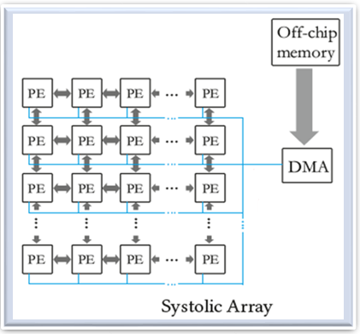
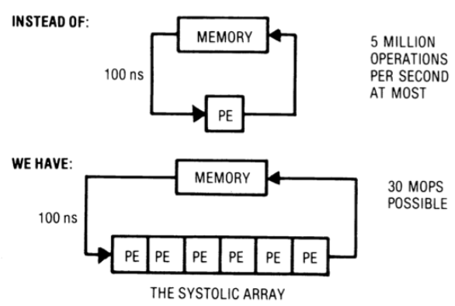
Systolic array
Idea: Data flows from the computer memory, passing through many processing elements before it returns to memory.
The principal for systolic array:
Notes:
Differences from pipelining:
These are individual PEs, they are not stages of instruction execution. (in pipelining each stage executes a piece of instruction, and each stage is not a processing element)
Array structure can be nonlinear and multi-dimensional. It can be 2 dimensional or 3 dimensional.
The connection between processing elements can be multidimensional. ( if you have a two-dimensional array of PEs, each PE can be connected to all its neighbors.)
Each PE can have local memory.

Slide 36


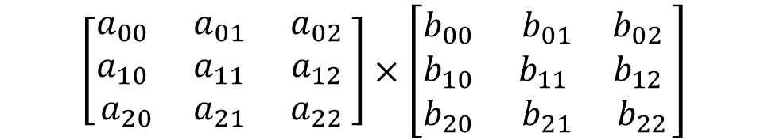
Systolic array
Assume we want to perform the matrix multiplication by a Systolic array:
$$Matrix A$$
$$Matrix B$$
$$\left[\begin{matrix}a_{00} & a_{01} & a_{02} \\ a_{10} & a_{11} & a_{12} \\ a_{20} & a_{21} & a_{22} \end{matrix}\right]×\left[\begin{matrix}b_{00} & b_{01} & b_{02} \\ b_{10} & b_{11} & b_{12} \\ b_{20} & b_{21} & b_{22}\end{matrix}\right]$$

Slide 37





















Systolic array
$$b_{22}$$
Columns $of B$
$$b_{21}$$
$$b_{12}$$
$$b_{20}$$
$$b_{11}$$
$$b_{02}$$
$$b_{10}$$
$$b_{01}$$
$$b_{00}$$
$$Rows of A$$
$$a_{00}$$
$$a_{02}$$
$$a_{01}$$
$$a_{12}$$
$$a_{11}$$
$$a_{10}$$
$$a_{22}$$
$$a_{21}$$
$$a_{20}$$
$$T=0$$

Slide 38





















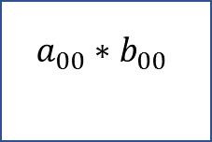
Systolic array
$$b_{22}$$
Columns $of B$
$$b_{21}$$
$$b_{12}$$
$$b_{20}$$
$$b_{11}$$
$$b_{02}$$
$$b_{10}$$
$$b_{01}$$
$$b_{00}$$
$$Rows of A$$
$$a_{00}$$
$$a_{00}∗b_{00}$$
$$a_{02}$$
$$a_{01}$$
$$a_{12}$$
$$a_{11}$$
$$a_{10}$$
$$a_{22}$$
$$a_{21}$$
$$a_{20}$$
$$T=1$$

Slide 39























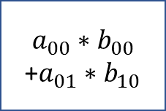
Systolic array
$$b_{22}$$
Columns $of B$
$$b_{21}$$
$$b_{12}$$
$$b_{20}$$
$$b_{11}$$
$$b_{02}$$
$$Rows of A$$
$$b_{10}$$
$$b_{01}$$
$$a_{02}$$
$$a_{01}$$
$$a_{00}∗b_{00}$$
+$a_{01}∗b_{10}$
$$a_{00}$$
$$a_{00}∗b_{01}$$
$$b_{00}$$
$$a_{10}$$
$$a_{12}$$
$$a_{11}$$
$$a_{10}∗b_{00}$$
$$a_{22}$$
$$a_{21}$$
$$a_{20}$$
$$T=2$$

Slide 40


























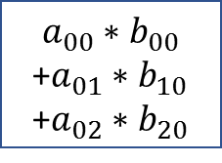


Systolic array
$$b_{22}$$
Columns $of B$
$$b_{21}$$
$$b_{12}$$
$$b_{20}$$
$$b_{11}$$
$$b_{02}$$
$$Rows of A$$
$$a_{02}$$
$$a_{00}∗b_{00}$$
+$a_{01}∗b_{10}$
+$a_{02}∗b_{20}$
$$a_{01}$$
$$a_{00}∗b_{01}$$
$$a_{00}$$
$$a_{00}∗b_{02}$$
$${+a}_{01}∗b_{11}$$
$$b_{10}$$
$$b_{01}$$
$$a_{11}$$
$$a_{10}$$
$$a_{10}∗b_{01}$$
$$a_{12}$$
$$a_{10}∗b_{00}$$
$${+a}_{11}∗b_{10}$$
$$b_{00}$$
$$a_{20}$$
$$a_{20}∗b_{00}$$
$$a_{22}$$
$$a_{21}$$
$$T=3$$

Slide 41



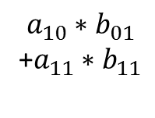

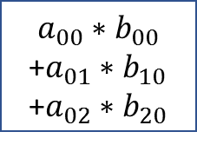



























Systolic array
Columns $of B$
$$b_{22}$$
$$b_{21}$$
$$b_{12}$$
$$Rows of A$$
$$a_{00}∗b_{00}$$
+$a_{01}∗b_{10}$
+$a_{02}∗b_{20}$
$$a_{02}$$
$$a_{00}∗b_{01}$$
$$a_{01}$$
$$+a_{01}∗b_{11}$$
$$a_{00}∗b_{02}$$
$$a_{02}∗b_{21}$$
$${+a}_{01}∗b_{12}$$
$$b_{20}$$
$$b_{11}$$
$$b_{02}$$
$$a_{12}$$
$$a_{10}∗b_{00}$$
$$a_{11}$$
$$a_{10}∗b_{01}$$
+$a_{11}∗b_{11}$
$$a_{10}$$
$${+a}_{11}∗b_{10}$$
$$a_{10}∗b_{02}$$
$${+a}_{12}∗b_{20}$$
$$b_{10}$$
$$b_{01}$$
$$a_{21}$$
$$a_{20}∗b_{00}$$
$$a_{20}$$
$$a_{20}∗b_{01}$$
$$a_{22}$$
$${+a}_{21}∗b_{10}$$
$$T=4$$

Slide 42





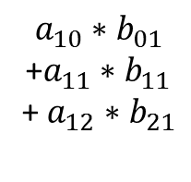



























Systolic array
Columns $of B$
$$b_{22}$$
$$Rows of A$$
$$a_{00}∗b_{00}$$
+$a_{01}∗b_{10}$
+$a_{02}∗b_{20}$
$$a_{00}∗b_{01}$$
$$a_{02}$$
$$a_{00}∗b_{02}$$
$$+a_{01}∗b_{11}$$
$${+a}_{01}∗b_{12}$$
$$a_{02}∗b_{21}$$
$${+a}_{02}∗b_{22}$$
$$b_{21}$$
$$b_{12}$$
$$a_{10}∗b_{00}$$
$$a_{12}$$
$$a_{10}∗b_{01}$$
+$a_{11}∗b_{11}$
+ $a_{12}∗b_{21}$
$$a_{11}$$
$${+a}_{11}∗b_{10}$$
$$a_{10}∗b_{02}$$
$${+a}_{12}∗b_{20}$$
$${+a}_{11}∗b_{12}$$
$$b_{20}$$
$$b_{11}$$
$$b_{02}$$
$$a_{22}$$
$$a_{20}∗b_{00}$$
$$a_{21}$$
$$a_{20}∗b_{01}$$
$$a_{20}$$
$$a_{20}∗b_{02}$$
$${+a}_{21}∗b_{10}$$
$${+a}_{22}∗b_{20}$$
$$T=5$$
$$a_{21}∗b_{11}$$

Slide 43



























Systolic array
Columns $of B$
$$Rows of A$$
$$a_{00}∗b_{00}$$
+$a_{01}∗b_{10}$
+$a_{02}∗b_{20}$
$$a_{00}∗b_{01}$$
$$a_{00}∗b_{02}$$
$$+a_{01}∗b_{11}$$
$${+a}_{01}∗b_{12}$$
$${+a}_{02}∗b_{21}$$
$${+a}_{02}∗b_{22}$$
$$b_{22}$$
$$a_{10}∗b_{00}$$
$$a_{10}∗b_{01}$$
+$a_{11}∗b_{11}$
+ $a_{12}∗b_{21}$
$$a_{12}$$
$$a_{10}∗b_{02}$$
$${+a}_{11}∗b_{10}$$
$${+a}_{11}∗b_{12}$$
$${+a}_{12}∗b_{22}$$
$${+a}_{12}∗b_{20}$$
$$b_{21}$$
$$b_{12}$$
$$a_{20}∗b_{00}$$
$$a_{22}$$
$$a_{20}∗b_{01}$$
$$a_{21}$$
$${+a}_{21}∗b_{11}$$
$${+a}_{22}∗b_{21}$$
$$a_{20}∗b_{02}$$
$${+a}_{21}∗b_{12}$$
$${+a}_{21}∗b_{10}$$
$${+a}_{22}∗b_{20}$$
$$T=6$$

Slide 44
























Systolic array
Columns $of B$
$$Rows of A$$
$$a_{00}∗b_{00}$$
+$a_{01}∗b_{10}$
+$a_{02}∗b_{20}$
$$a_{00}∗b_{01}$$
$$a_{00}∗b_{02}$$
$$+a_{01}∗b_{11}$$
$${+a}_{01}∗b_{12}$$
$${+a}_{02}∗b_{21}$$
$${+a}_{02}∗b_{22}$$
$$a_{10}∗b_{00}$$
$$a_{10}∗b_{01}$$
+$a_{11}∗b_{11}$
+ $a_{12}∗b_{21}$
$$a_{10}∗b_{02}$$
$${+a}_{11}∗b_{10}$$
$${+a}_{11}∗b_{12}$$
$${+a}_{12}∗b_{22}$$
$${+a}_{12}∗b_{20}$$
$$b_{22}$$
$$a_{20}∗b_{00}$$
$$a_{20}∗b_{01}$$
$$a_{22}$$
$$a_{20}∗b_{02}$$
$${+a}_{21}∗b_{12}$$
$${+a}_{22}∗b_{22}$$
$${+a}_{21}∗b_{10}$$
$${+a}_{22}∗b_{20}$$
$${+a}_{21}∗b_{11}$$
$${+a}_{22}∗b_{21}$$
$$T=7$$
Notes:
On the TPU V2 board there are four TPU chips and within a single TPU chip, there are two TPU cores.
They use High Bandwidth Memory because the memory bandwidth requirement of matrix multiplication is high.
TPU can be used for training and inference.
Each TPU core has scalar, vector and matrix units (MXU).

Slide 45

Memory Access is Energy Hog

Slide 46


Data access in DNN
How can we have energy efficient device?
DNNs have lots of parameters and MAC operations. The parameters have to be stored in external memory (DRAM).
Each MAC operation requires three memory accesses to be performed.
DRAM accesses require up to several orders of magnitude higher energy consumption than MAC computation.
Thus, If all accesses go to the DRAM, the latency and energy consumption of the data transfer may exceed the computation itself.
energy cost of data movement in different level of memory hierarchy.
Notes:
We discuss the memory access energy is high. Now we will see how we can utilize the architecture with memory hierarchy for energy efficient CNNs accelerators.
The actual bottle neck is how we access data.
For each multiply and accumulate unit, we have to read three pieces of data from memory and then we need to push the result back to the memory.

Slide 47


Data reuse opportunities in CNN
To reduce energy consumption of data movement, every time a piece of data is moved from an expensive level to a lower cost memory level , the system should reuse the data as much as possible.
In convolutional neural network, we can consider three forms of data reuse:
1.Convolutional reuse:
The same input feature map activations and filter weights are used within a given channel, just in different combinations for different weighted sums.
Reuse: $\left\{\begin{matrix}Activations \\ Filter weights\end{matrix}\right.$
Notes:
In the previous slide we saw the energy consumption of memory hierarchy and figured out that reading and writing on external memory (data movement toward DRAM) is expensive. So , we are looking to find ways to minimize DRAM access. In other words, every time that a piece of data is moved from an expensive level to a lower cost memory level, we want to reuse it as much as possible.
Here, there are three ways to reuse the data in CNN computation.

Slide 48




Data reuse opportunities in CNN (cont.)
Reuse: $Activations$
2.Feature map reuse
When multiple filters are applied to the same feature map, the input feature map activations are used multiple times across filters.
3.Filter reuse
When the same filter weights are used multiple times across input features maps.
Multiple input frames/images can be simultaneously processed.
Reuse: $Filter weights$
Notes:
For example: if we could take advantage of these data reuse opportunities, the DRAM accesses in AlexNet can be reduced from 2896M to 61M accesses. This will increase energy efficiency.

Slide 49


Compression
Compression methods try to reduce the number of weights or reduce the number of bits used for each activation or weight. This technique lowers down the computation and storage requirements.
Quantization
Quantization or reduced precision approach allocates the smaller number of bits for representing weight and activations.
Uniformed quantization:
It uses a mapping function with uniform distance between each quantization level.
Nonuniformed quantization: The distribution of the weights and activations are not uniform so nonuniform quantization, where the spacing between the quantization levels vary, can improve accuracy in comparison to uniformed quantization.
Log domain quantization : quantization levels are assigned based on logarithmic distribution.
Learned quantization or weight sharing
Notes:
Large size of deep neural networks model is an issue because we can not fit them on devices such as cell phones.
The second problem of those large models is that the training speed is extremely slow.
The third problem of those large models is energy efficiency. Large models basically mean more memory references which result in more energy consumption.

Slide 50
Quantization (cont.)
Learned quantization or weight sharing: weight sharing forces several weights to share a single value so it will reduce the number of unique weights that we need to store. Weights can be grouped together using a k-means algorithm, and one value assigned to each group.
weights (32-bit float)
cluster index (2-bit float)
2.09
-0.98
1.48
0.09
3
0
2
1
2.00
3:
0.05
-0.14
-1.08
2.12
1
1
0
3
1.50
clustering
2:
-0.91
1.92
0
-1.03
0
3
1
0
0.00
1:
1.87
0
1.53
1.49
3
1
2
2
-1.00
0:
Note: the quantization can be fixed or variable.
Bitwidth of the group index = $\log_{2} (the number of unique weights)$
Notes:
(2.09, 2.12, 1.92, 1.87 )all the blue square values are in one group and their value is saved in index3.
So we need to store the two bits index rather than the 32 bits floating point number. ( We need only two bits to represent each number)
We can do both pruning and quantization on the model.
It should be mentioned that the quantization can be fixed ( when the same method is used for all data types and layers, filters, and channels in the network) or it can be variable ( different methods of quantization can be used for weights and activations, and different layers, filters, and channels in the networks)

Slide 51

Quantization

Slide 52

Pruning
What is neural network pruning?
Pruning algorithms reduce the size of the neural networks by removing unnecessary weights and activations.
It can make neural network more power and memory efficient, and faster at inference with minimum loss in accuracy.
Synapses and neurons before and after pruning
Procedure of pruning
Consider a network and train it
Prune Connections
Repeat this step iteratively
Train the remaining weights
It gives smaller model without losing accuracy
Han et. al.
Notes:
One way of Pruning is to prune the low-weight connections. All connections with weights below a threshold are removed from the network, converting a dense network into a sparse network.
Then we should retrain the network to learn the final weights for the remaining sparse connections. This step is critical. If we use pruned network without retraining, accuracy is significantly impacted.
Example: by pruning we could reduce the AlexNet parameters from 60 Million to 6 Million which means ten times less computations.

Slide 53


Pruning (cont.)
Network pruning can reduce parameters without drop in performance.
Comparing l1 and l2 regularization with and without retraining.
Han et.al. Learning both Weights and Connections for Efficient Neural Networks, NeurIPS, 2015
Notes:
For example, the purple line shows the accuracy drops by 4.5 percent when we prune the 80percent of the parameters. But if we retrain the remaining weights the accuracy can be recovered. (which is shown in green line). If we continue training and retraining, we can prune away 90 percent of the parameters and still have the same accuracy.(red line in the figure).

Slide 54
Edge versus Data Center
Computer Vol. 54, No.1, 2021

Slide 55
Energy Efficiency of Edge AI Chips as a function of Computational Precision
Computer Vol. 54, No.1, 2021

Slide 56
Edge Device Requirements
Trained neural network models are deployed on edge devices for inference
  Energy Efficiency
  Limited Hardware Resources
  Latency
  Cost
Edge devices must also be secured, many cryptographic algorithms require true random number generation
  Traditional RNG hardware units are non-trivial and not power efficient
  RRAM switching is inherently stochastic this behaviour can be exploited for random number generation

Slide 57

VMM operations with NVM Crossbar arrays
Key Points
In memory computation
  Model weights do not require separate storage
Low Power
Suitable for inference deployment
Acceptable accuracy
DAC/ADC units do add overheads

Slide 58
Which NVM device is the most suitable for crossbar arrays?
Crossbar arrays can be constructed with many types of nonvolatile memories which have programmable resistances.
Resistive RAM
Phase Change Memory
ECRAM
NOR/NAND Flash cells
MRAM
STT-RAM
Which technology is ideal for neural network acceleration on edge?

Slide 59

Applications of RRAM in Edge Devices
RRAM is a storage class Non Volatile Memory
  Resistance is programmable
  Stochastic
  Stable for 10+years
RRAM is compatible with back end of line (BEOL) CMOS processes
  Typically consists of a metal oxide layer sandwiched between metal layers
Potential Applications of RRAM
  Storage Devices
  Vector-Matrix Computations
  Compute In Memory
  Random Number Generation for security

Slide 60


Random Number Generation
Switching of RRAM devices are stochastic thus an array of RRAM devices can be programmed with pulses resulting in an random number of devices switching
Used for:
PUFs
Hash Functions
Notes:
Application of Resistive Random Access Memory in
Hardware Security: A Review
Gokulnath Rajendran, Writam Banerjee,* Anupam Chattopadhyay,*
and Mohamed M. Sabry Aly

Slide 61


Overview of Usage
Mythic AI an analog hardware acceleration company uses NOR flash cells
IBM has published extensive research on PCM devices
Finding new metal oxides for RRAM devices is an active research area
The device that will win consumes little power, physically small, has little device to device variations, and has multiple bits of resolution.

Slide 62
Conclusions and Final Remarks
New applications related to ML are having a major impact on the design of future computer systems.
Many architectural ideas some old and some new are being applied to meet the computation needs of ML
The main computation thread is matrix-vector multiplication
Some of the target domains, as is the case for edge platforms, need low power and efficient implementations, such as NVM
Hybrid accelerators are most likely the future of computing for ML

