Slide 1
Nonlinear methods of analysis of electrophysiological data and Machine learning methods application in clinical practice
Dr Milena Čukić
Dpt. General Physiology with Biophysics
University of Belgrade, Serbia

Slide 2
Complex dynamics of living systems
Living organisms are complex both in their structures and functions. Parameters of human physiological functions such as arterial blood pressure (Blaber et al 1996), breathing (Dirksen et al 1998) and heart rate (Huikuri et al 2000), etc, are not stable but do fluctuate in time (Glass 2001). The actual pattern of these fluctuations results from an interaction between disturbances from the external or internal environments and actions on the part of control mechanisms attempting to maintain the equilibrium state of the system. The actual value of a parameter is measured by some form of a receptor whose signal is then compared by
a control centre to an internal reference value, the set-point. The difference in the two, the error signal, determines the direction and magnitude of change that brings the actual value of the controlled parameter near the set-point. The homeostatic view of physiological control places emphasis on the constancy of the controlled parameter in spite of its evident fluctuations around the set-point. Temporal fluctuations, however, can also result from intrinsic sources, such as the activity of organism or ageing both affecting the set-point to varying extent. Hence the hemodynamic concept of physiological control seems more realistic (Goodwin 1997).
Understanding the actual mechanisms involved is usually attempted in two ways:
(i) the reductionistic approach identifies the elements of the system and attempts to determine the nature of their interactions;
(ii) the holistic approach looks at detailed records of the variations of the controlled parameter(s) and seeks a consistent pattern indicative of the presence of a control scheme. These approaches are not mutually exclusive; they are indeed often used together. Both use mathematical (e.g. statistical) methods and lately mathematical models for rendering the findings conclusive or shaping and strengthening the hypotheses.

Slide 3
Complexity
Fluctuations in physiological systems are nonperiodic. Stochastic, chaotic and noisy chaotic models can mathematically treat these patterns. The stochastic (random) models assume that the fluctuations result from a large number of weak influences. The chaotic models conceptualize that strong nonlinear interactions between a few factors shape the fluctuations. A combination of these two into the noisy chaotic model is possible. Among the stochastic approaches, the fractal models give the best description of reality. In this review we concentrate on the fractal analysis of time series capturing the nonperiodic fluctuations of physiological systems.
The classic theory of homeostasis focused on the set-point as determined by the mean of the physiological signal, the fluctuations around the mean were thus discarded as ‘noise’.
Research of the last decades revealed that the homeodynamic and holistic concepts, such as fractal and nonlinear analyses could be very useful in understanding the complexity of physiological functions.

Slide 4
Physiological complexity
Researches revealed that :
(1) physiological processes can operate far from equilibrium;
(2) their fluctuations exhibit a long-range correlation that extends across many time scales;
(3) and underlying dynamics can be highly nonlinear ‘driven by’ deterministic chaos.
In our view the fractal and chaotic approaches are not mutually exclusive, because they present two ways of looking at physiological complexity (Bassingthwaighte et al 1994).
The fractal approach is aimed at demonstrating the presence of scale-invariant self-similar features (correlation, memory) in a detailed record of temporal variations of a physiological parameter, while the very same record can also be analysed according to the concept of deterministic chaos attempting to find the minimal set of often simple differential equations capable of
producing the erratic, random dynamics of time series on deterministic grounds.

Slide 5
An overview of nonlinear dynamics
Fundamental concepts
System may be defined as an orderly working totality, a set of units combined by nature, by science, or by art to form a whole.
System is not just a set of elements but includes also interactions between both the system’s elements and with the ‘external world’.
Interactions may be static or dynamic i.e. through an exchange of mass, energy, electric charge or through exchange of information
A living organism is an open system, supplied with free energy from biochemical reactions. There are also effects of information interactions.
In physics state of a system in a given moment of time is characterized by values of state variables (at this moment).
The minimum number of independent state variables that are necessary to characterize the system's state is called the number of degrees of freedom of the system. If a system has n degrees of freedom then any state of the system may be characterized by a point in an n-dimensional space with appropriately defined coordinates, called the system's phase space

Slide 6
Fundamental concepts and definitions
Process is defined as a series of gradual changes in a system that succeed one another. Every process exhibits a characteristic time, τ, that defines the time scale for this process. In the system's phase space a process is represented by a series of connected points called trajectory.
Attractor is a subset of the system's phase space that attracts trajectories (i.e. the system tends towards the states that belong to some attractor).
Signal is a detectable physical quantity or impulse (as a voltage, current, magnetic field strength) by which information can be transmitted from a given system to other systems, e.g. to a measuring device (EEG, ECG, EMG)
Noise is any unwanted signal that interferes with the desired signal

Slide 7
Nonlinear vs linear
Linearity in science means more or less the same as proportionality or additivity. But linearity has its limits. (Nonlinearity-nonadditivity)
Reductionism, a methodological attitude of explaining properties of a system through properties of its elements alone, may work only for linear systems.
Some systems have properties that depend more on the
way how the elements are connected than on what the specific properties of individual elements are.
Far from equilibrium vs equilibrium: Thermodynamic equilibrium means a complete lack of differences between different parts of the system and, as a consequence, a complete lack of changes in the system – all processes are stopped. 'Living' states of any system are nonequilibrium states.
Equilibrium, the unique state when all properties are equally distributed, is the state of 'death'. It is true not just for a single cell or an organism. In the systems being close to equilibrium one can observe linear processes while in the systems being far from equilibrium processes are nonlinear. Life appears to be a nonlinear phenomenon

Slide 8
Nonstationarity vs stationarity
Stationarity of a signal means that the signal, and so the time series representing this signal, has the same mean and variance throughout. Stationarity does not mean constancy – stationary signal may be changeable like e.g. voltage in alternating current outlets.
Nonstationarity means that signal's statistical characteristics change with time. In statistics nonstationary mean time series refer to time series whose average or mean value is not constant, like in time series with trends or seasonalities; nonstationary covariance time series are time series whose correlation or covariance changes with time
Biosignals are usually nonstationary (if source of a signal changes with time then the signal is obviously nonstationary)

Slide 9
Stochastic vs Deterministic
Deterministic means more or less the same as predictable. If a system is deterministic one can predict the system's future states. Deterministic systems are either characterized by sufficiently small number of degrees of freedom or some state variables are of negligible importance compared to those of the greatest importance.
Deterministic systems are modelled by linear ordinary differential equations (ODE). But to use a model of a deterministic system one needs to know exactly its initial conditions, i.e. the exact values of state variables at the initial moment t = t0, and exact values of systems parameters.
Stochastic means nondeterministic, nonpredictable. Stochastic system has a very big number of degrees of freedom of similar importance.
So, the difference between deterministic and stochastic system is rather quantitative (number of equally important degrees of freedom) than qualitative.
Stochastic systems are modelled using probability theory. They used also to be called chaotic.

Slide 10
Nonlinear dynamics, deterministic chaos, fractals
  Sensitivity to initial conditions
Nonlinear dynamics is the theory of nonlinear systems and processes, those where result is not proportional to the cause.
Nonlinear dynamics includes theory of deterministic chaos. Chaotic systems behave like there were stochastic but in fact they are deterministic. They show predictability in a short-time-scale but non-predictability in a long-time scale due to extremely high sensitivity to initial conditions and to system's parameters.
Example of deterministic chaos / Lorenz attractor (ODE vs QLODE)-extreme sensitivity to small changes in initial conditions
Chaotic systems are inherently connected with fractals and fractal geometry. When represented in a phase space chaotic systems shows so called strange attractors
Shortcomings of linear methods of biosignal analysis
Linear methods are rooted in medical tradition, nonlinear methods are not

Slide 11
Nonlinear Biomedical Physics-examples of application
Monitoring the depth of anesthesia and of sedation
Monitoring the phases of sleep
Bright light therapy and seasonal Affective disorder
Monitoring the phases of depression
Early detection of Epileptic seizures
Determining drowsiness from sleep
Sub-epileptic events in children
Early prediction of Parkinson’s disease
Classification of depressive patients
Differentiation of kinds of tremors
Analysis of posturographic signals
Evoked EEG and photo-stimulation
Influence of electromagnetic fields (or different kinds of electromagnetic stimulation)

Slide 12
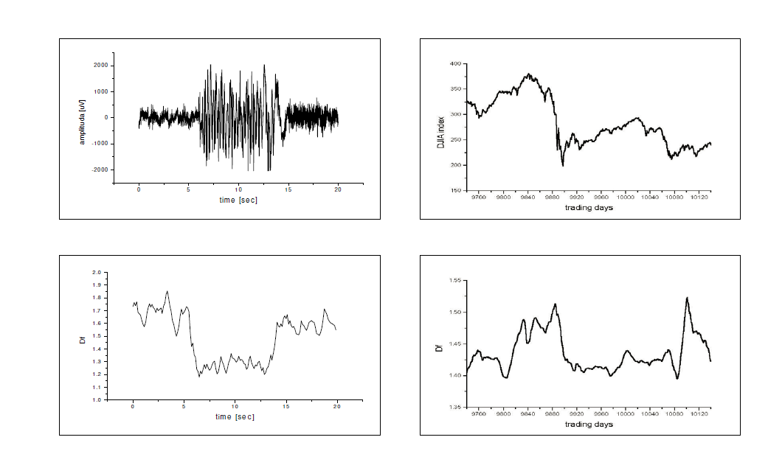
An example of FD use: left, and epileptic seizure, and right, Dow Jones index from period of a ‘big crash’ (Klonowski, 2007)

Slide 13
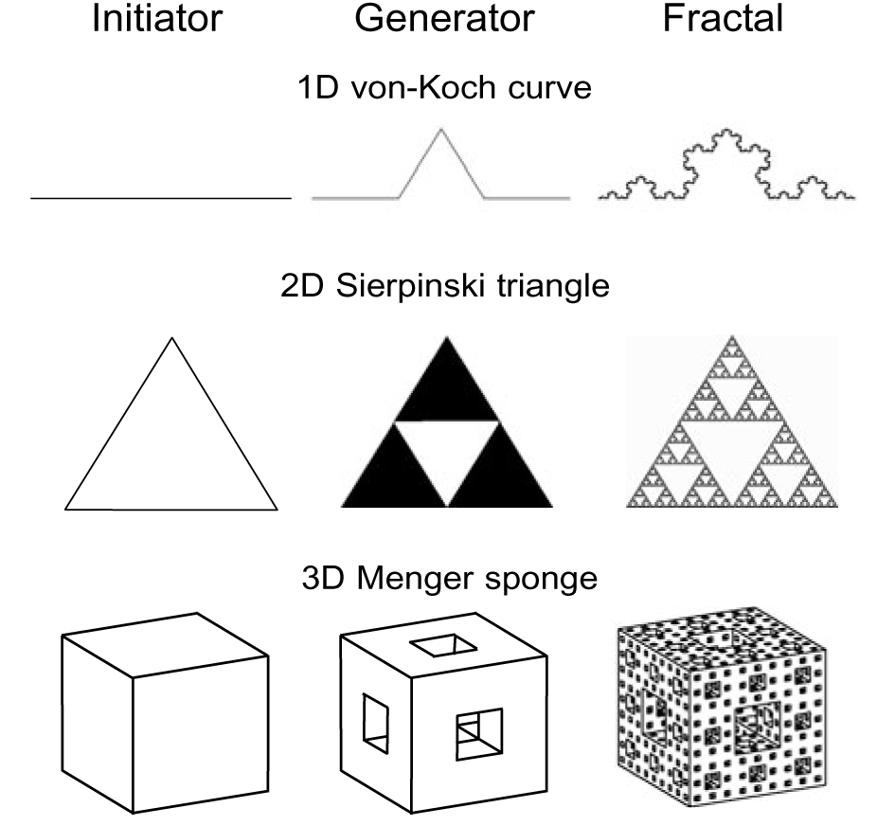
Concept of fractal geometry
Fractal geometry is rooted in the works of late 19th
and early 20th century mathematicians who found their fancy in generating complex geometrical structures from simple objects like a line, a triangle, a square, or a cube (the initiator) by applying a simple rule of transformation (the generator) in an infinite number of iterative steps.
The complex structure that resulted from this iterative process proved equally rich in detail at every scale of observation, andwhen their pieces were compared to larger pieces or to those of the whole, they proved similar to each other (see von Koch curve, Sierpinski gasket, Menger sponge (figure 1), Cantor set, Peano and Hilbert curve (Peitgen et al 1992)).
These peculiar-looking geometrical structures lay dormant until Benoit Mandelbrot realized that they represent a new breed of geometry suitable to describe the essence in the complex shapes and forms of nature (Mandelbrot 1982). Indeed, traditional Euclidean geometry with its primitive forms cannot describe the elaborated forms of natural objects.

Slide 14


Concept of fractal geometry
As Mandelbrot (1982) put it: ‘Clouds are not spheres, mountains are not cones, coastlines are not circles, and bark is not smooth, nor does lightning travel in a straight line.’
Euclidean geometry can handle complex structures only by breaking them down into a large number of Euclidean objects assembled according to an equally large set of corresponding spatial coordinates. The complex structure is thus converted to an equally complex set of numbers unsuitable to grab the essence of a design or to characterize its complexity. In nature, similarly
to the iterative process of the von Koch curve, complex forms and structures, such as a tree, begin to take shape as a simple nitiator, the first sprout that is, and evolve by reapplying the coded rule of the generator by branching dichotomously over several spatial scales. A holistic geometrical description of a tree is thus possible by defining the starting condition (initiator),the rule of morphogenesis (generator) and the number of scales to which this rule should be applied (scaling interval).

Slide 15
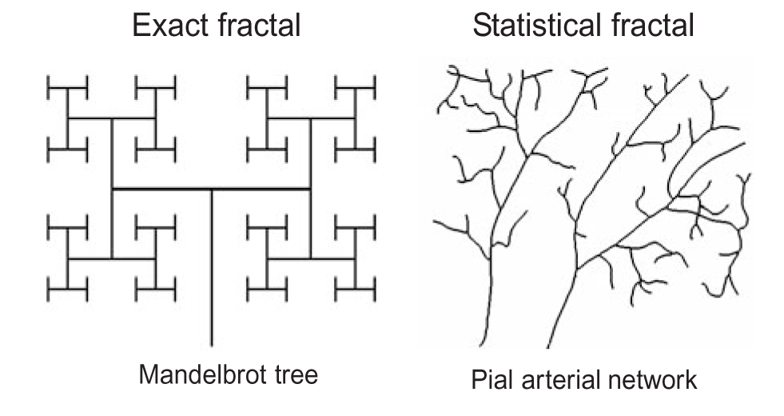
Properties of fractal structures and processes
Unlike Euclidean geometry that applies axioms and rules to describe an object of integer dimensions (1, 2 and 3), the complex geometrical objects mentioned above can be characterized
by recursive algorithms that extend the use of dimension to the noninteger range (Herm´an et al 2001).
Hence, Mandelbrot named these complex structures fractals emphasizing their fragmented character, and the geometry that describes them as fractal geometry using the Latin word ‘fractus’ (broken, fragmented). Fractals cannot be defined by axioms but as a set of properties instead, whose presence indicates that the observed structure is indeed fractal (Falconer 1990).
An exact fractal is assembled from pieces that are an exact replica of the whole, unlike the case of statistical fractals where exact self-similar elements cannot be recognized. These structures, like the skeletonized arborization of a pial arterial tree running along the brain cortex of the cat, are fractals, too, but their self-similarity is manifested in the power law scaling of the parameters characterizing their structures at different scales of observation

Slide 16
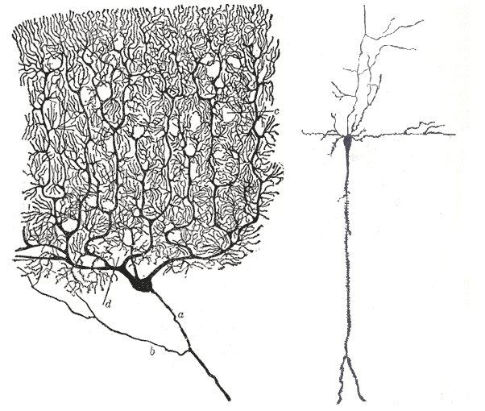
Self-similarity
Pieces of a fractal object when enlarged
are similar to larger pieces or to that of the whole. If these pieces are an identical rescaled replica of the other, the fractal is exact (previous fig.).
When the similarity is present only in between statistical populations of observations of a given feature made at different scales, the fractal is statistical. Mathematical fractals such as the Cantor set or the von Koch curve are exact; most natural fractal objects are statistical.
Self-similarity needs to be distinguished from self-affinity. Self-similar objects are isotropic; i.e. the scaling is identical in all directions, therefore when self-similarity is to be demonstrated the pieces should be enlarged uniformly in all directions. Self-affine objects are also fractals, but scaling is anisotropic, i.e. in one direction the proportions between the enlarged pieces are different from those in the other. This distinction is, however, often smeared and for the purpose of being more expressive, self-similarity is used when self-affinity is meant (Beran 1994).
Formally, physiological time series are self-affine temporal structures,because the units of their amplitude is not time (figure 3) (Eke et al 2000).

Slide 17
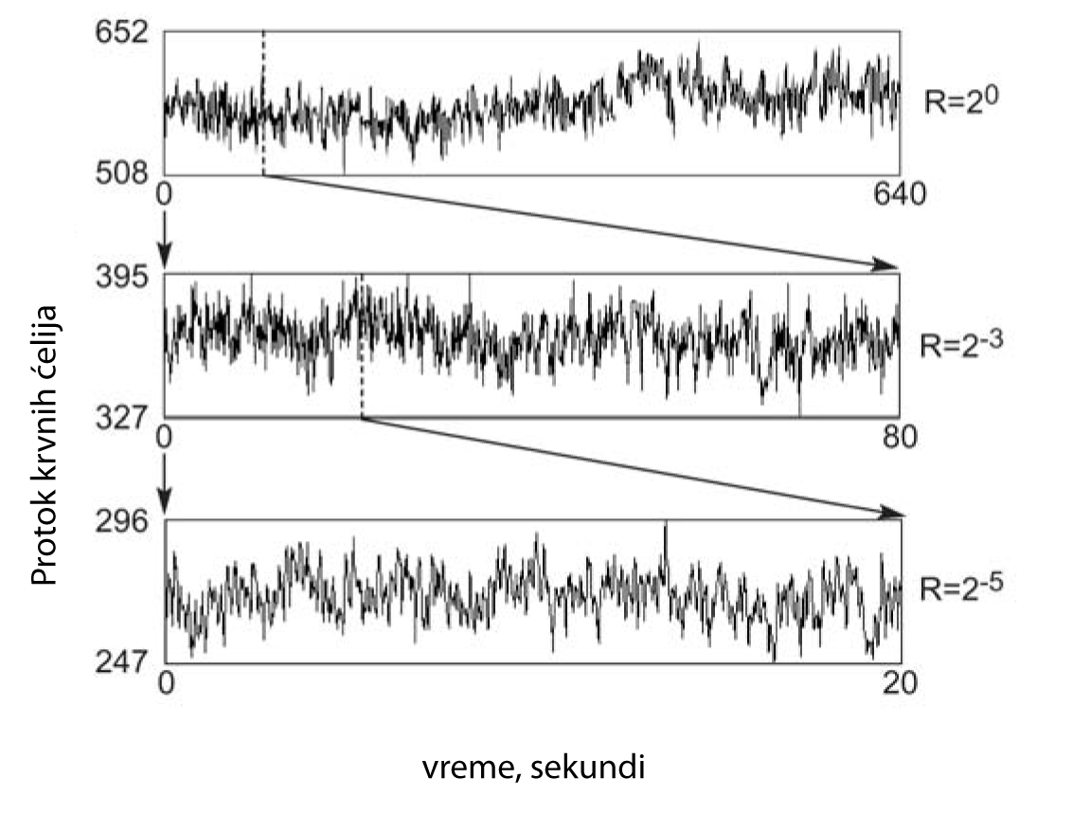
Power law scaling relationship
When a quantitative property, q, is measured in quantities of s (or on scale s, or with a precision s), its value depends on s according to the following scaling relationship:
q = f (s)
When the object is not fractal, the estimates of q using progressively smaller units of measure, s, converge to a single value. (Consider a square of 1×1m, where q is its diagonal. Estimates of q in this case converge to the value of √2 m.)
For fractals, q does not converge but, instead exhibits a power law scaling relationship with s, whereby with decreasing s it increases without any limit
q = psε
where p is a factor of proportionality (prefactor) and ε is a negative number, the scaling exponent. The value of ε can be easily determined as the slope of the linear regression fit to the data pairs on the plot of logq versus log s:
log q = log p + ε log s. (3)
Data points for exact fractals are lined up along the regression slope, whereas those of statistical fractals scatter around it since the two sides of equation (3) are equal only in distribution.
Self-affinity of temporal statistical fractals. Fractals exist in space and time. Here, blood
cell perfusion time series monitored by laser-Doppler flowmetry (LDF) from the brain cortex of an anesthetized rat is shown (Eke et al 2000). The first 640 elements of the 217 elements of the LDF time series are shown that were 3.2 s long in real time. Note the spontaneous, seemingly random (uncorrelated) fluctuation of this parameter. Scale-independent, fractal temporal patterns in these blood cell perfusion fluctuations can be revealed. Compare the segments of this perfusion time series, displayed at different resolutions given by R shown on the right. If any enlarged segment of the series is observed at scale s = 1/R and its amplitude is rescaled by RH, where H is the Hurst coefficient, the enlarged segment is seen to look like the original. The impression is that the segments have a similar appearance irrespective of the timescale at which the signal is being observed. The degree of randomness resulting from the range of excursions around the signal mean blending different frequencies into a random pattern, indeed seems similar. Because scaling for this structure is anisotropic in that in one direction (time) the proportions between the enlarged
pieces is different than in the other (amplitude of perfusion), this structure is not self-similar but
self-affine. (For this particular time series H = 0.23.)

Slide 18
Scaling range
For natural fractals scale-invariance holds only for a restricted range of the absolute scale (Avnir et al 1998) and these fractals are often referred to as prefractals (Bassingthwaighte et al 1994).
The upper limit of validity,or the upper cut-off point of equation (7), smax, for prefractals falls into the range of the size of the structure itself, likewise the lower cut-off point, smin, falls into the dimensions of the smallest structural elements. The scaling range, SR, is given in decades
SR = log10(smax/smin).

Slide 19
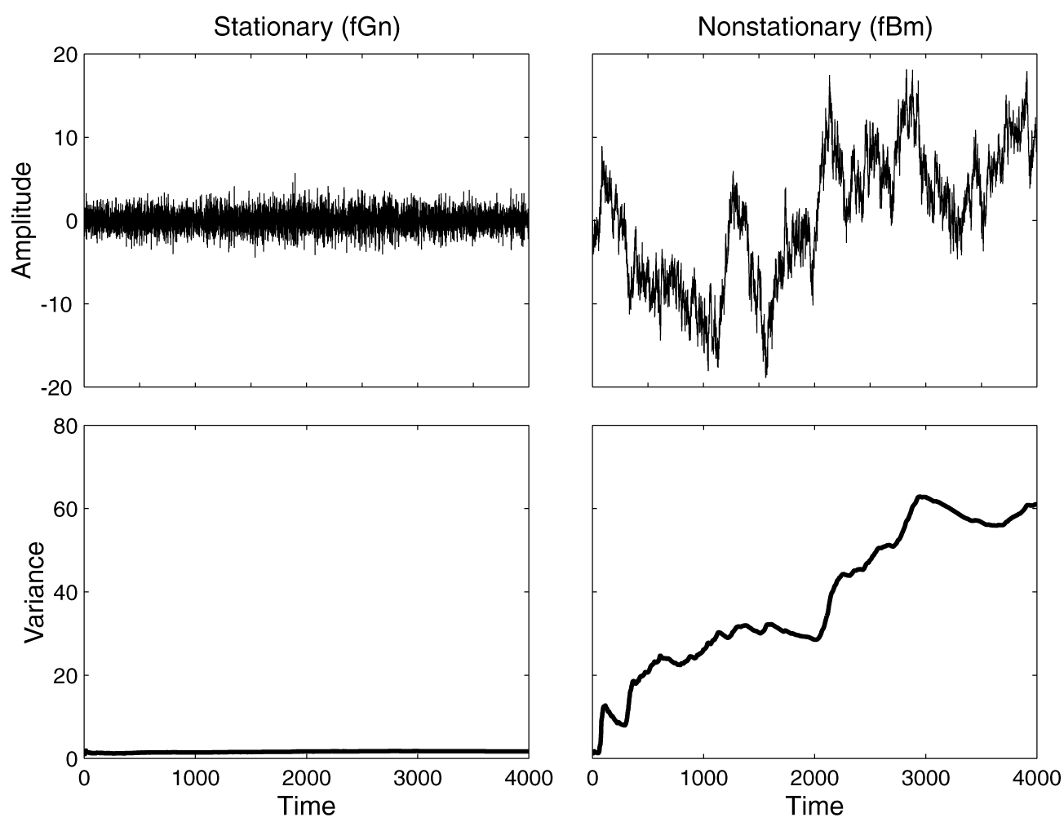
Time domain methods
Stationary and nonstationary time series. The two pure monofractal time series (upper panels) were generated by the method of Davies and Harte (DHM) (1987) according to the dichotomous model of fractional Gaussian noise (fGn) and fractional Brownian motion (fBm)
(Eke et al 2000). DHM produces an fGn signal, whose cumulatively summed series yields an fBm signal. These two signals differ in their variance (lower panels) in that the fGn signal is stationary, hence its variance is constant, unlike that of the nonstationary fBm signal whose variance increases with time. This difference explains why the analysis of these signals in the time domain require special methods capable of accounting for the long-term fluctuations and increasing variance in the fBm signal.

Slide 20
Additional analysis
Hurst’s rescaled range analysis (R/S)
Autocorrelation analysis (AC)
  On this ground, fractal signals are often clled long-memory processes
Detrended fluctuation analysis (DFA) (Peng et al, 1994) was developed to improve on root mean square analysis of highly nonstationary data by removing nonstationary trends from long-range –correlated time series.
Coarse graining spectral analysis (CGSA) separates the fractal and the harmonic components in the signal and can thus estimate the spectral index, β, without the interference of the latter (Yamamoto and Hughson 1991).
Frequency domain methods (Power spectra density analysis , PSD)
Time-freqyency (time-scale) domain analysis (Short time Fourier transform, STFT)
Fractal wavelet analysis
Linear system analysis of fractal time series (fARIMA)

Slide 21
Why there are renewed interest in EEG and MEG data ?
The realization that a full understanding of the neurophysiological mechanisms underlying normal and disturbed higher brains functions cannot be derived from a purely reductionistic approach and requires the study of emergent phenomena such as large scale synchronization of neural networks in the brain.
The introduction of new techniques, concepts and analytical
tools which made possible to extract more and more meaningful information from recordings of brain electro magnetic activity.
An example of those techniques is the nonlinear time series analysis, that opens new perspectives and create a new interdisciplinary field: Nonlinear Brain Dynamics.

Slide 22
The emergencde of nonlinear brain dynamics
‘Now that neuroscientists are beginning seriously to contemplate higher levels of brain functioning in terms of neuronal networks and reverberating circuits, electroencephalographers can take satisfaction in the knowledge that after some time of unfashionability their specialty is once again assuming a central role. As they suspected all along, there does appear to be important information about how the brain works contained in the empirically useful but inscrutable oscillations of the EEG’ (Jones, 1999).
This renewed interest in EEG and MEG has two different sources:
(i) the realization that a full understanding of the neurophysiological mechanisms underlying normal and disturbed higher brain functions cannot be derived from a purely reductionistic approach and requires the study of emergent phenomena such as large scale synchronization of neuronal networks in the brain
(ii) the introduction of new techniques, concepts and analytical tools which make it possible to extract more and more meaningful information from recordings of brain electro magnetic activity. Examples of such new developments are the use of combined recording of EEG and fMRI,wavelets, analysis with artificial neural networks, and advanced source modelling

Slide 23
Historical background
Nonlinear EEG analysis started in 1985, when it was described the ’chaos analysis’ of spontaneous neural activity in the motor cortex of a monkey (Rapp et al, 1985) and the correlation dimension of human sleep EEG (Babloyantz et al, 1985).
One might say that nonlinear dynamics was born in 1665 when Christiaan Huygens, lying ill in his bed, observed that two clocks hanging from the same wall tended to synchronize the motion of
their pendulums. Synchronization of dynamical systems is a key nonlinear phenomenon. (*BS)

Slide 24
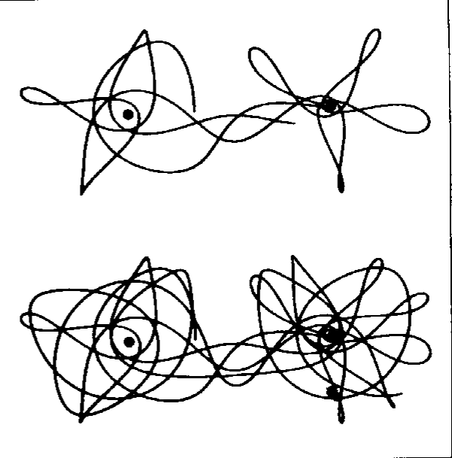
Historical background…
In 1889 Henri Poincare, called ’father of chaos theory’, showed that a simple gravitational system of three interacting bodies can display completely unpredictable behavior, a paradoxical phenomenon, because the nonlinear equations are completely deterministic. This phenomenon is now called ’deterministic chaos’.
In 1963, the meteorologist Edward Lorenz, studying a simple nonlinear model of atmosphere, using numerical integration, rediscovered Poincar´e’s chaotic dynamics and published the
famous ’Lorenz attractor’.
x˙ = (y − x); y˙ = x( − z) − y ; z˙ = xy − z.
(BS)Movie Lorenz attractor
Orbits related to the thee-body problem (Modified from Stewart, 1991)

Slide 25
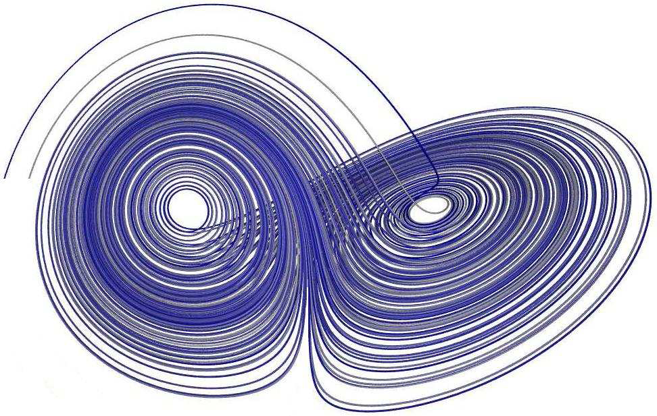
Lorenz attractor

Slide 26
Development
In 1980, it was shown that a time series of observations could be
transformed into a representation of the system dynamics in a
multi-dimensional state space or phase space, called the
’reconstructed space’ (Packard et al, 1980). In 1981, Floris
Takens proved that a reconstructed attractor has the same basic
properties as the true attractor.
In 1983, Grassberger and Procaccia compute the correlation
dimension of a reconstructed attractor. This made it possible to
apply chaos theory to almost any set of observations. ’Rapp et’
al published the first chaos analysis to EEG signals two years
later, in 1985.
Between 1985 and 1990, the EEG analysis was characterized by
the search for low-dimensional chaos of the signals.

Slide 27
Development
Around 1990, some limitations of the nonlinear time series
algorithms became clear, and the method of ’surrogate data
testing’ was introduced to check the validity of the results.
Subsequently, some works clamming for ’chaos in the brain’were critically reexamined and, often, rejected.
Since then, nonlinear EEG analysis has directed its focus in two less ambitious but more realistic directions:
i) detection, characterization and modeling of nonlinear dynamics rather than strict deterministic chaos;
ii) development of new nonlinear measures which are more suitable to be applied to noisy, non stationary and high-dimensional EEG data.

Slide 28
The concept of a dynamical system
Dynamical system is a model that determines the evolution of a system given only the initial state. Then, the current state is a function of a previous state. The state of a system, described by m variables, can be represented as a point in the m-dimensional space, called state space or phase space.
The dynamics of the system is a set of laws or equations that describe how the state changes over time. Usually this set consists of a system of coupled differential equations.
A dynamical system is linear if all their equations are linear,
otherwise is nonlinear. If it’s linear, small causes have small
effects. If it’s nonlinear, small causes may have large effects.

Slide 29
The concept of a dynamical system
A dynamical system is conservative if their important quantities (related to its energy) are preserved over time, otherwise the system is dissipative.
A dynamical system is deterministic if their equations don’t have noise or or stochastic terms (probabilities), otherwise the system is stochastic.
The realistic biological systems are likely to be nonlinear dissipative systems, whether they are deterministic or stochastic.

Slide 30
Attractors and their properties
If we observe a dissipative deterministic dynamical system for a sufficient long time (after transience), the trajectory will converge to a subspace of the total phase space. This subspace is a geometrical object called attractor of the system.
If the deterministic dissipative system is linear, the attractor is a simple point in the phase state. If it’s nonlinear, apart from point attractors, more three types can occur: limit cycle, torus and strange attractors (related to fractal geometry and deterministic chaos).

Slide 31
Attractors and their properties

Slide 32
Detection of Chaos and Fractals from Experimental Time Series/Additional
Aperiodicity
A unique feature of signals with seemingly irregular dynamics is the absence of periodicity,or being aperiodic. Traditionally, therefore, spectral analysis is first applied to a given time series to search for hidden periodicities that might explain the source of signal variability. For example, in the simplest case, the presence of a harmonic or sinusoidal oscillator is suspected when a power spectrum Pxx(w), given by the squared norm of the Fourier transform of a time series x(t) as
(1) has a single sharp peak.
The harmonic motion represented by the peak is the solution of a linear differential equation , and this equation can simply be reduced to a system of first-order (linear) differential equations as . Generally, a system of first-order differential equations in the form of
(2) is called a dynamical system. The forms of trajectories or orbits of the dynamical system in phase space (x1,…,xn), e.g., (x, y) in the two-dimensional case mentioned above, characterize the dynamics of the solution of the original differential equation. For example,for the harmonic motion, the orbit is an ellipsoid, indicating that the sustained periodic
oscillation is sinusoidal (Fig.1A). In a nonlinear two-dimensional dynamical system, such as , the time series is still highly periodic although the
final trajectory, called an attractor, is not ellipsoidal and the spectrum contains higher harmonics (Fig.1B). This type of periodic oscillations is called a limit cycle.

Slide 33
A simple harmonic motion (A) and periodic dynamics of two-dimensional dynamical system
B): . From top to bottom, the panels show a time series of x, the dynamics in a phase space (x, y), and the power spectra (Pxx(w)) as a function of frequency

Slide 34
A limit cycle (A) and a torus (B) of nonlinearly coupled harmonic oscillators , and chaotic dynamics of the Lorenz equations (C). From top to bottom, the panels show a time series of x, the dynamics in a phase space (x, y, z), and the power spectrum (Pxx(w)) as a function of frequency

Slide 35
Detection of Chaos and Fractals from Experimental Time Series/Additional
Sensitive Dependence on Initial Conditions
The reason why chaotic systems show aperiodic dynamics is that phase space trajectories that have nearly identical initial states will separate from each other at an exponentially increasing rate captured by the Lyapunov exponent.
This is defined as follows: consider two (usually the nearest) neighboring points in phase space at time 0 and at time t, the points' distances in the i-th direction being , respectively.
The Lyapunov exponent is then defined by the average growth rate λi of the initial distance
Chaotic systems are characterized by having at least one positive λi . This indicates that any neighboring points with infinitesimal differences at the initial state abruptly separate from each other in the i-th direction. In other words, even if the initial states are close, the final states are much different. This phenomenon is sometimes called sensitive dependence on initial conditions. Although the exponential separation causes chaotic systems to exhibit much of the same long-term behavior as stochastic systems, the positive Lyapunov exponent is only observed for chaotic systems. The Lyapunov exponents for stochastic signals are zero, indicating that and remain the same independent of time.

Slide 36
Determinism
Even if aperiodic chaotic motions mimic stochastic signals in some respects, they possess a hidden order generating the complex and seemingly irregular behavior. The order behind chaos can be in vestigated and visualized by examining the so-called (Poincaré return map . The return map of an attractor in n-dimensional phase space is a sequence of stroboscopic projections on the (n–1)-dimensional plane called the Poincaré section . (Note that this is where a discrete map, not autonomous (i.e., without input forcings) continuous systems, of lower than three dimensions exhibits chaotic behavior.)
That is, the return map maps the repeated crossings of the trajectory through the Poincaré section. For example, when looking at the y-component of the Lorenz attractor's return map (though not “one-to-one”), there is indeed a fairly regular pattern indicating that some types of determinism are present in the dynamics. And each crossing of the orbit across the plane z = 27 (Fig.3B) is governed by a switching between two N-shaped maps from yi to yi+1.
In low-dimensional chaotic systems, it is sometimes, though not always, possible to find this type of clear deterministic map in
the Poincaré section.

Slide 37
Power Spectral Analysis
Computer-generated fractional Brownian motion with different values of the spectral exponent β (left) and the power-law (1/fb-type) spectra in log-log axes (right).
For comparison of
the low-frequency behavior in the spectra, low-pass filtered white noise and its spectrum are shown.

Slide 38
Method of Surrogate Data
In the early 1990s, the method of surrogate data was proposed (Theiler et al. 1992) as a means to study possible chaotic dynamics and discriminate them from stochastic noise. In this method, stochastic surrogate data are generated that have the same power spectra as the original, but have random phase relationships among the Fourier components.
If any numerical procedures for studying chaotic dynamics produce the same results for the surrogates as for the original data, we cannot reject a null hypothesis that the observed dynamics is generated by a linear stochastic model rather than representing deterministic chaos. (This is because the surrogate data generated as such can be regarded
as an output of a linear, e.g., autoregressive, model.)
While measures for chaos such as the correlation dimension and the (largest) Lyapunov exponent are usually given by a single number, the repeated generation of surrogate data provides a confidence interval for the null effect range, enabling hypothesis testing.

Slide 39
Our recent research in nonlinear analysis of EEG
After several years of applying different nonlinear measures on different electrophysiological signals we came to conclusion that it is always recommended to utilize several measures on the same set of data. Every different measure is showing you something else about the data
Methodological comparison between Higuchi’s Fractal Dimension (Higuchi, 1988)-HFD and Sample Entropy (Richman and Moorman, 2000)-SampEn, showed that they are methodologically compatible in the sense that they are differently sensitive on the frequency content of the signal. Also Kalauzi (2012) showed that applying Fourier analysis on EEG is redundant, because HFD are the weighted functions of Fourier’s amplitudes. Mind the Klonowski (2007) and Rabinovich (2006) reasoning why for biosignals nonlinear measures are superior.
We showed (publication in the process of publication) that SampEn is more sensitive to lower frequencies (less than 60Hz) and HFD is more sensitive to higher frequencies in the signal.
Our sample for the initial study was electromyogram (EMG) recorded in the protocol of applying Transcranial Magnetic Stimulation (TMS) over Motor cortex of man

Slide 40
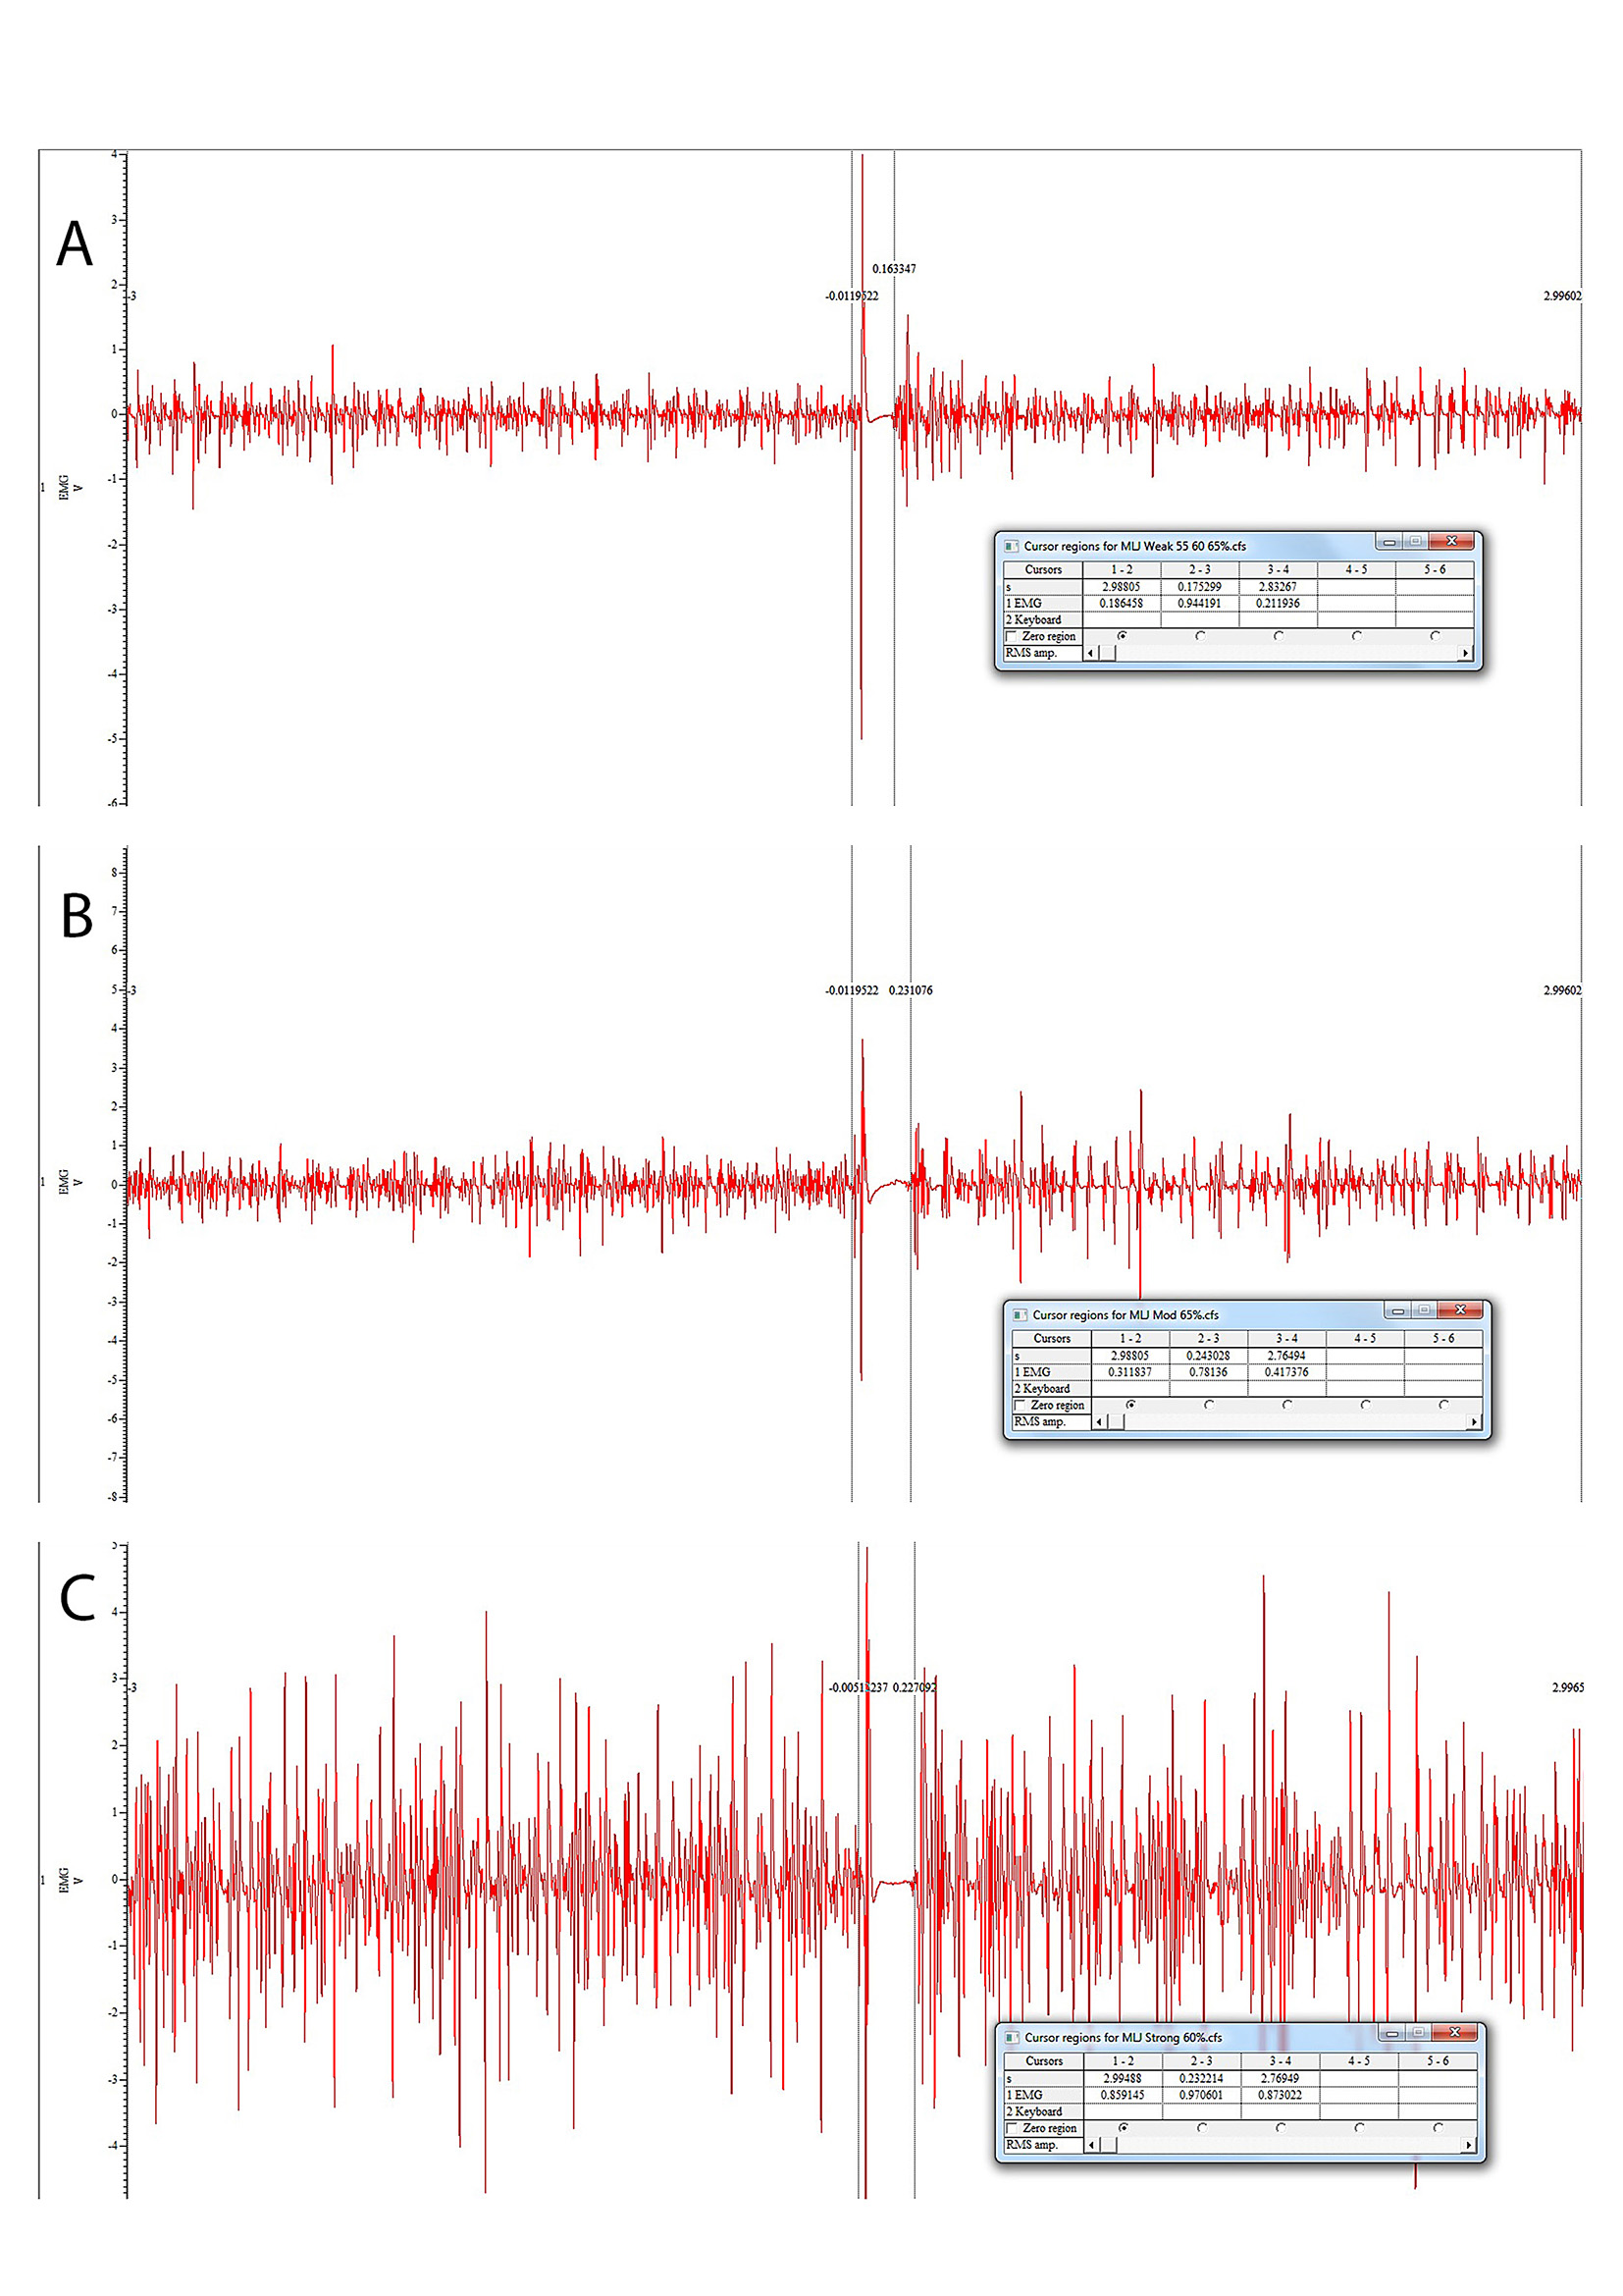

Slide 41
Further application in complexity studies
Depression is expected to impose the second biggest health burden globally by 2020 (according to WHO Report, now extended to 2030); greater even than heart disease, arthritis and many forms of cancer.
Similar to some movement disorders, it seems that behind the spectrum of depressive disorders might be the anatomical change in deeper brain structures (Kim et al 2013, Kwasterniet et al, 2013). As an answer to decreased functional connectivity within the fronto-limbic system, brain is possibly trying to compensate for that impairment, resulting in higher excitability of cortex (like in PD)
We decided to combine engineering, biophysics, neuroscience and nonlinear analysis methods in order to provide possible clinical use of this kind of complexity analysis. Based on similar complexity markers confirmed in PD, we investigated complexity changes in different depressive persons in comparison to healthy controls.

Slide 42
Disturbed resting state EEG synchronization in bipolar disorder: A Graph theoretical analysis
Kim et al. 2013: Meta-analysis of whole brain diffusion tensor imaging (DTI) studies demonstrated decreased fractional anisotropy (FA) affecting the right hemisphere white matter near the parahippocampal gyrus and cingulate cortex (Vederine et al 2011). Because signaling among brain regions is dependent on WM tracts, these findings suggest that functional measures of neurotransmission and connectivity between brain regions in BD (Calhoun et al., 2011; Frangou, 2011; Houenou et al., 2012) were changed.
Moreover, there is increasing consensus of decreased connectivity among ventral prefrontal and limbic regions may reflect a key deficit in BD (Anticevic et al., 2013; Strakowski et al., 2012)
A recent review of the BD literature suggest that increased theta and delta and decreased alpha band power are the most robust findings for resting EEG (Degabriele and Lagopoulos, 2009). …increased beta but decreased theta power (Howells et al., 2012) have been also reported

Slide 43
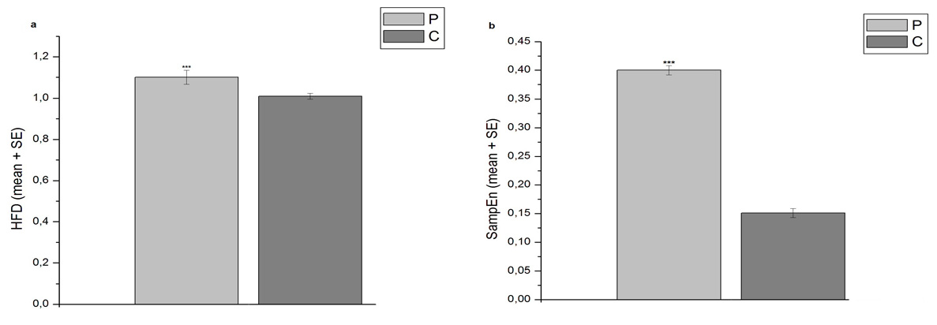
Our first Pilot study on complexity changes in EEG in Bipolar Depression Disorder patients
Patients versus Controls (Healthy age matched controls), on 16 patients, plus 20 controls. The significant statistical difference (p<0.001) confirmed on all the electrodes of EEG

Slide 44
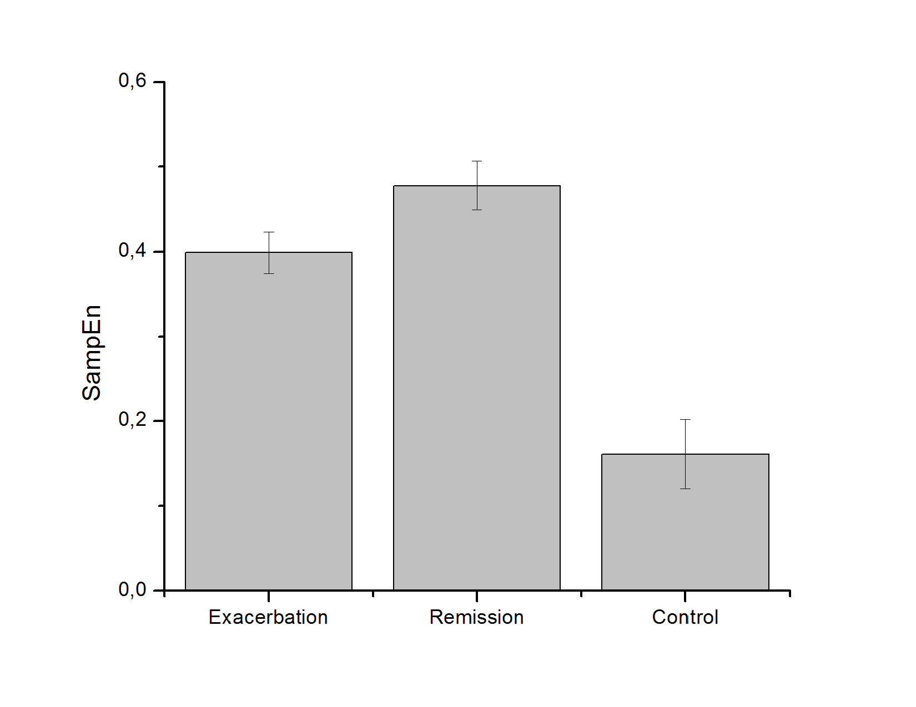
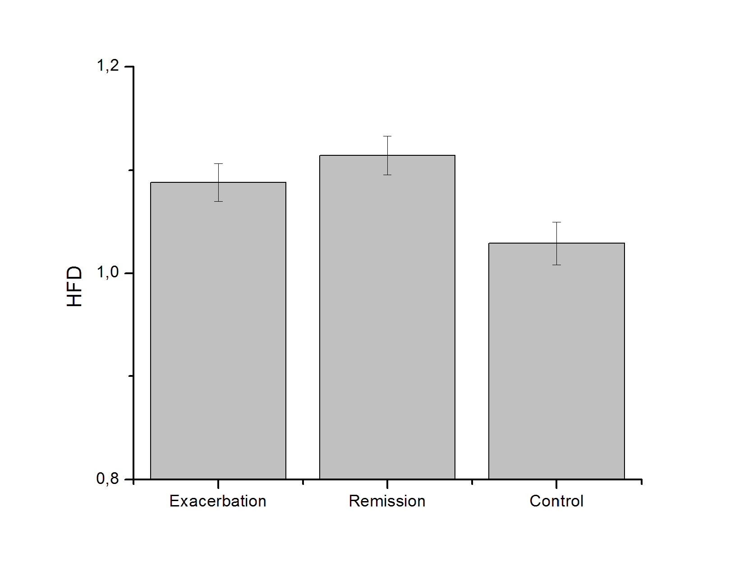
Classification of depression based on complexity measures (HFD and SampEn)
This study on 26 recurrent depression patients and 20 controls used improved methodology with an aim to detect separation between Remission and Exacerbation period of the disease

Slide 45
Machine learning
Principal Component analysis (PCA) has been frequently used to visually demonstrate class separability. Labbe et al used PCA to show the linear separability of 3-class LIBS spectroscopy data. …these classes were not linearly separated
We combine an efficient version of PCA algorithm suitable for application on very high dimensional data with SVM classifier to perform multi- class classification.
Prior to classification we perform linear feature extraction using Principal Component Analysis to reduce both the dimensionality of the original dataset and the variability within each class.
To determine the optimal number of extracted features, we utilize the wrapper method which examines performance of the chosen classifier with varied number of the utilized principal components. …

Slide 46
Support Vector Machines (SVM)
The goal of classification is to learn a function f, such that each sample is assigned to class label i.e. f(xi)=yi
Prior to performing any classification technique, we reduce the dimensionality of the original data set by linear feature extraction (using PCA).
Support Vector Machines (SVM) are classifiers based on the following two paradigms : (1) projection of data into higher dimensional space, (2) construction of separation hyperplanes to maximize the minimal distance between the planes and the training examples (the separation margin). Formally, learning SVM for a two-class problem can be represented as the optimization problem which involves maximization of the dual Lagrangian with the respect to dual variables.
We train a two-class SVM classifier for each pair of m classes, resulting in total of m(m-1)/2 two-class classifiers.
In Vapnik and Chevronenkins Information Theory (1988), SVM algorithm was intended to minimize the error margin (with especial attention on VC dimension). SVM were not that popular in USA in time of publication, but many European and Japanese Researchers embraced the technique and made a huge number of applications

Slide 47
One of the first results/
The data are clearly separable

Slide 48
Results of comparison of seven different ML methods on our data
 | Features
 | HFDª |  | SampEn^{b} |  | SampEn+HFD |  |  | Average accuracy per classifier
Classifier | Accuracy | AUC^{d} | Accuracy | AUC | Accuracy | AUC
Multilayer perceptron | 100% | 0.998 | 97.56% | 0.995 | 95.12% | 0.995 |  | 97.56%
Logistic regression | 92.68% | 0.960 | 92.68% | 0.995 | 97.56% | 0.998 |  | 94.31%
SVM^{c} with linear kernel | 85.37% | 0.857 | 95.12% | 0.952 | 95.12% | 0.952 |  | 91.87%
SVM with polinomial kernel (p=2) | 80.49% | 0.810 | 95.12% | 0.952 | 95.12% | 0.954 |  | 90.24%
Decision tree | 92.68% | 0.904 | 97.56% | 0.975 | 95.12% | 0.952 |  | 95.12%
Random forest | 92.68% | 0.970 | 95.12% | 0.988 | 92.68% | 0.987 |  | 93.49%
Naïve Bayes | 85.37% | 0.945 | 92.68% | 0.990 | 92.68% | 0.983 |  | 90.24%
Average accuracy per feature set | 89.90% |  | 95.12% |  | 94.77%

Slide 49
Future direction of a research
Based on previous literature (Ahmadlou et al, 2012; Bachman et al, 2013; Hosseinifard et al 2013; Bairy et al , 2015) and own two pilot studies which mainly confirmed previous trend in complexity change and significantly improved the Methodology of analysis of data, we aim at innovative application in clinical practice in Neurology and Neuropsychiatry clinics. Our method can foster differential diagnosis, based on very low cost EEG recordings and combination of measures which are robust even in case of noisy data and are computationally fast.
EEG based study aimed on early prediction of PD and clinically applicable classification of Depression
Nonlinear methods instead of classical ones, data mining more powerful than classical statistical methods

Slide 50

Thank you for your kind attention!
Any questions?

