Slide 1

Introduction to
Quantum Computing
Giannicola Scarpa
Facultad de Matemáticas UCM

Slide 2
Overview
Part I: What is Quantum Computing?
Qubits, quantum operations, measurements
Part II: Are quantum computers more powerful?
Simple example, main algorithms, complexity classes
Part III: Some quantum cryptography
Non-locality (certified randomness), quantum key distribution,
quantum position verification

Slide 3
Part I:
What is Quantum Computation?

Slide 4
Computation powered by Schrödinger's cat

Slide 5
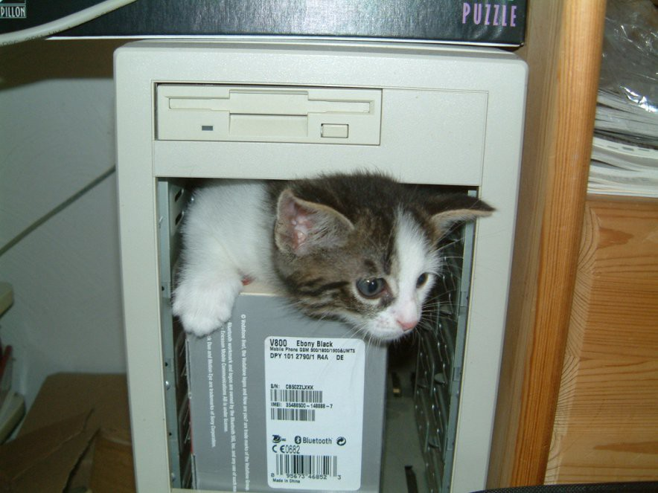
Computation powered by Schrödinger's cat

Slide 6
Some History
First quantum paper: Max Planck, 1900
The field developed strongly during the 1920s
A Turing Machine (1936) is a classical object
1980s: Quantum Computing “updates” the model to the latest physics
  Uses some non-intuitive concepts:
  Superposition, collapse of the wave function, interference, entanglement, no-cloning...
  You will know about all of these in a hour or so.

Slide 7
Classical bit

Slide 8
Classical bit
Quantity that is either 0 or 1

Slide 9
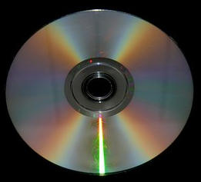
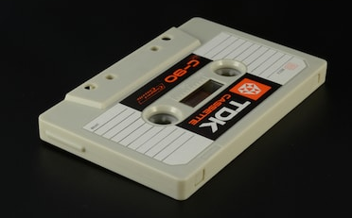
Classical bit
Quantity that is either 0 or 1

Slide 10
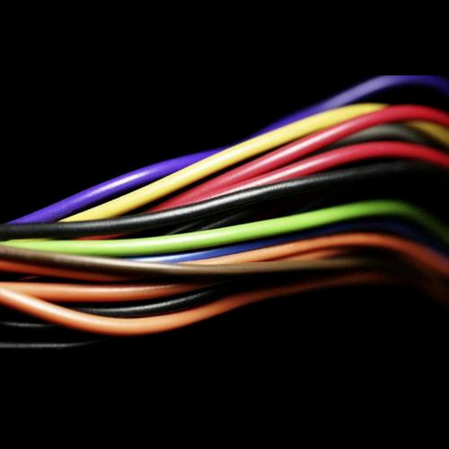
Classical bit
Quantity that is either 0 or 1

Slide 11
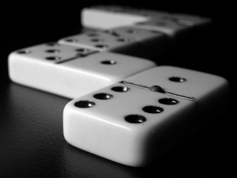
Classical bit
Quantity that is either 0 or 1

Slide 12
Quantum bit

Slide 13
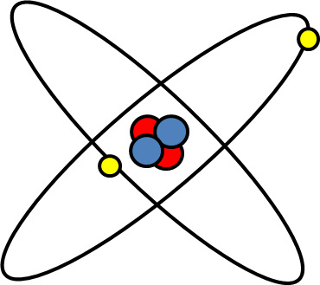
Quantum bit

Slide 14
Quantum bit
0
1

Slide 15

Quantum bit
Associate 0 and 1 with orthogonal vectors:
$\left|0\right\rangle =\left[\begin{aligned}1 \\ 0\end{aligned}\right]$ $\left|1\right\rangle =\left[\begin{aligned}0 \\ 1\end{aligned}\right]$
Quantum bit is a superposition:
$α_{o}\left|0\right\rangle +α_{1}\left|1\right\rangle =\left[\begin{aligned}α_{0} \\ α_{1}\end{aligned}\right]$
Unit vector in $ℂ^{2}: {\left|α_{0}\right|}^{2}+{\left|α_{1}\right|}^{2}=1$

Slide 16
Wait, you’re cheating!

Slide 17

Wait, you’re cheating!
$$α_{o}\left|0\right\rangle +α_{1}\left|1\right\rangle$$

Slide 18

Wait, you’re cheating!
$$α_{o}\left|0\right\rangle +α_{1}\left|1\right\rangle$$
0.0001000101011101100110011…..

Slide 19



Wait, you’re cheating!
$$α_{o}\left|0\right\rangle +( 1− )\left|1\right\rangle$$

Slide 20

Wait, you’re cheating!
$$α_{o}\left|0\right\rangle +( 1− )\left|1\right\rangle$$
Valid unit vector, because${\left|α_{0}\right|}^{2}+{\left|α_{1}\right|}^{2}=1$

Slide 21


Wait, you’re cheating!
$$α_{o}\left|0\right\rangle +( 1− )\left|1\right\rangle$$
Valid unit vector, because${\left|α_{0}\right|}^{2}+{\left|α_{1}\right|}^{2}=1$
Where’s the catch here?

Slide 22

Measurement
$$\left|0\right\rangle$$

Slide 23

Measurement
$$\left|0\right\rangle$$
Measurement collapses the qubit
Observe 0 with probability ${\left|α_{0}\right|}^{2}$
Observe 1 with probability ${\left|α_{1}\right|}^{2}$
QC is the art of using this hidden information

Slide 24
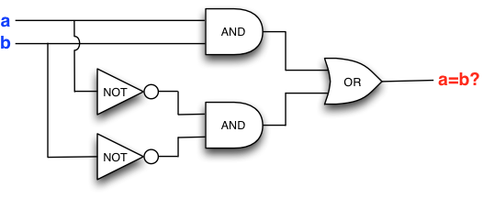
Operations on classical bits
What can we do with one bit?
  Either we leave it alone, or we flip it! (NOT gate)
What can we do with many bits?
  Many things, but AND, OR, NOT are a sufficient set of gates to represent any function as a circuit.

Slide 25

Operations on one qubit
Quantum mechanics allows to do linear operations on qubits before observing them
Norm-preserving matrices in $ℂ^{2×2}$ :
$U\left[\begin{aligned}α_{0} \\ α_{1}\end{aligned}\right]=\left[\begin{aligned}α_{0}^{′} \\ α_{1}^{′}\end{aligned}\right]$ such that ${\left|α_{0}^{′}\right|}^{2}+{\left|α_{1}^{′}\right|}^{2}=1$
NOT gate: $X=\left[\begin{matrix}0 & 1 \\ 1 & 0\end{matrix}\right]$ $\left[\begin{matrix}0 & 1 \\ 1 & 0\end{matrix}\right] \left[\begin{aligned}α_{0} \\ α_{1}\end{aligned}\right]=\left[\begin{aligned}α_{1} \\ α_{0}\end{aligned}\right]$
Hadamard gate: $H=\frac{1}{\sqrt{2}}\left[\begin{matrix}1 & 1 \\ 1 & −1\end{matrix}\right]$

Slide 26

Hadamard gate
$H=\frac{1}{\sqrt{2}}\left[\begin{matrix}1 & 1 \\ 1 & −1\end{matrix}\right]$

Slide 27
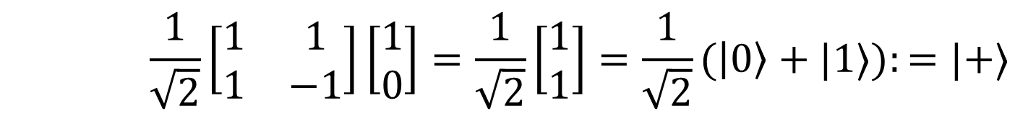

Hadamard gate
$H=\frac{1}{\sqrt{2}}\left[\begin{matrix}1 & 1 \\ 1 & −1\end{matrix}\right]$
$$H\left|0\right\rangle =\frac{1}{\sqrt{2}}\left[\begin{matrix}1 & 1 \\ 1 & −1\end{matrix}\right]\left[\begin{aligned}1 \\ 0\end{aligned}\right]=\frac{1}{\sqrt{2}}\left[\begin{aligned}1 \\ 1\end{aligned}\right]=\frac{1}{\sqrt{2}}(\left|0\right\rangle +|1⟩):=|+⟩$$

Slide 28
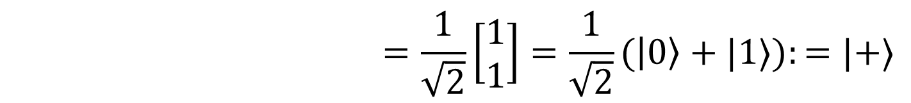
Hadamard gate
$H=\frac{1}{\sqrt{2}}\left[\begin{matrix}1 & 1 \\ 1 & −1\end{matrix}\right]$
$$H\left|0\right\rangle =\frac{1}{\sqrt{2}}\left[\begin{matrix}1 & 1 \\ 1 & −1\end{matrix}\right]\left[\begin{aligned}1 \\ 0\end{aligned}\right]=\frac{1}{\sqrt{2}}\left[\begin{aligned}1 \\ 1\end{aligned}\right]=\frac{1}{\sqrt{2}}(\left|0\right\rangle +|1⟩):=|+⟩$$

Slide 29
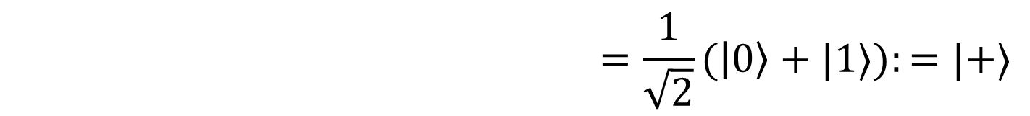
Hadamard gate
$H=\frac{1}{\sqrt{2}}\left[\begin{matrix}1 & 1 \\ 1 & −1\end{matrix}\right]$
$$H\left|0\right\rangle =\frac{1}{\sqrt{2}}\left[\begin{matrix}1 & 1 \\ 1 & −1\end{matrix}\right]\left[\begin{aligned}1 \\ 0\end{aligned}\right]=\frac{1}{\sqrt{2}}\left[\begin{aligned}1 \\ 1\end{aligned}\right]=\frac{1}{\sqrt{2}}(\left|0\right\rangle +|1⟩):=|+⟩$$

Slide 30
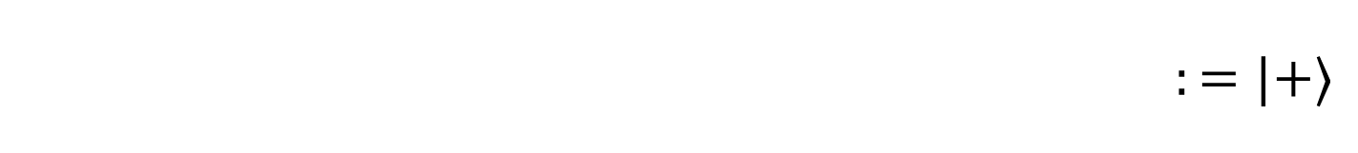
Hadamard gate
$H=\frac{1}{\sqrt{2}}\left[\begin{matrix}1 & 1 \\ 1 & −1\end{matrix}\right]$
$$H\left|0\right\rangle =\frac{1}{\sqrt{2}}\left[\begin{matrix}1 & 1 \\ 1 & −1\end{matrix}\right]\left[\begin{aligned}1 \\ 0\end{aligned}\right]=\frac{1}{\sqrt{2}}\left[\begin{aligned}1 \\ 1\end{aligned}\right]=\frac{1}{\sqrt{2}}(\left|0\right\rangle +|1⟩):=|+⟩$$

Slide 31

Hadamard gate
$H=\frac{1}{\sqrt{2}}\left[\begin{matrix}1 & 1 \\ 1 & −1\end{matrix}\right]$
$$H\left|0\right\rangle =\frac{1}{\sqrt{2}}\left[\begin{matrix}1 & 1 \\ 1 & −1\end{matrix}\right]\left[\begin{aligned}1 \\ 0\end{aligned}\right]=\frac{1}{\sqrt{2}}\left[\begin{aligned}1 \\ 1\end{aligned}\right]=\frac{1}{\sqrt{2}}(\left|0\right\rangle +|1⟩):=|+⟩$$

Slide 32
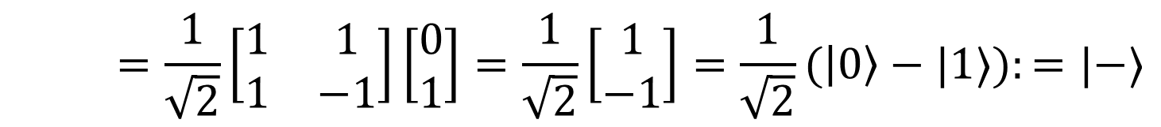
Hadamard gate
$H=\frac{1}{\sqrt{2}}\left[\begin{matrix}1 & 1 \\ 1 & −1\end{matrix}\right]$
$$H\left|0\right\rangle =\frac{1}{\sqrt{2}}\left[\begin{matrix}1 & 1 \\ 1 & −1\end{matrix}\right]\left[\begin{aligned}1 \\ 0\end{aligned}\right]=\frac{1}{\sqrt{2}}\left[\begin{aligned}1 \\ 1\end{aligned}\right]=\frac{1}{\sqrt{2}}(\left|0\right\rangle +|1⟩):=|+⟩$$
$$H\left|1\right\rangle =\frac{1}{\sqrt{2}}\left[\begin{matrix}1 & 1 \\ 1 & −1\end{matrix}\right]\left[\begin{aligned}0 \\ 1\end{aligned}\right]=\frac{1}{\sqrt{2}}\left[\begin{aligned}1 \\ −1\end{aligned}\right]=\frac{1}{\sqrt{2}}(\left|0\right\rangle −|1⟩):=|−⟩$$

Slide 33
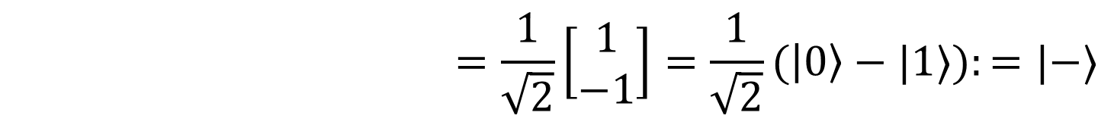
Hadamard gate
$H=\frac{1}{\sqrt{2}}\left[\begin{matrix}1 & 1 \\ 1 & −1\end{matrix}\right]$
$$H\left|0\right\rangle =\frac{1}{\sqrt{2}}\left[\begin{matrix}1 & 1 \\ 1 & −1\end{matrix}\right]\left[\begin{aligned}1 \\ 0\end{aligned}\right]=\frac{1}{\sqrt{2}}\left[\begin{aligned}1 \\ 1\end{aligned}\right]=\frac{1}{\sqrt{2}}(\left|0\right\rangle +|1⟩):=|+⟩$$
$$H\left|1\right\rangle =\frac{1}{\sqrt{2}}\left[\begin{matrix}1 & 1 \\ 1 & −1\end{matrix}\right]\left[\begin{aligned}0 \\ 1\end{aligned}\right]=\frac{1}{\sqrt{2}}\left[\begin{aligned}1 \\ −1\end{aligned}\right]=\frac{1}{\sqrt{2}}(\left|0\right\rangle −|1⟩):=|−⟩$$

Slide 34
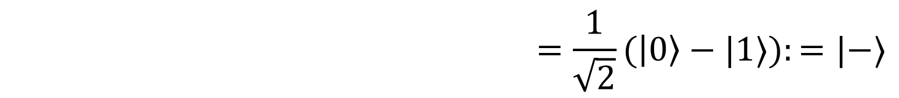
Hadamard gate
$H=\frac{1}{\sqrt{2}}\left[\begin{matrix}1 & 1 \\ 1 & −1\end{matrix}\right]$
$$H\left|0\right\rangle =\frac{1}{\sqrt{2}}\left[\begin{matrix}1 & 1 \\ 1 & −1\end{matrix}\right]\left[\begin{aligned}1 \\ 0\end{aligned}\right]=\frac{1}{\sqrt{2}}\left[\begin{aligned}1 \\ 1\end{aligned}\right]=\frac{1}{\sqrt{2}}(\left|0\right\rangle +|1⟩):=|+⟩$$
$$H\left|1\right\rangle =\frac{1}{\sqrt{2}}\left[\begin{matrix}1 & 1 \\ 1 & −1\end{matrix}\right]\left[\begin{aligned}0 \\ 1\end{aligned}\right]=\frac{1}{\sqrt{2}}\left[\begin{aligned}1 \\ −1\end{aligned}\right]=\frac{1}{\sqrt{2}}(\left|0\right\rangle −|1⟩):=|−⟩$$

Slide 35
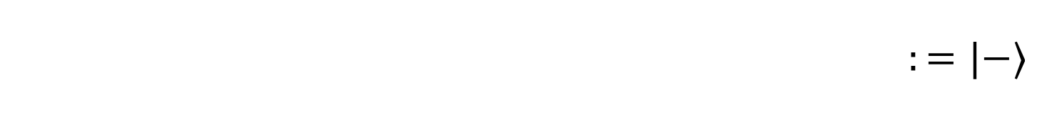
Hadamard gate
$H=\frac{1}{\sqrt{2}}\left[\begin{matrix}1 & 1 \\ 1 & −1\end{matrix}\right]$
$$H\left|0\right\rangle =\frac{1}{\sqrt{2}}\left[\begin{matrix}1 & 1 \\ 1 & −1\end{matrix}\right]\left[\begin{aligned}1 \\ 0\end{aligned}\right]=\frac{1}{\sqrt{2}}\left[\begin{aligned}1 \\ 1\end{aligned}\right]=\frac{1}{\sqrt{2}}(\left|0\right\rangle +|1⟩):=|+⟩$$
$$H\left|1\right\rangle =\frac{1}{\sqrt{2}}\left[\begin{matrix}1 & 1 \\ 1 & −1\end{matrix}\right]\left[\begin{aligned}0 \\ 1\end{aligned}\right]=\frac{1}{\sqrt{2}}\left[\begin{aligned}1 \\ −1\end{aligned}\right]=\frac{1}{\sqrt{2}}(\left|0\right\rangle −|1⟩):=|−⟩$$

Slide 36

Hadamard gate
$H=\frac{1}{\sqrt{2}}\left[\begin{matrix}1 & 1 \\ 1 & −1\end{matrix}\right]$
$$H\left|0\right\rangle =\frac{1}{\sqrt{2}}\left[\begin{matrix}1 & 1 \\ 1 & −1\end{matrix}\right]\left[\begin{aligned}1 \\ 0\end{aligned}\right]=\frac{1}{\sqrt{2}}\left[\begin{aligned}1 \\ 1\end{aligned}\right]=\frac{1}{\sqrt{2}}(\left|0\right\rangle +|1⟩):=|+⟩$$
$$H\left|1\right\rangle =\frac{1}{\sqrt{2}}\left[\begin{matrix}1 & 1 \\ 1 & −1\end{matrix}\right]\left[\begin{aligned}0 \\ 1\end{aligned}\right]=\frac{1}{\sqrt{2}}\left[\begin{aligned}1 \\ −1\end{aligned}\right]=\frac{1}{\sqrt{2}}(\left|0\right\rangle −|1⟩):=|−⟩$$

Slide 37
Hadamard gate
$H=\frac{1}{\sqrt{2}}\left[\begin{matrix}1 & 1 \\ 1 & −1\end{matrix}\right]$
$$H\left|0\right\rangle =\frac{1}{\sqrt{2}}\left[\begin{matrix}1 & 1 \\ 1 & −1\end{matrix}\right]\left[\begin{aligned}1 \\ 0\end{aligned}\right]=\frac{1}{\sqrt{2}}\left[\begin{aligned}1 \\ 1\end{aligned}\right]=\frac{1}{\sqrt{2}}(\left|0\right\rangle +|1⟩):=|+⟩$$
$$H\left|1\right\rangle =\frac{1}{\sqrt{2}}\left[\begin{matrix}1 & 1 \\ 1 & −1\end{matrix}\right]\left[\begin{aligned}0 \\ 1\end{aligned}\right]=\frac{1}{\sqrt{2}}\left[\begin{aligned}1 \\ −1\end{aligned}\right]=\frac{1}{\sqrt{2}}(\left|0\right\rangle −|1⟩):=|−⟩$$
Are these two states distinguishable?

Slide 38


Distinguishing $|+⟩$ from $|−⟩$
$\frac{1}{\sqrt{2}}(\left|0\right\rangle +|1⟩)$ vs $\frac{1}{\sqrt{2}}(\left|0\right\rangle −|1⟩)$
Let us try then to apply Hadamard again!
$$H\left[\frac{1}{\sqrt{2}} (\left|0\right\rangle +|1⟩)\right]=\frac{1}{\sqrt{2}} (H\left|0\right\rangle +H|1⟩)=|0⟩$$
$$H\left[\frac{1}{\sqrt{2}} (\left|0\right\rangle −|1⟩)\right]=\frac{1}{\sqrt{2}} (H\left|0\right\rangle −H|1⟩)=|1⟩$$
INTERFERENCE!

Slide 39

Distinguishing $|+⟩$ from $|−⟩$
$\frac{1}{\sqrt{2}}(\left|0\right\rangle +|1⟩)$ vs $\frac{1}{\sqrt{2}}(\left|0\right\rangle −|1⟩)$
Let us try then to apply Hadamard again!
$$H\left[\frac{1}{\sqrt{2}} (\left|0\right\rangle +|1⟩)\right]=\frac{1}{\sqrt{2}} (H\left|0\right\rangle +H|1⟩)=|0⟩$$
$$H\left[\frac{1}{\sqrt{2}} (\left|0\right\rangle −|1⟩)\right]=\frac{1}{\sqrt{2}} (H\left|0\right\rangle −H|1⟩)=|1⟩$$
INTERFERENCE!

Slide 40

Distinguishing $|+⟩$ from $|−⟩$
$\frac{1}{\sqrt{2}}(\left|0\right\rangle +|1⟩)$ vs $\frac{1}{\sqrt{2}}(\left|0\right\rangle −|1⟩)$
Let us try then to apply Hadamard again!
$$H\left[\frac{1}{\sqrt{2}} (\left|0\right\rangle +|1⟩)\right]=\frac{1}{\sqrt{2}} (H\left|0\right\rangle +H|1⟩)=|0⟩$$
$$H\left[\frac{1}{\sqrt{2}} (\left|0\right\rangle −|1⟩)\right]=\frac{1}{\sqrt{2}} (H\left|0\right\rangle −H|1⟩)=|1⟩$$
INTERFERENCE!

Slide 41
Distinguishing $|+⟩$ from $|−⟩$
$\frac{1}{\sqrt{2}}(\left|0\right\rangle +|1⟩)$ vs $\frac{1}{\sqrt{2}}(\left|0\right\rangle −|1⟩)$
Let us try then to apply Hadamard again!
$$H\left[\frac{1}{\sqrt{2}} (\left|0\right\rangle +|1⟩)\right]=\frac{1}{\sqrt{2}} (H\left|0\right\rangle +H|1⟩)=|0⟩$$
$$H\left[\frac{1}{\sqrt{2}} (\left|0\right\rangle −|1⟩)\right]=\frac{1}{\sqrt{2}} (H\left|0\right\rangle −H|1⟩)=|1⟩$$
INTERFERENCE!

Slide 42

More qubits
$$α_{00}\left|00\right\rangle +α_{01}\left|01\right\rangle +α_{10}\left|10\right\rangle {+α}_{11}\left|11\right\rangle$$
How to model n qubits?
Unit vector in larger space (dimension $2^{n}$)
Norm-preserving operations and measurements in this exponentially large space
This is why QC is expensive to simulate on classical computers “in the obvious way”.

Slide 43
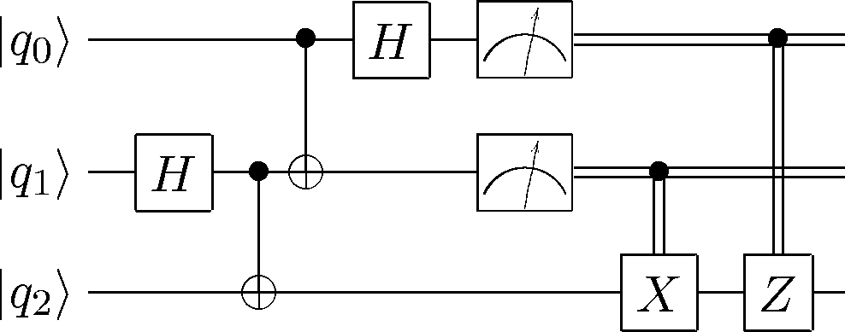
Quantum circuit model

Slide 44
Part II:
Are Quantum Computers more powerful?

Slide 45


Computing Parity
$$f\left(0,0\right)=0 \\ f\left(0,1\right)=1 \\ f\left(1,0\right)=1 \\ f\left(1,1\right)=0$$
Parity function:
  $$f\left(x_{0},x_{1}\right)=x_{0} XOR x_{1}$$
Query complexity: count the number of times we need to access the memory.
In the classical case: 2 queries needed.
  Why? After we read the first bit, the function value is unknown: $f\left(x_{0},x_{1}\right)=0 ⇔$ $x_{0}=x_{1}$

Slide 46
Computing parity with quantum

Slide 47

Computing parity with quantum
A quantum query has the form
$O\left|i\right\rangle ={\left(−1\right)}^{x_{i}}|i⟩$

Slide 48

Computing parity with quantum
A quantum query has the form
$O\left|i\right\rangle ={\left(−1\right)}^{x_{i}}|i⟩$
As a circuit, we compute parity:
$$|0⟩$$

Slide 49
Computing parity with quantum
A quantum query has the form
$O\left|i\right\rangle ={\left(−1\right)}^{x_{i}}|i⟩$
As a circuit, we compute parity:
$$|0⟩$$
H

Slide 50

Computing parity with quantum
A quantum query has the form
$O\left|i\right\rangle ={\left(−1\right)}^{x_{i}}|i⟩$
As a circuit, we compute parity:
$$|0⟩$$
H
O

Slide 51
Computing parity with quantum
A quantum query has the form
$O\left|i\right\rangle ={\left(−1\right)}^{x_{i}}|i⟩$
As a circuit, we compute parity:
$$|0⟩$$
H
O
H

Slide 52
Computing parity with quantum
A quantum query has the form
$O\left|i\right\rangle ={\left(−1\right)}^{x_{i}}|i⟩$
As a circuit, we compute parity:
$$|0⟩$$
H
O
H

Slide 53


Computing parity with quantum
A quantum query has the form
$O\left|i\right\rangle ={\left(−1\right)}^{x_{i}}|i⟩$
As a circuit, we compute parity:
$$|0⟩$$
H
O
H
$$x_{0}=0 \\ x_{1}=0$$

Slide 54

Computing parity with quantum
A quantum query has the form
$O\left|i\right\rangle ={\left(−1\right)}^{x_{i}}|i⟩$
As a circuit, we compute parity:
$$|0⟩$$
H
O
H
$$x_{0}=0 \\ x_{1}=0$$
$$\frac{1}{\sqrt{2}}(\left|0\right\rangle +|1⟩)$$

Slide 55

Computing parity with quantum
A quantum query has the form
$O\left|i\right\rangle ={\left(−1\right)}^{x_{i}}|i⟩$
As a circuit, we compute parity:
$$|0⟩$$
H
O
H
$$x_{0}=0 \\ x_{1}=0$$
$$\frac{1}{\sqrt{2}}(\left|0\right\rangle +|1⟩)$$
$$\frac{1}{\sqrt{2}}(\left|0\right\rangle +|1⟩)$$

Slide 56


Computing parity with quantum
A quantum query has the form
$O\left|i\right\rangle ={\left(−1\right)}^{x_{i}}|i⟩$
As a circuit, we compute parity:
$$|0⟩$$
H
O
H
$$x_{0}=0 \\ x_{1}=0$$
$$\frac{1}{\sqrt{2}}(\left|0\right\rangle +|1⟩)$$
$$\frac{1}{\sqrt{2}}(\left|0\right\rangle +|1⟩)$$
$$|0⟩$$

Slide 57

Computing parity with quantum
A quantum query has the form
$O\left|i\right\rangle ={\left(−1\right)}^{x_{i}}|i⟩$
As a circuit, we compute parity:
$$|0⟩$$
H
O
H
$$x_{0}=0 \\ x_{1}=1$$

Slide 58
Computing parity with quantum
A quantum query has the form
$O\left|i\right\rangle ={\left(−1\right)}^{x_{i}}|i⟩$
As a circuit, we compute parity:
$$|0⟩$$
H
O
H
$$x_{0}=0 \\ x_{1}=1$$
$$\frac{1}{\sqrt{2}}(\left|0\right\rangle +|1⟩)$$

Slide 59

Computing parity with quantum
A quantum query has the form
$O\left|i\right\rangle ={\left(−1\right)}^{x_{i}}|i⟩$
As a circuit, we compute parity:
$$|0⟩$$
H
O
H
$$x_{0}=0 \\ x_{1}=1$$
$$\frac{1}{\sqrt{2}}(\left|0\right\rangle +|1⟩)$$
$$\frac{1}{\sqrt{2}}(\left|0\right\rangle −|1⟩)$$

Slide 60

Computing parity with quantum
A quantum query has the form
$O\left|i\right\rangle ={\left(−1\right)}^{x_{i}}|i⟩$
As a circuit, we compute parity:
$$|0⟩$$
H
O
H
$$x_{0}=0 \\ x_{1}=1$$
$$\frac{1}{\sqrt{2}}(\left|0\right\rangle +|1⟩)$$
$$\frac{1}{\sqrt{2}}(\left|0\right\rangle −|1⟩)$$
$$|1⟩$$

Slide 61
Wait a second, you’re cheating!
A quantum query has the form
$O\left|i\right\rangle ={\left(−1\right)}^{x_{i}}|i⟩$
As a circuit, we compute parity:
$$|0⟩$$
H
O
H
$$x_{0}=0 \\ x_{1}=1$$
$$\frac{1}{\sqrt{2}}(\left|0\right\rangle +|1⟩)$$
$$\frac{1}{\sqrt{2}}(\left|0\right\rangle −|1⟩)$$
$$|1⟩$$

Slide 62
Yeah, what about THIS???
A quantum query has the form
$O\left|i\right\rangle ={\left(−1\right)}^{x_{i}}|i⟩$
As a circuit, we compute parity:
$$|0⟩$$
H
O
H
$$x_{0}=0 \\ x_{1}=1$$
$$\frac{1}{\sqrt{2}}(\left|0\right\rangle +|1⟩)$$
$$\frac{1}{\sqrt{2}}(\left|0\right\rangle −|1⟩)$$
$$|1⟩$$

Slide 63
Well, fair enough. Please continue.
A quantum query has the form
$O\left|i\right\rangle ={\left(−1\right)}^{x_{i}}|i⟩$
As a circuit, we compute parity:
$$|0⟩$$
H
O
H
$$x_{0}=0 \\ x_{1}=1$$
$$\frac{1}{\sqrt{2}}(\left|0\right\rangle +|1⟩)$$
$$\frac{1}{\sqrt{2}}(\left|0\right\rangle −|1⟩)$$
$$|1⟩$$

Slide 64

Quantum parallelism
Quantum computers are able to calculate an exponential number of computations at once.
Any classical program can be encoded in a quantum circuit $C$ that maps $\left|x\right\rangle \left|0\right\rangle ↦\left|x\right\rangle |f\left(x\right)⟩$
Many inputs cane be given in superposition:
$C\left(\sum_{x}{α_{x}\left|x\right\rangle |0⟩}\right)=\sum_{x}{α_{x}\left|x\right\rangle |f(x)⟩}$
Problem: measure collapses to a random $x,f\left(x\right)$…

Slide 65

Quantum parallelism
Quantum computers are able to calculate an exponential number of computations at once.
Any classical program can be encoded in a quantum circuit $C$ that maps $\left|x\right\rangle \left|0\right\rangle ↦\left|x\right\rangle |f\left(x\right)⟩$
Many inputs cane be given in superposition:
$C\left(\sum_{x}{α_{x}\left|x\right\rangle |0⟩}\right)=\sum_{x}{α_{x}\left|x\right\rangle |f(x)⟩}$
Problem: measure collapses to a random $x,f\left(x\right)$…
Again: QC is the art of using this hidden information

Slide 66

Recipe for a quantum algorithm
Put the input in superposition
Apply a circuit $C$ to everything
Do something clever to put more “weight” on the pairs $x,f(x)$ of interest
Repeat (2) and (3) a certain number of times
  (How many? Good luck figuring that out)
Measure and enjoy your output

Slide 67

Recipe for a quantum algorithm
Put the input in superposition
Apply a circuit $C$ to everything
Do something clever to put more “weight” on the pairs $x,f(x)$ of interest
Repeat (2) and (3) a certain number of times
  (How many? Good luck figuring that out)
Measure and enjoy your output
$$|0⟩$$
H
O
H

Slide 68
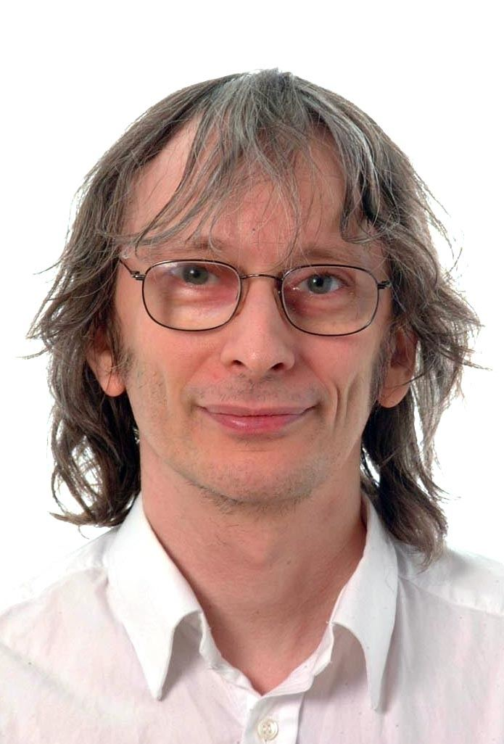
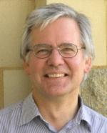
Famous quantum speedups
Deutsch-Jozsa (’92)
n/2 classical queries vs 1 quantum query
“Is this string constant or balanced?”

Slide 69
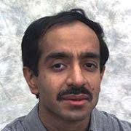
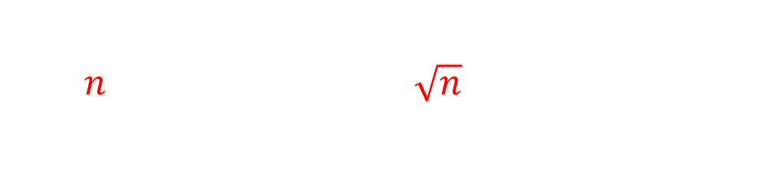
Famous quantum speedups
Deutsch-Jozsa (’92)
n/2 classical queries vs 1 quantum query
“Is this string constant or balanced?”
Grover’s search (’96)
$n$ classical queries vs $\sqrt{n}$ quantum queries
“Does this string contain a 1?”

Slide 70
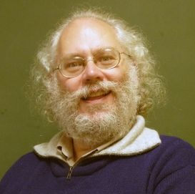
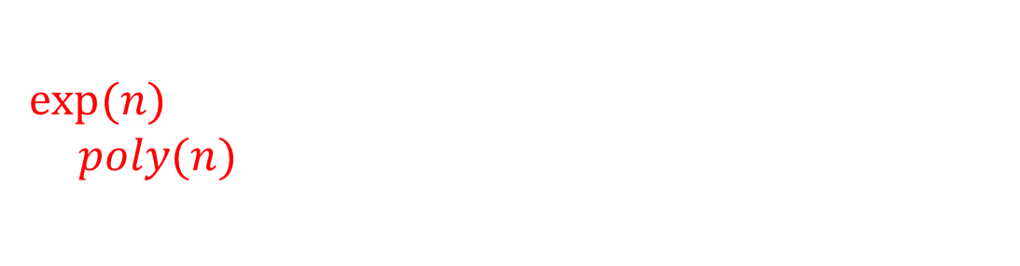
Famous quantum speedups
Deutsch-Jozsa (’92)
n/2 classical queries vs 1 quantum query
“Is this string constant or balanced?”
Grover’s search (’96)
$n$ classical queries vs $\sqrt{n}$ quantum queries
“Does this string contain a 1?”
Shor’s Factoring (’94)
$exp⁡(n)$ classical running time (best known!)
vs $poly(n)$ quantum running time
“Find the prime factors of $x$”

Slide 71
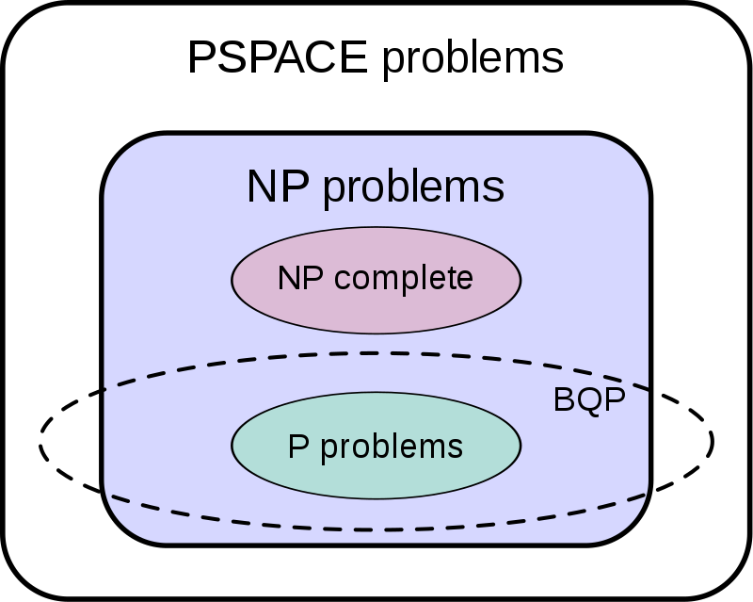
Conjectured complexity classes

Slide 72
Change the Church-Turing thesis?
Church-Turing thesis:
“A Turing machine can simulate all realistic models of computation”
Complexity-Theoretical Church-Turing thesis:
“A Turing machine can efficiently simulate all realistic models of computation”

Slide 73
Change the Church-Turing thesis?
Church-Turing thesis:
“A Turing machine can simulate all realistic models of computation”
Complexity-Theoretical Church-Turing thesis:
“A quantum Turing machine can efficiently simulate all realistic models of computation”

Slide 74
Part III:
Some Quantum Cryptograhy

Slide 75
Results in cryptography
Three previously impossible tasks that can be done via simple manipulation of quantum information
Generation of certified randomness
Detection of a spy
Certification of GPS coordinates

Slide 76
Non-Locality
Can the microscopic have macroscopic consequences?
Non-Local game: challenge for collaborating but non-communicating players
(like when the police cross-checks suspects)
Bell inequality: upper bound on winning probability
Quantum players can perform better than the classical players: they violate the Bell inequality
An implementation disproves classical physics
  (They have done it, classical physics is officially false)

Slide 77

CHSH game

Slide 78


CHSH game
$$x$$
$$y$$

Slide 79


CHSH game
$$x$$
$$y$$
$$a$$
$$b$$

Slide 80

CHSH game
$$x$$
$$y$$
$$a$$
$$b$$
The players win if
$$a⊕b=x⋅y$$

Slide 81

CHSH game
$$x$$
$$y$$
$$a$$
$$b$$
The players win if
$$a⊕b=x⋅y$$
Input Winning output
00 same thing
01 same thing
10 same thing
11 different things
$$⇔$$

Slide 82

CHSH game
$$x$$
$$y$$
$$a$$
$$b$$
The players win if
$$a⊕b=x⋅y$$
Input Winning output
00 same thing
01 same thing
10 same thing
11 different things
$$⇔$$
$$\operatorname{Pr}\left(win\right)≤0.75$$

Slide 83
How do quantum players play?
We need some technical details…

Slide 84
Measurement in other bases

Slide 85


Measurement in other bases
$$\left|0\right\rangle$$
$$\left|1\right\rangle$$

Slide 86

Measurement in other bases
$$\left|0\right\rangle$$
$$\left|+\right\rangle$$
$$\left|1\right\rangle$$

Slide 87


Measurement in other bases
$$\left|0\right\rangle$$
$$\left|+\right\rangle$$
$$\frac{1}{\sqrt{2} }$$
$$\left|1\right\rangle$$
$$\frac{1}{\sqrt{2} }$$

Slide 88



Measurement in other bases
$$\left|0\right\rangle$$
$$\left|−\right\rangle$$
$$\frac{1}{\sqrt{2} }$$
$$\left|1\right\rangle$$
$$\frac{1}{\sqrt{2} }$$

Slide 89




Measurement in other bases
$$\left|0\right\rangle$$
$$\left|+\right\rangle$$
$$\left|−\right\rangle$$
$$\frac{1}{\sqrt{2} }$$
$$\frac{1}{\sqrt{2} }$$

Slide 90






Measurement in other bases
$$\left|0\right\rangle$$
$$\left|a\right\rangle$$
$$cos⁡(α)$$
$$\left|b\right\rangle$$
$$α$$
$$β$$
$$cos⁡(β)$$

Slide 91

Entanglement
$$\frac{\left|00\right\rangle +|11⟩}{\sqrt{2}}$$

Slide 92
Wait, how’s this different from having two correlated coins?
$$\frac{\left|00\right\rangle +|11⟩}{\sqrt{2}}$$

Slide 93
Wait, how’s this different from having two correlated coins?

Slide 94

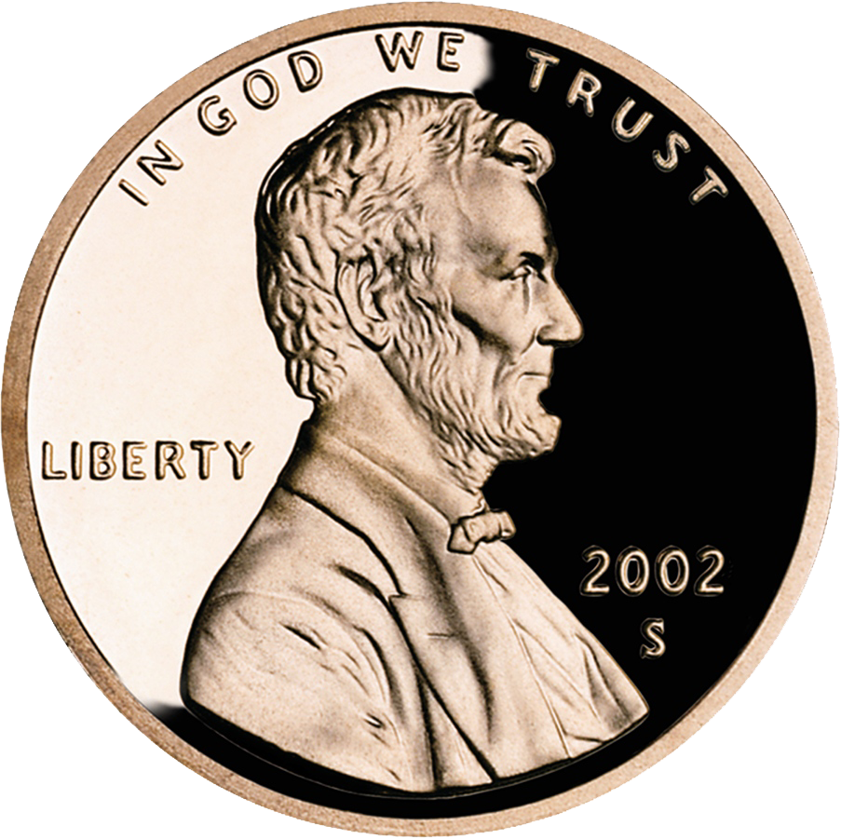
Wait, how’s this different from having two correlated coins?

Slide 95
Wait, how’s this different from having two correlated coins?

Slide 96
Wait, how’s this different from having two correlated coins?

Slide 97

$$\frac{\left|00\right\rangle +|11⟩}{\sqrt{2}}$$

Slide 98

$$\left|00\right\rangle$$

Slide 99


$$\frac{\left|00\right\rangle +|11⟩}{\sqrt{2}}$$
$$\left|a\right\rangle$$
$$\left|b\right\rangle$$

Slide 100


$$\left|aa\right\rangle$$
$$\left|a\right\rangle$$
$$\left|a\right\rangle$$
$$\left|b\right\rangle$$

Slide 101
$$\left|aa\right\rangle$$
$$\left|a\right\rangle$$
$$\left|a\right\rangle$$
$$\left|b\right\rangle$$

Slide 102
But how does this happen?
$$\left|aa\right\rangle$$
$$\left|a\right\rangle$$
$$\left|a\right\rangle$$
$$\left|b\right\rangle$$

Slide 103
CHSH quantum strategy
$$x$$
$$y$$
$$a$$
$$b$$

Slide 104

CHSH quantum strategy
$$x$$
$$\frac{\left|00\right\rangle +|11⟩}{\sqrt{2}}$$
$$y$$
$$a$$
$$b$$

Slide 105
CHSH quantum strategy
$$x$$
$$\frac{\left|00\right\rangle +|11⟩}{\sqrt{2}}$$
$$y$$
$$a$$
$$b$$
On input 0,1

Slide 106
CHSH quantum strategy
$$x$$
$$\frac{\left|00\right\rangle +|11⟩}{\sqrt{2}}$$
$$y$$
$$a$$
$$b$$
On input 0,1

Slide 107

CHSH quantum strategy
They want: $a⊕b=x⋅y$
0
0
0
0
1
1
1
1
On input 0,1
On input 0,1

Slide 108
CHSH quantum strategy
They want: $a⊕b=x⋅y$
0
0
0
1
1
1
On input 0
On input 0,1

Slide 109
CHSH quantum strategy
They want: $a⊕b=x⋅y$
0
0
0
1
1
1
On input 0
On input 0,1

Slide 110

CHSH quantum strategy
They want: $a⊕b=x⋅y$
0
0
0
1
1
1
On input 0
$$\operatorname{Pr}\left(win\right)=\cos^{2}{\frac{π}{8}≈0.85}$$
On input 0,1

Slide 111
CHSH quantum strategy
They want: $a⊕b=x⋅y$
0
0
0
1
1
1
On input 1
$$\operatorname{Pr}\left(win\right)=\cos^{2}{\frac{π}{8}≈0.85}$$
On input 0,1

Slide 112
Bell inequality violation
Classical players win with at most 75% probability
Quantum players win with probability ~ 85% !
This is the most famous Bell inequlity violation...
  but there are also unbounded ones!
The CHSH game is used in protocols for randomness certification
(e.g Vazirani-Vidick 2011)

Slide 113
Quantum key distribution [BB’84]
Alice & Bob want to establish a secret key
They communicate through a public quantum channel
They make use of the following 2 facts:
  No-cloning theorem: one cannot perfectly copy an unknown quantum state.
  Information disturbance: if one does not know the encoding basis, one cannot decode a qubit perfectly without perturbing (collapsing) it.

Slide 114

No-cloning theorem
There is no quantum operation such that, $∀\left|a\right\rangle$
$U\left(\left|a\right\rangle \left|0\right\rangle \right)=\left|a\right\rangle |a⟩$

Slide 115

No-cloning theorem
There is no quantum operation such that, $∀\left|a\right\rangle$
$U\left(\left|a\right\rangle \left|0\right\rangle \right)=\left|a\right\rangle |a⟩$
Proof

Slide 116

No-cloning theorem
There is no quantum operation such that, $∀\left|a\right\rangle$
$U\left(\left|a\right\rangle \left|0\right\rangle \right)=\left|a\right\rangle |a⟩$
Proof
Take two arbitrary states $\left|a\right\rangle$ and $\left|b\right\rangle$

Slide 117

No-cloning theorem
There is no quantum operation such that, $∀\left|a\right\rangle$
$U\left(\left|a\right\rangle \left|0\right\rangle \right)=\left|a\right\rangle |a⟩$
Proof
Take two arbitrary states $\left|a\right\rangle$ and $\left|b\right\rangle$
Then we must have (since $U$ is norm-preserving)
${(\left|a\right\rangle |0⟩)}^{T}\left|b\right\rangle \left|0\right\rangle$

Slide 118

No-cloning theorem
There is no quantum operation such that, $∀\left|a\right\rangle$
$U\left(\left|a\right\rangle \left|0\right\rangle \right)=\left|a\right\rangle |a⟩$
Proof
Take two arbitrary states $\left|a\right\rangle$ and $\left|b\right\rangle$
Then we must have (since $U$ is norm-preserving)
${(\left|a\right\rangle |0⟩)}^{T}\left|b\right\rangle \left|0\right\rangle$ $={(U\left(\left|a\right\rangle | 0\right\rangle ))}^{T}U(\left|b\right\rangle |0⟩)$

Slide 119

No-cloning theorem
There is no quantum operation such that, $∀\left|a\right\rangle$
$U\left(\left|a\right\rangle \left|0\right\rangle \right)=\left|a\right\rangle |a⟩$
Proof
Take two arbitrary states $\left|a\right\rangle$ and $\left|b\right\rangle$
Then we must have (since $U$ is norm-preserving)
${(\left|a\right\rangle |0⟩)}^{T}\left|b\right\rangle \left|0\right\rangle$ $={(U\left(\left|a\right\rangle | 0\right\rangle ))}^{T}U(\left|b\right\rangle |0⟩)$
$={(\left|a\right\rangle |a⟩)}^{T}\left|b\right\rangle \left|b\right\rangle$

Slide 120

No-cloning theorem
There is no quantum operation such that, $∀\left|a\right\rangle$
$U\left(\left|a\right\rangle \left|0\right\rangle \right)=\left|a\right\rangle |a⟩$
Proof
Take two arbitrary states $\left|a\right\rangle$ and $\left|b\right\rangle$
Then we must have (since $U$ is norm-preserving)
${(\left|a\right\rangle |0⟩)}^{T}\left|b\right\rangle \left|0\right\rangle$ $={(U\left(\left|a\right\rangle | 0\right\rangle ))}^{T}U(\left|b\right\rangle |0⟩)$
$={(\left|a\right\rangle |a⟩)}^{T}\left|b\right\rangle \left|b\right\rangle$
But this implies ${(\left|a\right\rangle }^{T}|b⟩)={{(\left|a\right\rangle }^{T}|b⟩)}^{2}$

Slide 121

No-cloning theorem
There is no quantum operation such that, $∀\left|a\right\rangle$
$U\left(\left|a\right\rangle \left|0\right\rangle \right)=\left|a\right\rangle |a⟩$
Proof
Take two arbitrary states $\left|a\right\rangle$ and $\left|b\right\rangle$
Then we must have (since $U$ is norm-preserving)
${(\left|a\right\rangle |0⟩)}^{T}\left|b\right\rangle \left|0\right\rangle$ $={(U\left(\left|a\right\rangle | 0\right\rangle ))}^{T}U(\left|b\right\rangle |0⟩)$
$={(\left|a\right\rangle |a⟩)}^{T}\left|b\right\rangle \left|b\right\rangle$
But this implies ${(\left|a\right\rangle }^{T}|b⟩)={{(\left|a\right\rangle }^{T}|b⟩)}^{2}$
and this happens when $a,b$ are equal or orthogonal

Slide 122
Quantum Key distribution (part 1)

Slide 123
Quantum Key distribution (part 1)

Slide 124
Quantum Key distribution (part 1)
Random string:
0111001101

Slide 125
Quantum Key distribution (part 1)
Random string:
0111001101
Her random bases:
+x+xx++x+x
His random bases:
x++x++xx+x

Slide 126
Quantum Key distribution (part 1)
Random string:
0111001101
Her random bases:
+x+xx++x+x
His random bases:
x++x++xx+x
ENCODE & SEND

Slide 127
Quantum Key distribution (part 1)
Random string:
0111001101
Her random bases:
+x+xx++x+x
His random bases:
x++x++xx+x
ENCODE & SEND
DECODE
1111000101

Slide 128
Quantum Key distribution (part 1)
Random string:
0111001101
Her random bases:
+x+xx++x+x
His random bases:
x++x++xx+x
ENCODE & SEND
DECODE
1111000101

Slide 129
Quantum Key distribution (part 2)
Random string:
0111001101
+x+xx++x+x
x++x++xx+x
ENCODE & SEND
DECODE
1111000101
Over a public channel:
Inform each other of the choice of bases
Randomly test equality for half of the red positions
  (Spy detection - no-cloning, disturbance)
If pass previous point, other half is the shared key!

Slide 130
Position verification

Slide 131
Position verification

Slide 132
Position verification
p

Slide 133

Position verification
p

Slide 134
Position verification
x
y
p

Slide 135
Position verification
x
y
x+y
x+y
p

Slide 136
Position verification
p

Slide 137
Position verification
p
Blah blah blah blah

Slide 138
Position verification
p
Blah blah speed of light

Slide 139
Position verification
p
Blah blah 20 milliseconds

Slide 140
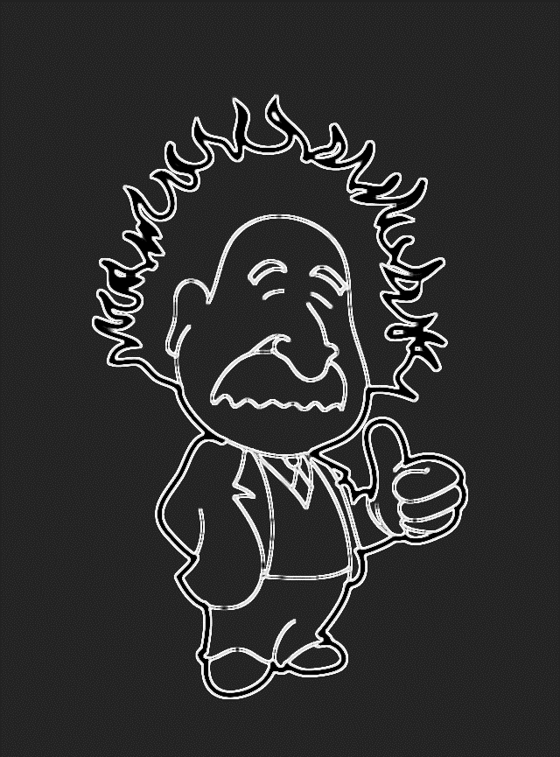
Position verification
p
She was at P!
She was at P!

Slide 141
Position verification: attack
p

Slide 142
Position verification: attack
x
y

Slide 143
Position verification: attack
x
y
x
y
p

Slide 144
Position verification: attack
x
y
x
y
x+y
x+y
p

Slide 145
Position verification: attack
x
y
x
y
x+y
x+y
p

Slide 146
Position verification: attack
x
y
x
y
x+y
x+y
p
She was at P!
She was at P!

Slide 147
Quantum position verification
p

Slide 148

Quantum position verification
Basis: $×$ or $+$
p

Slide 149
Quantum position verification
Basis: $×$ or $+$
qubit
p

Slide 150
Quantum position verification
Basis: $×$ or $+$
qubit
outcome
outcome
p

Slide 151
Quantum position verification
Basis: $×$ or $+$
qubit
outcome
outcome
p
She was at P!
She was at P!

Slide 152
Quantum position verification
p

Slide 153

Quantum position verification
Basis: $×$ or $+$
qubit
p

Slide 154
Quantum position verification
Basis: $×$ or $+$
qubit
p

Slide 155
Quantum position verification
Basis: $×$ or $+$
qubit
p
No cloning theorem:
Bob cannot keep a copy of the qubit.

Slide 156
Quantum position verification
Basis: $×$ or $+$
qubit
p
No cloning theorem:
Bob cannot keep a copy of the qubit.
Information disturbance:
Bob cannot attempt to measure, as he doesn’t know the basis!

Slide 157

Quantum position verification
Basis: $×$ or $+$
qubit
p
No cloning theorem:
Bob cannot keep a copy of the qubit.
Information disturbance:
Bob cannot attempt to measure, as he doesn’t know the basis!

Slide 158
But wait!!!

Slide 159
But wait!!!
p

Slide 160
But wait!!!
p
Open problem: actually prove
the security of this protocol!
[Buhrman et al, 2011]

Slide 161
What to bring home?
Quantum computing is a model of computation based on the latest physics
  You do not need deep knowledge of physics to work with it!
There are many tasks that do not require a full quantum computer that are doable today
QC’s full power is still unknown, but it looks like it can give some meaningful speedups
  Proving quantum advantage is tricky.
  Careful about big advertisement claims!

Slide 162
FAQs
Is quantum computing a reality now?
Will we have a quantum computer in our pockets?
Do quantum computers solve useful problems?
Does entanglement allow for faster-than-light communication? My cousin told me so.

