Slide 1

SDN + NFV
The Necessary Network Virtualization Equation
Diego R. Lopez
Telefonica I+D
July 2014

Slide 2
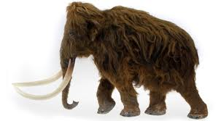
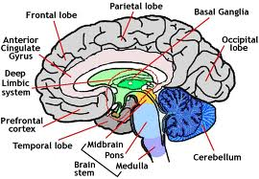


Enter the Software Era
Telco players
Internet players
Very intensive in hardware
Capital intensive
Software is not at the core
x
Very intensive in software
Can have global impact with not too much capital
Hardware is a support, and is located in the network periphery
-
SOFTWARE
+
+
HARDWARE
-
Network Virtualization takes the “Software-defined” as a key tool for transforming the industry

Slide 3
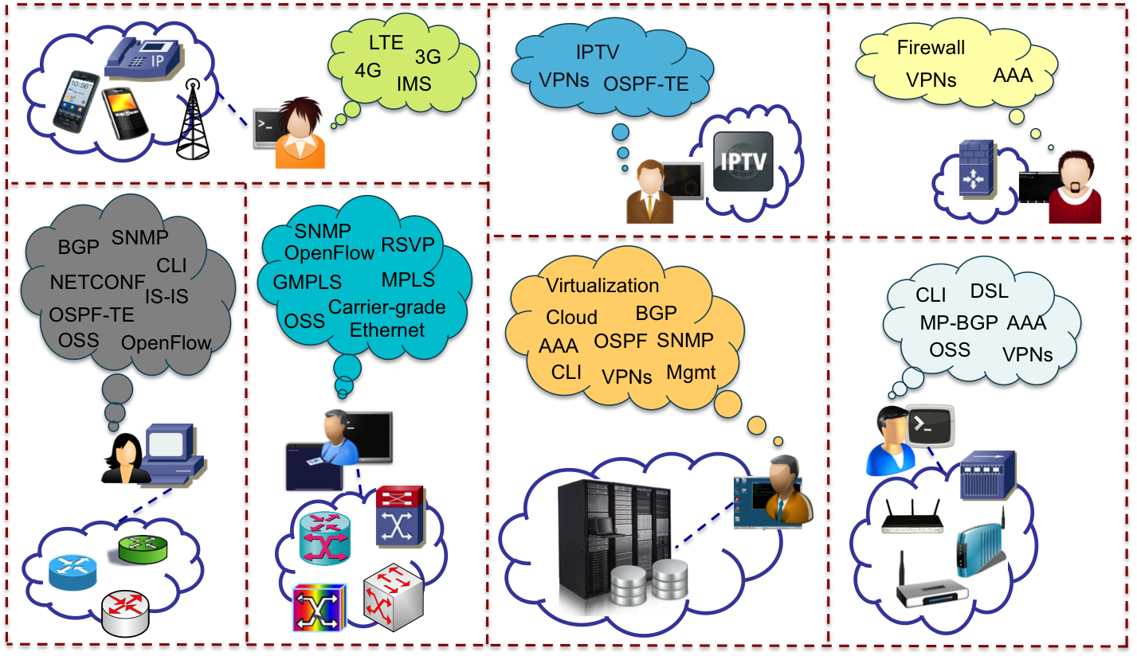
The Network Dystopia…
  Segmented management: High OPEX, often with low utilization of resources, high complexity, and slow time-to-market for deploying any kind of network service…

Slide 4
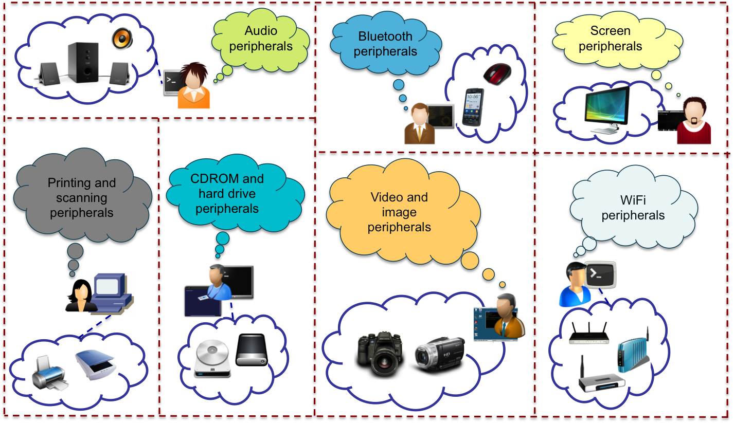
…Makes IT Nonsense
  Mapping to computers how networks have evolved…

Slide 5
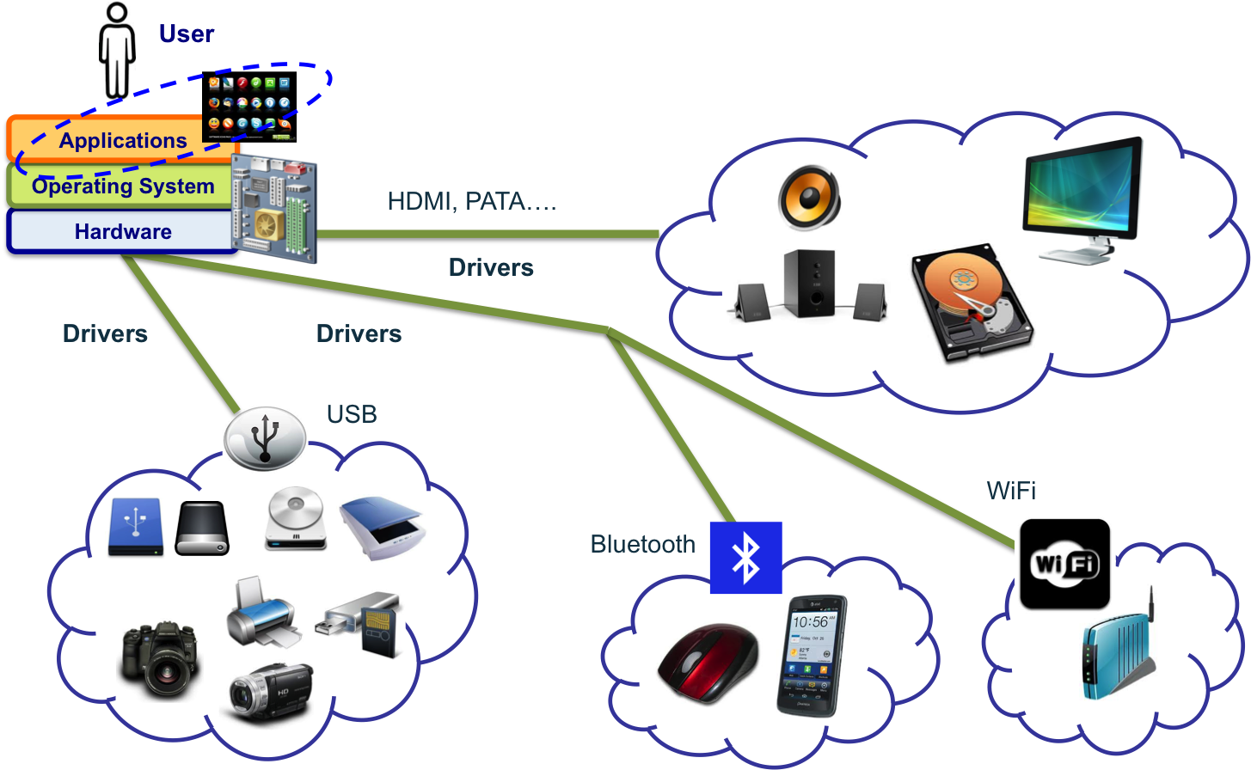
The Key Role of Virtualization
  A layered model virtualizing devices and resources

Slide 6
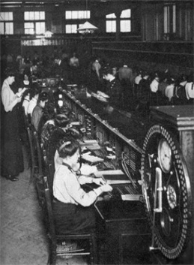
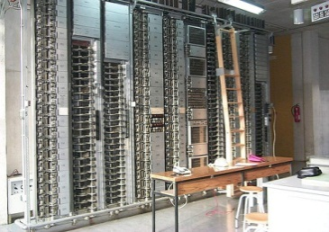
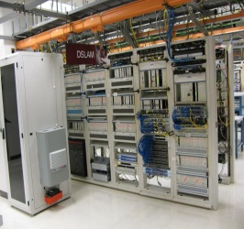


Scale and Virtualization in the Timeline
Early twentieth century
Mid-twentieth century
Manual Switching
Very intensive in human tesources
Era dominated by hardware
x
Electromechanical Switching
Less intensive in human resources
Era dominated by complex hardware
Virtualization technologies enables overcoming physical constraints and generating multiplexing gains…
Digital Switching
Much less intensive in human resources
Era dominated by complex and specific hardware. Software appears and is important
Services defined by telco
x
Internet connectivity opens the door to the development of OTT services (without operator)
Software becomes a differentiation asset
x
Second half of the twentieth century
Early twenty-first century

Slide 7

Network Virtualization = SDN + NFV
Provide a general interface to network resources
  Abstracting actual infrastructure details
Decouple the planes conforming the network
  Relying on software mechanisms to support functionality
SDN
Decouple the control and data planes
  Gain programmability
  Simplify data plane elements
  Software in the network
NFV
Separate functionality from capacity
  Increase network elasticity
  Reduce heterogeneity
  The network in software

Slide 8



Software Defined Networking
SDN
Network equipment as
Black boxes
Open interfaces (OpenFlow) for instructing the boxes what to do
FEATURE
FEATURE
OPERATING SYSTEM
FEATURE
FEATURE
SPECIALIZED PACKET FORWARDING HARDWARE
FEATURE
FEATURE
SDN
OPERATING SYSTEM
OPERATING SYSTEM
SPECIALIZED PACKET FORWARDING HARDWARE
FEATURE
FEATURE
SPECIALIZED PACKET FORWARDING HARDWARE
OPERATING SYSTEM
SPECIALIZED PACKET FORWARDING HARDWARE
Boxes with autonomous
behaviour
Decisions are taken out of the box
SDN
FEATURE
FEATURE
OPERATING SYSTEM
FEATURE
FEATURE
SPECIALIZED PACKET FORWARDING HARDWARE
FEATURE
FEATURE
OPERATING SYSTEM
OPERATING SYSTEM
SPECIALIZED PACKET FORWARDING HARDWARE
FEATURE
FEATURE
SPECIALIZED PACKET FORWARDING HARDWARE
OPERATING SYSTEM
Simpler OSS to manage the SDN controller
SPECIALIZED PACKET FORWARDING HARDWARE
Adapting OSS to manage black boxes

Slide 9

Make the Network *A* Computer
We can apply software development techniques and tools
Software development and operation being multifaceted
  Different tools for different tasks
Static and dynamic verification
Translation: assemblers, compilers, interpreters, linkers
Testing and debugging
Version and configuration control
Dynamic composition and linking
Development flows
And any other abstraction capability
SDN Controller
SDN Forwarder
OVS
OVS
OVS
OVS

Slide 10
Network Brokering
Applications use SDN to learn about the network
And then talk to the network to optimize performance
SDN acts in a similar way to an ESB (or CORBA, for the old-timers)
  An adaptor to go from protocols to APIs and vice versa
  A translator, which summarizes network properties
  A security/policy gateway that enforces which application is allowed to learn what and change what, and who gets priority
CDN
DC Orchestrator
BoD
OSS
…
ALTO Server
OFC
. . .
Network Elements

Slide 11
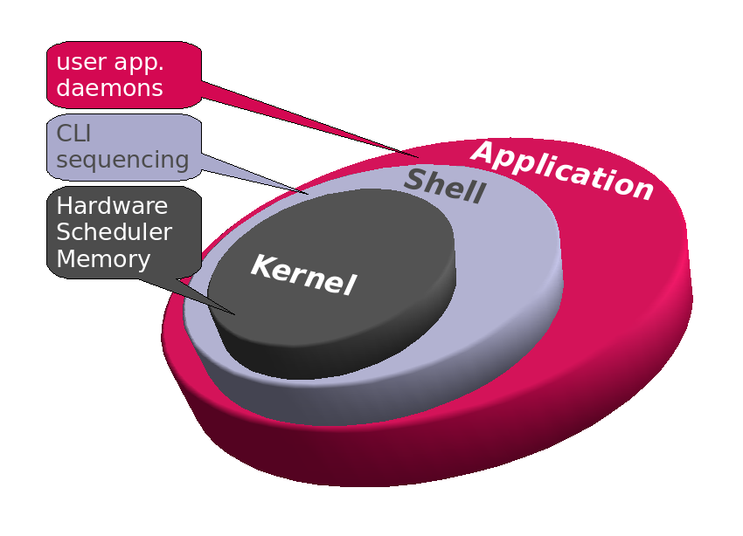
Network OS
Providing a consistent interface to control, data and management plane
  A layered model
  The first take could follow an analogy with existing OS
The kernel is realized by control plane mechanisms
Data plane is associated with the file system
The management plane is mapped to the system tools
  Remember the shell
Specific services to enforce policy and security
And the APIs

Slide 12
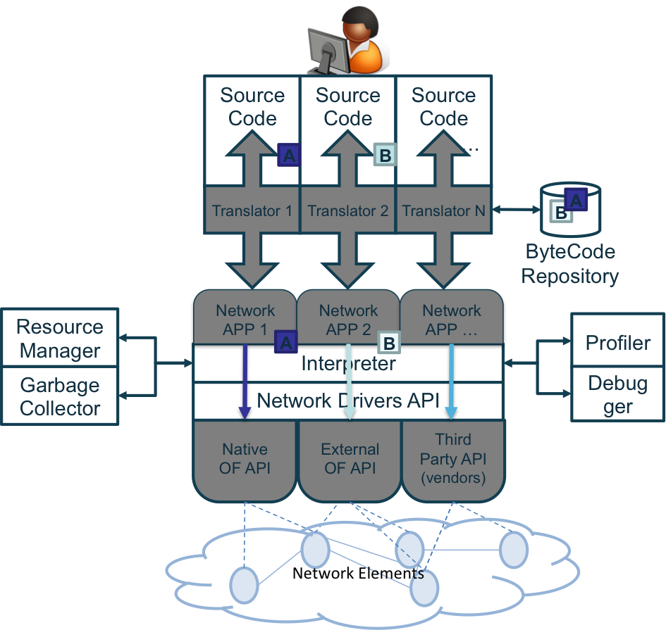
The Road to a Network IDE
The natural consequence of applying concepts and tools related to software development
Supporting a complete design flow
  High-level definition and manipulation
  Validation from simulation
  to actual debugging
  Beta versions by slicing
  Phased deployment
  Integrate virtualized and non-virtualized functional elements
  Aligned with parallel IT development

Slide 13
Putting It All Together: The NetOS Architecture
NFV Orchestrator
IDE
SDN App
User Space (/usr)
Northbound Interface
SDN Apps
Libraries
Services
TE
vSwitch
Topology
vRouter
…
App Execution Environment(s)
Virtual Network Layer
Kernel (/kernel)
Common Representation Model
Security and Ancillary Services
Namespaces and Module Management
Dist IF
Distributed OS / State Consistency
Security / Accounting / Namespaces
Network Abstraction Layer (NAL)
Devices and Drivers (/dev)
Southbound Interface
NAL
Drivers
OpenFlow
VNF
NetConf
I2RS
Network Elements

Slide 14
Network Functions Virtualisation
A means to make the network more flexible and simple by minimising dependence on HW constraints
v
v
Traditional Network Model:
APPLIANCE APPROACH
Virtualised Network Model:
VIRTUAL APPLIANCE APPROACH
VIRTUAL APPLIANCES
DPI
CG-NAT
GGSN/
SGSN
DPI
BRAS
BRAS
Firewall
PE Router
GGSN/SGSN
ORCHESTRATED, AUTOMATIC
& REMOTE INSTALL
PE Router
STANDARD HIGH VOLUME SERVERS
Session Border Controller
Firewall
CG-NAT
Network Functions are based on specific HW&SW
One physical node per role
Network Functions are SW-based over well-known HW
Multiple roles over same HW

Slide 15

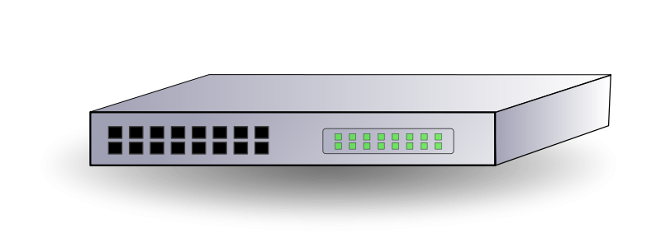
The NFV Concept
Network functions are fully defined by SW, minimising dependence on HW constraints
VIRTUAL NETWORK FUNCTIONS
DPI
CG-NAT
GGSN/
SGSN
FUNCTION
BRAS
Firewall
PE Router
COMMON HW
(Servers & Switches)
CAPACITY

Slide 16

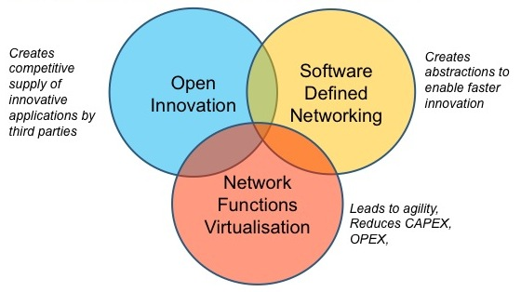
The ETSI NFV ISG
Global operators-led Industry Specification Group (ISG) under the auspices of ETSI
  >200 member organisations
Open membership
  ETSI members sign the “Member Agreement”
  Non-ETSI members sign the “Participant Agreement”
  Opening up to academia
Operates by consensus
  Formal voting only when required
Deliverables: Specifications addressing challenges and operator requirements
  As inputs to SDOs
Currently, four WGs and two EGs
  Infrastructure
  Software Architecture
  Management & Orchestration
  Reliability & Availability
  Performance & Portability
  Security

Slide 17
The NFV ISG in Numbers
Growing membership and activitiy
  207 Member companies, (85 ETSI Members, 128 Participant Members)
  1095 people subscribed to the principal NFV mailing list
  15 active Work Items
And results
  Published 4 framework documents - Use Cases, Requirements, E2E Architecture and Terminology
  4 stable drafts available on the Open area
  Created easy to navigate websites for access to public material
  18 accepted PoCs
Planning a second phase

Slide 18
Service-Oriented Use Cases
Mobile core network and IMS
  Elastic, scalable, more resilient EPC
  Specially suitable for a phased approach
Mobile base stations
  Evolved Cloud-RAN
  Enabler for SON
Home environment
  L2 visibility to the home network
  Smooth introduction of residential services
CDNs
  Better adaptability to traffic surges
  New collaborative service models
Fixed access network
  Offload computational intensive optimization
  Enable on-demand access services

Slide 19
The NFV Framework
E2E Network Service
End Point
End Point
Network Service
Logical Abstractions
VNF
VNF
VNF
VNF
VNF
Logical Links
VNF Instances
SW Instances
VNF
VNF
VNF
VNF
VNF : Virtualized Network Function
NFV Infrastructure
Virtual Resources
Virtual
Compute
Virtual
Storage
Virtual
Network
Virtualization SW
Virtualization Layer
HW Resources
Compute
Storage
Network

Slide 20
The NFV Reference Architecture
Os-Ma
Orchestrator
OSS/BSS
Se-Ma
Service, VNF and Infrastructure Description
Or-Vnfm
EMS 1
EMS 2
EMS 3
Ve-Vnfm
VNF
Manager(s)
VNF 1
VNF 2
VNF 3
Or-Vi
Vn-Nf
Vi-Vnfm
NFVI
Virtual Computing
Virtual Storage
Virtual Network
Virtualized
Infrastructure
Manager(s)
Nf-Vi
Virtualization Layer
Vl-Ha
Hardware resources
Computing
Hardware
Storage
Hardware
Network
Hardware
Execution reference points
Other reference points
Main NFV reference points

Slide 21
Architectural Use Cases
Network Functions Virtualisation Infrastructure as a Service
  Network functions go to the cloud
Virtual Network Function as a Service
  Ubiquitous, delocalized network functions
Virtual Network Platform as a Service
  Applying multi-tenancy at the VNF level
VNF Forwarding Graphs
  Building E2E services by composition

Slide 22
The New Roles - XaaS for Network Services
NSP
User
VNF Forwarding Graph
VNF
Admin
User
VNF
VNF
VNPaaS
Admin
User
VNF
VNF
VNFaaS
Hosting Service Provider
VNF
VNF
VNF
VNF
VNF
VNF
VNF
VNF
VNF
VNF Tenants
NFVIaaS
NFVI
Provider
IaaS
NaaS
NaaS
PaaS
PaaS
SaaS

Slide 23
It Ain’t Cloud Applied to Carriers
The network differs from the computing environment in
2 key factors…
1
Data plane workloads
(which are huge!)
HIGH PRESSURE ON PERFORMANCE
2
Network requires shape
(+ E2E interconnection)
GLOBAL NETWORK VIEW IS REQUIRED FOR MANAGEMENT
…which are big challenges for vanilla cloud computing.
AN ADAPTED VIRTUALIZATION ENVIRONMENT IS NEEDED
TO OBTAIN CARRIER-CLASS BEHAVIOUR

Slide 24
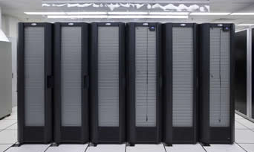
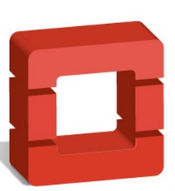





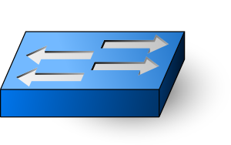
A Proper Balance between NFV & SDN
Service-layer SDN
Simplify management, closing the gap between business logic and operation
NFV
Separation of HW and SW
No vertical integration
  HW vendor ≠ SW vendor ≠ Mgmt vendor
Once network elements are SW-based, HW can be managed as a pool of resources
Pool
admin
Session mgmt
UPnP
IPv4 / IPv6
NAT
DHCP
NAT
ctrl.
TR-069
Infrastructural SDN
Virtual backplane
Separation of control and data plane
Easy orchestration with SW domain

Slide 25


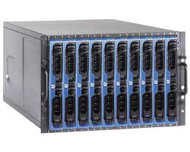

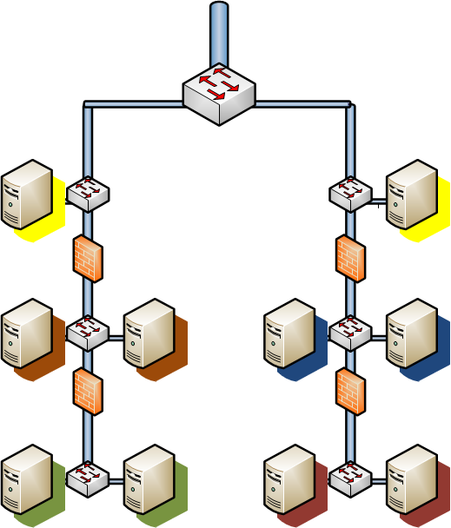
An Evolutionary Approach
NFV and SDN imply a significant change for current network infrastructures
  No zero-day approach is feasible
  Avoiding disruptions
Identify relevant use cases
  Emerging services
  Reuse of equipment still in amortization
  Leverage on new planned elements in architecture
Plan for phased deployments
  Interworking with existing infrastructure
  Not breaking current operational practice
Take advantage of virtualization advantages
  Flexibility
  Extensibility
  Reusability
Soft-Node
DS vCPE

Slide 26




Current Targets: Virtual Residential CPE
Shifting network functions deployed in home environment to the network…
Telco Network environment
Home environment
Virtual
CPE
STB
UPnP
FW
Access Point
Switch
Módem
IPv4/IPv6
TR-069
DHCP
NAT
Simple, stable along the time and cheaper customer premises equipment
Quick and transparent migration to IPv6
Service evolution and operation is supported inside telco network
Monetize cloud and video services (virtual set top box)
Monetize security and digital identity features
Live trial today
Commercial before end 2014
MATURITY LEVEL
EXPLORE
PoC
TRIAL
DEPLOY

Slide 27
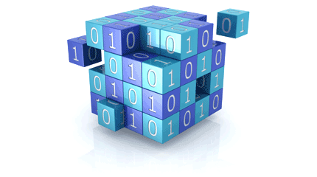






Current Targets: Elastic DPI
CENTRALISED INTELLIGENCE
Other data
Deeper
Network Big Data
RELEVANT INFO
Metadata interface
REAL-TIME ANALYSIS
NFV
domain
xDRs
Security
Alarms
Copy
OpenFlow
RAW USER TRAFFIC
POLICY DECISIONS
RAW USER TRAFFIC
MITIGATION
OF Controller
SDN
domain
OF Switch
>80 Gbps line rate per server
Stable signatures
Flexible data analysis and signature upgrade
Forensic analysis feasible.
MATURITY LEVEL
EXPLORE
PoC
TRIAL
DEPLOY

Slide 28


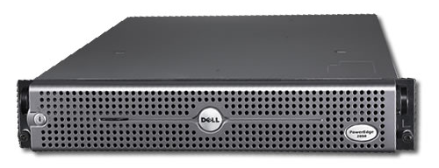
Current Targets: Enhanced Virtual Router
Leverage on open source routing project (Quagga) as rich and widely tested protocol suite while assuring data plane performance
OPEN-SOURCE CONTROL PLANE
(Quagga + Linux)
Common routing protocols supported and extended by open source project.
Well-known router command line.
OPTIMIZED
DATA PLANE
(DPDK-based)
High-performance line-rate data plane.
Running as separate process, does not lead to licensing issues.
MATURITY LEVEL
EXPLORE
PoC
TRIAL
DEPLOY

Slide 29

Counting a Few
Orchestration has the key
  Pieces at all infrastructure layers
  Need to go beyond just fitting them together
  Big data in the loop
  Seize the opportunity to simplify systems and processes
Identify interstitial security threats
  Topologies
  Trusted boot
  Several identity layers and accounting
Design patterns
  Big multi-user VMs vs small single-user ones
  Componentization
  Building services by composition
Dealing with topology layers
  Up to three: infrastructural, virtualized, and service
  Mapping to current practices and protocols

